Slide 1


Contracts for Scala
Martin Odersky
RV 2010

Slide 2
Contracts

Slide 3
What’s in a Contract?
Contracts cover:
  Assertions
  Preconditions
  Postconditions
  Class invariants
Usually evaluated at run-time
Optional, checking can be turned off
Alternatives:
  Static checking,
  or a mixture of static and dynamic
Examples: Eiffel, JML, Spec#, .NET contracts

Slide 4


Slide 5
Where it comes from
Scala has now established itself as one of the main alternative languages on the JVM.
Prehistory:
  1996 – 1997: Pizza
  1998 – 2000: GJ, Java generics, javac
  ( “make Java better” )
Timeline:
  2003 – 2006: The Scala “Experiment”
  2006 – 2009: An industrial strength programming language
  ( “make a better Java” )

Slide 6





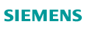












Some Users

Slide 7
Why Scala?

Slide 8
Scala is a Unifier
Agile, with lightweight syntax
Object-Oriented Functional
Safe and performant, with strong static typing

Slide 9
Let’s see some code:

Slide 10

A class ...
public class Person {
public final String name;
public final int age;
Person(String name, int age) {
this.name = name;
this.age = age;
}
}
class Person(val name: String,
val age: Int) {}

Slide 11
... and its usage
import java.util.ArrayList;
...
Person[] people;
Person[] minors;
Person[] adults;
{ ArrayList<Person> minorsList = new ArrayList<Person>();
ArrayList<Person> adultsList = new ArrayList<Person>();
for (int i = 0; i < people.length; i++)
(people[i].age < 18 ? minorsList : adultsList)
.add(people[i]);
minors = minorsList.toArray(people);
adults = adultsList.toArray(people);
}
A function value
An infix method call
A simple pattern match
val people: Array[Person]
val (minors, adults) = people partition (_.age < 18)

Slide 12
But there’s more to it

Slide 13
Embedding Domain-Specific Languages
Scala’s flexible syntax makes it
easy to define
high-level APIs &
embedded DSLs
Examples:
- Scala actors (the core of
Twitter’s message queues)
- specs, ScalaCheck
- ScalaFX
- ScalaQuery, ScalaQL, squeryl
scalac’s plugin architecture makes it easy to typecheck DSLs and to enrich their semantics.
// asynchronous message send
actor ! message
// message receive
receive {
case msgpat₁ => action₁
…
case msgpat_{n} => action_{n}
}

Slide 14
The Bottom Line
When going from Java to Scala, expect at least a factor of 2 reduction in LOC.
But does it matter?
Doesn’t Eclipse write these extra lines for me?
This does matter. Eye-tracking experiments* show that for program comprehension, average time spent per word of source code is constant.
So, roughly, half the code means half the time necessary to understand it.
Guy Steele: “Switching from Java to Scala reduced
size of Fortress typechecker by a factor of 4”.
*G. Dubochet. Computer Code as a Medium for Human Communication: Are Programming Languages Improving?
In 21st Annual Psychology of Programming Interest Group Conference, pages 174-187, Limerick, Ireland, 2009.

Slide 15
Scalability demands extensibility
Guy Steele has formulated a benchmark for measuring language extensibility [Growing a Language, OOPSLA 98]:
  Can you add a type of complex numbers to the library and make it work as if it was a native number type?
Similar problems: Adding type BigInt, Decimal, Intervals, Polynomials...
scala> import Complex._
import Complex._
scala> val x = 1 + 1 * i
x: Complex = 1.0+1.0*i
scala> val y = x * i
y: Complex = -1.0+1.0*i
scala> val z = y + 1
z: Complex = 0.0+1.0*i
1-<number>

Slide 16
Implementing complex numbers
Infix operations are method calls:
a + b is the same as a.+(b)
Objects replace static class members
+ is an identifier; can be used as a method name
Class parameters instead of fields+ explicit constructor
object Complex {
val i = new Complex(0, 1)
implicit def double2complex(x: Double): Complex = new Complex(x, 0)
...
}
class Complex(val re: Double, val im: Double) {
def + (that: Complex): Complex = new Complex(this.re + that.re, this.im + that.im)
def - (that: Complex): Complex = new Complex(this.re - that.re, this.im - that.im)
def * (that: Complex): Complex = new Complex(this.re * that.re - this.im * that.im,
this.re * that.im + this.im * that.re)
def / (that: Complex): Complex = {
val denom = that.re * that.re + that.im * that.im
new Complex((this.re * that.re + this.im * that.im) / denom,
(this.im * that.re - this.re * that.im) / denom)
}
override def toString = re+(if (im < 0) "-"+(-im) else "+"+im)+"*I"
...
}
Implicit conversions for mixed arithmetic
1-<number>

Slide 17
Implicits are Poor Man’s Type Classes
/** A “type class” */
class Ord[T] { def < (x: T, y: T): Boolean }
/** An “instance definition” */
implicit object intOrd extends Ord[Int] {
def < (x: Int, y: Int) = x < y
}
/** Another instance definition */
implicit def listOrd[T](implicit tOrd: Ord[T]) = new Ord {
def < (xs: List[T], ys: List[T]) = (xs, ys) match {
case (_, Nil) => false
case (Nil, _) => true
case (x :: xs, y :: ts) => x < y || x == y && xs < ys
}
}
1-<number>

Slide 18
Adding new control structures
For instance using for resource control (in Java 7)
Instead of:
using (new BufferedReader(new FileReader(path))) {
f => println(f.readLine())
}
val f = new BufferedReader(new FileReader(path))
try {
println(f.readLine())
} finally {
if (f != null)
try f.close()
catch { case ex: IOException => }
}
1-<number>

Slide 19
Implementing new control structures:
Here's how one would go about implementing using:
T is a type parameter...
… supporting a close method
def using[T <: { def close() }]
(resource: T)
(block: T => Unit) =
try {
block(resource)
} finally {
if (resource != null)
try resource.close()
catch { case ex: IOException => }
}
A closure that takes a T parameter
1-<number>

Slide 20
What About Contracts in Scala?

Slide 21
Nada
Scala does not have them in the language.
Try to keep language reasonably small
Can they be added after the fact?
What we want to include:
  assertions
  preconditions
  postconditions
  invariants
Other question: How to mix code & specification?
1-<number>

Slide 22
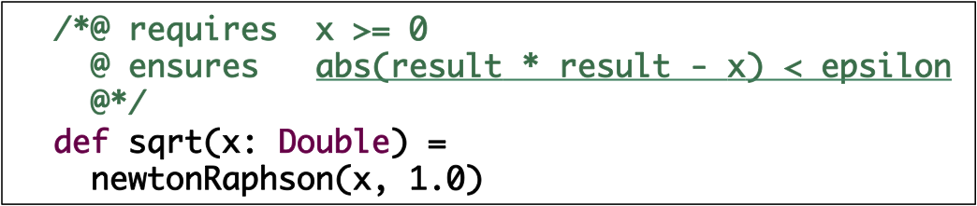
Contracts as Comments?
Maybe like JML:
+ Separates specification from code
− Disconnect with language’s modularity mechanisms
− Has to do its own parsing and type checking.

Slide 23
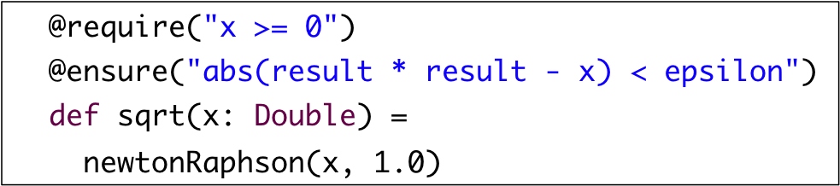
Contracts as Annotations?
Maybe like this:
That’s just like comments in different clothes.

Slide 24
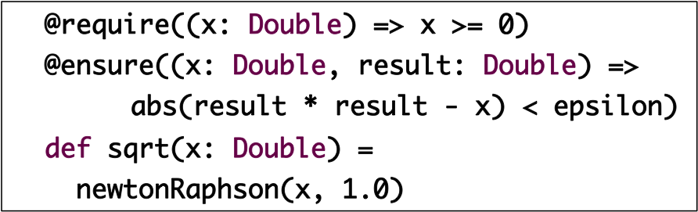
Contracts as Annotations?
Or like this:
+ Good re-use of language features.
+ Parsing, type-checking come for free.
+ Can re-use modularity features of embedding language
− Verbose; bindings have to be modeled by closures.

Slide 25
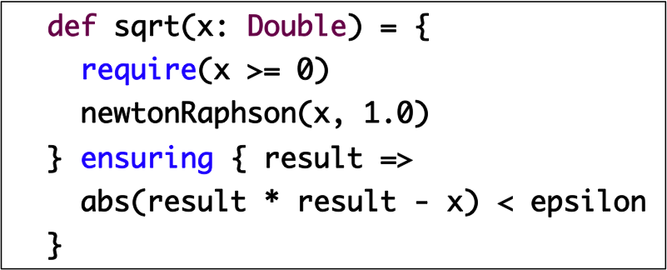
Contracts as Code
Four constructs: assert, assume, require, ensuring.
Compared to .NET Code contracts:
  fixed programming language.
  no byte-code rewriting (but could be added in the future).

Slide 26
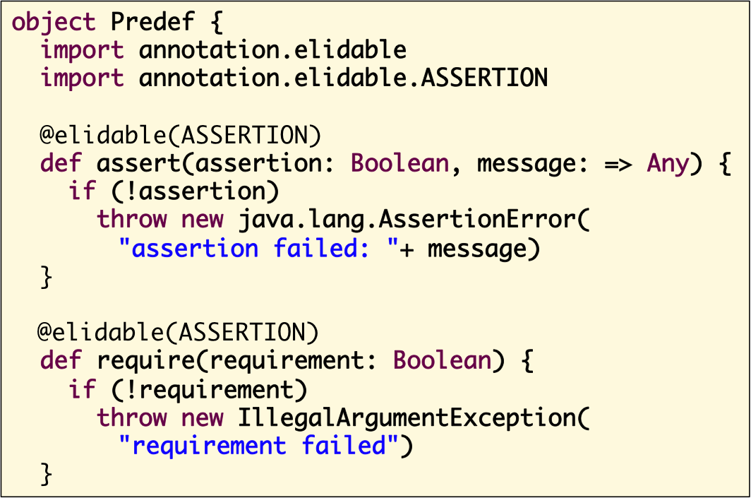
How are they implemented?
Assert, require: Simple definition in Predef object
Call by name
parameter

Slide 27
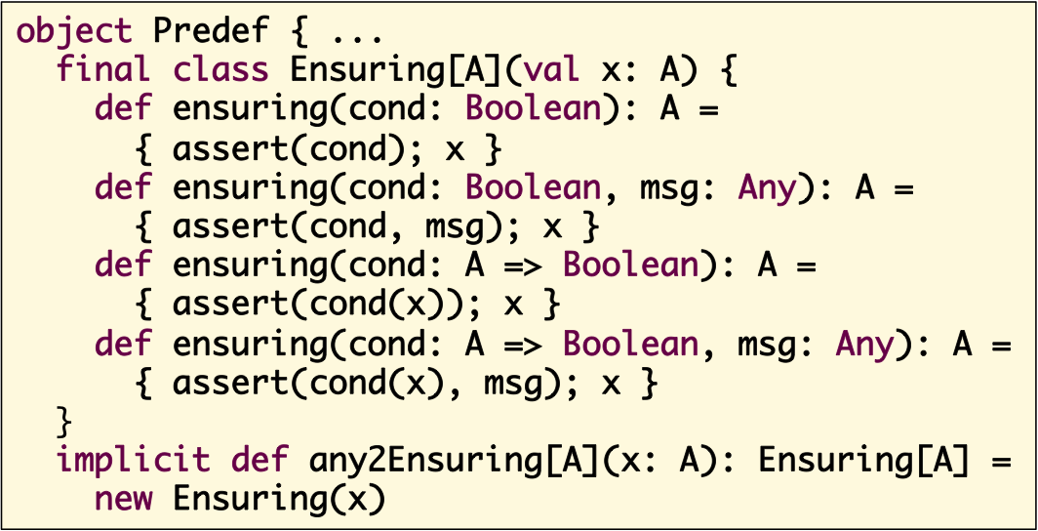
Implementing ensuring
Technically, ensuring is a method call.
Can be called on any object.
Made possible by an implicit conversion that produces a wrapper.

Slide 28
How to do invariants?
Everything described so far is part of the standard Scala distribution.
Invariants are not (yet), but they turn out to be easy to add.
Idea: encapsulate mechanism in a trait Invariants.

Slide 29
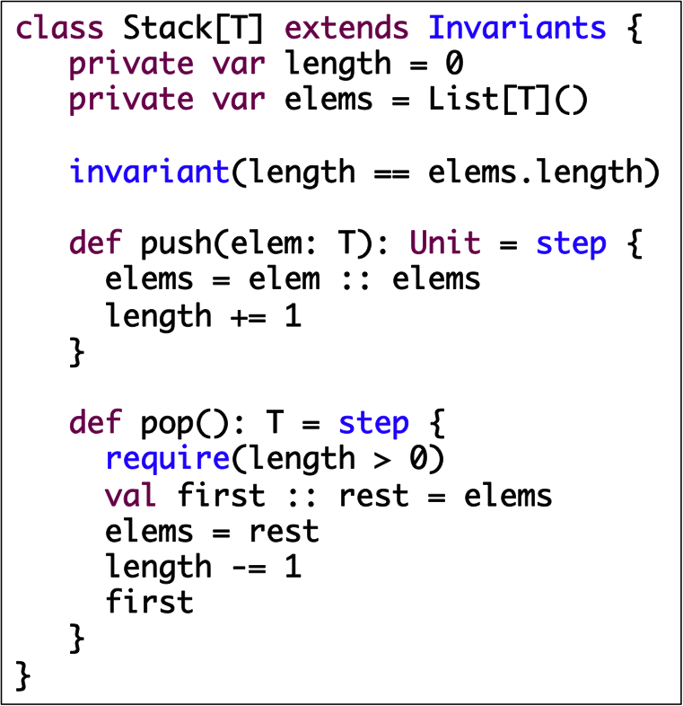
Using Invariants
Classes using
invariant
need to extend trait Invariants.
Invariants are checked at entry/exit to step blocks.

Slide 30
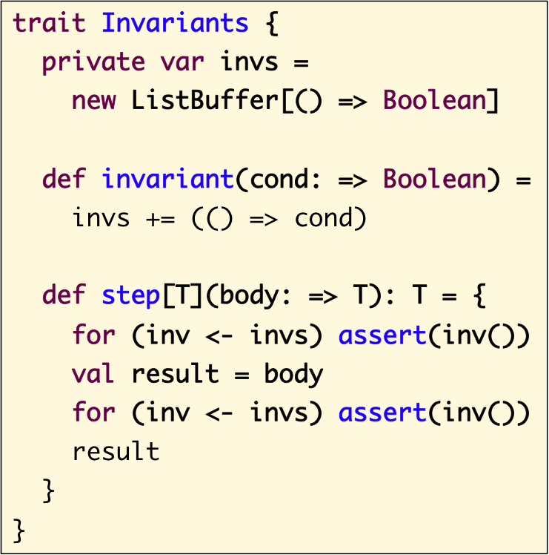
Implementing Invariants
Trait Invariants keeps all invariants to check in internal
data structure invs.
invariant adds its call-by-name parameter as a closure to invs.
step tests all stored invariants on entry/exit.

Slide 31
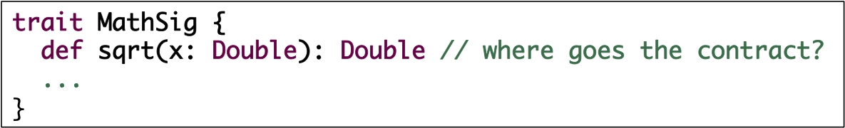
Assessment of Contracts as Code
+ Best possible re-use of language features
➔ Extremely lightweight.
− Some constraints on syntax.
− Entanglement of code and specification.
− How to attach a contract to an abstract method?

Slide 32

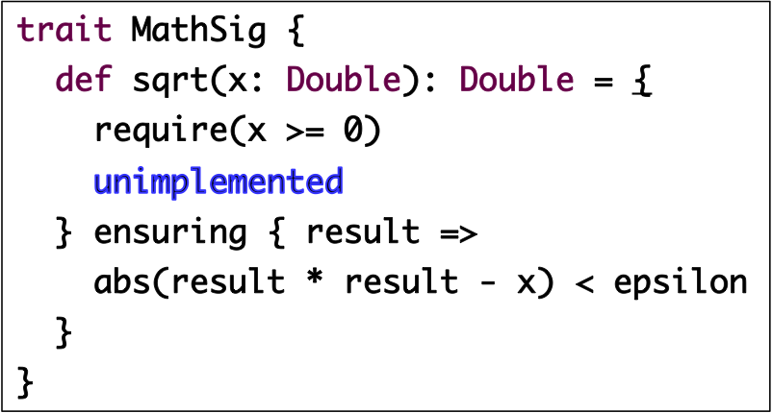
Adding Contracts to Abstract Methods
- first try -
Introduce a value undefined.
Then an “abstract” sqrt could be written like this:
?
- No abstract method checks
Conflicts with trait composition
Makes signatures heavyweight

Slide 33
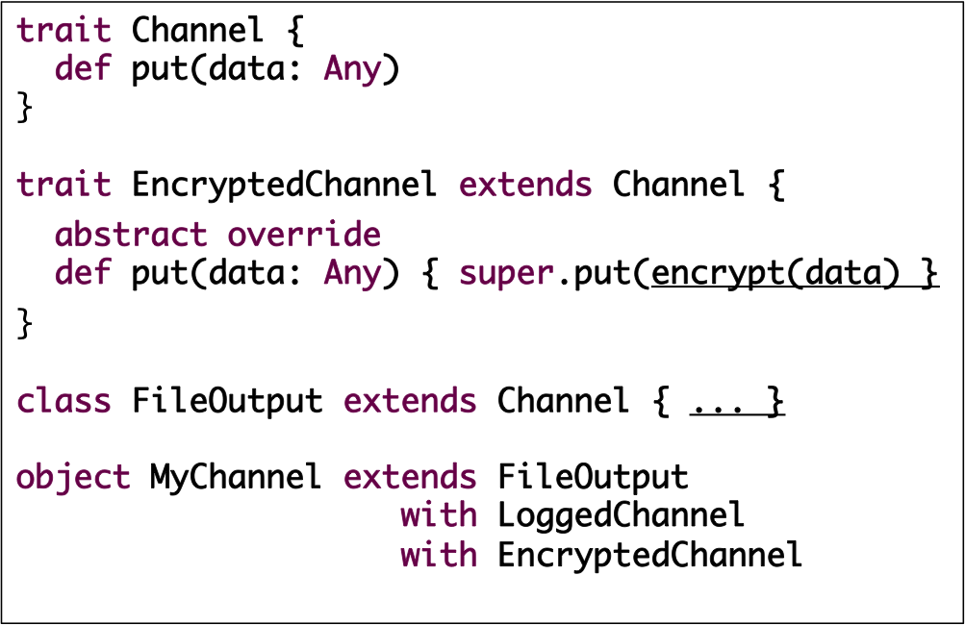
Traits to the Rescue
Traits are composable units of behavior
Multiple inheritance, with a twist: super is virtual.

Slide 34
Traits to the Rescue
The notion of “super” gets changed by mixin composition.
Inheritance:
Channel
FileOutputChannel
LoggedChannel
EncryptedChannel
MyChannel

Slide 35
Traits to the Rescue
The notion of “super” gets changed by mixin composition.
Inheritance: Super:
Channel
FileOutputChannel
LoggedChannel
EncryptedChannel
MyChannel

Slide 36
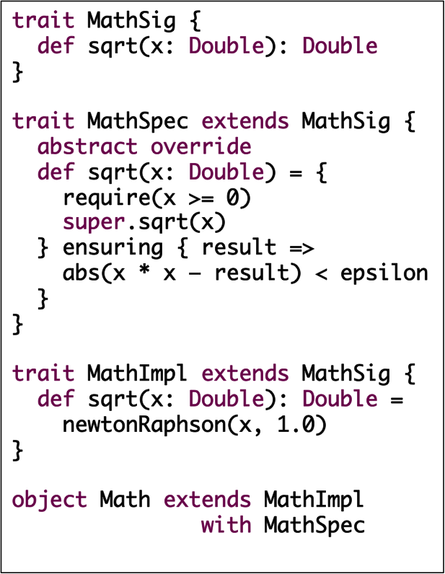
Traits and Specs
We can use traits to separate
  signature,
  specification,
  implementation
MathSig
MathSpec
MathImpl
Math

Slide 37
Not Covered
Old values
  need to define snapshots explicitly
  less of a problem because of Scala’s functional emphasis.
  could be done using bytecode rewriting
Modifies clauses, effects
  Flexible effect analysis is ongoing work.
Nullable types
  also ongoing work.

Slide 38
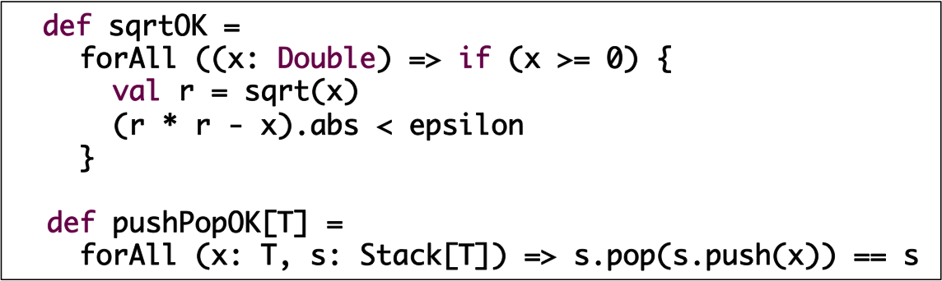
Complementary:
Random Testing in ScalaCheck
ScalaCheck [Nilsson] is Scala’s adaptation of Haskell’s QuickCheck [Hughes & Klaasen 2000].
Allows quantified properties.
Tested through type-directed randomized tests.
Useful feature: Minimization of counter examples.

Slide 39
Complementary: Program Synthesis
Instead of checking code, can also synthesize, e.g. [Kuncak et al., PLDI 09]
Essentially: replace in a specification
  super.f(args) ensuring { params => predicate }
by
  choose { params => predicate }
def secondsToTime(totalSeconds: Int) : (Int, Int, Int) =
choose { (h: Int, m: Int, s: Int) =>
h * 3600 + m * 60 + s == totalSeconds &&
h >= 0 &&
m >= 0 && m < 60 &&
s >= 0 && s < 60
}

Slide 40
Status
Methods assert, assume, require, ensuring available now.
Methods invariant, step: expected in 2.9, by Jan 2011
bytecode rewriting – nothing concrete planned but, hey, it’s open source, contributions very much appreciated!

Slide 41
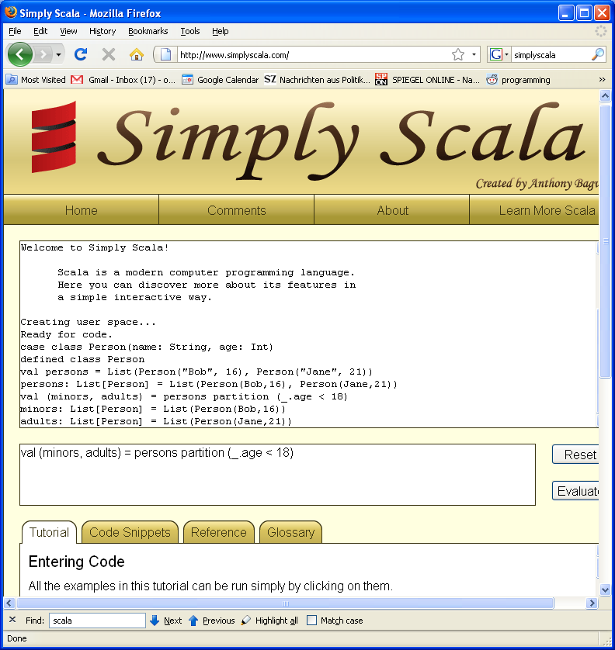
How to get started with Scala
100s of resources on the
web.
Here are three great
entry points:
Simply Scala
Scalazine @ artima.com
Scala for Java
refugees

Slide 42
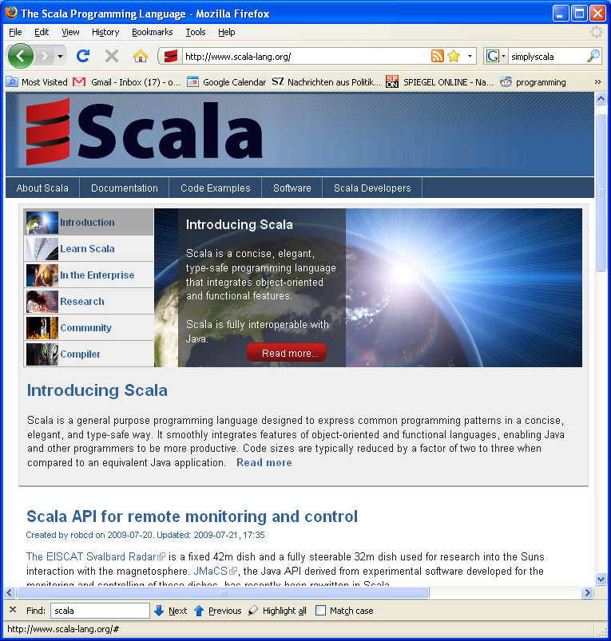
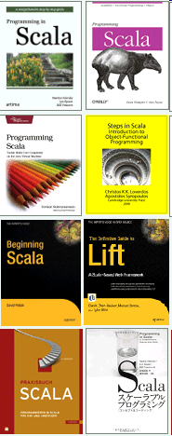
How to find out more
Scala site: www.scala-lang.org 13 books so far
Commercial support: www.scalasolutions.com

