Slide 1
Breitbandausbau Simulator 2015
Broadband deployment simulator 2015
Nikolai Neugebauer
Tim Sanwald

Slide 2
Research Question
How straight is a straight line
  Drawn within given time
  Drawn in specific directions

Slide 3


Assumptions
Line is bent upwards (typical thumb movement)
Bending depends on direction and position on screen

Slide 4
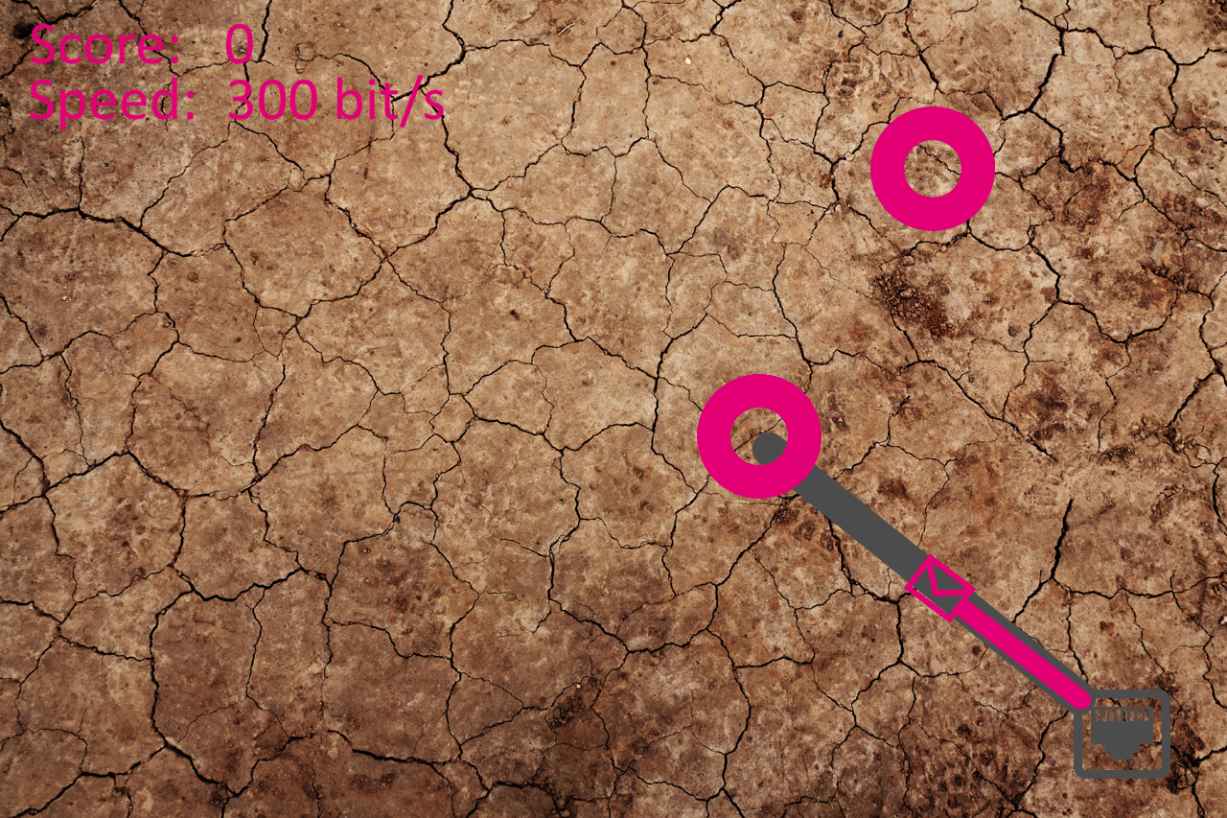
Game (I)

Slide 5
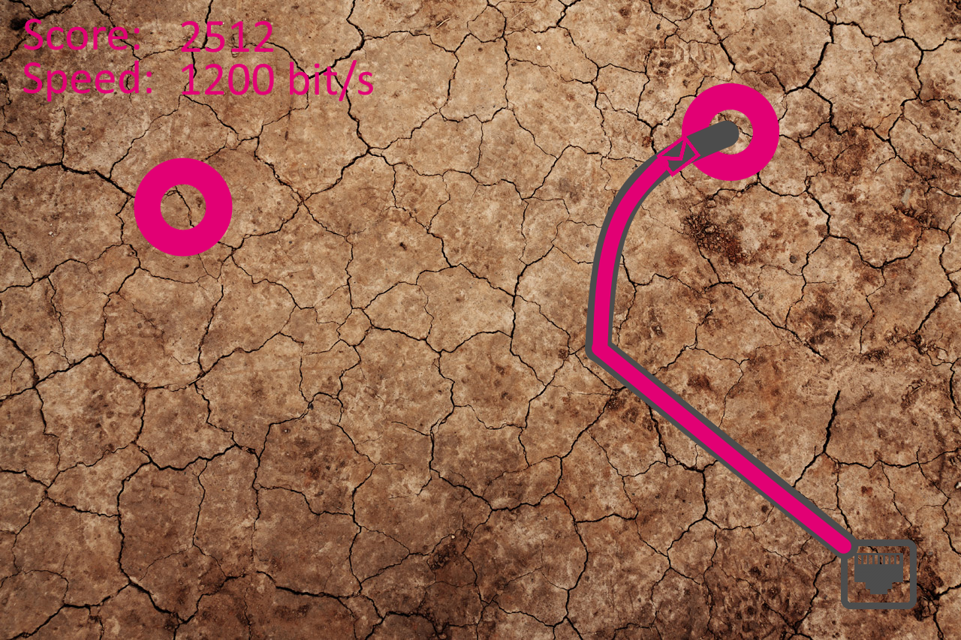
Game (II)

Slide 6
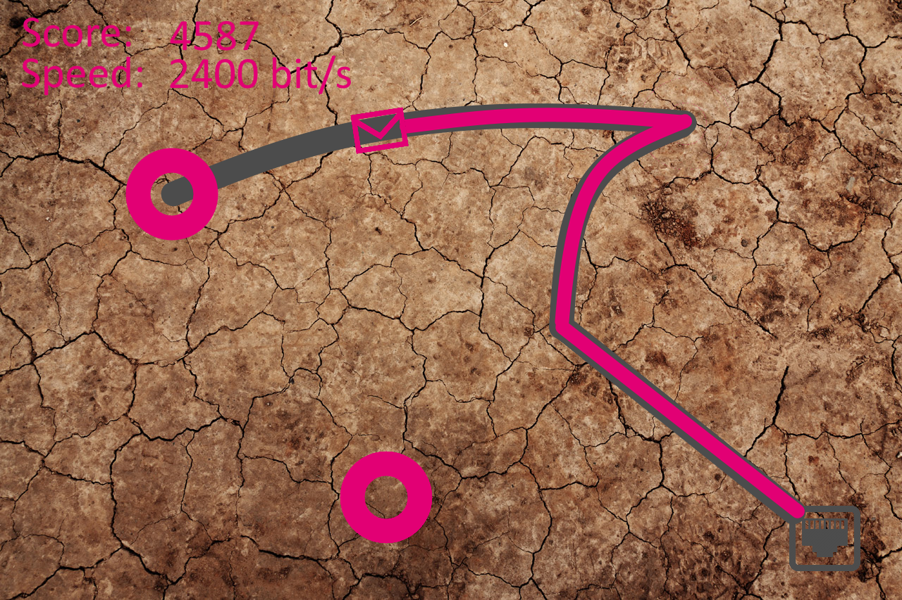
Game (III)

Slide 7
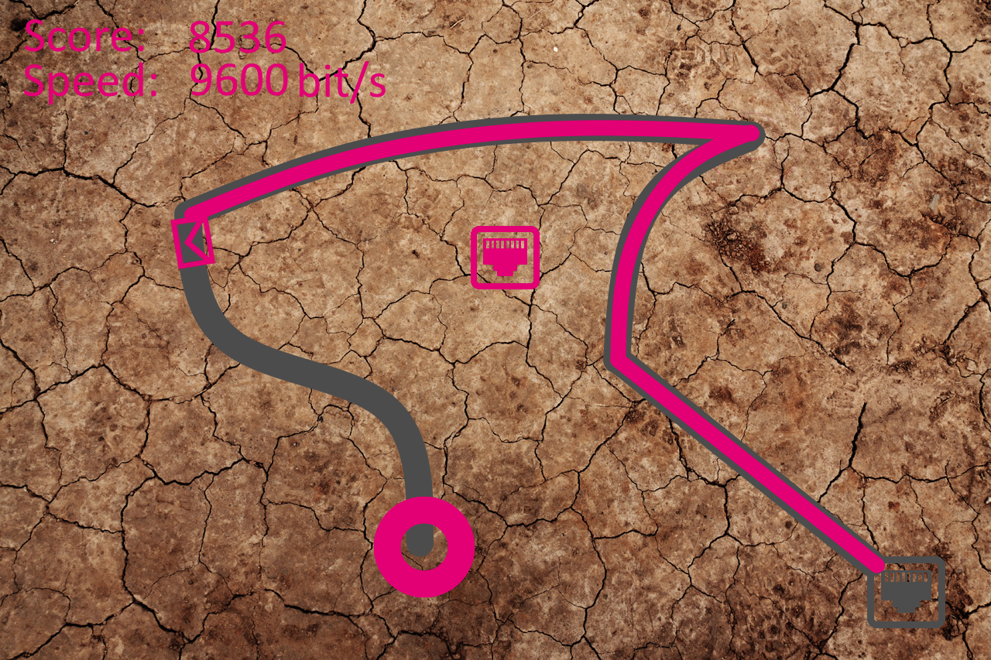
Game (IV)

Slide 8
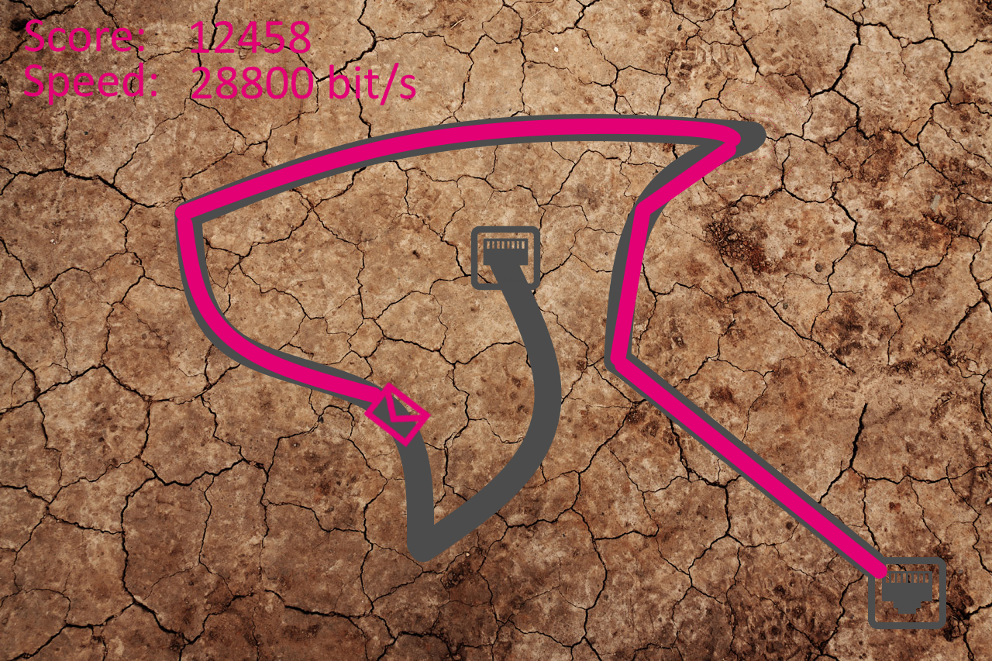
Game (V)

Slide 9
Features
Barricades (e.g. bomb, water, other cables, …)
Power-Ups
Awards
Different scrolling directions
Different companies

Slide 10
Breitbandausbau Simulator 2015
Become Beta-Tester now…
Only /!\ ONE /!\ space left

