Slide 1

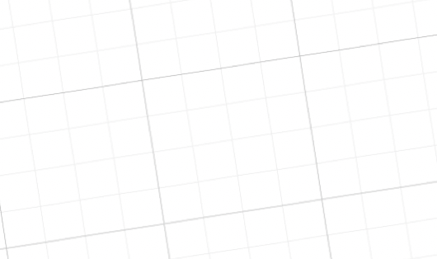
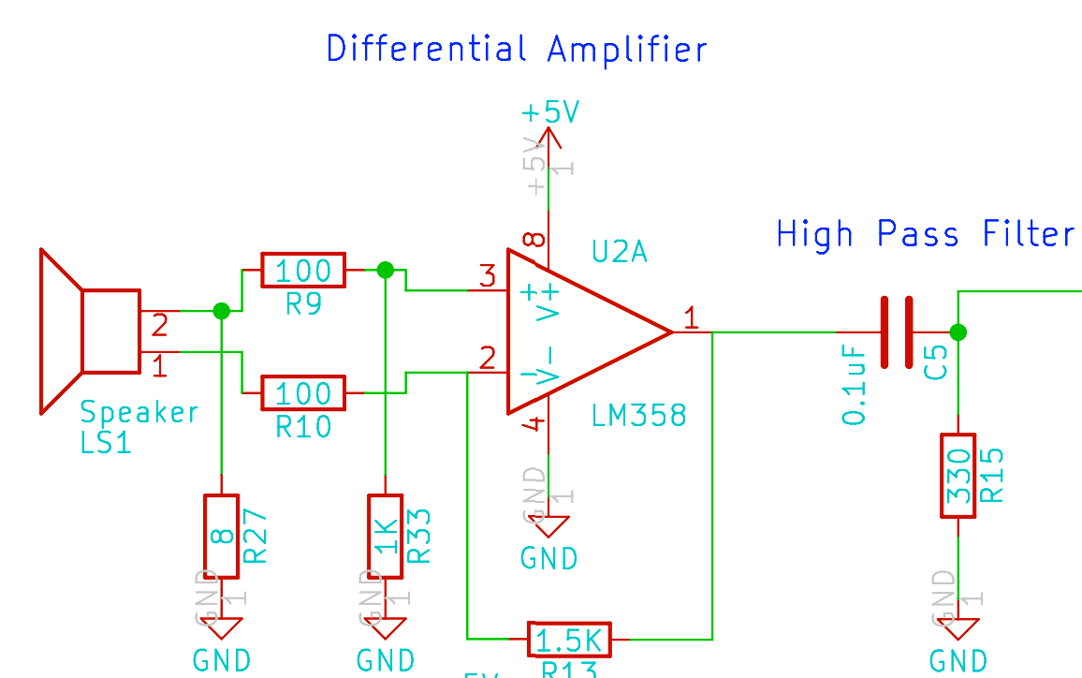


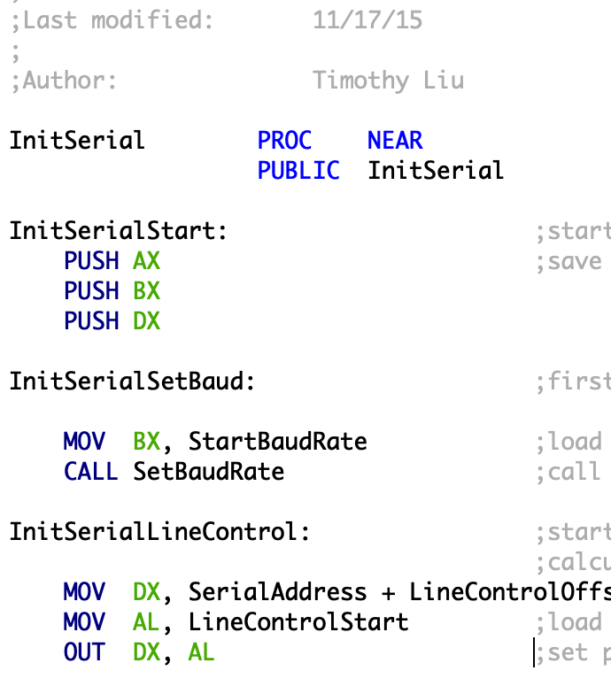

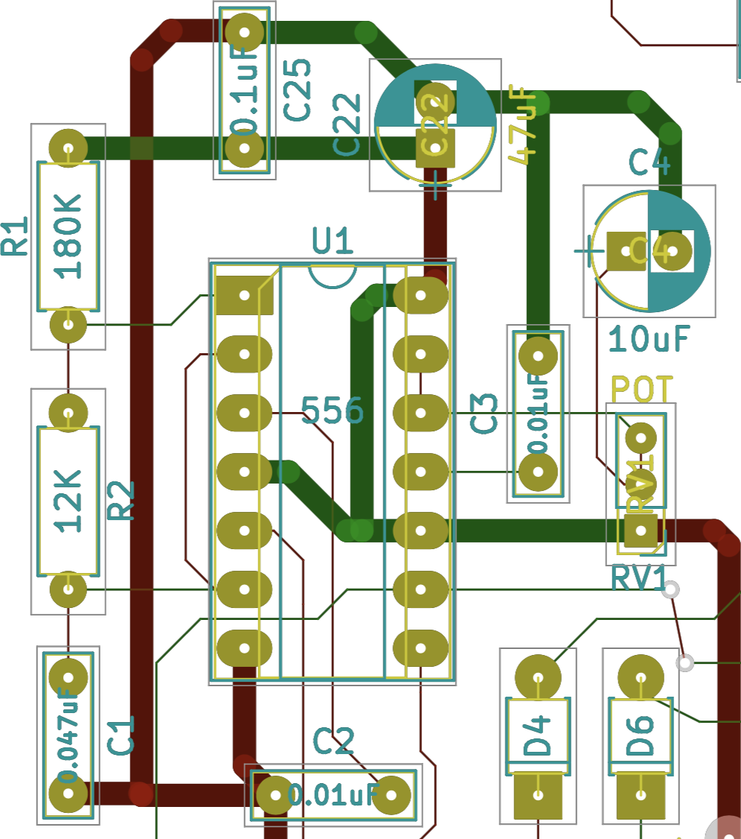
Professor James Ballard has an audacious dream: to a build a telescope powerful enough to find civilizations on planets orbiting faraway stars. It could be the greatest discovery in history, irrefutable evidence of alien life. But exploration for exploration’s sake doesn’t come cheap, if it happens at all. The pursuit of science and knowledge will have to overcome a cost that can’t be measured in dollars for Professor Ballard’s dream to come true.
Flybys and Foci
By: Timothy Liu

