Slide 1
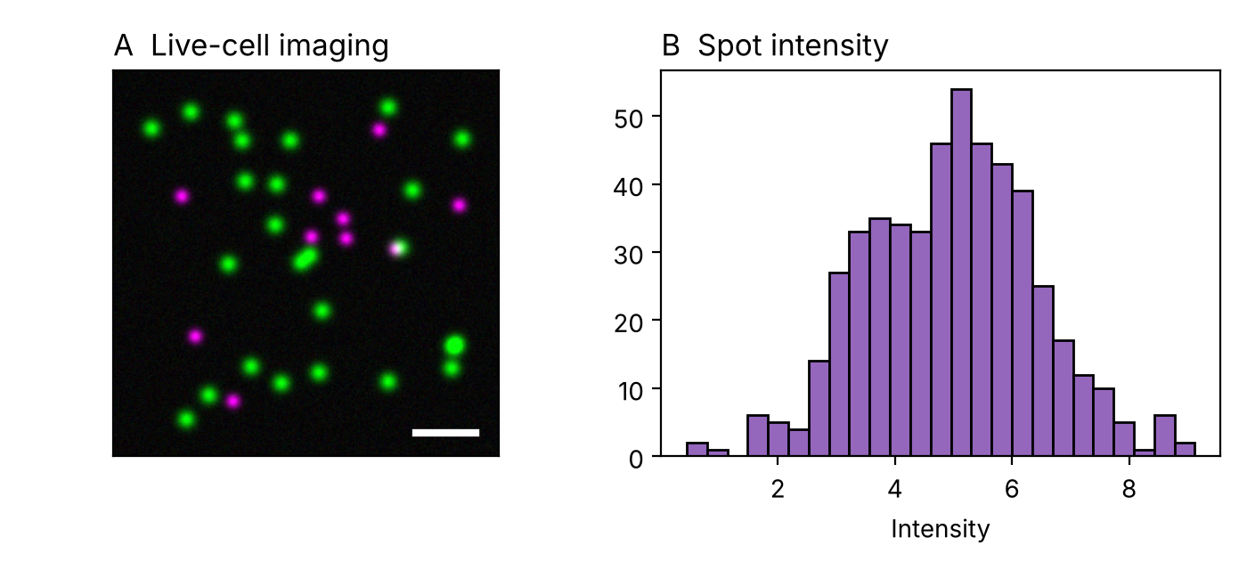
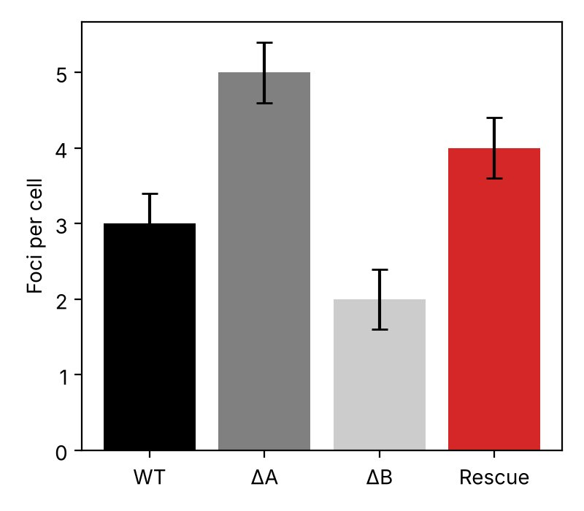
Live-cell imaging of translation
Single-mRNA translation sites tracked for 30 min
Red text stays red; dark navy text gets lifted; gray text inverts.

Slide 2
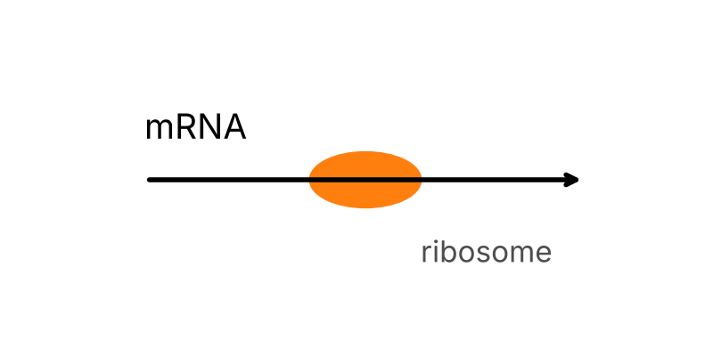
Shapes, lines and tables
Default blue shape, white text
White box, black text
Yellow box, black text
light gray
r0c0 | r0c1 | r0c2
r1c0 | r1c1 | r1c2
r2c0 | r2c1 | r2c2

Slide 3
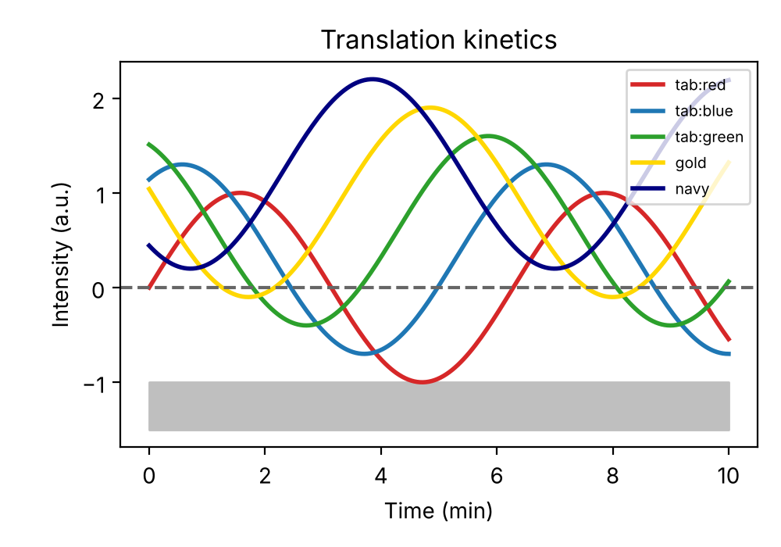
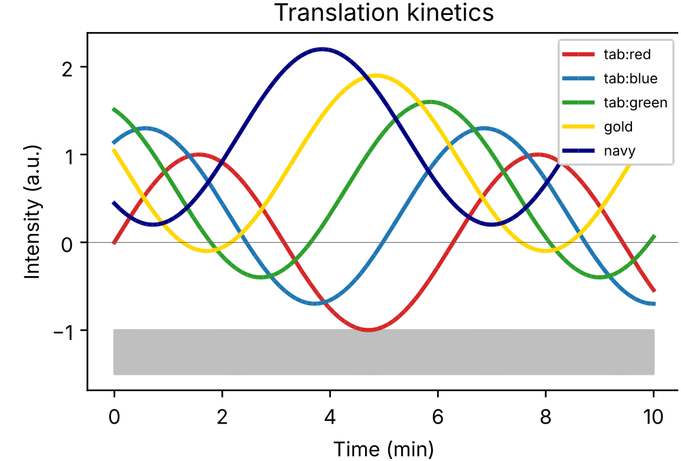
Vector figures: SVG and EMF

Slide 4
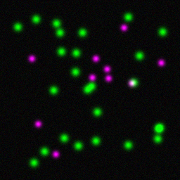
Native chart and a micrograph

