Slide 1

ENPM611 Class Project Spring 2025
Tim Sweeney, Aman Thanvi
Group 3

Slide 2

Background
Poetry – Open-source project for a Python package management system.
Crucial for Python dependency management, used widely in the open-source ecosystem.
Maintained on Github
592 contributors, 2.3k forks, 33.1k stars
First release (version 0.2.0) was March 1, 2018
Project: Generate insights by analyzing repository issues

Slide 3
Requirements – Functional Requirements
Functional Requirements
Produce 3 analyses
Analyze issue creation trends over time
Visualize contributor relationships.
Calculate average and median issue resolution time.
One analysis must take an input and provide insight about the subset of issues relevant to that input
At least 2 analyses must make use of charts
Build modular scripts for data preprocessing and analysis.

Slide 4
Requirements – Non-Functional Requirements
Non-Functional Requirements
Use only open-source libraries
Code must be maintainable and modular.
Output should include interactive and static visualizations.
Code and plots should be reproducible by others.

Slide 5
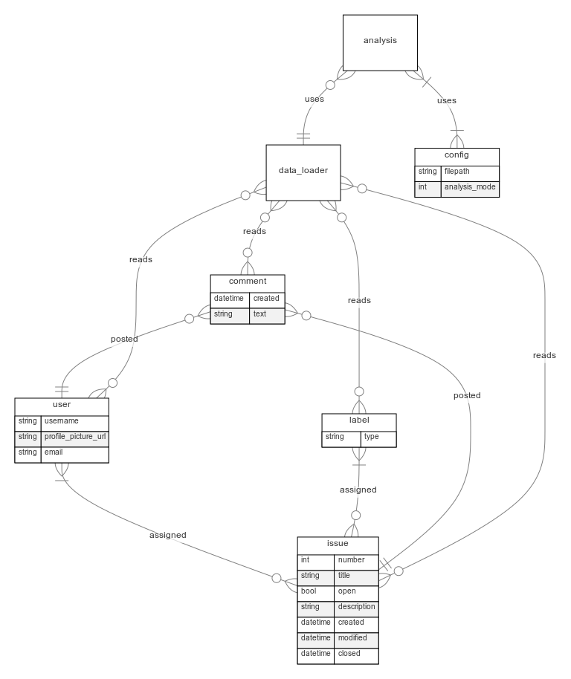
Design
Entity Relationship Diagram

Slide 6
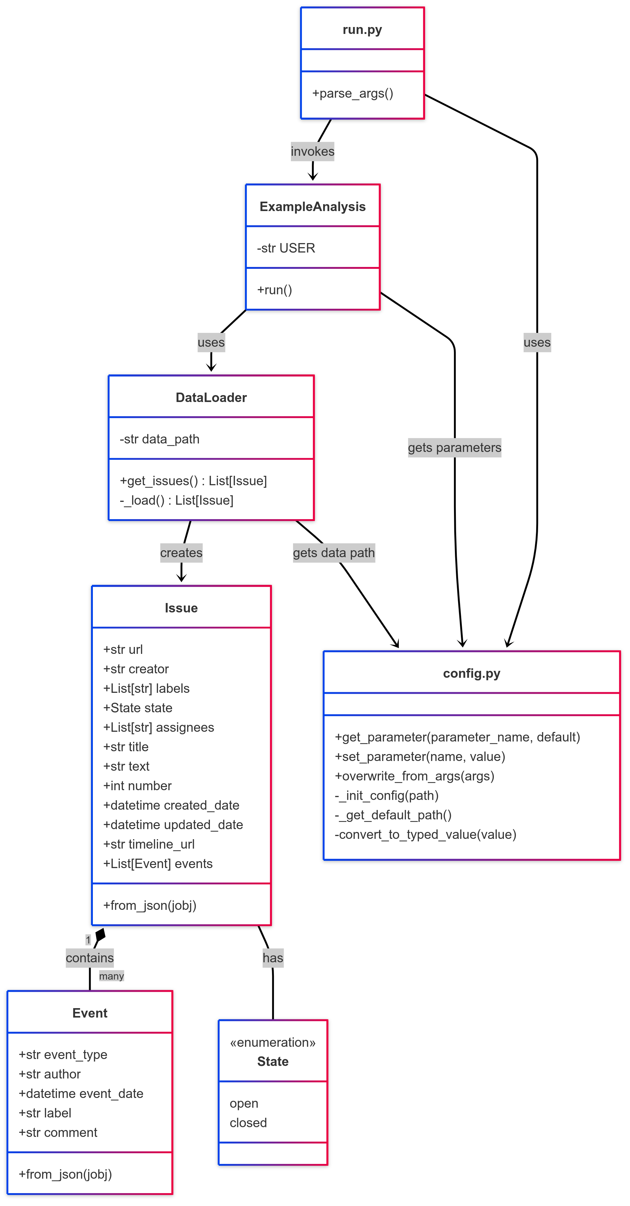
Design
Class Structure Diagram

Slide 7
Design – 3 Analyses
Analysis 1
Time analysis: Visualize the trend of issue creation over time
Analysis 2
Contributor Network Analysis: Visualize which users are working together
Analysis 3
Issue Lifecycle Analysis: Examines how long issues remain open and identifies patterns in issue resolution

Slide 8
Design – 3 Analyses Flow
[GitHub API / JSON Data]
[DataLoader.py] → [Preprocessed DataFrame]
[Analysis Modules] → [Visualizations + CSVs]
Modular architecture for data collection, preprocessing, and analysis.

Slide 9



Implementation – Tech Stack & Implementation
Language: Python 3.11+
IDE: Visual Studio Code
Version Control: Git and GitHub
Environment Management: Python venv and requirements.txt

Slide 10





Implementation – Libraries Used
Pandas – data cleaning, transformation, time-series binning
Matplotlib & Seaborn – static visualizations (histograms, trends)
Plotly – interactive graphs (network graph)
NetworkX – contributor graph construction and metrics

Slide 11
Implementation – Repository Structure
data_loader.py – loads & preprocesses JSON data
analysis_1.py – Time-based issue creation analysis
analysis_2.py – Contributor network graph generation
analysis_3.py – Issue resolution time computation
config.py – Centralized config variables (paths, repo info)
run.py – Unified script to execute all analyses
requirements.txt – Dependency management
design/ - Class & entity diagrams
README.md - Documentation

Slide 12
Implementation – Modularity & Workflow
Data Ingestion: GitHub issue data parsed from JSON
Data Preprocessing: Handled by data_loader.py
Analysis Modules:
analysis_1: Trends in issue creation by month
analysis_2: Contributor collaboration network
analysis_3: Resolution time stats and plots
Output: Static/interactive plots saved as PNG

Slide 13
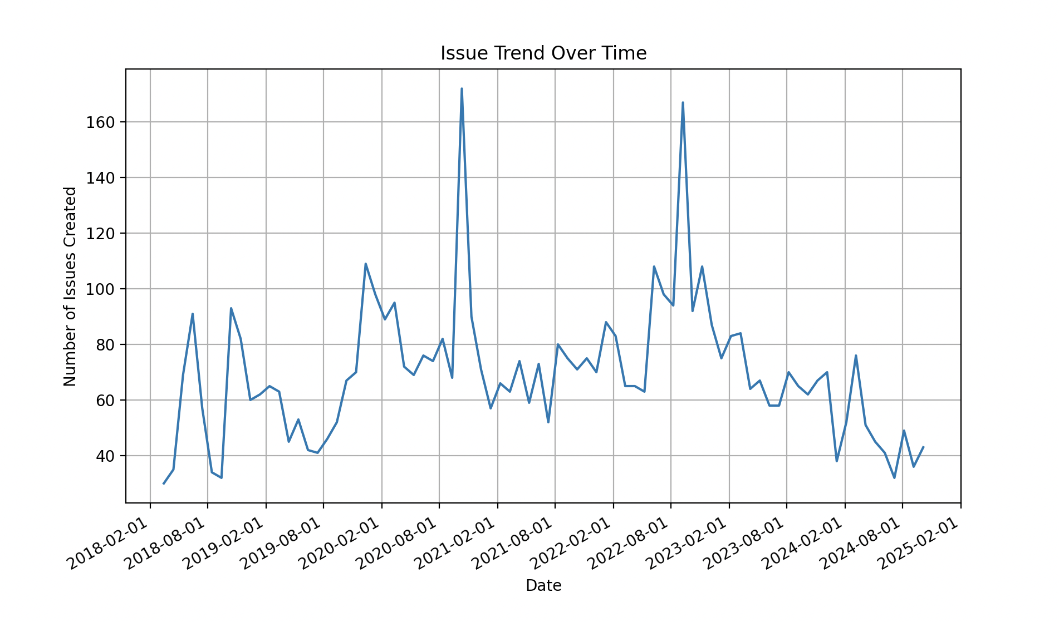
Analysis 1 – Issue Creation Over Time
Release of v 1.1.0
Release of v 1.2.0
- Full Dataset
Dataset is binned by month
Spikes in issue creation after release suggests reactive community that is catching bugs not found in pre-release testing

Slide 14
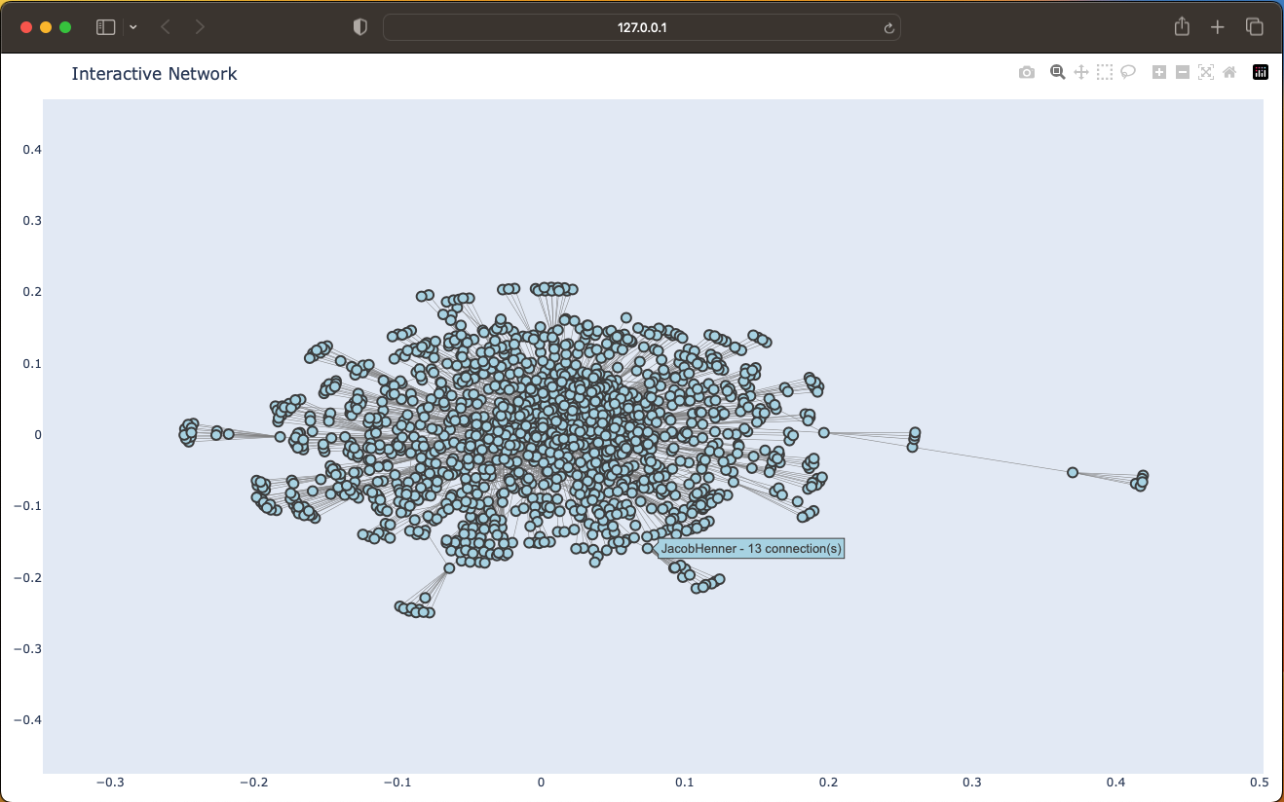
Analysis 2 – Contributor Network Graph
Nodes: Users
Edge Weights: Number of interactions
Useful for visualization of contributor interactions.
Dense core contributors with many transient contributors

Slide 15
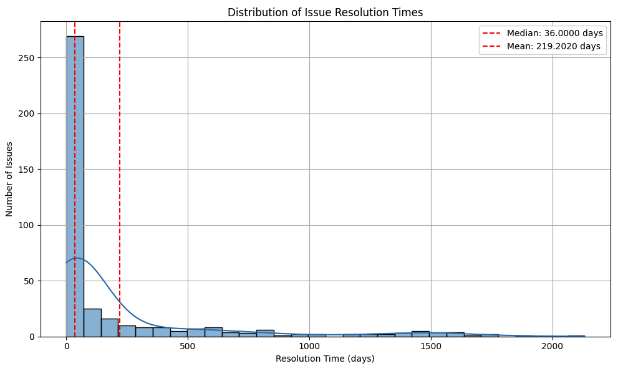
Analysis 3 – Issue Resolve Time

Slide 16
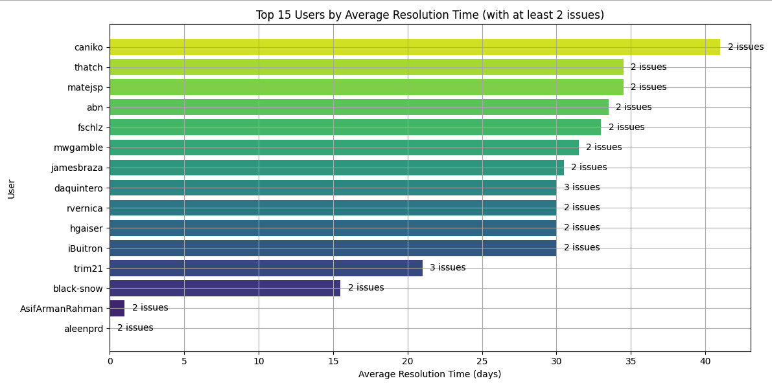
Analysis 3 – Issue Resolve Time

Slide 17
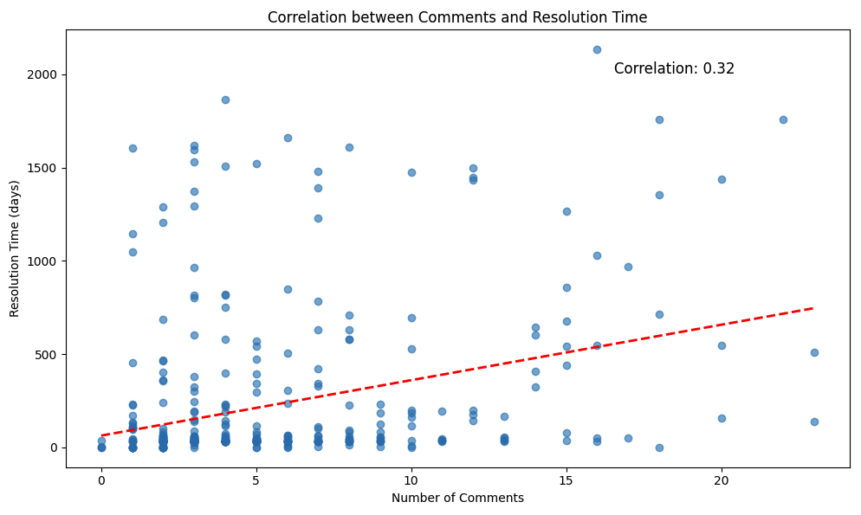
Analysis 3 – Issue Resolve Time

Slide 18
Testing – From Group 2
Name Stmts Miss Cover Missing
--------------------------------------------------------
analysis_1.py 38 1 97% 84
analysis_2.py 63 1 98% 54
analysis_3.py 86 7 92% 125, 179-182, 188-189
config.py 68 14 79% 79, 87, 111-123
data_loader.py 22 1 95% 49
example_analysis.py 28 1 96% 64
model.py 63 0 100%
test_analysis_1.py 26 1 96% 39
test_analysis_2.py 43 1 98% 72
test_analysis_3.py 124 1 99% 321
test_config.py 71 1 99% 89
test_data_loader.py 62 1 98% 95
test_example_analysis.py 38 1 97% 66
test_model.py 65 1 98% 118
--------------------------------------------------------
TOTAL 797 32 96%

Slide 19
Testing – From Group 2
Ran 48 tests in 1.767s
FAILED (failures=7)
======================================================================
FAIL: test_issue_handles_missing_state_field_gracefully (test_model.TestIssue)
----------------------------------------------------------------------
======================================================================
FAIL: test_run_handles_none_issues (test_example_analysis.TestExampleAnalysis)
----------------------------------------------------------------------
======================================================================
FAIL: test_data_loader_handles_missing_file_gracefully (test_data_loader.TestDataLoader)
----------------------------------------------------------------------
======================================================================
FAIL: test_init_config_handles_invalid_json (test_config.TestConfig)
----------------------------------------------------------------------
Notes:
The tests that were run break the code in a way that we never intended on using it
Implementing changes based on results would result in more robust code

Slide 20
Testing –
On Group 1
Name Stmts Miss Cover
-----------------------------------------------
config.py 85 4 95%
data_loader.py 22 1 95%
duplicates_finder.py 40 4 90%
example_analysis.py 30 3 90%
label_comparison.py 103 2 98%
model.py 63 6 90%
origin_comparison.py 83 2 98%
report_time_comparison.py 85 2 98%
run.py 26 2 92%
tests/test_config.py 132 3 98%
tests/test_run.py 63 1 98%
-----------------------------------------------
TOTAL 732 30 96%
Notes:
Our testing covered all the analysis and support files.
No faults found, did not intentionally try to break for robustness testing

Slide 21

Live Demo

Slide 22
Thank you!

Slide 23
Appendix
Repository:
https://github.com/timsweeney7/enpm611-project-app

