Slide 1
Performance Enhancement Tips
Don’t Write too much
Wen Chang Hsu

Slide 2

石頭湯

Slide 3
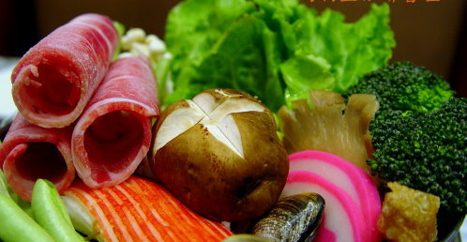
主菜們站出來

Slide 4
Who am I
Wen Chang Hsu ( you can find me via Tim)
Dorm7 Software, 好客民宿
Slide Note 我想讓它上線…..

Slide 5
Repository find timtan in GitHub
https://github.com/timtan/python-performance-tips.git
pip install -r requirement.txt

Slide 6
Profile
Now see profile_sample1.py

Slide 7
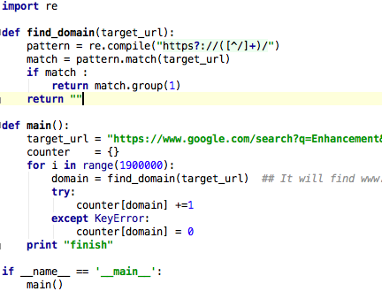
profile_sample1

Slide 8
Who is slow?
python -m cProfile -s cumulative profile_sample1.py
-m cProfile means directly invoke the module
-s is the sort order.

Slide 9
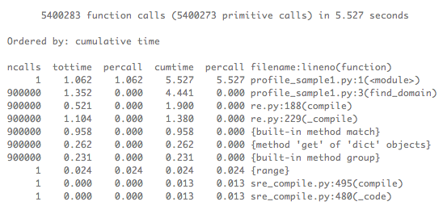

Slide 10
The nature of cProfile
Deterministic profiling,
Python interpreter have hook on each function call.

Slide 11
Summary
Profiling first, don’t guess
Use the command
python -m cProfile -s cumulative profile_sample1.py

Slide 12
If you don’t have time
Reduce complex is better
You can use pypy !!

Slide 13



Slide 14
But !!
C Extension is not available
However, original standard library written in C are replaced with pure python

Slide 15
How Quora think
http://www.quora.com/PyPy/Will-PyPy-be-the-standard-Python-implementation
Page loading time boost 2x. But lxml, pyml cannot runs in PyPy.
Communications between Cpython and PyPY

Slide 16
You can use Cython
Compile python module to C code
Compile the c Code to python module
You change no code, 20% boost

Slide 17
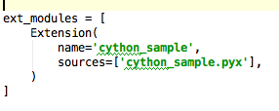
Key Point to use Cython

Slide 18
In the example
type make in your shell
How to write setup.py is a little tricky if you want to use cython and setuptools at the same time.

Slide 19
Summary
PyPy is good and near production
C Extension is in experiment
Cython is more realistic, and you can integrate it with existing C module easily

Slide 20
Parallel ?
大量的資料做同樣的事
Gevent, multiprocessing, Thread
Celery ( I won’t cover this today )

Slide 21
Reddit says
Thread in python sucks
Multiprocessing is good

Slide 22
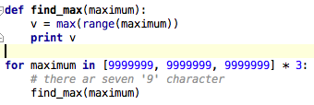
computation_parallel_example.py

Slide 23

7 second

Slide 24
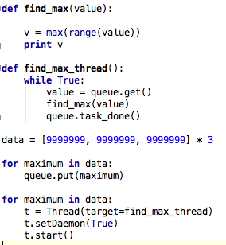
computation_parallel_example_threading.py

Slide 25

7 seconds again

Slide 26
Why
Python Has a GIL
The max function call is not preemptable, it is written in C
The interrupter cannot yield form the function call

Slide 27
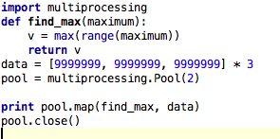
Multiprocessing

Slide 28

4s, faster than multithreading

Slide 29
Summary Multiprocessing
It did fork process. (consumes memory)
It can utilize all your core

Slide 30
Trick For Multiprocessing
pool = multiprocessing.Pool(10)
pool.map( function, data)
Than you get 10 workers that will help you process data

Slide 31
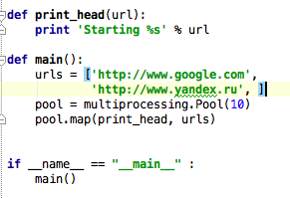
e.g.

Slide 32
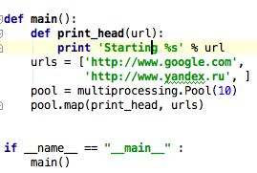
Error !!!

Slide 33
Summary of Multiprocessing
It did fork !!
Previous data is duplicated, you should
The only way to communicate data between process. It use IPC
The argument, return value function should be pickable

Slide 34
PyCon TW needs U
不要再叫 Tim 了

