Slide 1
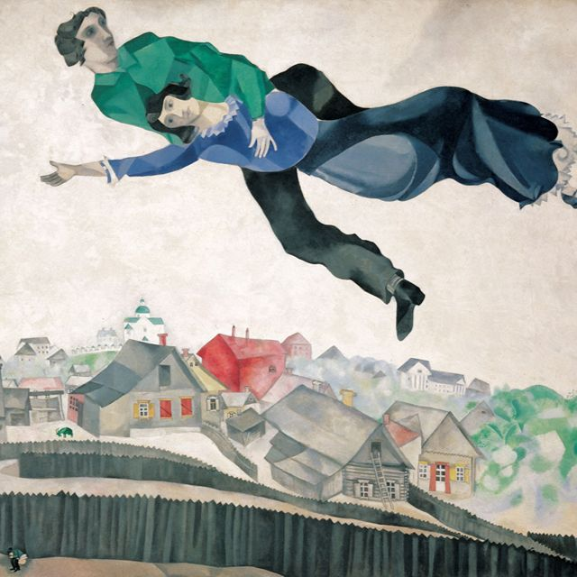
Neural Style Transfer
Web Application
Made by Taimuraz Tibilov with GPT5
BABDS242
HSE’25-26

Slide 2
Neural Style Transfer Web Application
Upload your photo and apply famous artist styles.
Built with Python Flask and PyTorch.
Minimalist interface with progress tracking and style preview.

Slide 3
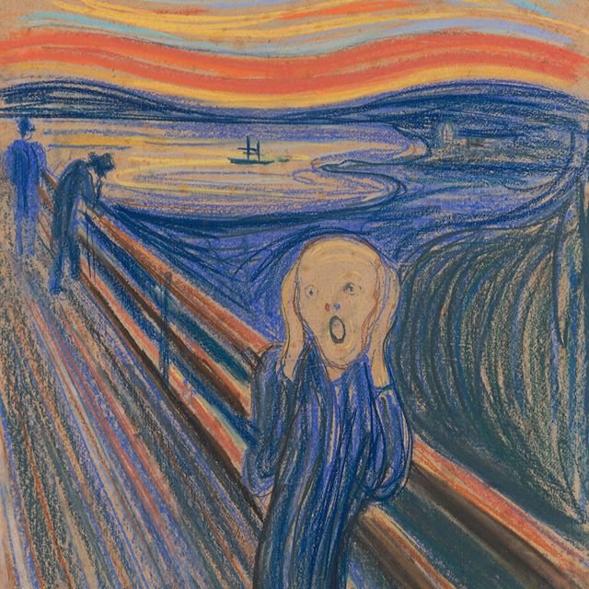
Key Features
Upload a photo and choose a style from 7 famous artists
(Van Gogh, Picasso, Dali, Munch, Klimt, Chagall, Mucha).
Style preview before generating.
Soft style application preserves original details.
Progress bar shows generation status.
Single session image processing, no history stored.

Slide 4
Architecture
Frontend: HTML + Bootstrap, upload form,
style preview, progress bar, result display.
Backend: Flask server, handles uploads and style transfer,
SSE for progress, logs to server.log.
Neural Style Transfer Engine: PyTorch, VGG19 preloaded,
soft style application configurable via weights.

Slide 5
How NST Works
Input: Content image + Style image.
VGG19 extracts content and style features.
Content loss preserves structure; Style loss transfers colors/textures.
Gradient-based optimization updates input image iteratively.
Output: Stylized image preserving original content.

Slide 6
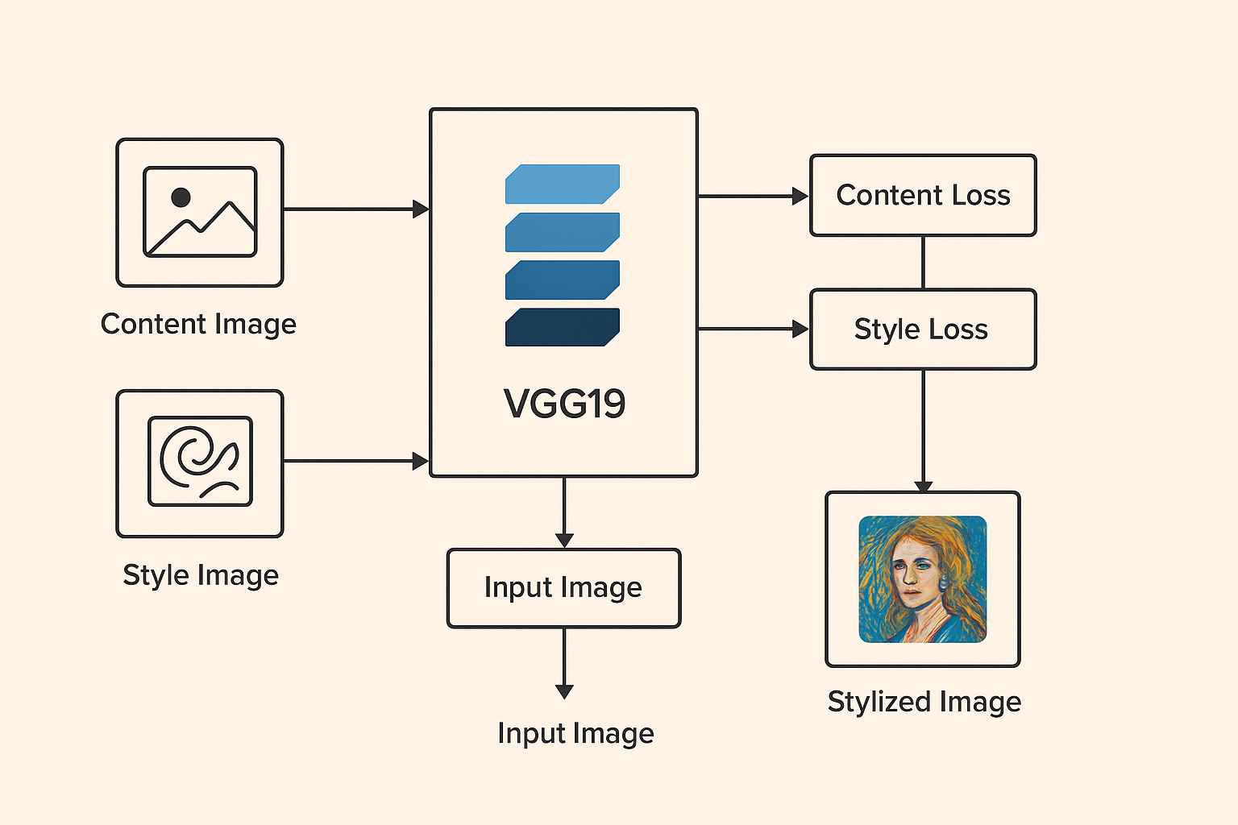
How NST Works

Slide 7
Workflow
1. Upload photo.
2. Select artist style.
3. Frontend shows style preview.
4. Click Generate, backend processes NST in a separate thread.
5. Progress bar updates in real-time.
6. Final styled image displayed on the same page.

Slide 8
Technology Stack & Notes
Python 3, Flask, PyTorch / Torchvision, PIL (Pillow), Bootstrap 5.
Simple, lightweight, and easy to deploy.
Designed for single-user sessions.
Style intensity adjustable via weights in NST.
Can be deployed on GitHub Pages + Heroku/Docker for demo purposes.

