Slide 1
Reinforcement man vs. ghostmaster
Jonas Mahn Julius Taylor

Slide 2


The scenario
Two RL-agents compete
The Wanderer
The GhostMaster
Maze-like environment
Fully observable, deterministic
States:
Single game frames
Is faster than ghosts
Anticipation needed
Rewards:
+reward for collecting coins
-reward for not collecting coin
--reward for being caught
Action space:
${\left[\text{up}\text{, }\text{down}\text{, }\text{left}\text{, }\text{right}\right]}^{1}$
Ghosts are slower than Wanderer
Coordination needed
Rewards:
++reward for catching Wanderer
-reward for not catching Wanderer
Action space:
${\left[\text{up}\text{, }\text{down}\text{, }\text{left}\text{, }\text{right}\right]}^{4}$

Slide 3
Ok you got us…
…we’re playing PacMan.
… but also the ghosts.

Slide 4
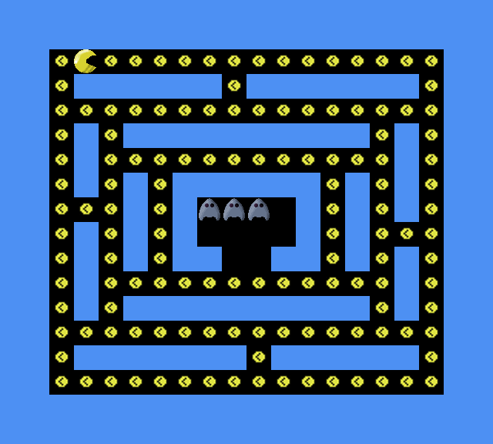

The Implementation
The Game Environment
PyGame
Reinforcement Learning
Deep Q-Learning
off-policy control
$ε$-greedy action selection
Q-Function Approximation using a convolutional neural network
Tensorflow & Numpy

Slide 5
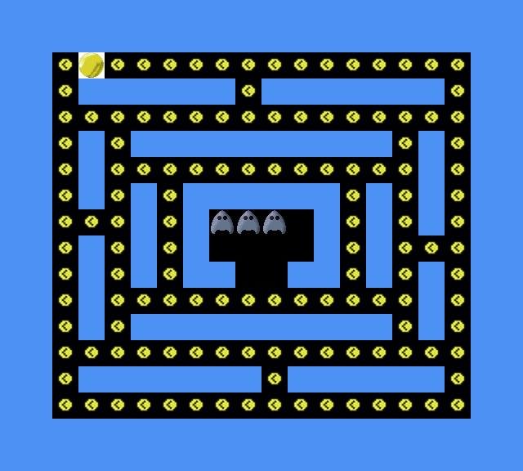


Deep q-network (of the Wanderer)
$$S_{0}$$
[$Q\left(S_{0},A_{0},\right), {Q(S}_{0}, A_{1}), Q\left(S_{0},A_{2}\right), Q(S_{0}, A_{3})$]
→ e.g. [1.2, 200, 4.3, 0.1]
[vector of pixels] (state) →
reward per action [UP, DOWN, LEFT, RIGHT]

Slide 6
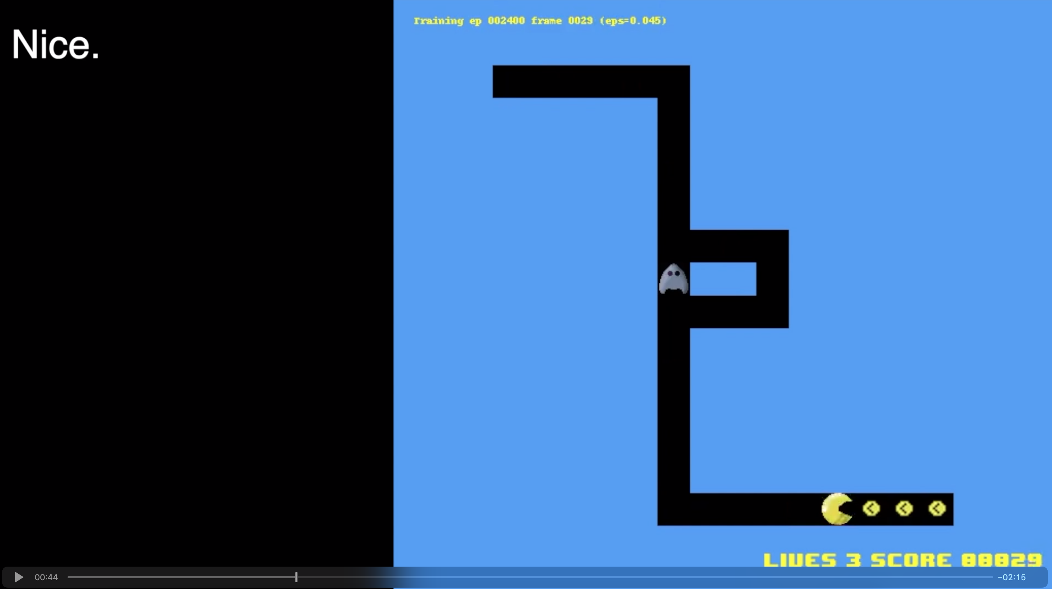
Video Here

Slide 7
Current Status
Implemented Features
Environment
Multiple Levels with various difficulties
Deep Q Learning for Wanderer
Learns perfect policy (minimal num steps) for levels with static ghost(s)
Performance with randomly moving ghosts could be better
Replay Buffer
Train/Test Procedure, Video Out, Plotting
Missing
GhostMaster agent(s)
- Play against trained Wanderer

Slide 8
Improving Wanderer Agent
- State becomes (previousFrame, currentFrame) to allow movement direction
detection of ghosts
- Larger network?

Slide 9
outlook
TODOS:
Find solution for large action space of GhostMaster controlling several Ghosts
Implement The GhostMaster
Train both agents in an adversarial fashion
How does the behavior of the Wanderer change in such a setup?
WISHLIST:
Ghosts
Tactical behavior like surrounding, covering choke points
Maybe only limited vision (proximity)
GhostMaster must coordinate
Wanderer
Should avoid dangerous spots in the maze
Should anticipate capabilities of the GhostMaster
Additional features:
Power-ups for the Wanderer

Slide 10
Thank you!

