Slide 1
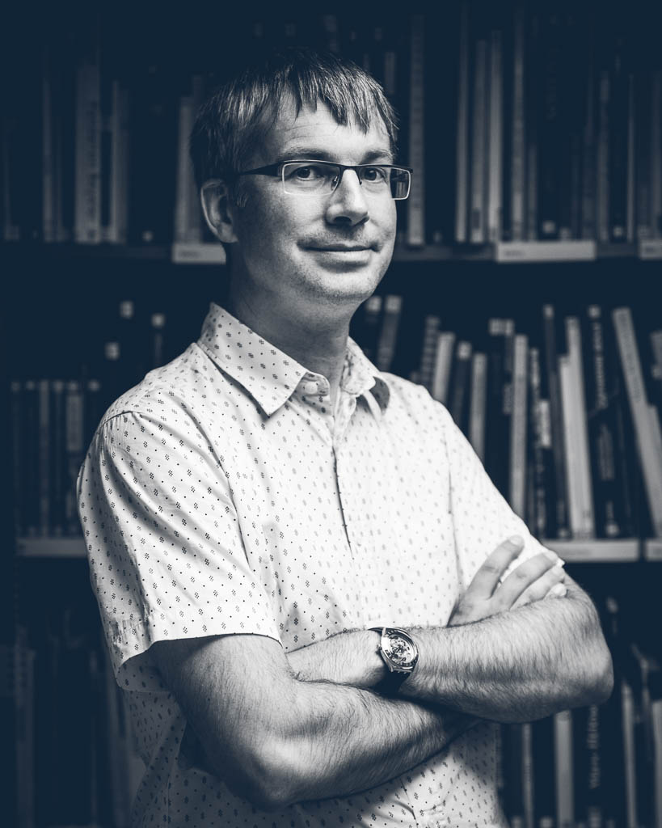




Welcome!
Thomas Guignard
Library technology consultant and project manager. Québec (QC)
Get in touch:
thomas.guignard@gmail.com
@timtomch
@concretelibraries

Slide 2
Challenge
Task: list files in the data-shell folder
- ordered by size
- smallest file first
Hint: use man ls or ls --help to see a list of options

Slide 3
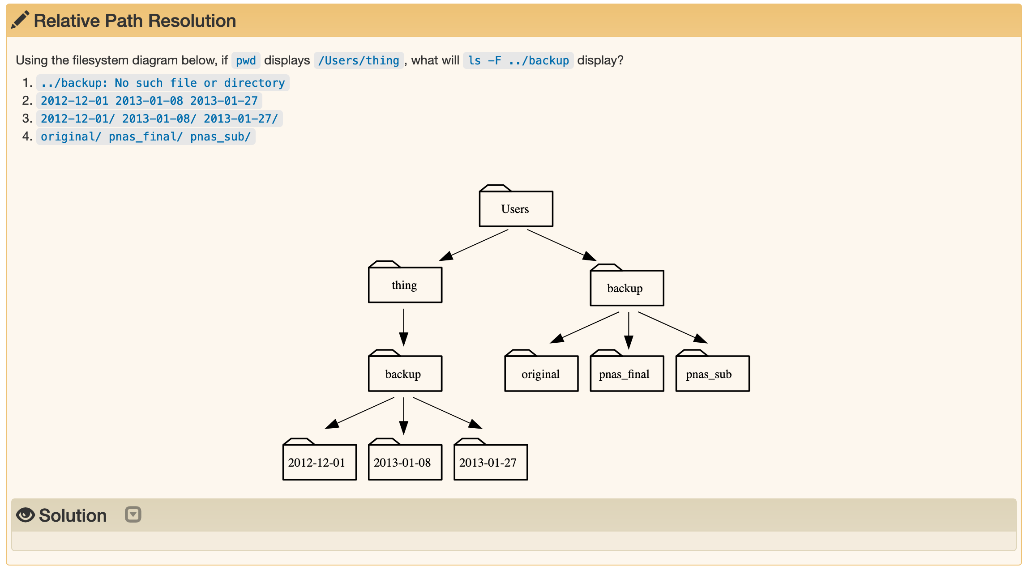
Challenge

Slide 4
Challenge
Task: Create a backup of the molecules folder
1. Move molecules to be inside data
2. Create a folder called backup
3. Create a subdirectory backup/2021-02-17
4. Copy the contents of the molecules folder to
backup/2021-02-17

Slide 5
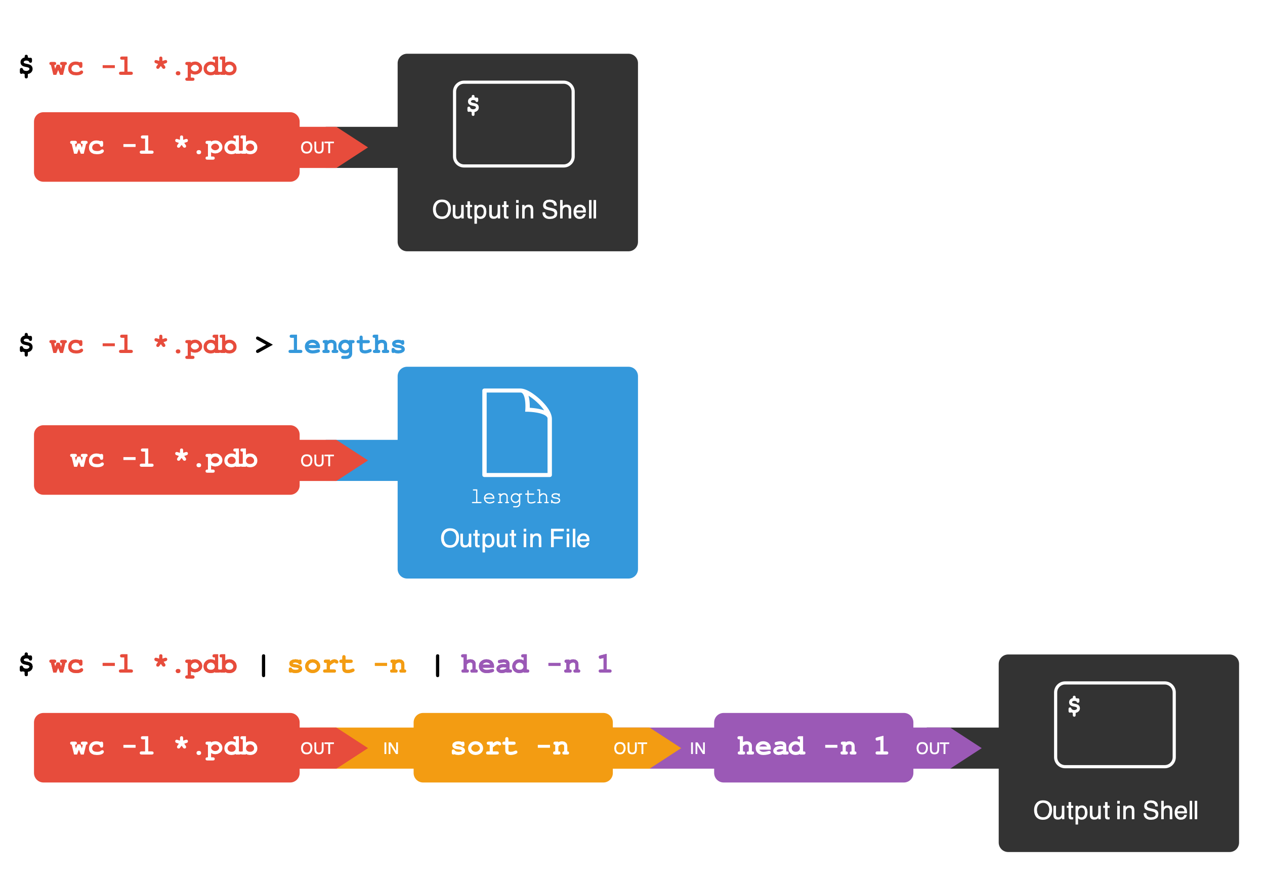

Slide 6
Challenge
wc -l *.pdb | sort -n | head -1 outputs the shortest molecule
Task: write an expression that outputs the longest molecule
Hint: tail outputs the last line of a file

Slide 7
Challenge
Task: write for loop to make a backup copy of each file ending in
*.dat

Slide 8
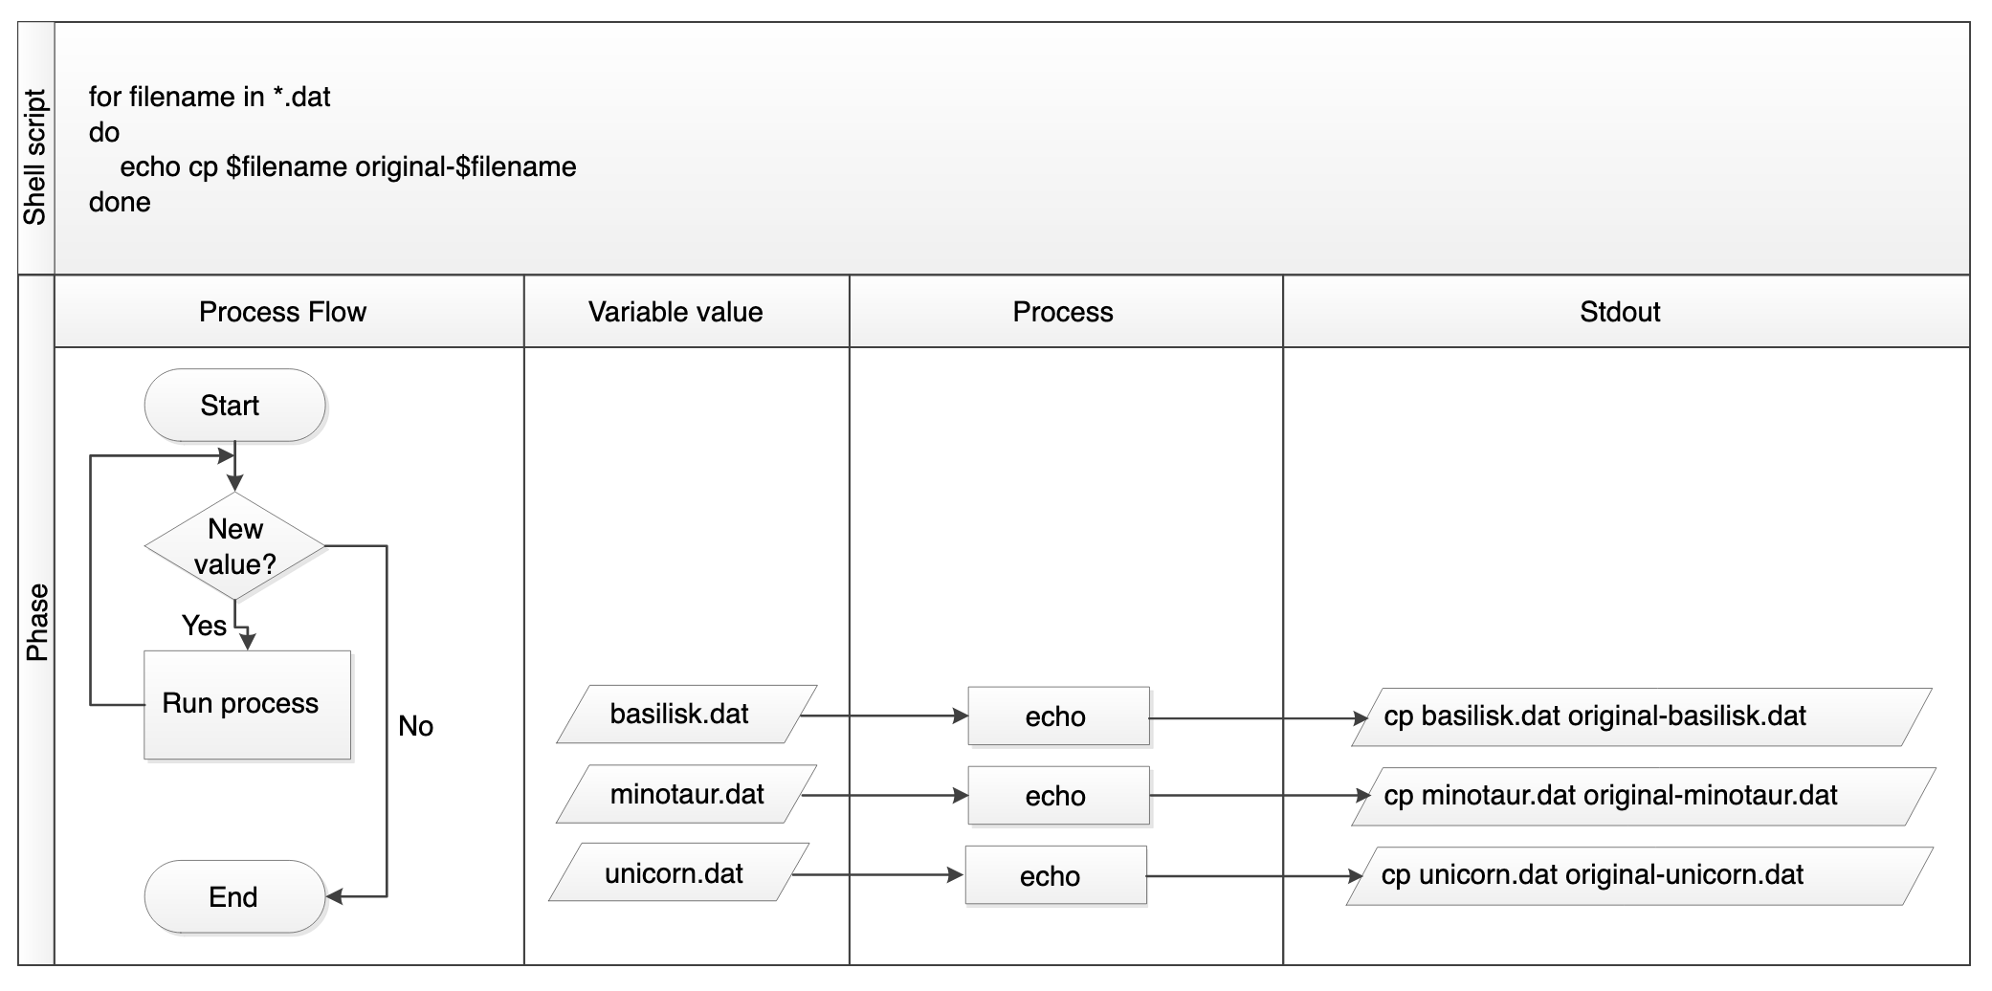

Slide 9
Challenge
Task: Write a script that takes two arguments
- the name of a directory
- a file extension
and outputs the longest file (with the most lines) in that
directory with that extension

Slide 10
Capstone challenge
Task: Find how many times the characters Jo, Meg, Beth and
Amy are mentioned in the novel Little Women.
Hints:
full text in data-shell/writing/data/LittleWomen.txt
use for loop
use grep
remember to use man or --help to find options

