Slide 1
author_ID | family | personal | occupation | birth | death
1 | Kline | Kevin E. |  | 1966
7 | Chandra | Vikram | Writer | 1961
8 | Piketty | Thomas | Economist | 1971
work_ID | title | ISBN | date | place | publisher | edition | pages
619 | dyer | rad | 9.82
619 | dyer | sal | 0.13
622 | dyer | rad | 7.8
622 | dyer | sal | 0.09
734 | pb | rad | 8.41
734 | lake | sal | 0.05
734 | pb | temp | -21.5
735 | pb | rad | 7.22
735 |  | sal | 0.06
735 |  | temp | -26.0
Authors
ident | site | dated
619 | DR-1 | 1927-02-08
622 | DR-1 | 1927-02-10
734 | DR-3 | 1939-01-07
735 | DR-3 | 1930-01-12
751 | DR-3 | 1930-02-26
752 | DR-3
837 | MSK-4 | 1932-01-14
844 | DR-1 | 1932-03-22
Works
name | lat | long
DR-1 | -49.85 | -128.57
DR-3 | -47.15 | -126.72
MSK-4 | -48.87 | -123.4
Visited
Site

Slide 2
Challenge
Write a query that selects only site names from the Site table
name | lat | long
DR-1 | -49.85 | -128.57
DR-3 | -47.15 | -126.72
MSK-4 | -48.87 | -123.4
Site

Slide 3
Challenge
Write a query that displays the full names of the scientists in the Person table, ordered by family name.
ident | personal | family
dyer | William | Dyer
pb | Frank | Pabodie
lake | Anderson | Lake
roe | Valentina | Roerich
danforth | Frank | Danforth
Person

Slide 4
Challenge
Write a query that selects all records from Survey with salinity values outside of the 0.0-1.0 range.
taken | person | quant | reading
619 | dyer | rad | 9.82
619 | dyer | sal | 0.13
622 | dyer | rad | 7.8
622 | dyer | sal | 0.09
734 | pb | rad | 8.41
734 | lake | sal | 0.05
Survey

Slide 5
Challenge
Write a query that sorts the records in Visited by date in ascending order, omitting entries for which the date is not known (i.e., is null)
ident | site | dated
619 | DR-1 | 1927-02-08
622 | DR-1 | 1927-02-10
734 | DR-3 | 1939-01-07
735 | DR-3 | 1930-01-12
751 | DR-3 | 1930-02-26
752 | DR-3
837 | MSK-4 | 1932-01-14
844 | DR-1 | 1932-03-22
Visited

Slide 6
Challenges
Write a query that lists all radiation readings from the DR-1 site.
Write a query that lists all salinity readings taken north of the 49th parallel (lat > -49).

Slide 7
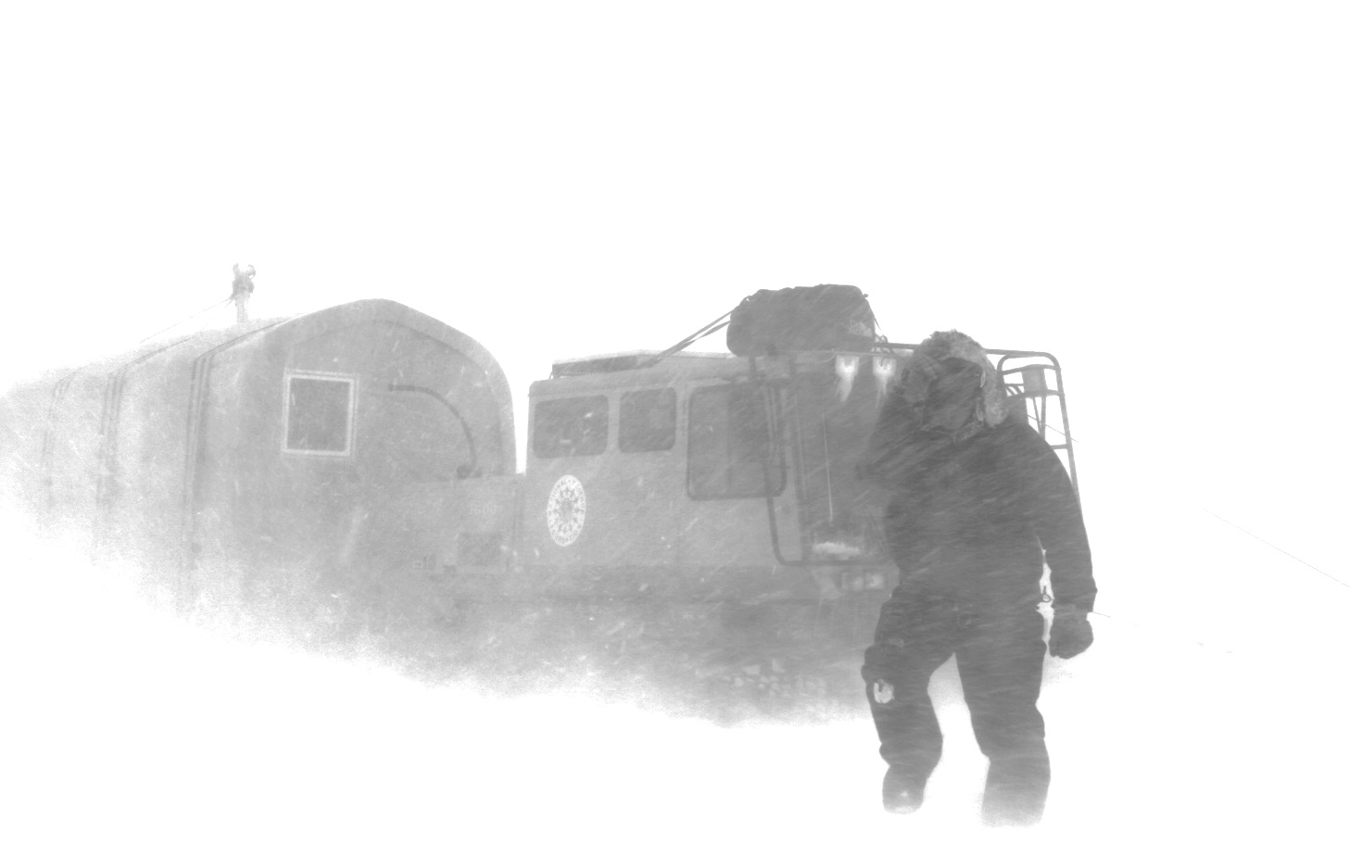
Infected researchers
Write a query that displays the full name of the researcher(s) that took readings on the visit(s) for which the date was not recorded (is null).

Slide 9
Extra challenge
How many temperature readings did Frank Pabodie record, and what was their average value?

