Slide 1
ALCHE
No longevity brand occupies the intersection of deep science and human joy
Evidence from 30 brands across the $6.8T wellness economy
30
4
0
brands analyzed
positioning axes
in the white space
Competitive Positioning Analysis · February 2026

Slide 2
01 — THE RETENTION PROBLEM
90% of wearable users abandon their device within 12 months
90%
3.4%
health app retention at day 30
wearable abandonment rate
The current model optimizes for measurement. Users leave anyway.
01
Sources: Industry research data on wearable retention and health app engagement

Slide 3
02 — THE BACKLASH
The Global Wellness Summit named the over-optimization backlash its #2 trend for 2026
Trend #2 of 2026
“
Rehumanizing wellness — from metrics-obsessed to experience-centered
Wellness experiences will embrace what humans actually are: imperfect, emotional, relational and sensory.
Consumer signal
Data-overload fatigue driving users away is cultural, not technical
— Global Wellness Summit, Future of Wellness 2026
Market implication
Brands combining scientific rigor with emotional resonance will capture the backlash
02
Sources: GWS Future of Wellness 2026, PR Newswire, Global Wellness Institute

Slide 4
03 — THE GENDER GAP
Women’s health receives 6% of private healthcare investment despite being 51% of the population
6%
$40B
$100M
of private healthcare investment goes to women’s health
menopause market by 2030 (8× growth)
Melinda French Gates commitment to women’s health R&D
Source: WEF
Source: BCG
Source: Pivotal Ventures
“
The booming longevity market, like medicine decades before it, is tacitly male. — GWS 2026
03

Slide 5
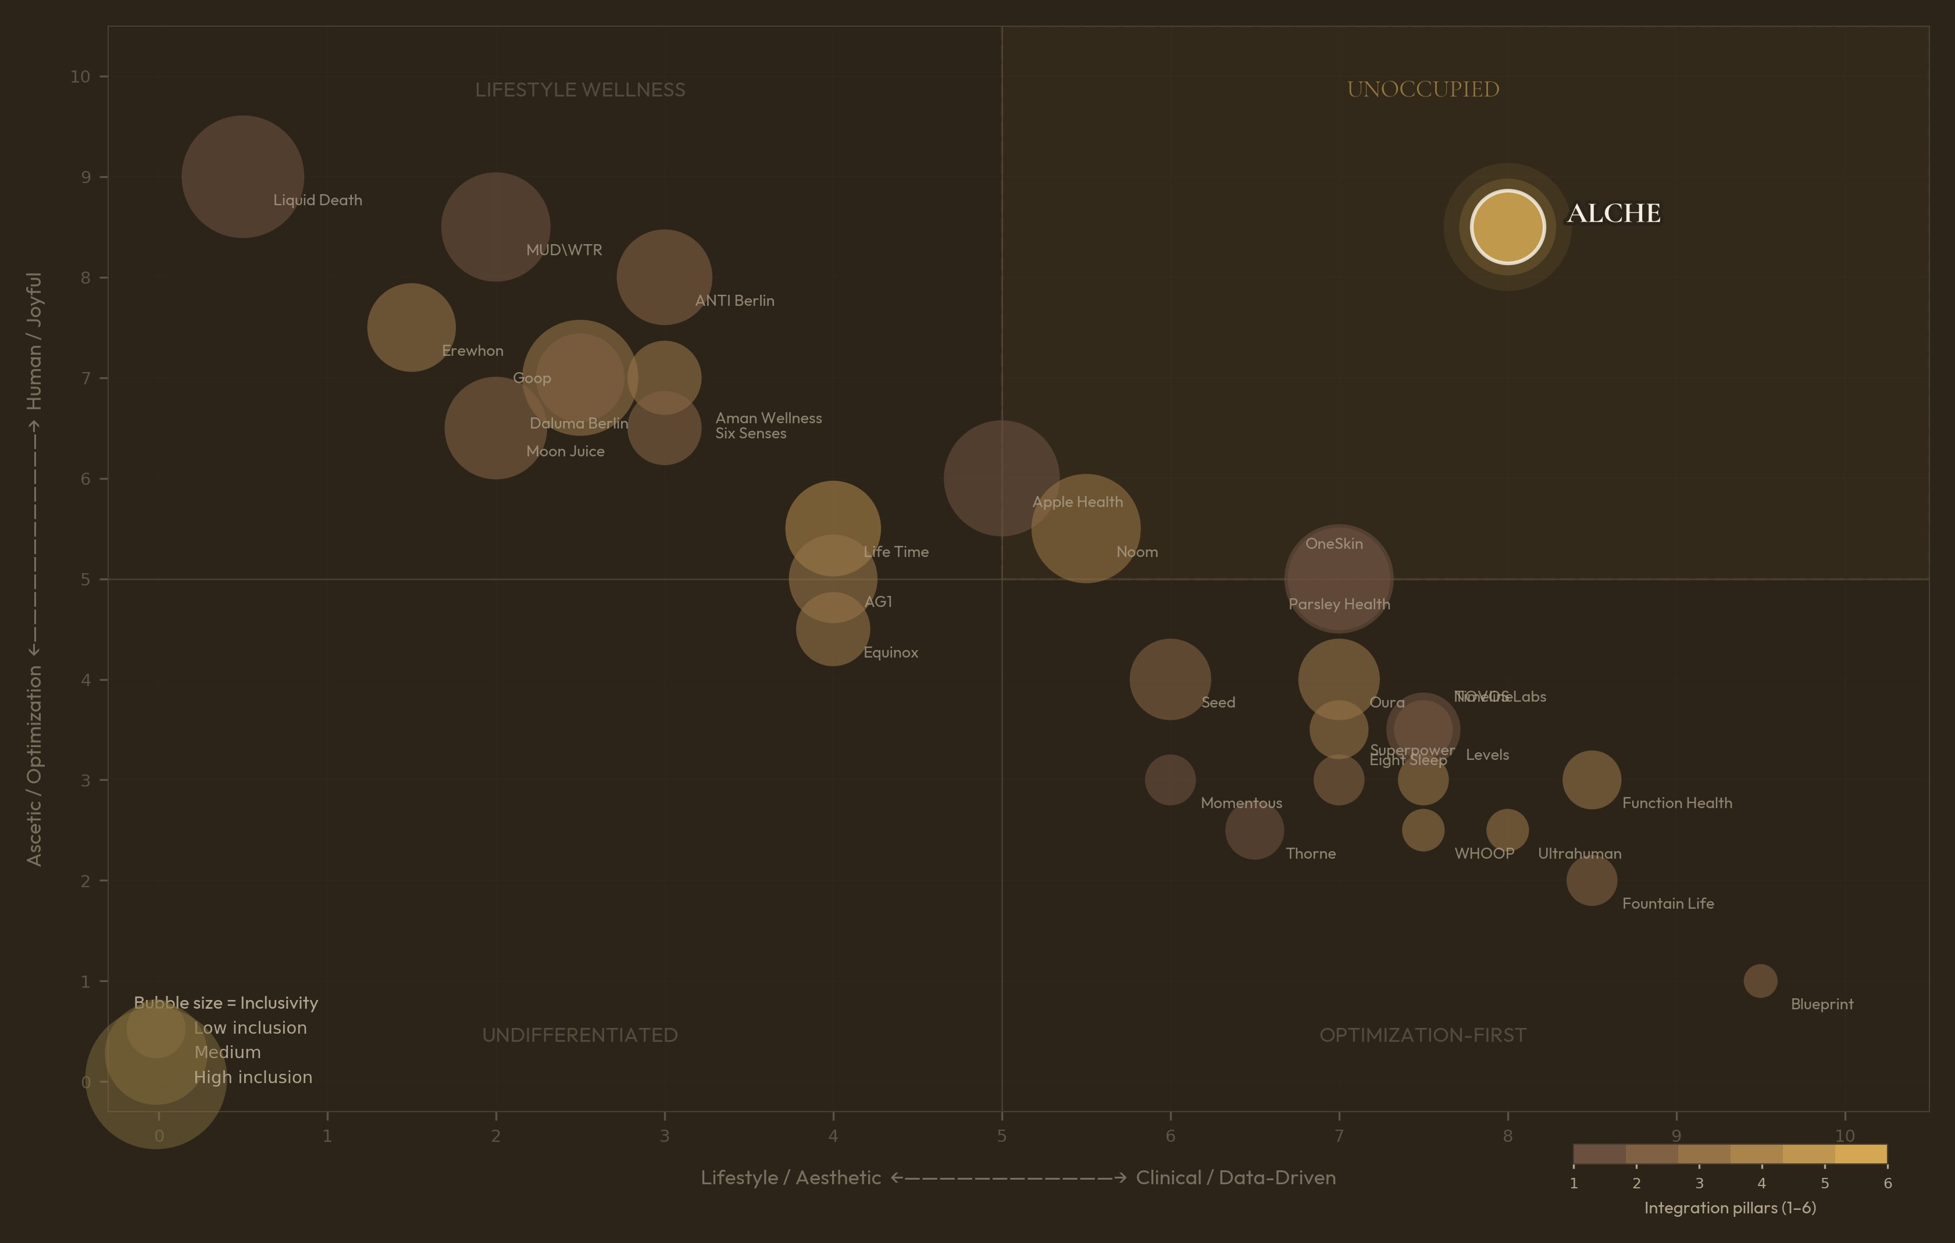
04 — POSITIONING MAP
30 brands plotted on 4 axes — the top-right quadrant is empty
04

Slide 6
05 — OPTIMIZATION-FIRST QUADRANT
High-science brands default to ascetic positioning and male-oriented design
Blueprint
Function Health
Science 9.5 · Humanity 1.0 · Inclusion 1.5
Science 8.5 · Humanity 3.0 · Inclusion 3.0
Bryan Johnson’s protocol-driven approach. Highest science, lowest humanity in dataset.
100+ biomarker testing platform. Clinical positioning, limited lifestyle integration.
WHOOP
Ultrahuman
Science 7.5 · Humanity 2.5 · Inclusion 2.0
Science 8.0 · Humanity 2.5 · Inclusion 2.0
Performance-first wearable. Core audience: male athletes and biohackers.
Metabolic tracking via CGM. Tech-forward language, narrow demographic appeal.
05

Slide 7
06 — LIFESTYLE WELLNESS QUADRANT
High-humanity brands lack clinical depth or longevity specificity
Goop
Erewhon
Science 2.5 · Humanity 7.0 · Inclusion 7.0
Science 1.5 · Humanity 7.5 · Inclusion 5.0
Lifestyle-first wellness brand. Strong cultural resonance, limited scientific credibility.
Premium grocery as lifestyle brand. High aspiration, minimal health-outcome depth.
Moon Juice
Aman Wellness
Science 2.0 · Humanity 6.5 · Inclusion 6.0
Science 3.0 · Humanity 7.0 · Inclusion 4.0
Adaptogen-forward product brand. Aesthetic strength without clinical grounding.
Ultra-luxury wellness hospitality. Beautiful experience, low science integration.
06

Slide 8
07 — CATEGORY INVERSION PRECEDENT
Liquid Death reached $1.4B valuation by inverting category conventions in water
Liquid Death
MUD\WTR
Commoditized water → punk aesthetic
Anti-hustle-culture coffee alternative
$1.4B
valuation
$47M
revenue (2024 est.)
$333M
revenue (2024)
Sources: Fueler, Sacra, Entrepreneur
Sources: ecdb, Owler
Neither operates in longevity. The archetype is proven but the category is untouched.
07

Slide 9
08 — THE PROPOSED POSITION
Alche sits at the intersection: clinical-grade science, inclusive design, joyful brand
Clinical Science
Human Brand
Inclusive Design
8.0 / 10
8.5 / 10
9.0 / 10
• Bloodwork & biomarker panels
• Permission-giving, not punishing
• Women-first approach
• AI-personalized protocols
• Lifestyle integration over restriction
• Hormonal health integration
• Evidence-based supplementation
• Joyful aesthetics & cultural edge
• Diverse bodies & life stages
• Longitudinal health tracking
• Community over competition
• Accessible entry points
08

Slide 10
09 — INTEGRATION MOAT
Alche scores 6/6 on integration pillars; the highest competitor scores 4/6
Physical Space
Products
AI App
Membership
Community
Integrated Info System
ALCHE
✓
✓
✓
✓
✓
✓
6/6
Life Time
✓
✓
✓
✓
—
—
4/6
WHOOP
—
✓
✓
✓
—
—
3/6
Equinox
✓
—
✓
✓
—
—
3/6
Source: Alche 6-pillar integration analysis of 30+ wellness & longevity companies
09

Slide 11
10 — MARKET CONTEXT
The wellness economy is $6.8T and growing to $10T by 2029
$6.8T
$10T
$40B
global wellness economy (2025)
projected by 2029
menopause market by 2030
Source: Global Wellness Institute
Source: Global Wellness Institute
Source: BCG
57%
84%
6%
prioritize aging well more than 5 yrs ago
say wellness is a top priority
of private healthcare investment → women
Source: NielsenIQ
Source: McKinsey
Source: WEF
10

Slide 12
11 — BERLIN CONTEXT
Berlin has an existing longevity scene and cultural DNA that aligns with the position
1
ANTI Berlin
Longevity + culture hybrid on Brunnenstraße. 20K Instagram followers. Single location proving demand for science-meets-lifestyle in Berlin.
Source: IGNANT, antispaces.com
2
Berlin Biohackers
2,213 members in the Berlin Biohackers meetup group. Active community of self-experimenters already engaged with longevity.
Source: Meetup / Reddit research
3
LIFE Summit 2026
Berlin hosting a dedicated longevity summit. The city is becoming a European hub for longevity discourse and innovation.
Source: LIFE Summit
11

Slide 13
ALCHE
The unoccupied position in longevity
Competitive Positioning Analysis / February 2026

