Slide 1
ALCHE
No longevity brand occupies the intersection of deep science and human joy
Evidence from 30 brands across the $6.8T wellness economy
30
4
0
BRANDS ANALYZED
POSITIONING AXES
IN THE WHITE SPACE
Competitive Positioning Analysis · February 2026

Slide 2
01 — THE RETENTION PROBLEM
90% of wearable users abandon their device within 12 months
90%
3.4%
health app retention at day 30
wearable abandonment rate
The current model optimizes for measurement. Users leave anyway.
01
Sources: Industry research data on wearable retention and health app engagement

Slide 3
02 — THE BACKLASH
The Global Wellness Summit named the over-optimization backlash its #2 trend for 2026
“
Trend #2 of 2026:
Wellness experiences will embrace what humans actually are: imperfect, emotional, relational and sensory.
Rehumanizing wellness — moving from metrics-obsessed to experience-centered
Consumer signal:
The data-overload fatigue driving users away from wearables is cultural, not technical
— Global Wellness Summit, Future of Wellness 2026
Market implication:
Brands that combine scientific rigor with emotional resonance will capture the backlash demand
02
Sources: GWS Future of Wellness 2026, PR Newswire, Global Wellness Institute

Slide 4
03 — THE GENDER GAP
Women’s health receives 6% of private healthcare investment despite being 51% of the population
6%
of private healthcare investment goes to women's health
“
The booming longevity market, like medicine decades before it, is tacitly male.
Source: WEF / Cosmeticsdesign-europe
$40B
menopause market by 2030 (8× growth from 2023)
— Global Wellness Summit 2026
Source: BCG
This creates a structural opportunity: the first longevity platform to center women’s health captures an underserved majority.
$100M
committed by Melinda French Gates to women's health R&D
Source: Pivotal Ventures
03

Slide 5
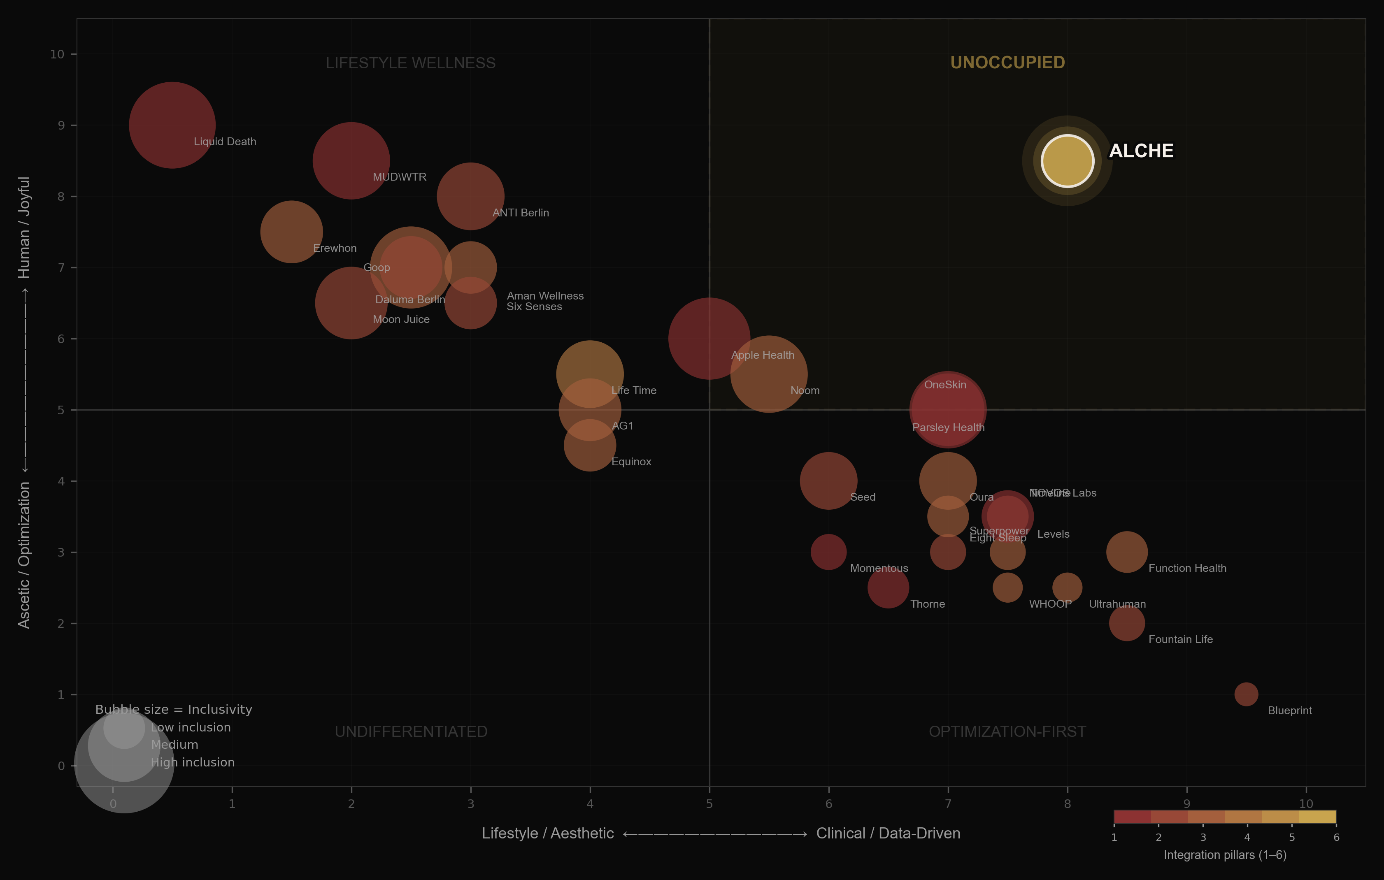
04 — POSITIONING MAP
30 brands plotted on 4 axes — the top-right quadrant is empty
04

Slide 6
05 — OPTIMIZATION-FIRST QUADRANT
High-science brands default to ascetic positioning and male-oriented design
Blueprint
Function Health
Science: 9.5 · Humanity: 1.0 · Inclusion: 1.5
Science: 8.5 · Humanity: 3.0 · Inclusion: 3.0
Bryan Johnson’s protocol-driven approach. Highest science score, lowest humanity score in dataset.
100+ biomarker testing platform. Clinical positioning with limited lifestyle integration.
WHOOP
Ultrahuman
Science: 7.5 · Humanity: 2.5 · Inclusion: 2.0
Science: 8.0 · Humanity: 2.5 · Inclusion: 2.0
Performance-first wearable. Core audience: male athletes and biohackers.
Metabolic tracking via CGM. Tech-forward brand language, narrow demographic appeal.
05

Slide 7
06 — LIFESTYLE WELLNESS QUADRANT
High-humanity brands lack clinical depth or longevity specificity
Goop
Erewhon
Science: 2.5 · Humanity: 7.0 · Inclusion: 7.0
Science: 1.5 · Humanity: 7.5 · Inclusion: 5.0
Lifestyle-first wellness brand. Strong cultural resonance but limited scientific credibility.
Premium grocery as lifestyle brand. High aspiration, minimal health-outcome depth.
Moon Juice
Aman Wellness
Science: 2.0 · Humanity: 6.5 · Inclusion: 6.0
Science: 3.0 · Humanity: 7.0 · Inclusion: 4.0
Adaptogen-forward product brand. Aesthetic strength without clinical grounding.
Ultra-luxury wellness hospitality. Beautiful experience, low science integration.
06

Slide 8
07 — CATEGORY INVERSION PRECEDENT
Liquid Death reached $1.4B valuation by inverting category conventions in water
Liquid Death
MUD\WTR
Commoditized water → punk aesthetic
Anti-hustle-culture coffee alternative
$1.4B
valuation
$47M
revenue (2024 est.)
$333M
revenue (2024)
Sources: Fueler, Sacra, Entrepreneur
Sources: ecdb, Owler
Neither operates in longevity. The archetype is proven but the category is untouched.
07

Slide 9
08 — THE PROPOSED POSITION
Alche sits at the intersection: clinical-grade science, inclusive design, joyful brand
Clinical Science
Human Brand
Inclusive Design
8.0 / 10
8.5 / 10
9.0 / 10
• Bloodwork & biomarker panels
• Permission-giving, not punishing
• Women-first approach
• AI-personalized protocols
• Lifestyle integration over restriction
• Hormonal health integration
• Evidence-based supplementation
• Joyful aesthetics & cultural edge
• Diverse bodies & life stages
• Longitudinal health tracking
• Community over competition
• Accessible entry points
08

Slide 10
09 — INTEGRATION MOAT
Alche scores 6/6 on integration pillars; the highest competitor scores 4/6
Physical Space
Products
AI App
Membership
Community
Integrated Info System
ALCHE
✓
✓
✓
✓
✓
✓
6/6
Life Time
✓
✓
✓
✓
—
—
4/6
WHOOP
—
✓
✓
✓
—
—
3/6
Equinox
✓
—
✓
✓
—
—
3/6
Source: Alche 6-pillar integration analysis of 30+ wellness & longevity companies
09

Slide 11
10 — MARKET CONTEXT
The wellness economy is $6.8T and growing to $10T by 2029
$6.8T
$10T
$40B
global wellness economy (2025)
projected by 2029
menopause market by 2030
Source: Global Wellness Institute
Source: Global Wellness Institute
Source: BCG
57%
84%
6%
prioritize aging well more than 5 years ago
of consumers say wellness is a top priority
of private healthcare investment goes to women’s health
Source: NielsenIQ
Source: McKinsey
Source: WEF
10

Slide 12
11 — BERLIN CONTEXT
Berlin has an existing longevity scene and cultural DNA that aligns with the position
1
ANTI Berlin
Longevity + culture hybrid on Brunnenstraße. 20K Instagram followers. Single location proving the demand for science-meets-lifestyle in Berlin.
Source: IGNANT, antispaces.com
2
Berlin Biohackers
2,213 members in the Berlin Biohackers meetup group. Active community of self-experimenters already engaged with longevity practices.
Source: Meetup / Reddit research
3
LIFE Summit 2026
Berlin hosting a dedicated longevity summit. The city is becoming a European hub for longevity discourse and innovation.
Source: LIFE Summit
11

Slide 13
ALCHE
The unoccupied position in longevity
Competitive Positioning Analysis / February 2026

