Slide 1

App Improvements: Investment Services
Project presentation
#wearedb

Slide 2
Team presentation
Michael Driesen
Software Engineer - Backend
Hannah Blair
Software Engineer – Front End
Timur Baev
Software Engineer - Backend
Andreas Tichy
Business Analyst
Daniel Grün
Business Analyst / Front End
Florian Schneider
Software Engineer - Backend

Slide 3









Overview: Technologies
Front End
Back End
Database

Slide 4
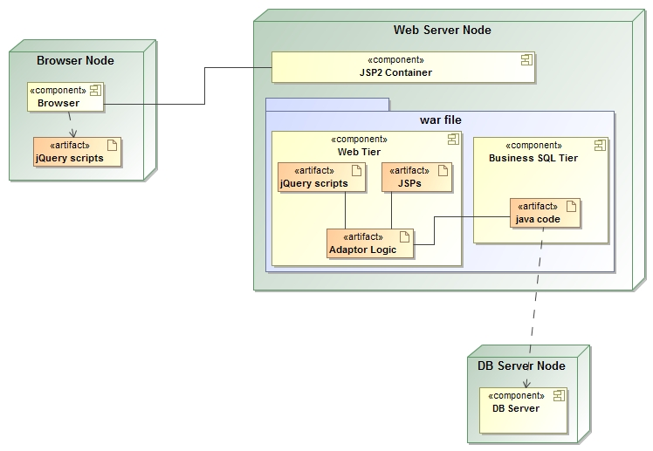

Slide 5
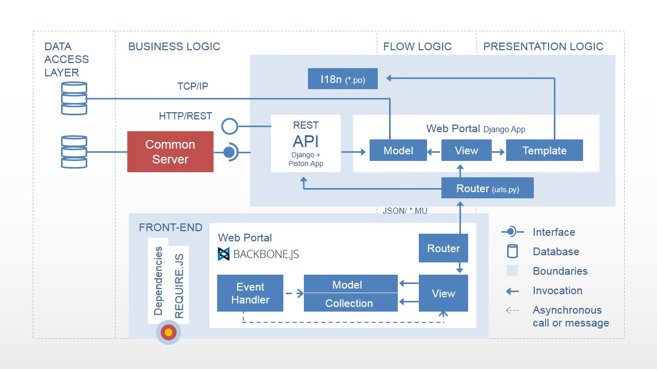

Slide 6
Data model: Snippet
deal
Deal_id (PK) Deal_time Deal_counterparty_id (FK) Deal_instrument_id (FK) Deal_type Deal_amount Deal_quantity
Overview()
0,…,*
0,…,*
▸is involved in
1
▸uses/ has
1
counterparty
Counterparty_id (PK) Counterparty_name Counterparty_status Counterparty_date_registered
getCorrelationCounterparty()
instrument
Instrument_id (PK) Instrument_name
getCorrelationInstrument()

Slide 7
Table single column
Text title Number title Text title Text and number title
Text 00.0 Text Text or number
Text 100.0 Text 00.0
Text 100.0 Text Text or number
Text 00.0 Text 00.0
Text 00.0 Text 00.0
Text 100.0 Text Text or number
Text 00.0 Text 00.0
Text 100.0 Text 00.0
Text 00.0 Text 00.0
Total 300.0 Text Text or number
Note: Numbers are right or decimal-aligned
Text is left or centre-aligned
Columns with numbers and text together are centre-aligned

Slide 8
Table two column
When table titles are too long
They can wrap over two lines and extend up (use soft return)
Percentage Deal size (%) (€m)
Really long Long Text title title (€m) text title
Text 00.0 00.0
Text 00.0 00.0
Text 00.0 00.0
Text 00.0 00.0
Text 00.0 00.0
Text 00.0 00.0
Text 00.0 00.0
Text 00.0 00.0
Total 00.0 00.0
Text 00.0 Text
Text 00.0 Text
Text 00.0 Text
Text 00.0 Text
Text 00.0 Text
Text 00.0 Text
Text 00.0 Text
Text 00.0 Text
Total 00.0 Text
Notes: 9pt, regular, bottom aligned, bottom margin only set at 0.2cm
(1) Footnote 9pt, regular, spacing 0pt
Source: 9pt, italic, spacing 0pt
Notes: 9pt, regular, bottom aligned, bottom margin only set at 0.2cm
(1) Footnote 9pt, regular, spacing 0pt
Source: 9pt, italic, spacing 0pt

Slide 9
Graph single column
Chart Title
Notes: 9pt, regular, bottom aligned, bottom margin only set at 0.2cm
(1) Footnote 9pt, regular, spacing 0pt
Source: 9pt, italic, spacing 0pt

Slide 10
Graph two column
Graph title
Graph title

Slide 11
Organisation Chart
Type text here
Type text here
Type text here
Type text here
Type text here
Type text here
Type text here
Type text here
Type text here

