Slide 1
Group C1.1: Selvyn’s favorite team
Investment Services App
Notes:
Andreas

Slide 2
Team presentation
Michael Driesen
Software Engineer - Backend
Hannah Blair
Software Engineer – Front End
Timur Baev
Software Engineer - Backend
Andreas Tichy
Business Analyst
Daniel Grün
Business Analyst / Front End
Florian Schneider
Software Engineer - Backend
Notes:
Andreas

Slide 3
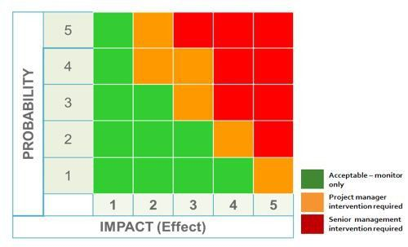
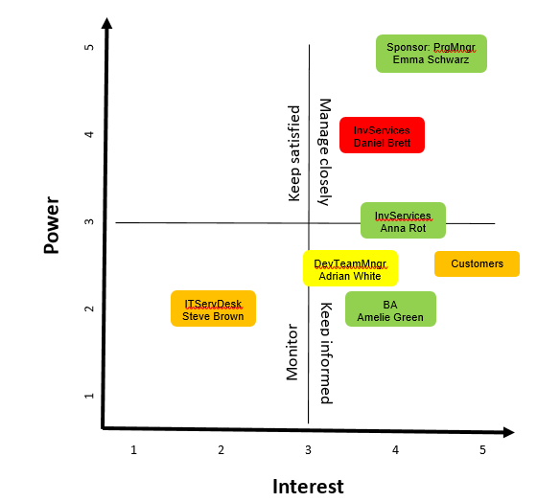
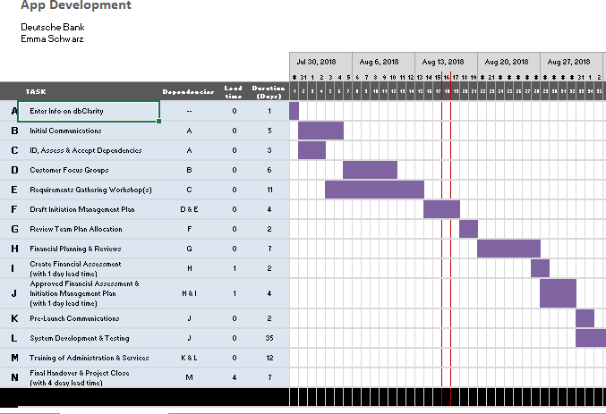
Business Methods
Notes:
Daniel

Slide 4
The Stakeholders
Findings:
Competitor has better app
Customers are not happy
The team is highly motivated
Experts and novices on board
Notes:
Daniel

Slide 5
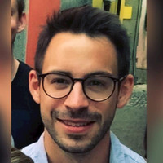
User Stories: DB Trading Team
Name: Florian Trader
Age: 35 years, married, two kids
Experience:
Trader for many years
Well analysation abilities
Member of the DB Trading Team
Problems with APP:
Frustrated about the previous app
Slow working, not all information displayed
Notes:
Mike

Slide 6









Overview: Technologies
Front End
Back End
Database
Notes:
Timur and Hannah

Slide 7
Lessons Learned
Agile Development Methodology
Time Management
Role Switching
Testing & Development Approach
Notes:
Hannah
Agile Development Methodology was an efficient approach. Carried out regular stand ups and updates within the team. Worked collaboratively.
Time Management could have been better – we ran into various issues such as bugs in our code. Issue with database connection and server communication. Should have mitigated against the time delays down the line by speeding up other processes early on.
Role Switching was perhaps a less efficient approach however team members learned valuable skills in development & business management. BA’s were able to learn about D3.js and data visualization using JavaScript and devs learned about business analysis.
On pace to deliver the full product in 4 months!!!!!! Wow!!!!
Testing and Development – could have used a more test driven approach.

Slide 8
Thank you!
IT
FUN
TGIF
DB
борщ
LONDON
Please be back seated soon ☺
Notes:
Hannah

Slide 10
Data model: Snippet
deal
Deal_id (PK) Deal_time Deal_counterparty_id (FK) Deal_instrument_id (FK) Deal_type Deal_amount Deal_quantity
Overview()
0,…,*
0,…,*
▸is involved in
1
▸uses/ has
1
counterparty
Counterparty_id (PK) Counterparty_name Counterparty_status Counterparty_date_registered
getCorrelationCounterparty()
instrument
Instrument_id (PK) Instrument_name
getCorrelationInstrument()

Slide 11
Requirements for the APP
Requirements:
Logon with feedback from server
User stays on page; no refresh, no history-back should work
Display JSON raw data from server
Don’t show team's login credentials
Filterable table, but data read-only
Display correlations between data, possible diagrams

Slide 12
Module 2: PESTEL – Part 1
Political
Currently high political uncertainty due to BREXIT, US government, and other conflicts e.g. in the middle east
Political trends to protect individuals’ rights and privacy
Increasing requirements for data security
Trend towards sustainability
Economical
Currently very good environment for investment in securities
Interest rate slowly raising, possibly indicating a slow-down of the market and therefore lower customer tendency to invest in shares (which will be bought through the app)
Increasing labour costs (hourly cost)
Low supply of qualified workforce to deliver first class service in bank branches
Sociological
Increasing trust into machines
More and more people, especially younger, are familiar with digital technology
Fear of digital frauds
Low interest in financial topics
Low knowledge in financial topics

Slide 13
Module 2: PESTEL – Part 2
Technological
Continuously progress in digitalisation
Improved soft- and hardware may result in better performing and designed (UI) applications
Wider spread of broad band results in a higher and real-time connectivity
Legal
Highly regulated financial market
Stricter regulations concerning private data (e.g. GDPR)
Environmental
Climate change: rising temperatures (will effect server cooling)
Rising sea level
In average higher risk for wild fires
Indoctrination required about the financial risk

Slide 14
Module 3: Stakeholder Analysis – Diagram

Slide 15
Module 3: Stakeholder Analysis – Part 1
Management Board
DB branding
Sponsor: programme manager (Emma Schwarz) [power: 5 , interest: 4.5]
very positive about all aspects of programme
believes it will deliver much higher level of benefits compared to Business Case
this is her first appointment as programme manager
Investment Services background
good relationships with most of the managers in Investment Services

Slide 16
Module 3: Stakeholder Analysis – Part 2
Representatives from Investment Services (Daniel Brett) [power: 4 , interest: 4]
10 year experience in Investment Services
has been critic of IT projects that have been rolled out in his area
previous projects have not delivered what he was asking for
Representatives from Investment Services (Anna Rot) [power:3 , interest:4]
New to DB but has worked for 2 competitors
Big fan of the way technology is engaging with customers

Slide 17
Module 3: Stakeholder Analysis – Part 3
Customers [power: 2.5 , interest: 5]
Initially accepted first version of Investment Services App
Frustrated: competitors offer better apps (easier to use, more information
Would like to have assistance in case something goes wrong while using the app
Increasing number of questions/concerns relating to data security
IT Service Desk (Steve Brown)
[power: 2 , interest: 2]
Believes a new app is a waste of time and tight targets
Would like to have fewer software updates

Slide 18
Module 3: Stakeholder Analysis – Part 4
Development Team Manager (Adrian White) [power: 3.5 , interest: 2]
High regard by his colleagues
Very successful in this type of project
Is frustrated that his team is used/abused to meet last-minute
Doesn’t have large enough team to deal with all of the conflicts
Business Analyst (Amelie Green) [power: 2 , interest: 4]
Will be her first project as BA
She is very keen, excited, has worked as developer at DB before

Slide 19
Module 4: Scope and Requirements
Stakeholder | Elicitation techniques | Reason for choice
Programme Manager (Emma Schwarz) | Interview | Build up a good relationship, receive information from that single source
Representatives from Investment Services (Daniel Brett and Anna Rot) | Interview | Understand Investment Services needs, build up good communication channel
Customers | Survey | Understand what customers expect from the new app and what their current complaints are
 | Prototype (analysis of competitor’s app) | Drawing out requirements for new app
IT Service Desk (Steve Brown) | Interview | Receive information from that single source
Development Team Manager (Adrian White) | Interview | Receive information from that single source
Business Analyst (Amelia Green) | Interview | Receive information from that single source

Slide 20
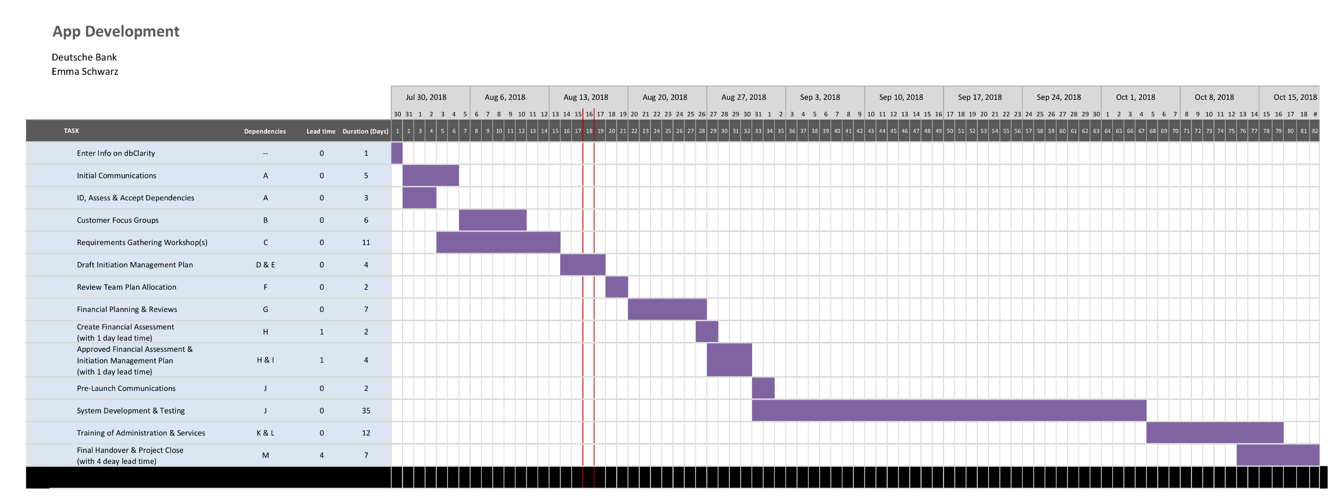
Module 6a: Gantt Chart

Slide 21
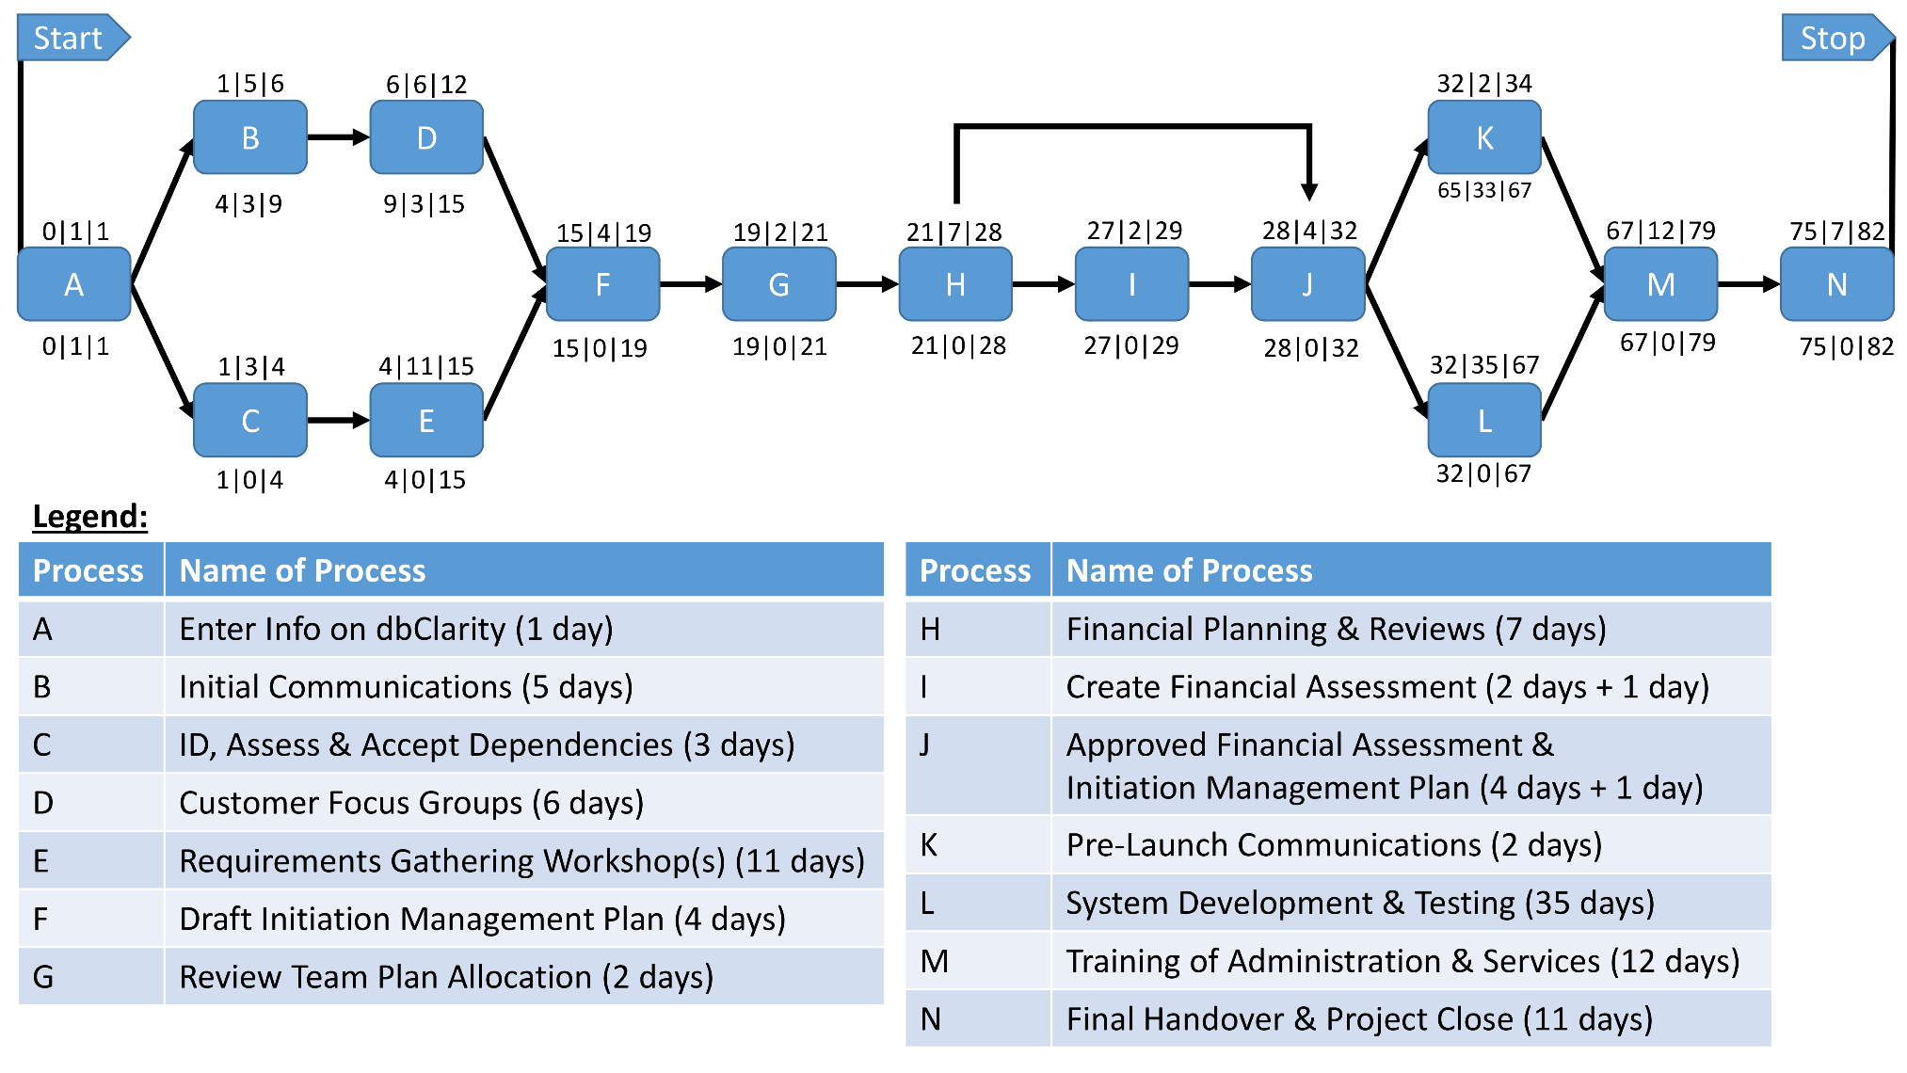
Module 6b: Network Diagram

