Slide 1
Group C1.1
Case Study: Investment Services App
Notes:
Andreas

Slide 2
Team presentation
Michael Driesen
Software Engineer - Backend
Hannah Blair
Software Engineer – Front End
Timur Baev
Software Engineer - Backend
Andreas Tichy
Business Analyst
Daniel Grün
Business Analyst / Front End
Florian Schneider
Software Engineer - Backend
Notes:
Andreas

Slide 3
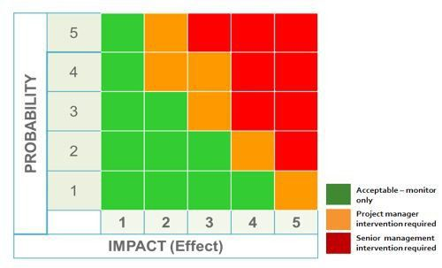
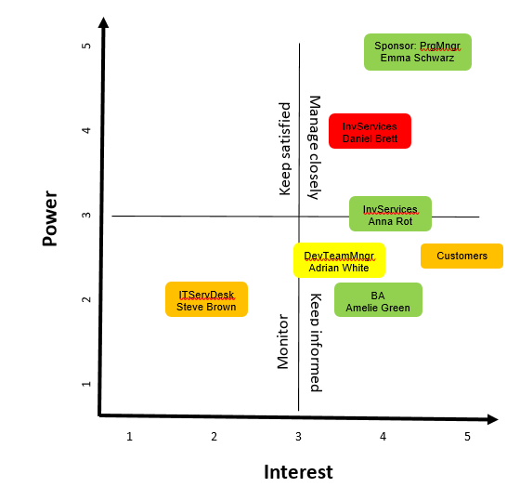
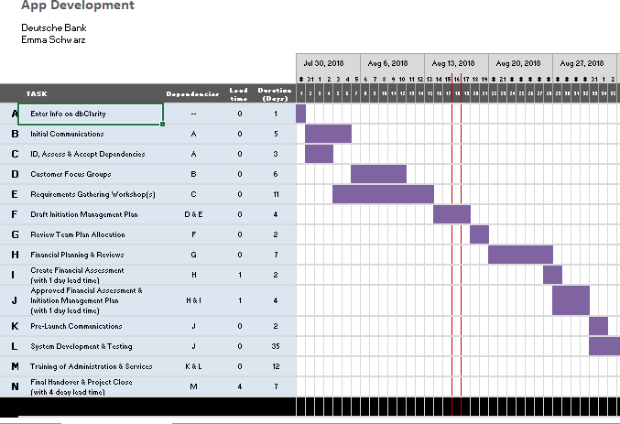
Business Methods
Notes:
Daniel

Slide 4
The Stakeholders
Findings:
Competitor has better app
Customers are not happy
The team is highly motivated
Experts and novices on board
Notes:
Daniel

Slide 5

User Stories: DB Trading Team
Name: Florian Trader
Age: 35 years, married, two kids
Experience:
Trader for many years
Well analysation abilities
Member of the DB Trading Team
Problems with APP:
Frustrated about the previous app
Slow working, not all information displayed
Notes:
Mike

Slide 6









Overview: Technologies
Front End
Back End
Database
Notes:
Timur and Hannah

Slide 7
Lessons Learned
Agile Development Methodology
Time Management
Role Switching
Testing & Development Approach
Notes:
Hannah
Agile Development Methodology was an efficient approach. Carried out regular stand ups and updates within the team. Worked collaboratively.
Time Management could have been better – we ran into various issues such as bugs in our code. Issue with database connection and server communication. Should have mitigated against the time delays down the line by speeding up other processes early on.
Role Switching was perhaps a less efficient approach however team members learned valuable skills in development & business management. BA’s were able to learn about D3.js and data visualization using JavaScript and devs learned about business analysis.
On pace to deliver the full product in 4 months!!!!!! Wow!!!!
Testing and Development – could have used a more test driven approach.

Slide 8
Thank you!
IT
FUN
TGIF
DB
борщ
LONDON
Please be back seated soon ☺
Notes:
Hannah

Slide 10
Data model: Snippet
deal
Deal_id (PK) Deal_time Deal_counterparty_id (FK) Deal_instrument_id (FK) Deal_type Deal_amount Deal_quantity
Overview()
0,…,*
0,…,*
▸is involved in
1
▸uses/ has
1
counterparty
Counterparty_id (PK) Counterparty_name Counterparty_status Counterparty_date_registered
getCorrelationCounterparty()
instrument
Instrument_id (PK) Instrument_name
getCorrelationInstrument()

Slide 11
Requirements for the APP
Requirements:
Logon with feedback from server
User stays on page; no refresh, no history-back should work
Display JSON raw data from server
Don’t show team's login credentials
Filterable table, but data read-only
Display correlations between data, possible diagrams

Slide 12
Module 1: Context and Governance
Possible: Regulatory, Strategic, Transformational
There is an already existing app, which has some issues with the usability and the access to the full range of information that customers expect. At dB a transformational change is defined as “activities to improve and develop the bank’s infrastructure, operations or any other material changes to organisational structures, processes and IT systems.” [week 1 – p.237]
It is not a Core Change Initiative,
Because small improvements of an existing app will be done and no core changes. Moreover, the criteria for being a CCI are not fulfilled, because there are no “[…] most important change initiatives, programs or projects for DB Group which are based on strategic impact, financial impact and implementation complexity.” [week 1 – p.238]
More detailed analyses, see “Types of Change Activities at DB” [week 1 – p.240]
Strategic impact:
Externally communicated initiative contributing to strategic targets → no breach
Significant reputational impact (incl. regulatory risk) → no breach
Risk of significant litigation charges/through civil lawsuit/criminal sanction or regulatory fines → no breach

Slide 13
Module 1: Context and Governance
More detailed analyses, see “Types of Change Activities at DB” [week 1 – p.240]
Substantial investment required:
Remaining lifetime investment > 50m (based on cash spend) → costs are less than 50k EUR → no breach
Balance sheet impact CRD4 > EUR 10bn, RWA > EUR 5bn → no breach
P&L impact – ACB reductions > EUR 50m, Revenue increase > 50m, FTE reduction > 500 → no information available about these cases, but rather no breach
Implementation complexity
Multi-year implementation timeline → project runs for 3-5 months, no support from IT services expected, no further info available → no breach
>= 3 divisions/functions involved → no breach
Crucial dependency for other CCI → no information → rather no breach

Slide 14
Module 1: Context and Governance
Required key documents
Artefact | Initiation | Planning | Execution | Closure | Case Study
Charter | Yes | No | No | No | required
RACI + Stakeholder List | Yes | Yes | Yes | Yes | required
Transformation Risk Assessment | Yes | Yes | Yes | Yes | required
Change Management Plan | No | Yes | Yes | Yes | required
Steering Committee … | -- | -- | -- | -- | no
Closure Doc. | No | No | No | Yes | required
Milestone Plan | Yes | Yes | Yes | Yes | required
Change Control Log | x | Yes | Yes | Yes | required
Tollgate Self-assessment | -- | -- | -- | -- | no
Gantt Chart |  |  |  |  | Will be delivered
PESTLE |  |  |  |  | Will be delivered
Requirements elicitation techniques |  |  |  |  | Will be delivered
Lessons learned report |  |  |  |  | Will be delivered
Probability/ Impact Matrix |  |  |  |  | Will be delivered

Slide 15
Module 2: PESTEL – Part 1
Political
Currently high political uncertainty due to BREXIT, US government, and other conflicts e.g. in the middle east
Political trends to protect individuals’ rights and privacy
Increasing requirements for data security
Trend towards sustainability
Economical
Currently very good environment for investment in securities
Interest rate slowly raising, possibly indicating a slow-down of the market and therefore lower customer tendency to invest in shares (which will be bought through the app)
Increasing labour costs (hourly cost)
Low supply of qualified workforce to deliver first class service in bank branches
Sociological
Increasing trust into machines
More and more people, especially younger, are familiar with digital technology
Fear of digital frauds
Low interest in financial topics
Low knowledge in financial topics

Slide 16
Module 2: PESTEL – Part 2
Technological
Continuously progress in digitalisation
Improved soft- and hardware may result in better performing and designed (UI) applications
Wider spread of broad band results in a higher and real-time connectivity
Legal
Highly regulated financial market
Stricter regulations concerning private data (e.g. GDPR)
Environmental
Climate change: rising temperatures (will effect server cooling)
Rising sea level
In average higher risk for wild fires
Indoctrination required about the financial risk

Slide 17
Module 3: Stakeholder Analysis – Diagram

Slide 18
Module 3: Stakeholder Analysis – Part 1
Management Board
DB branding
Sponsor: programme manager (Emma Schwarz) [power: 5 , interest: 4.5]
Very positive about all aspects of programme
Believes it will deliver much higher level of benefits compared to Business Case
This is her first appointment as programme manager
Investment Services background
Good relationships with most of the managers in Investment Services

Slide 19
Module 3: Stakeholder Analysis – Part 2
Representatives from Investment Services (Daniel Brett) [power: 4 , interest: 4]
10 year experience in Investment Services
Has been critic of IT projects that have been rolled out in his area
Previous projects have not delivered what he was asking for
Representatives from Investment Services (Anna Rot) [power:3 , interest:4]
New to DB but has worked for 2 competitors
Big fan of the way technology is engaging with customers

Slide 20
Module 3: Stakeholder Analysis – Part 3
Customers [power: 2.5 , interest: 5]
Initially accepted first version of Investment Services App
Frustrated: competitors offer better apps (easier to use, more information
Would like to have assistance in case something goes wrong while using the app
Increasing number of questions/concerns relating to data security
IT Service Desk (Steve Brown)
[power: 2 , interest: 2]
Believes a new app is a waste of time and tight targets
Would like to have fewer software updates

Slide 21
Module 3: Stakeholder Analysis – Part 4
Development Team Manager (Adrian White) [power: 3.5 , interest: 2]
High regard by his colleagues
Very successful in this type of project
Is frustrated that his team is used/abused to meet last-minute
Doesn’t have large enough team to deal with all of the conflicts
Business Analyst (Amelie Green) [power: 2 , interest: 4]
Will be her first project as BA
She is very keen, excited, has worked as developer at DB before

Slide 22
Module 4: Scope and Requirements
Stakeholder | Elicitation techniques | Reason for choice
Programme Manager (Emma Schwarz) | Interview | Build up a good relationship, receive information from that single source
Representatives from Investment Services (Daniel Brett and Anna Rot) | Interview | Understand Investment Services needs, build up good communication channel
Customers | Survey | Understand what customers expect from the new app and what their current complaints are
 | Prototype (analysis of competitor’s app) | Drawing out requirements for new app
IT Service Desk (Steve Brown) | Interview | Receive information from that single source
Development Team Manager (Adrian White) | Interview | Receive information from that single source
Business Analyst (Amelia Green) | Interview | Receive information from that single source

Slide 23
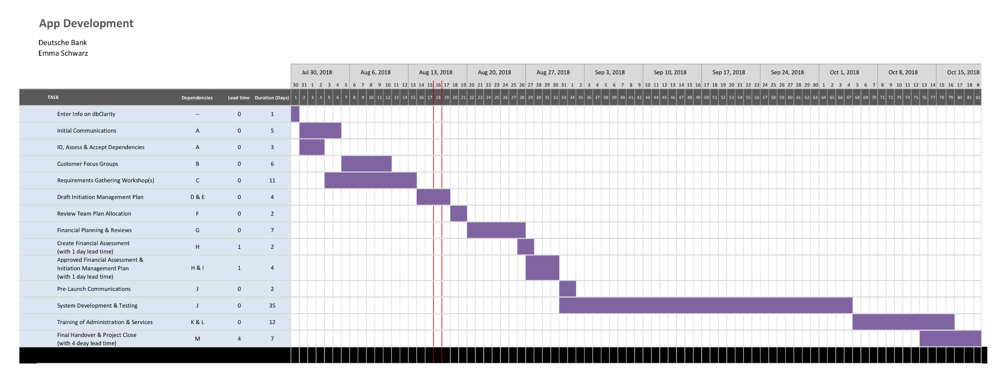
Module 6a: Gantt Chart

Slide 24
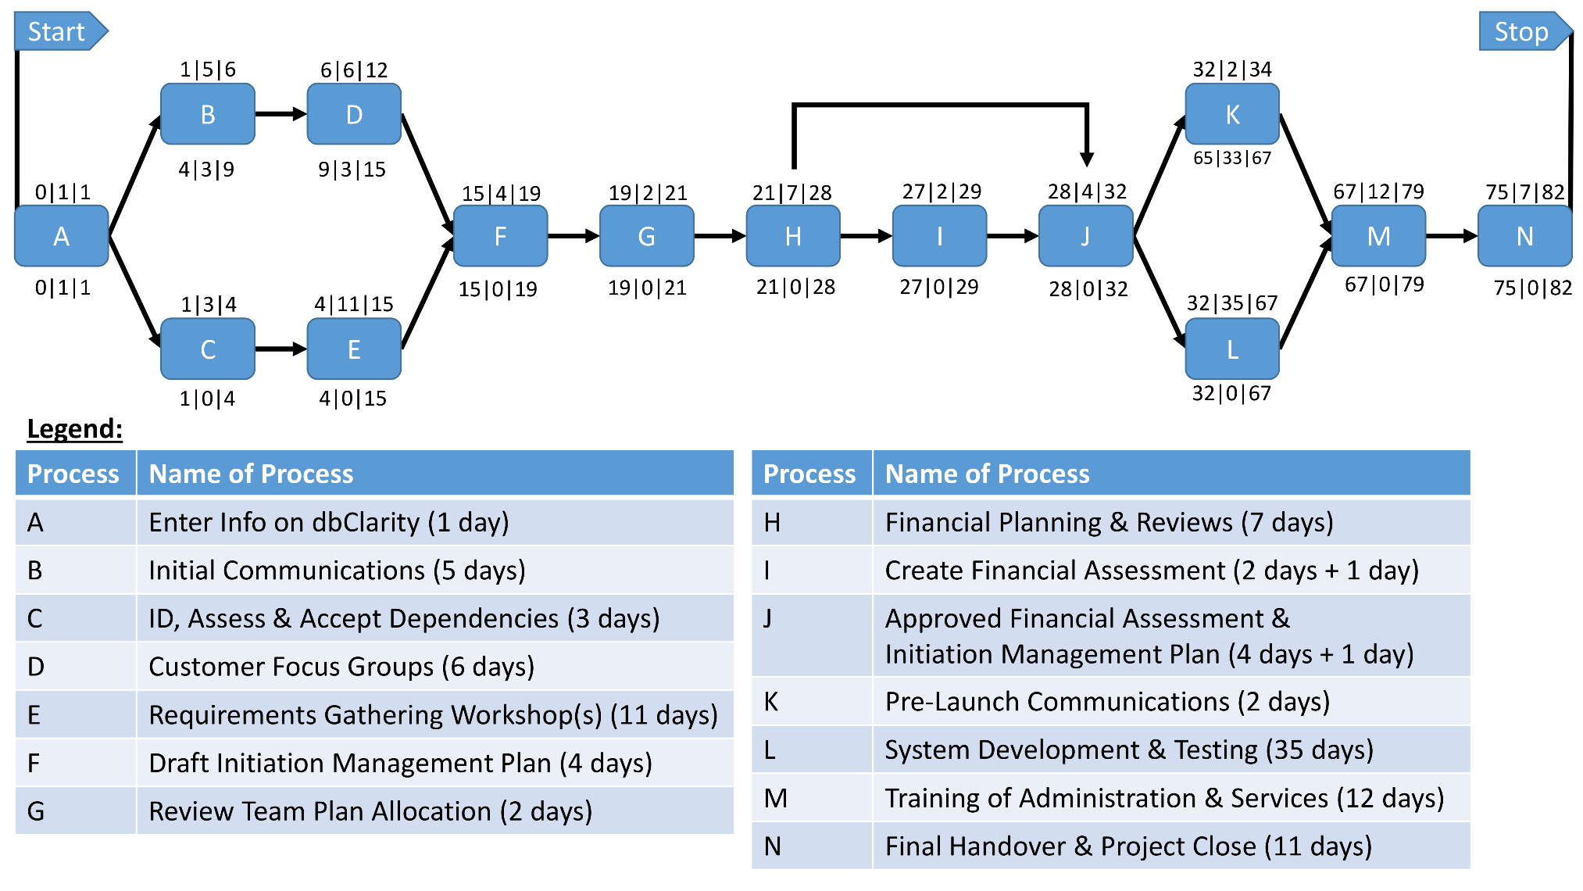
Module 6b: Network Diagram

Slide 25
Module 7: Risk Management – Part 1
Risk Description | Impact Description | Probability [1-5] | Impact [1-5] | Resolution/Mitigation
Projects requires more than the available 50k Euros | Insufficient funding might slow down or totally stop the development of the new app. Furthermore, insufficient funding might also affect the product's quality and scope | 3 | 2 | Agile
Projects requires more than the planned 5 months of development | Will delay the release of app. Project costs will probably exceed the budget due to higher workforce expenses | 4 | 1 | Agile
Team's motivation worsens due to failures | Lowers efficiency, longer dev times, higher dev costs | 2 | 4 | Agile, team events, workshops
No information on intended milestones from other projects in the programme. Difficult to confirm dependencies. Bad communication between projects and their managers, respectively | No/bad information flow between projects Redundancies, douplicity, doing work that has already been done before | 1 | 4 | Agile, weekly project manager meetings

Slide 26
Module 7: Risk Management – Part 2
Risk Description | Impact Description | Probability [1-5] | Impact [1-5] | Resolution/Mitigation
DB dev platform has being updated and new to developers. Training is only in around 3 weeks!! | Delays, longer dev times and higher costs | 4 | 2 | Rescheduling training, provide documentation asap
Customers do not accept new product due to poor usability | Customers will not use new technology or use competitors apps. No progress in efficiency and productivity of daily business. Wasted effort to develop new app | 2 | 5 | Customer surveys, customer service
Competitors products simply better than DB's app | Customers likely to use competitor's app | 1 | 4 | Market analysis, analysis of existing products
Data insecure, might be corrupted | Trust/reputation concerns, fines, customer acceptance | 2 | 5 | Make sure developers are aware of data security standards, security trainings

Slide 27
Module 7: Risk Management – Diagram
2
5
1
3
6
8
4
7

Slide 28
Module 8: Communication & Change Management
Media
Oral (scrum meeting)
Visual (.ppt presentation)
Written (email, reports)
Electronic (see above)
Methods
Interactive (team, other stakeholders)
Push (customers, sponsor)
Pull (sponsor, team)

Slide 29
Module 9: Project Change Management
Change
A project change. One of the developers has been taken off your project and put onto one with a higher priority. You have been asked to consider the options of extending your project by 2 weeks or spending €15k. Make a recommendation for the course of action and draft the related change request form.
Response
Agile – If project is on time and depending on the time of change a project delay of 2 weeks might be acceptable. Otherwise –if budget allows- spend additional 15k Euro to ensure quality and time scope of project.

