Slide 1

Group C1.-1: The Tick
Investment Services App

Slide 2
Team presentation
Michael Driesen
Software Engineer - Backend
Hannah Blair
Software Engineer – Front End
Timur Baev
Software Engineer - Backend
Andreas Tichy
Business Analyst
Daniel Grün
Business Analyst / Front End
Florian Schneider
Software Engineer - Backend

Slide 3
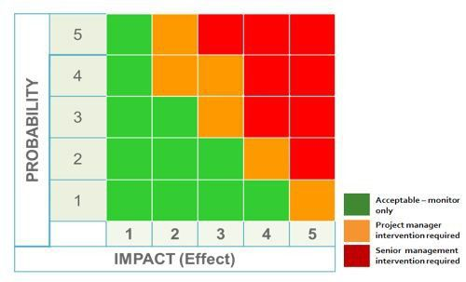
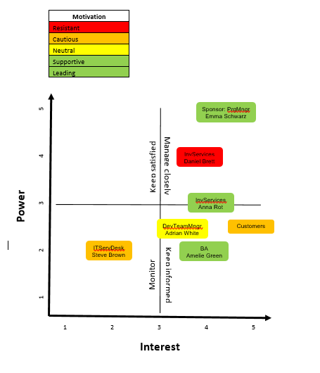
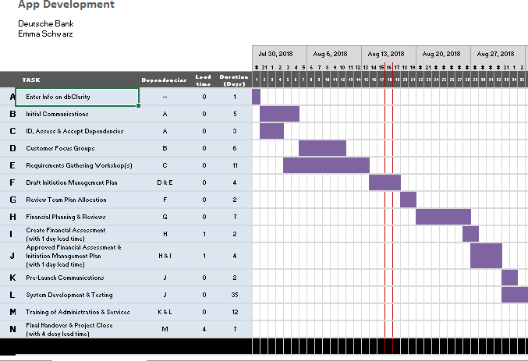
Business Methods

Slide 4
The Stakeholders
Findings
Competitor has better app
Customers are not happy
The team is highly motivated
Experts and novices on board

Slide 5

User Stories: DB Trading Team
Name: Florian Yellow
Age: 35 years, married, two kids
Experience:
Trader for many years
Well analysation abilities
Member of the DB Trading Team
Problems with APP:
Frustrated about the previous app
Slow working, not all information displayed

Slide 6
Requirements for the APP
Requirements:
Logon with feedback from server
User stays on page; no refresh, no history-back should work
Display JSON raw data from server
Don’t show team's login credentials
Filterable table, but data read-only
Display correlations between data, possible diagrams

Slide 7









Overview: Technologies
Front End
Back End
Database

Slide 8
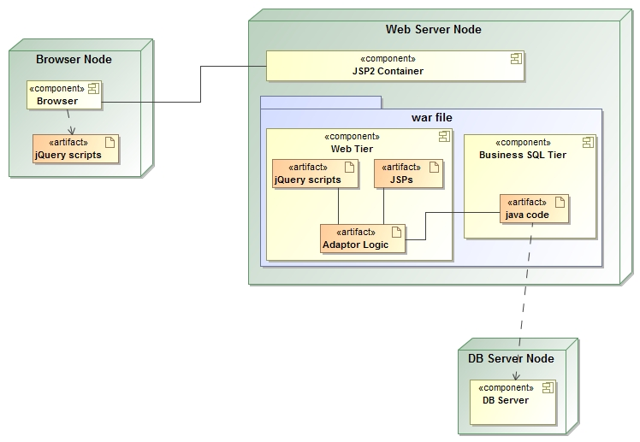
Overview: Structure

Slide 9
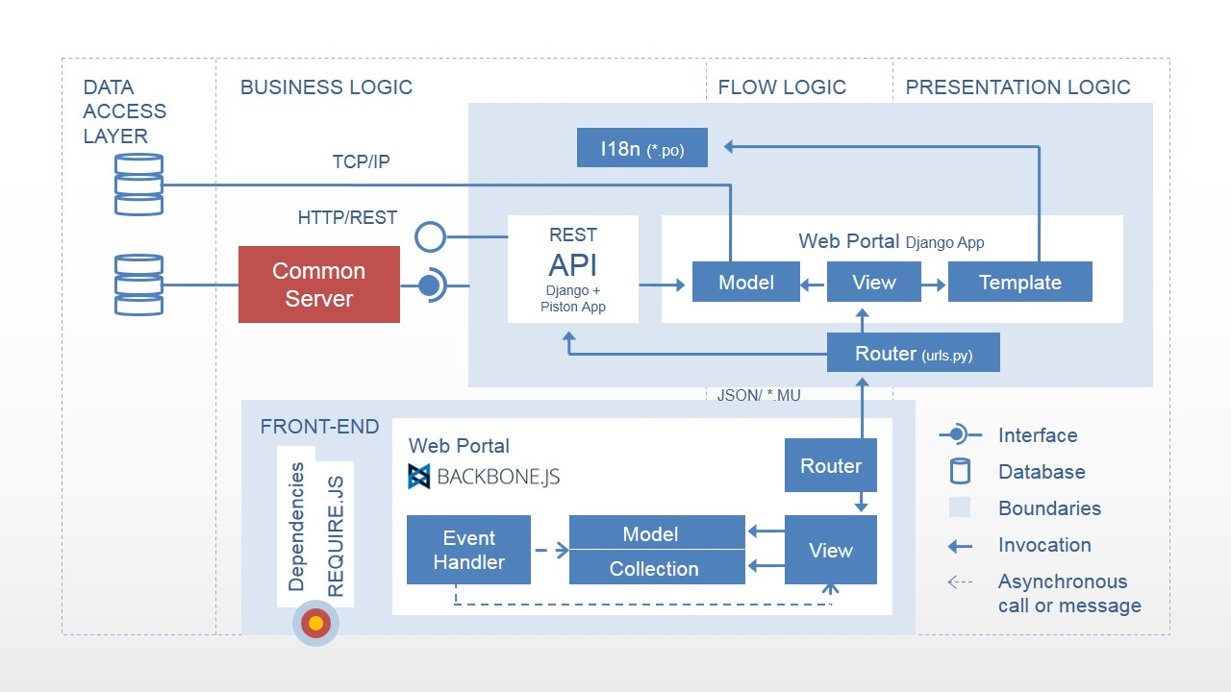
Overview: Detailed Structure

Slide 10
Data model: Snippet
deal
Deal_id (PK) Deal_time Deal_counterparty_id (FK) Deal_instrument_id (FK) Deal_type Deal_amount Deal_quantity
Overview()
0,…,*
0,…,*
▸is involved in
1
▸uses/ has
1
counterparty
Counterparty_id (PK) Counterparty_name Counterparty_status Counterparty_date_registered
getCorrelationCounterparty()
instrument
Instrument_id (PK) Instrument_name
getCorrelationInstrument()

Slide 11
Lessons Learned
Agile Development Methodology
Time Management
Role Switching
Testing & Development Approach
Notes:
Agile Development Methodology was an efficient approach. Carried out regular stand ups and updates within the team. Worked collaboratively.
Time Management could have been better – we ran into various issues such as bugs in our code. Issue with database connection and server communication. Should have mitigated against the time delays down the line by speeding up other processes early on.
Role Switching was perhaps a less efficient approach however team members learned valuable skills in development & business management. BA’s were able to learn about D3.js and data visualization using JavaScript and devs learned about business analysis.
On pace to deliver the full product in 4 months!!!!!! Wow!!!!
Testing and Development – could have used a more test driven approach.

Slide 12
Break
IT
FUN
TGIF
DB
борщ
LONDON
Please be back seated soon ☺

