Slide 1
Partial Homomorphic Encryption for Statistical Queries on Music Stored in Cloud Server
Timur Blair GORDON
TBG252

Slide 2
Dataset
3 Separate datasets:
My Top Songs 2019 (100 tracks)
Large Magic FM Playlist (608 tracks)
Incredibly Large Playlist (1042 tracks)
Columns
Index, Track Name, Album Name, Artist Name, Track Duration (ms), Play Count

Slide 3
QUERIES
Alice can query Carol with the following functions:
Get track by name or index (NA in homomorphic implementation)
Sum of track duration in playlist
Sum of play count in playlist
Average of track duration in playlist
Average of play count in playlist
The queries are implemented in both a unencrypted and encrypted scheme to compare correctness and performance.

Slide 4
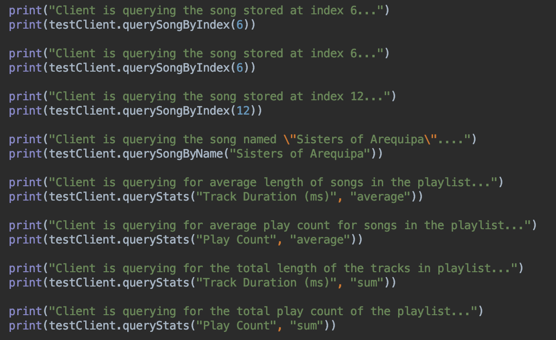
QUERIES (CODE)

Slide 5
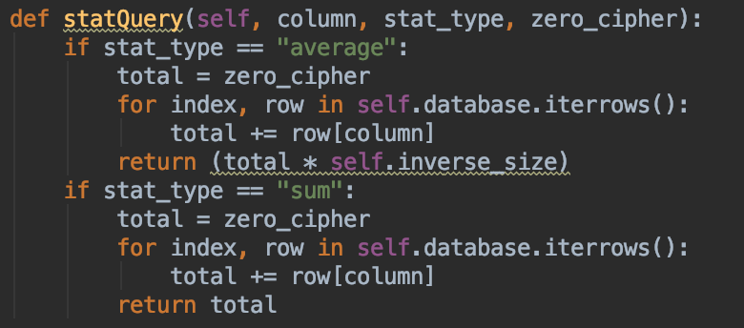
Homomorphic queries
In this example, the stats are calculated without decrypting values to their plain numerical form via Paillier encryption.

Slide 6
Encryption schemes
Symmetric encryption schemes are used to encrypt data:
AES for alphabetical data
Partial Homomorphic Paillier Scheme for numerical data
Since the statistical queries Alice can make only use multiplication and summation:
Paillier is an appropriate encryption scheme for this application

Slide 7
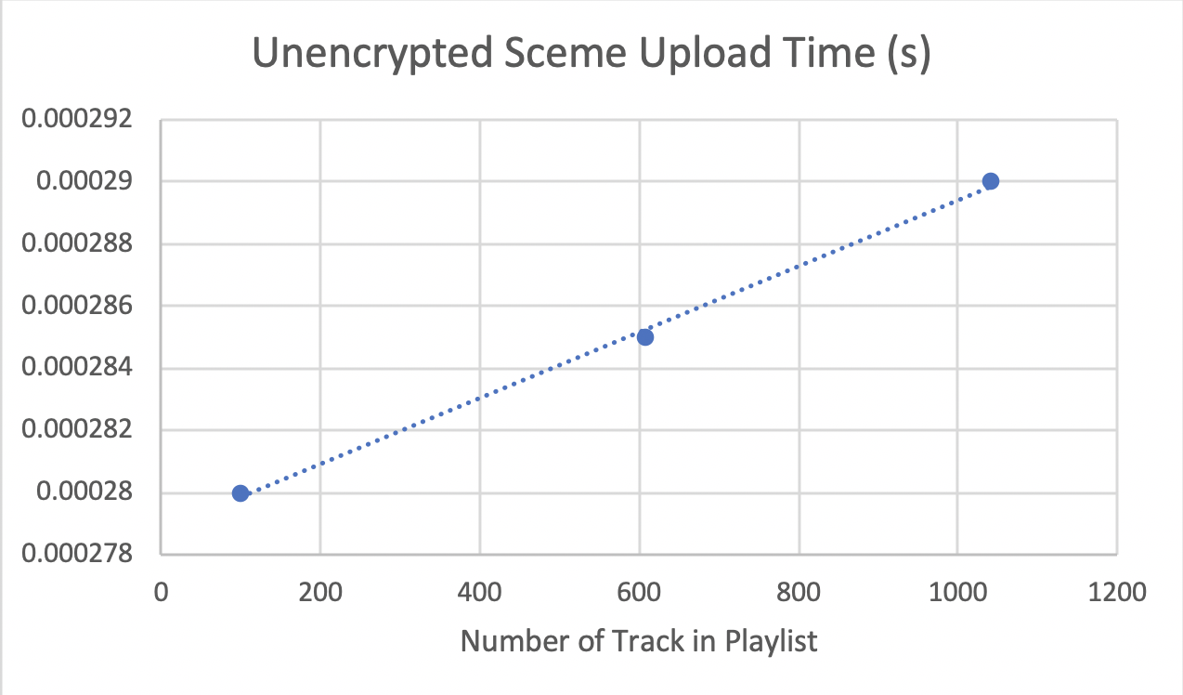
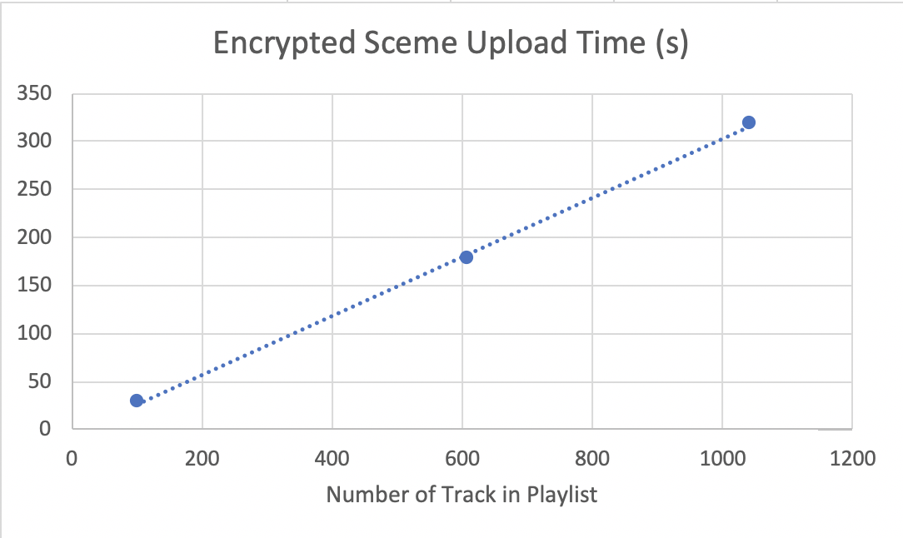
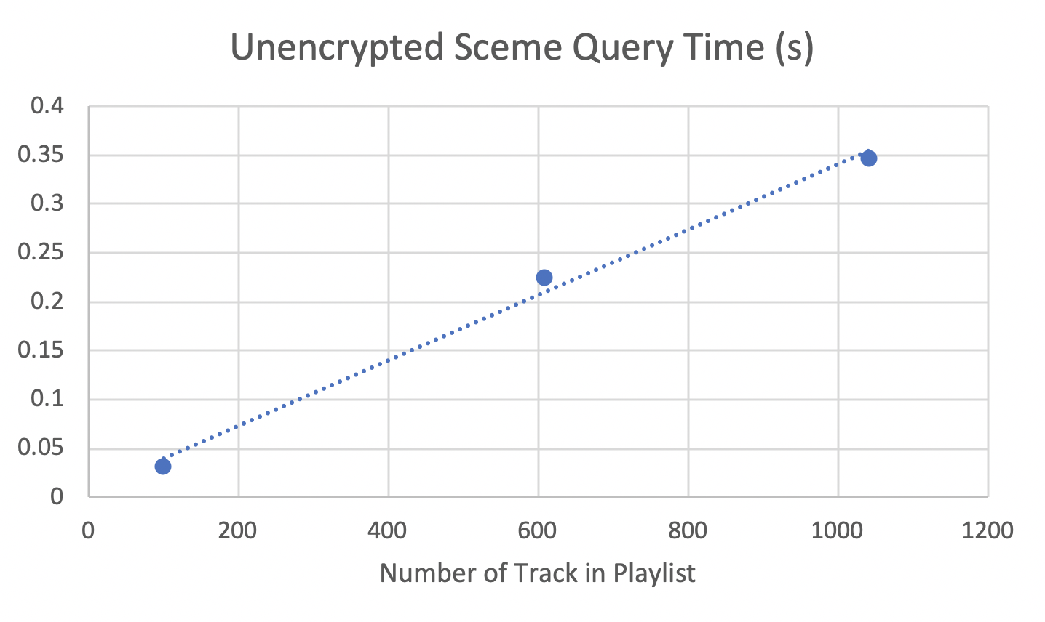
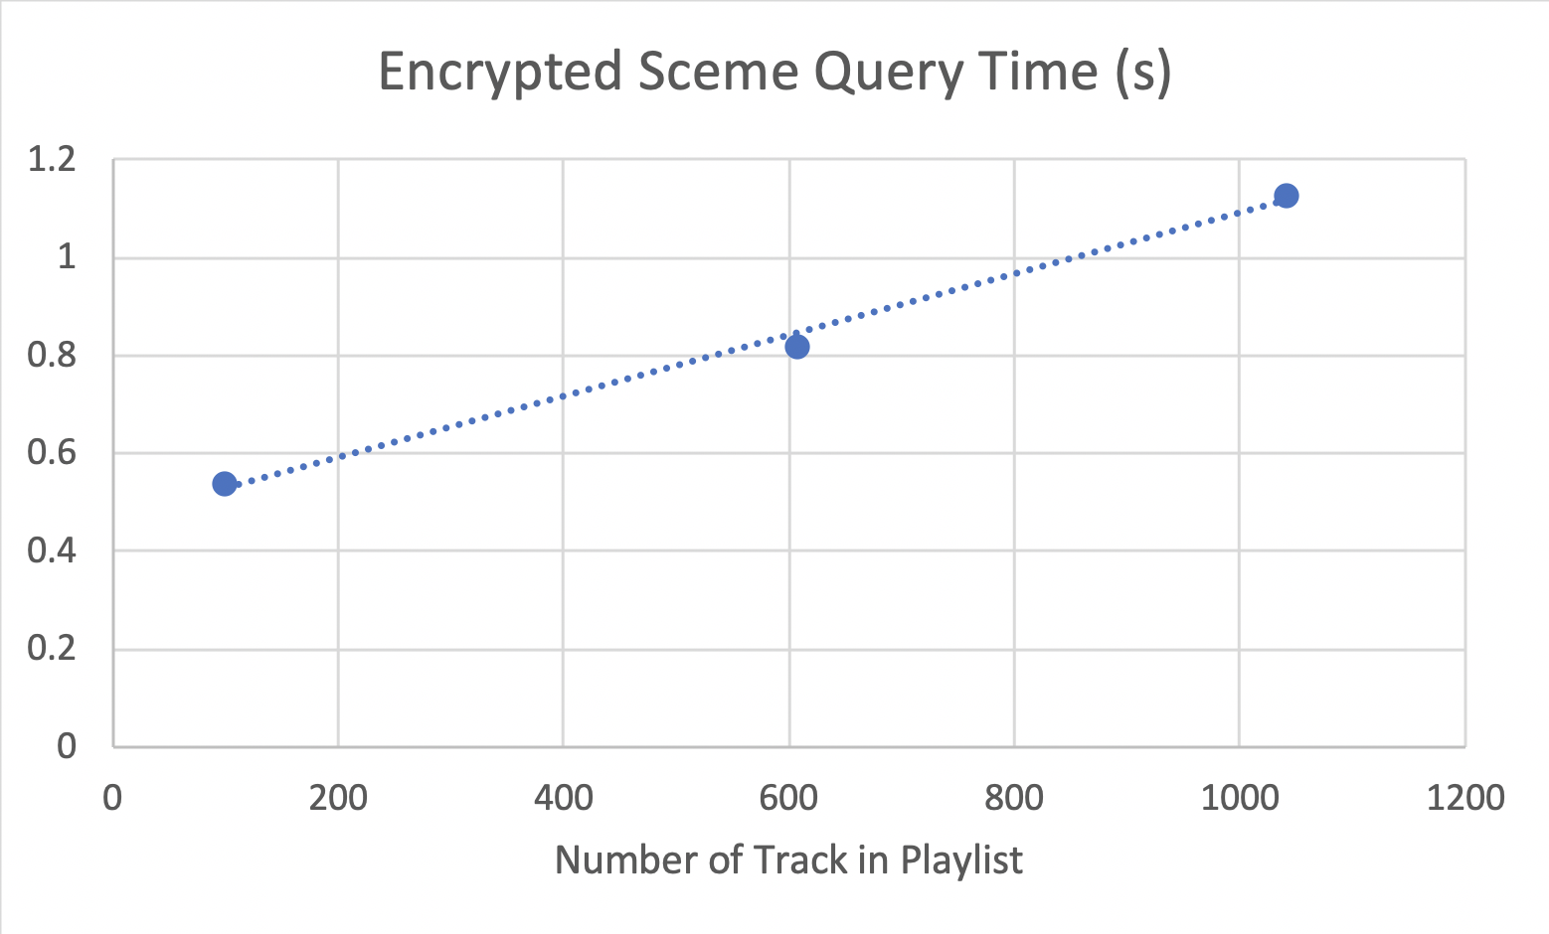
Performance (Graphs)

Slide 8
Performance
Encryption drastically increased upload times.
Query times didn’t show a significant difference between unencrypted and encrypted schemes
Once uploaded, homomorphic encryption doesn’t cause additional delays
In fact, since queries are computed in cloud server, less computation is done by client
Larger datasets needed to infer time complexity
However looks like between linear and squared polynomial time for uploading in encrypted scheme.

