Slide 1

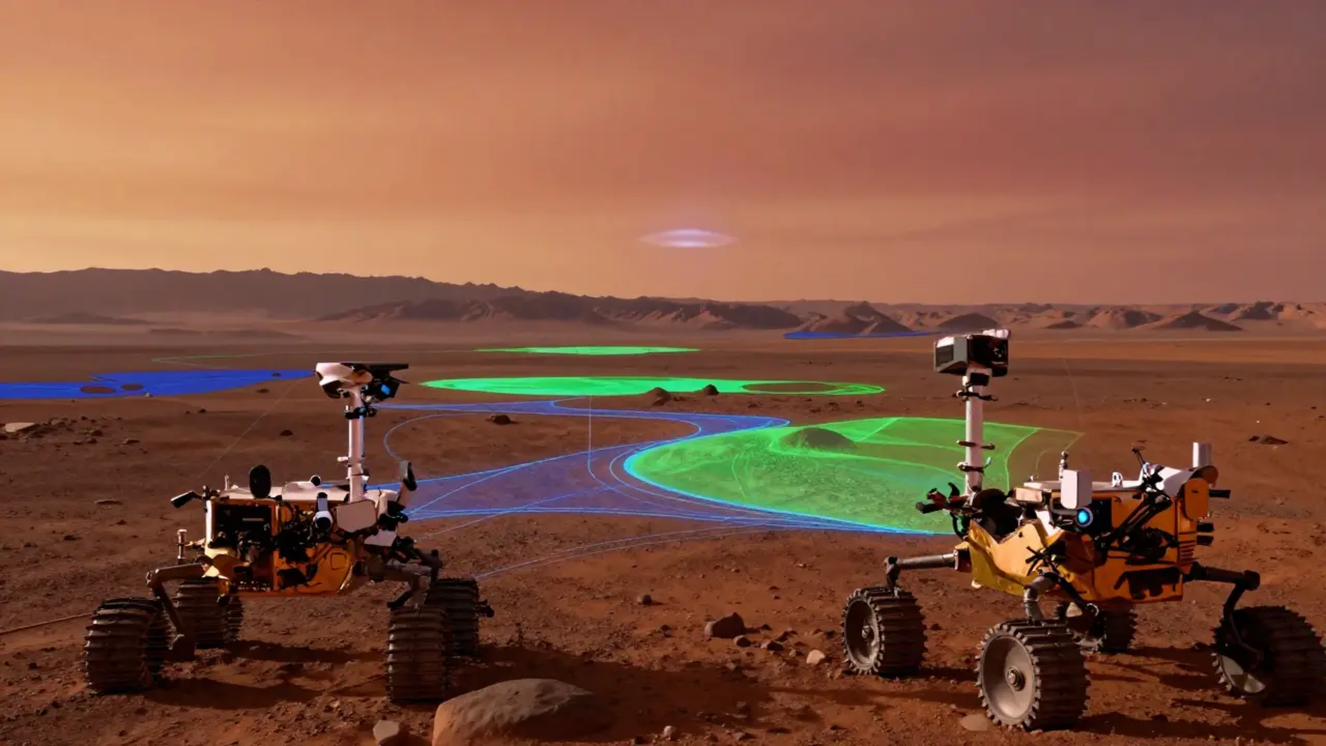


MACHINE LEARNING RESEARCH
AAU Klagenfurt — WS 2025/26
ObjectSegmentationMars
Fine-tuning DeepLabV3-ResNet50 for per-pixel terrain classification and autonomous rover navigation.
MODELING & EVALUATION
DATA & PREPROCESSING
Pavel
Timur
DATA & PREPROCESSING
TECHNICAL WRITING
Maksym
Mikhail
DEPLOYMENT
Sven
Report Date: 2026-02-07
PROJECT ID: WS25-MARS-04

Slide 2



















Executive Summary
PROJECT OVERVIEW & STRATEGIC DIRECTION
Primary Objective
Dataset & Scope
Implement **Semantic Segmentation** (per-pixel classification) on Mars surface imagery to support autonomous rover navigation. By identifying traversable vs. hazardous terrain, the project enhances mission safety and path planning efficiency.
Source: AI4Mars (NASA JPL)
Subset: 200 high-res RGB images + masks
Classes: Soil, Bedrock, Sand, Big Rock
Split: 80/20 Train-Validation ratio
Modeling Approach
Key Takeaways & Next Steps
Fine-tuned a pretrained **DeepLabV3** with a **ResNet-50** backbone from Torchvision.
Status: Augmentation and LR scheduling significantly improved model convergence.
Albumentations
LR Scheduling
Adam Optimizer
Implement mIoU and per-class IoU metrics
Verify class-id mapping & handle ignore labels
Establish a true test split for evaluation
Propelling Mars Exploration through Advanced Computer Vision

Slide 3




















Problem Definition & Motivation
ENABLING AUTONOMOUS PLANETARY EXPLORATION
Background
Task Formulation
Success Criteria
Mars rovers (Curiosity, Perseverance) face extreme navigation challenges in unstructured terrain.
INPUT (X)
Primary: Mean IoU
Target ≥ 75%
RGB Mars Surface Images (1024×1024)
Minimum Acceptable: 65%
Avoiding hazards like soft sand or large rocks.
LATENCY
< 1 Second
Identifying traversable paths for exploration.
Semantic Segmentation
Per Image Inference
Per-Pixel Classification
Need for real-time, on-board terrain understanding.
Precision
Recall
OUTPUT (Y)
Grayscale Masks (Classes {0,1,2,3})
Google Colab Environment
4-Class Multi-Classification
Constraint: No "Ignore Label" currently implemented in loss function

Slide 4
















Data Overview & Quality
Dataset Characteristics
Class Distribution Imbalance
Percentage of total annotated pixels
SOURCE
TOTAL SCOPE
NASA JPL (AI4Mars)
~35,000 Images
PROJECT SUBSET
RESOLUTION
200 Samples
1024 × 1024 (Raw)
Annotation Quality
Hybrid approach: 9–10 crowdsourced labelers per image to reach consensus, followed by expert validation from MSL/MER mission scientists.
CRITICAL RARITY
IGNORE LABELS
CLASS MAPPING
"Big Rock" class (~2%) poses a significant risk of underfitting without loss weighting.
No explicit "ignore_index" handled; rover hardware or distant areas may affect loss.
Notebook assumes indices 0–3 for Soil, Bedrock, Sand, and Big Rock; requires verification.

Slide 5


























Preprocessing & Augmentation
STANDARDIZING INPUTS & EXPANDING DIVERSITY
Core Preprocessing Pipeline
Resize
Normalize
Tensor Conversion
Validation Mode
768 × 768 pixels
Mean 0.5 | Std 0.5
ToTensorV2()
Clean evaluation only
Training-Time Augmentations
Critical Handling
Spatial Flips
Rotations
CLASS IMBALANCE
Horizontal & Vertical (p=0.5)
Random 90° (p=0.5)
No class weights or focal loss implemented. Model may favor majority classes (Soil/Bedrock).
Affine Transforms
Lighting Dynamics
Scale 0.9-1.1, Rot ±45°, Trans 6%
Random Brightness & Contrast (p=0.5)
SPECIAL LABELS
No

Slide 6














Modeling Approach
ARCHITECTURE SELECTION & TRAINING PIPELINE
DeepLabV3-ResNet50
Training Configuration
Selected for its superior performance in semantic segmentation within unstructured Martian environments.
LOSS FUNCTION
OPTIMIZER
Cross-Entropy
Adam (2e-4)
ASPP Module
Captures multi-scale context to distinguish soil vs. sand.
ResNet-50 Backbone
EPOCHS
BATCH SIZE
Provides robust pre-trained feature extraction.
50
2
Custom Classifier Head
Modified to 4 output classes via 1x1 Convolution.
Scheduler: ReduceLROnPlateau
Mode: Min (Validation Loss)
Factor: 0.5
Patience: 3 Epochs
Mars Terrain Semantic Segmentation Project
TECHNOLOGICAL FRAMEWORK

Slide 7























Evaluation Methodology
FRAMEWORK, STRATEGY & QUALITATIVE INSPECTION
Metrics Framework
Validation Strategy
Error Analysis Plan
PRIMARY METRIC
SUBSET SPLIT (N=200)
visualize_sample(model, dataset)
mIoU (Mean Intersection over Union)
TRAIN (160)
VAL (40)
Target: ≥ 75% | Threshold: 65%
Qualitative inspection via side-by-side comparison:
80% Training Set
20% Validation Set
SECONDARY METRICS
Manual index-based split on the first 200 images.
• Per-class IoU (Soil, Bedrock, etc.)
INPUT RGB
GROUND TRUTH
• Dice Coefficient
• Pixel Accuracy
No random shuffling or k-fold applied; potential for sampling bias.
PREDICTED MASK
CONFIDENCE
Current Status: Only training/val loss logged per epoch. Segmentation metrics discussed but not yet implemented.
True test set (unseen data) not yet defined.
TARGET FAILURE MODES:
• Misclassification of rare "Big Rock" class
• Boundary inaccuracies in texture-similar areas
• Performance in shadowed regions
Critical Limitation:
The current notebook lacks quantitative evaluation metrics (mIoU/Dice), preventing a final success assessment.
PENDING METRIC INTEGRATION

Slide 8




















Results & Ablations
PERFORMANCE ANALYSIS & ARCHITECTURAL REFINEMENTS
Quantitative Summary
PRIMARY METRIC
SECONDARY METRIC
OBSERVED TREND
mIoU Not Logged
Dice/Pixel Acc. Missing
Loss Convergence Achieved
Qualitative Success
Failure Modes
Strong performance on Soil and Bedrock
Struggles with rare Big Rock class
Clear segmentation boundaries in well-lit areas
Ambiguous boundaries at Sand/Soil edges
Successful feature extraction via ResNet-50
Inconsistent handling of shadowed regions
Ablation Study: Key Improvements
Reintroduced Augmentations
Learning Rate Scheduling
Impact
Horizontal/Vertical Flips, 90° Rotations, Affine & Brightness/Contrast.
ReduceLROnPlateau (mode='min', factor=0.5, patience=3) stepped on val loss.
Enhanced model convergence and robustness to lighting variations.
Note: Quantitative impact is qualitative assessment due to lack of logged mIoU values.

Slide 9



Discussion & Trade-offs
CRITICAL ANALYSIS OF MODEL PERFORMANCE AND DEPLOYMENT CONSTRAINTS
Approach Effectiveness
Multi-scale Context: DeepLabV3's ASPP module effectively distinguished subtle texture differences (e.g., Bedrock vs. Sand).
Stability: The

Slide 10


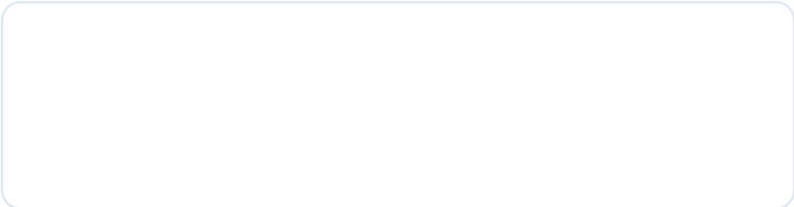
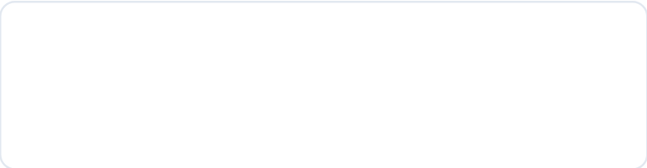












Deployment & Next Steps
INFERENCE ENGINEERING & PROJECT ROADMAP
Optimized Inference Pipeline
INPUT
MODEL
LOGIC
OUTPUT
Resize 768px & Normalize
DeepLabV3 Forward Pass
Argmax Classification
Mask Smoothing & Latency < 1s
Monitoring & Maintenance
Production Readiness Tasks
Performance Tracking
Implement mIoU & Per-Class IoU metrics
Continuous monitoring of mIoU drift. Trigger retraining if mIoU drops > 5%.
Retraining Plan
Verify Class-ID Mapping consistency
Monthly ingestion of new Perseverance rover imagery to handle domain shift.
Define "True Test Set" from unseen missions
Apply 'ignore_index' for masked regions
* Target Hardware: NVIDIA RTX 3090/Jetson Orin for On-Rover Deployment
PHASE 2: OPERATIONALIZATION

Slide 11











Conclusion
FROM PROOF-OF-CONCEPT TO MISSION READINESS
Key Outcomes
Path to Deployment
Viable Pipeline: Established a robust end-to-end semantic segmentation workflow using DeepLabV3-ResNet50.
Quantitative Rigor: Implement mIoU, per-class IoU, and Dice metrics to meet the ≥75% success threshold.
Hardware Optimization: Address inference latency for resource-constrained onboard rover systems.
Enhanced Robustness: Reintroduced augmentations and LR scheduling, significantly improving training convergence.
Generalization: Expand dataset to include Perseverance mission data to combat domain shift risks.
Validated Prototype: Successfully processed AI4Mars imagery, identifying primary classes like Soil and Bedrock.
Standardization: Verify class-id mapping and implement explicit "ignore label" handling in loss functions.
ObjectSegmentationMarsWS25 | Final Project Review
MARS EXPLORATION 2026

