Slide 1
cosim
Timur Kelin
Co-simulation of the simSCHD Static Scheduler and simSIMD Vector Cores
Cambridge 2020

Slide 2
Contents
Overview
Simulated System
Conventions for the Simulator Preferences
Design Examples
References

Slide 3
Overview

Slide 4
Objectives
Co-simulation environment allows to utilize simSCHD static scheduler as a Scalar Core which controls multiple simSIMD vector cores.
Seamless top-down approach for the development of the complete Vector Processing system
Please refer to [2] for simSCHD Static Scheduler and [3] for simSIMD Application Specific Vector Processor.

Slide 5
Development Phases
Outline of the system structure and control procedures is developed and verified on the simSCHD platform at a high abstraction level
Granularity of the system structure and control procedures is increased to match the components which are available inside simSIMD vector cores
simSIMD vector core or cores are then connected in place of the corresponding execution blocks for co-simulation and more detailed evaluation.

Slide 6
Simulated System

Slide 7
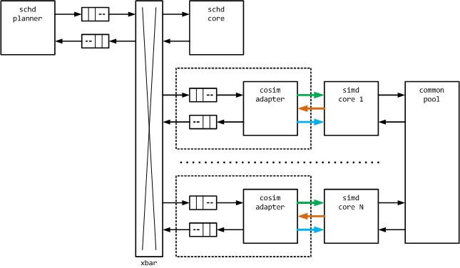
Block Diagram of the Co-Simulation Platform

Slide 8
Co-Simulation System Components
SCHD Planner: see [2]
SCHD Core: see [2]
SIMD Core: see [3]
Common Pool: see [3]
Co-simulation adapter: translates data supplied by the SCHD Planner into the control structures for SIMD Core, and other way around: events and statuses from the SIMD Core into the format which is acceptable by SCHD Planner

Slide 9
Conventions for the Simulator Preferences

Slide 10
Simulator Preferences
Preferences are supplied to the simulator via the JSON file specified as a single command line parameter

Slide 11
Top-level JSON Fields
“threads”: an array of thread specifications
“tasks”: an array of task specifications
“executors”: an array of the names of the execution blocks available in the system
“common”: an array of common resource specifications
“time”: specification of the simulation time and resolution
“trace”: specification of the VCD trace and waveform translation
“dump”: an array of data dump specifications for the different points of the simulated system
“report”: controls for SystemC logging and reporting
Please refer to the examples for the specification details

Slide 12
Thread Specification

Slide 13
Task Specification

Slide 14
Execution Block Specification

Slide 15
Common Resource Specification

Slide 16
VCD Trace Specification

Slide 17
Data Dump Specification

Slide 18
Logging and Reporting Specification

Slide 19
Design Examples

Slide 20
References

Slide 21
Source Code and Documentation
[1] Co-simulation environment:
https://github.com/timurkelin/cosim
[2] Simulation Framework for the Static Scheduler:
https://github.com/timurkelin/simschd
[3] Simulation framework for Application Specific Vector Processor:
https://github.com/timurkelin/simsimd
[4] IEEE Std 1666-2011, IEEE Standard for Standard SystemC Language Reference Manual

