Slide 1
simSCHD
Timur Kelin
Evaluation of the Static Scheduling and Timing Budget
Cambridge 2019

Slide 2
Contents
Overview
Simulated System
Simulator Configuration and Preferences
Design Examples
References

Slide 3
Overview

Slide 4
Objectives
A simulation platform for the evaluation of the scheduling and timing budget.
Simplifies the initial stages of the architecture development for Hard Real Time systems.
Allow for the simulation driven development and optimization of the architecture
Flexible, highly abstract and independent of the implementation target (HW or SW)

Slide 5
Objectives
Input:
Top-level timing requirements
Outline of the processing flow
Output:
Processing schedule and timing diagrams
List of the execution blocks and common resources as well as the requirements for both

Slide 6
Objectives
Benefits of using SystemC
Short update-simulation-analysis cycle which allows for simulation driven development and optimization of the architecture
High level of abstraction for the scheduler and execution core preferences to stay focused on the architectural tasks
Integration into the existing simulation frameworks and workflows
Open source

Slide 7
Simulated System

Slide 8
System Model
Real-Time System is simulated as a number of concurrently running Threads
Each Thread is a succession of the Tasks to execute and the Events to generate
New Thread is initiated when the specific set of the Events has been generated (Thread synchronization)
Each Task is a specification of
Execution time,
Set of the Execution Blocks to be occupied for the duration of the execution time, and
Demand requested from the Common Resources by the Execution Blocks from the set.
Competition for the Execution Block is resolved by the priorities which were specified in the Thread preferences

Slide 9
Execution Blocks and Common Resources
Each Common Resource simulates an instance which is shared by multiple Execution Blocks in the cooperative manner.
The Common Resource is characterized by its capacity
Examples
Shared memory interface with throughput limit. Capacity: max throughput.
Power source with the current limit. Capacity: max current.

Slide 10
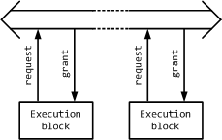
Transaction-Level Operation
At the level of elementary transactions each request from the Execution Block is granted when the Common Resource is ready to process this request.
If the Common Resource is not ready to process this request straight away, then the execution block is stalled until its request is granted.
These stalls or wait states reduce the processing performance of the Execution Block which results in the increase of the processing time.

Slide 11
“Capacity and Demand” Model
Difing the Task execution timeframe the Execution Block demands some fraction from the capacity of the Common Resource.
If the total requested demand is less than the capacity of the Common Resource then the Execution Blocks operate at full speed.
If the total requested demand exceeds the capacity of the Common Resource then the Execution Blocks slow down. Their execution time increases to simulate stalls or wait states

Slide 12
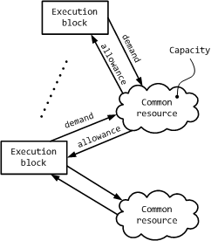
Simulation of the Capacity Exceeding
If the total requested demand exceeds the capacity of the Common Resource then the execution time of the Tasks, which use this Common Resource, increases.
All the Execution Blocks, which are involved in the execution of these Tasks, slow down.
Total demand from the Execution Blocks operating at lower speed doesn’t exceed the capacity of the Common Resource.
The slowdown decreases the demand requested from other Common Resources

Slide 13
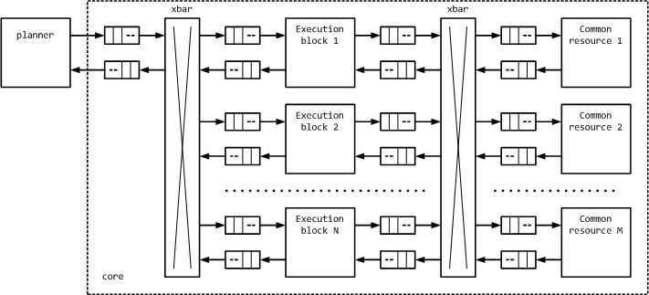
Block Diagram of the Simulation Platform

Slide 14
Planner
Executes multiple concurrent Threads
Keeps the register of the Events generated by the running Threads
Events are used for the synchronization between the Threads
Assigns the available Execution Blocks to the Tasks which are called by the running Threads
Resolves Thread priorities
Transmits runtime configuration to the Execution Blocks and receives their state
Keeps the record of the available and busy Execution Blocks

Slide 15
Execution Block
Receives runtime configuration from the Planner
Transmits requests with the demand values to the Common Resources
Receives the information from the Common Resource about its total demand, combines the information from the multiple Common Resources and adjusts the execution time accordingly
Transmits “available” status to the Planner when the execution time is expired

Slide 16
Common Resource
Receives requests with the demand values from the Execution Blocks
Calculates total demand requested by all of the Execution Blocks which are using this Resource
Broadcasts the value of the total demand to all of the Execution Blocks which are using this Resource

Slide 17
Simulator Configuration and Preferences

Slide 18
Design Examples

Slide 19
References

Slide 20
Source Code and Documentation
Simulation Framework for the Static Scheduler:
https://github.com/timurkelin/simschd
simSCHD and simSIMD Co-simulation environment:
https://github.com/timurkelin/cosim

