Slide 1
simSCHD
Timur Kelin
Evaluation of the Static Scheduling and Timing Budget
Cambridge 2019

Slide 2
Contents
Overview
Simulated System
Simulator Configuration and Preferences
Design Examples
References

Slide 3
Overview

Slide 4
Objectives
A simulation platform for the evaluation of the scheduling and timing budget.
Simplifies the initial stages of the architecture development for Hard Real Time systems.
Allow for the simulation driven development and optimization of the architecture
Flexible, highly abstract and independent of the implementation target (HW or SW)

Slide 5
Objectives
Input:
Top-level timing requirements
Outline of the processing flow
Output:
Processing schedule and timing diagrams
List of the execution blocks and common resources as well as the requirements for both

Slide 6
Objectives
Benefits of using SystemC
Short update-simulation-analysis cycle which allows for simulation driven development and optimization of the architecture
High level of abstraction for the scheduler and execution core preferences to stay focused on the architectural tasks
Integration into the existing simulation frameworks and workflows
Open source

Slide 7
Simulated System

Slide 8
System Model
Real-Time System is simulated as a number of concurrently running Threads
Each Thread is a succession of the Tasks to execute and the Events to generate
New Thread is initiated when the specific set of the Events has been generated (Thread synchronization)
Each Task is a specification of
Execution time,
Set of the Execution Blocks to be occupied for the duration of the execution time, and
Demand requested from the Common Resources by the Execution Blocks from the set.
Competition for the Execution Block is resolved by the priorities which were specified in the Thread preferences

Slide 9
Execution Blocks and Common Resources
Each Common Resource simulates an instance which is shared by multiple Execution Blocks in the cooperative manner.
The Common Resource is characterized by its capacity
Examples
Shared memory interface with throughput limit. Capacity: max throughput.
Power source with the current limit. Capacity: max current.

Slide 10
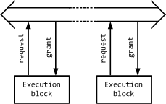
Transaction-Level Operation
At the level of elementary transactions each request from the Execution Block is granted when the Common Resource is ready to process this request.
If the Common Resource is not ready to process this request straight away, then the execution block is stalled until its request is granted.
These stalls or wait states reduce the processing performance of the Execution Block which results in the increase of the processing time.

Slide 11
“Capacity and Demand” Model
Defining the Task execution timeframe the Execution Block demands some fraction from the capacity of the Common Resource.
If the total requested demand is less than the capacity of the Common Resource then the Execution Blocks operate at full speed.
If the total requested demand exceeds the capacity of the Common Resource then the Execution Blocks slow down. Their execution time increases to simulate stalls or wait states

Slide 12
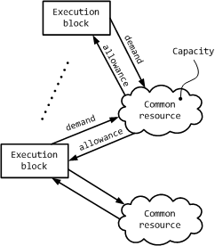
Simulation of the Capacity Exceeding
If the total requested demand exceeds the capacity of the Common Resource then the execution time of the Tasks, which use this Common Resource, increases.
All the Execution Blocks, which are involved in the execution of these Tasks, slow down.
Total demand from the Execution Blocks operating at lower speed doesn’t exceed the capacity of the Common Resource.
The slowdown decreases the demand requested from other Common Resources

Slide 13
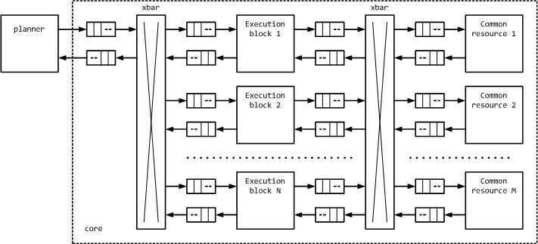
Block Diagram of the Simulation Platform

Slide 14
Planner
Executes multiple concurrent Threads
Keeps the register of the Events generated by the running Threads
Events are used for the synchronization between the Threads
Assigns the available Execution Blocks to the Tasks which are called by the running Threads
Resolves Thread priorities
Transmits runtime configuration to the Execution Blocks and receives their state
Keeps the record of the available and busy Execution Blocks

Slide 15
Execution Block
Receives runtime configuration from the Planner
Transmits requests with the demand values to the Common Resources
Receives the information from the Common Resource about its total demand, combines the information from the multiple Common Resources and adjusts the execution time accordingly
Transmits “available” status to the Planner when the execution time is expired

Slide 16
Common Resource
Receives requests with the demand values from the Execution Blocks
Calculates total demand requested by all of the Execution Blocks which are using this Resource
Broadcasts the value of the total demand to all of the Execution Blocks which are using this Resource

Slide 17
Simulator Configuration and Preferences

Slide 18
Simulator Preferences
Preferences are supplied to the simulator via the JSON file specified as a single command line parameter

Slide 19
Top-level JSON Sections
“threads”: an array of thread specifications
“tasks”: an array of task specifications
“executors”: an array of the names of the execution blocks in the system
“common”: an array of common resource specifications
“time”: specification of the simulation time and resolution
“trace”: specification of the VCD trace and waveform translation
“dump”: an array of data dump specifications for the different points of the simulated system
“report”: controls for SystemC logging and reporting
Please refer to the examples for the specification details

Slide 20
Thread Specification
“name”: name of the thread. It is used in the in the VCD trace map.
“priority”: numeric value which is used to allocate execution blocks in the case of competition.
“start”: array of the regex-es which correspond to the event names. All the events from the list should occur for the thread to start (and-list).
To restart the thread the new set of the events should occur.
__start__ is the name of the event which corresponds to the start of the simulation

Slide 21
Thread Specification
“sequence”: array of the tasks and events. The tasks are executed and the events are generated in the order of their appearance in the array.
“task”: specifies task parameters
“run”: name of the task to execute
“param”: task parameters for VCD trace map
“event”: name of the event to be generated. It is resolved in the “start” list of a thread.
“sequence” should start with a “task” specification
2 or more “event” specifications one right after another are not allowed

Slide 22
Task Specification
“name”: name of the task. The task is called by its name from the “sequence” array of a thread.
“exec”: array of the parameters specified for the execution blocks which are involved in the task execution. Each element of the array specifies:
“run”: name regex of the execution block
“use”: array of the parameters of the common resources. Each element of the array specifies:
“res”: name of the common resource which is addressed by the execution block
“demand”: demand from the common resource
“opt”: options which are passed to the execution block in the co-simulation environment

Slide 23
Task Specification
“runtime”: time of the task execution.
This time is specified in the assumption that the total demand from the common resources, which are specified in the “use” array of the “exec” elements, doesn’t exceed their capacity within the timeframe of the execution.
In other words “runtime” is specified without the effect of common resources been taken into account.
During the simulation the time for which the execution blocks are occupied can be different from the one specified in the “runtime” field

Slide 24
Execution Block Specification
“name”: name of the execution block. It is addressed from the “run” fields of the task specification

Slide 25
Common Resource Specification
“name”: name of the common resource.
“capacity”: capacity of the common resource.

Slide 26
Time Specification
“resolution”: specifies simulation time resolution. See [3] section 5.11.3
“finish”: specifies simulation time. See [3] section 4.3.4.2

Slide 27
VCD Trace Specification
“file”: Specification of the name for VCD and translation files. Extensions are added accordingly.
“viewer”: waveform viewer for which the translation file is generated. Currently supported viewers: “simvision” and “gtkwave”

Slide 28
VCD Trace Map Specification
“map”: array of the translation maps. Each map corresponds to the id of the job being executed by the execution block. Each element of the array contains the following fields:
“mask”: regex for a job id string which is constructed as thread_name#task_name#task_param
“format”: specification of the job id format to be displayed in the waveform viewer. See Boost.Format documentation for more details.
%1 - thread_name
%2 - task_name
%3 - task_param
“bgcolor”: X11 name for the background colour of the waveform
“opt”: optional map specification. See mmap description in [4].

Slide 29
Data Dump Specification
"buf_regex": regex for the name of the dump buffer. Please refer to the source code for the buffer names.
"time_start": start time of the dump.
"time_end": end time of the dump. “finish” corresponds to the end of simulation time.
"size_res": size of the dump vector for which memory is allocated.
"size_max": max size of the dump vector. If the size of the dump vector exceeds size_max field then the simulator reports an error.
"file": name of the dump file. Dumps are saved in the mat format and can be processed with Matlab or Octave.

Slide 30
Logging and Reporting Specification
“log_file”: name of the log file
“handler”: handler and formatter for report messages. “unchanged” – don’t change handler (integration); “default” – native SystemC handler. “schd” – compact messages.
“bearing”: array of bearings for different message types and severity levels. Please refer to section 8.3 in [3]

Slide 31
Design Examples

Slide 32
References

Slide 33
Source Code and Documentation
[1] Simulation Framework for the Static Scheduler:
https://github.com/timurkelin/simschd
[2] simSCHD and simSIMD Co-simulation environment:
https://github.com/timurkelin/cosim
[3] IEEE Std 1666-2011, IEEE Standard for Standard SystemC Language Reference Manual
[4] SimVision Command Language Reference

