Slide 1
Introduction to LLMs Week 8

Slide 2
Introduction to LLMs
A large language model (LLM) is a statistical model trained on a vast amount of text, designed for natural language processing (NLP) tasks
They do not possess any direct intelligence apart from the latent intelligence inherent in their training data
LLMs produce text one small piece at a time (a token)
Tokens can be words or parts of words (see tokenizer)
At each step, the LLM predicts which token should come next based on the prompt and what it has already written so far
LLMs can be fine-tuned for specific tasks or guided by ‘prompt engineering’

Slide 3
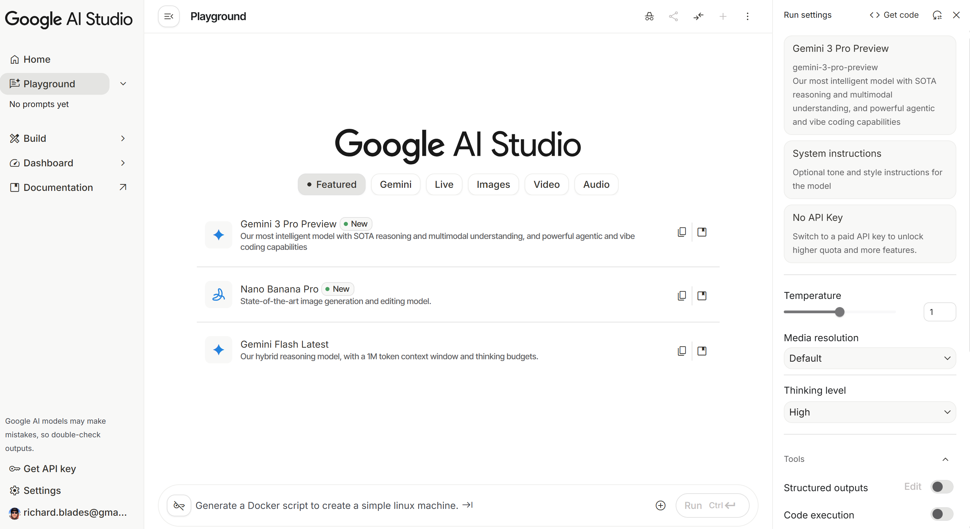
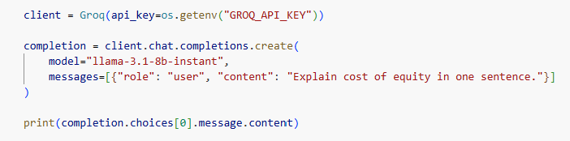
Two main ways to access LLMs
Programmatically, via APIs
(Week 9)
Via chat interface
(Week 8)

Slide 4
The main challenge with using LLMs is the “hallucinations”
Hallucinations are where an LLM generates content that is plausible and fluent but factually incorrect, nonsensical, or unfaithful to the provided source or instructions
They arise because LLMs generate text probabilistically, by predicting likely token sequences. Their answers are based on training data — not by verifying facts against a reliable source
It is not (yet) possible to 100% guarantee the same answer each time; however, it is possible to make answers extremely consistent

Slide 5
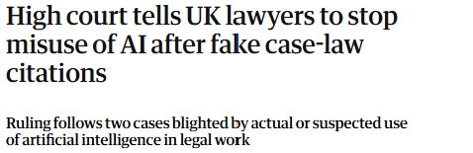
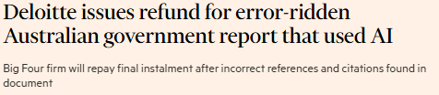
What happens when you don’t address hallucinations

Slide 6
This session will summarise several tools and techniques which can help mitigate the effects of hallucinations
Adjusting LLM hyperparameters
Prompt engineering, and associated techniques
Retrieval-Augmented Generation (RAG)
AI-as-judge
(Pinned models)

Slide 7
1) Adjusting LLM (hyper)parameters
Parameters | Meaning | Settings * | Considerations
Top P | Controls the “token pool” that the model selects from – a measure of creativity/ breadth | Low: Uses a smaller pool of words High: Considers a broader range of words [range: 0.0 – 1.0] | Trade off between creativity and determinism
Temperature | Controls the degree of randomness in token selection | Low: More likely to select the most probable tokens High: More diversity (randomness) in the choice of tokens [range: 0.0 - 1.0] | Trade off between creativity and determinism
* Temperature range is platform-dependent

Slide 8
Let’s test the effect of different hyperparameters using Google AI Studio (ai.dev)
Prompt | Model | Top P | Temperature
Describe the most important responsibilities of a finance manager for a FTSE 100 company | Gemini-Flash-Lite-Latest | 0.9 | 2 *
 |  | 1 | 0
Provide a paragraph which describes what cryptocurrencies are and why they are good investments | Gemini-Flash-Lite-Latest | 0.9 | 2 *
 |  | 1 | 0
* Models usually only offer Temperature in a range of 0-1. Gemini offers a 0-2 range.

Slide 9
General guidelines for Top_P and Temperature settings
Outcome | Example use cases | Top_P | Temperature *
Deterministic | Facts Calculations | 1 | 0
Controlled creativity | CV/ LinkedIn profile | 0.7 | 0.2
Highly creative/ random | Creative arts? | 1 | 1
* Temperature range is platform-dependent, but usually 0-1.

Slide 10
2) “Prompt engineering” helps to mitigate hallucinations
(1)
Prompt engineering is the crafting of detailed instructions to guide an AI (LLM) toward better outputs
It is important to differentiate between the prompt and the techniques
The prompt is a structured conduit for delivering several techniques to the AI
Prompt engineering is not a solution on its own
The key idea is to generate the truth
(2)

Slide 11
Prompt engineering ‘template’
## OBJECTIVE_AND_PERSONA
You are a [insert a persona, such as a "math teacher" or "automotive expert"]. Your task is to...
## INSTRUCTIONS
To complete the task, you need to follow these steps:
1.
2....
---
*Optional Components*
---
## CONSTRAINTS
Dos and don'ts for the following aspects
1. Dos
2. Don'ts
## CONTEXT
The provided context
(1)
.
(2)
## OUTPUT_FORMAT
The output format must be
1.
2.
...
## FEW_SHOT_EXAMPLES
Here we provide some examples:
1. Example #1
Input:
Thoughts:
Output:
...
## RECAP
Re-emphasise the key aspects of the prompt, especially the constraints, output format, etc.

Slide 12
2) “Prompt engineering”: Core information
## OBJECTIVE_AND_PERSONA
You are a [insert a persona, such as a "math teacher" or "automotive expert"]. Your task is to...
## INSTRUCTIONS
To complete the task, you need to follow these steps:
1.
2. …
---
*Optional Components*
---
## CONSTRAINTS
Dos and don'ts for the following aspects
1. Dos
2. Don'ts
## CONTEXT
The provided context
Provide all the core information needed to complete the task
As well as a persona, you could also provide information about the audience
Give clear and specific instructions about how you expect the task to be completed and in what sequence
Provide the context and any constraints/ rules critical for the task

Slide 13
2) “Prompt engineering”: Optional components
.
Consider using – e.g.:
Output types include: format/ style/ tone/ volume/ structure
Few-shot examples
Ask the AI to provide its reasoning
Specify grounding sources that the AI should use to perform the task (e.g., “cross-reference to Google Search”)
Specify tools (e.g., “use Python code to…”)
## OUTPUT_FORMAT
The output format must be
1.
2....
## FEW_SHOT_EXAMPLES
Here we provide some examples:
1. Example #1
Input:
Thoughts:
Output:
...
## RECAP
Re-emphasise the key aspects of the prompt, especially the constraints, output format, etc.

Slide 14
Other prompting strategies – “Few-shot” examples / reasoning / chaining
Include “few-shot” examples (small-scale ‘training’)
Instruct the model to explain its reasoning (“chain of thought”).
Going through this process can sometimes improve accuracy, especially for challenging queries
“Prompt chaining”:
Breaking complex tasks into smaller, sequential, and manageable steps, where the output of one prompt becomes the input for the next

Slide 15
Perform the same sentence evaluation, using: i) a basic prompt, ii) an engineered prompt
Prompt | Model | Top P | Temperature
Does the following sentence relate to valuation? Answer yes or no. “Due to aggressive discounting, the firm experienced a decrease in cash inflows.” | Gemini-Flash-Lite-Latest | 1 | 0
Engineered prompt here: Few-shot examples here: | Gemini-Flash-Lite-Latest | 1 | 0

Slide 16

3) Retrieval-Augmented Generation (RAG)
RAG systems combine a general-purpose LLM with document retrieval mechanisms, allowing integration with user-supplied sources
NotebookLM, developed by Google, is an example for everyday use
A Google account is required to use it
Free tier (limited to 100 docs/’sources’)
Multiple output formats, including text (chat), audio (podcast) or flash cards/ quiz
https://notebooklm.google.com/
When you hear of corporates developing “their own LLM”, it’s likely this is a RAG system (e.g., BloombergGPT)
https://assets.kpmg.com/content/dam/kpmg/xx/pdf/2024/04/ai-in-financial-reporting-and-audit-web.pdf
What does the document say about the use of AI in financial reporting and audit, and what does it mean for the type of graduate jobs there will be in 3 years' time?

Slide 17

4) AI-as-judge framework
AI-as-judge uses a second LLM (Model B) to evaluate the response produced by another (Model A)
The judge (Model B) is given the original input and prompt, together with the output generated by Model A, and is instructed to assess whether the response satisfies specified (self-provided) evaluation criteria
The judge produces an evaluation indicating the quality of Model A’s response
Model A
Model B
Input A
Input A
Output A
Prompt A
Prompt A
Output A

Slide 18
5) Although it doesn’t help with hallucinations, using pinned models can deliver results with less unexpected variation
Version | Meaning | Examples | Considerations
Standard models | Models have different functionality Functionality (performance) is upgraded periodically | Gemini 3 Pro Gemini 2.5 Pro Gemini 2.5 Flash Gemini 2.0 Flash-Lite | Subject to ‘model drift’ Answers to the same prompt may change over time
Pinned models | Models which are fixed (and not updated) to a specific date. Fixed functionality and training set. | gpt-4.1-2025-04-14 | Not all model providers currently offer pinned models NB. Gemini is subject to ‘model drift’ even for models with a fixed version name

