Slide 1

Absolute Technologies Lab
DDRM Security

Slide 2
Team: Ryspekov Timur Polonskiy Vlad Klescheva Nastya
Winners: NASA Space Apps Challenge 2018 in New York, Worldwide Legal Hackathon in Toronto, Canada Mining Innovation Hackathon. Multiple winners of national and international championships, contests and competitions in computer science, scientific and technical creativity and robotics.
Timur Ryspekov - Top 25 Top Mathematicians of Canada in the Euclid contest. One of the best young scientists in the field of computer science, I enter the program of the President of the Republic of Kazakhstan "100 new faces" - honorary citizens.

Slide 3
Innovativeness
Symmetric and asymmetric encryption algorithms (AES, RSA and One-Time-Pad) with the support of a quantum random number generator(QRNG).
A new hashing algorithm that runs binary without collisions — two or more elements form a unique number [the collisionless range depends on the denominator of the mathematical progression with increasing difference]

Slide 4
Encryption
To familiarize yourself with each of the encryption algorithms, we created separate repositories on GitHub:
One-time- pad:
https://gist.github.com/timurryspekov/4290c85651ea5f94fed03fd9334bcfd2
RSA:
https://gist.github.com/timurryspekov/a3b852bad6ac485ef0786e9b8277cb55
https://github.com/timurryspekov/RSA_cryptography_messages
AES:
https://github.com/timurryspekov/Aes_cryptography

Slide 5
Quantum random number generator(QRNG)

Slide 6
QRNG
Request generation
Software
Random data
Encryption keys
based on random data

Slide 7
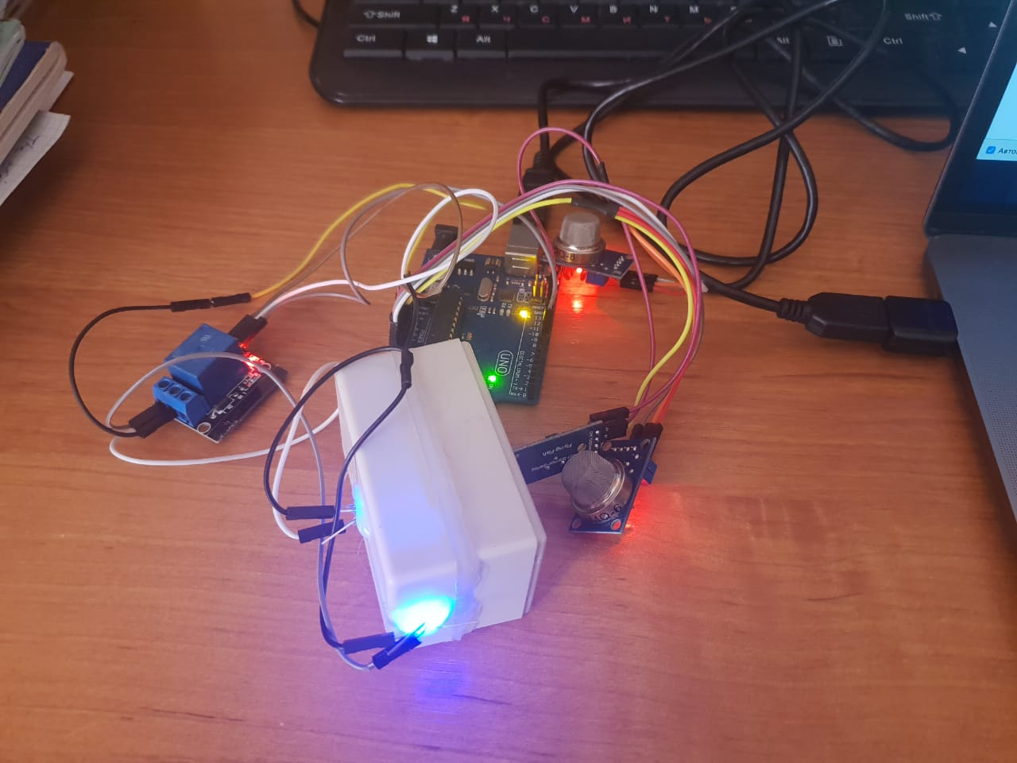

Slide 8
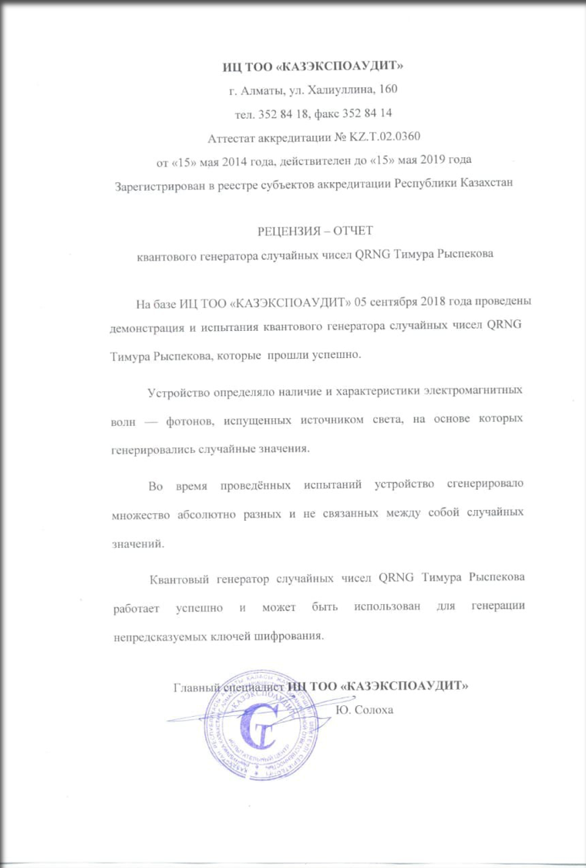

Slide 9
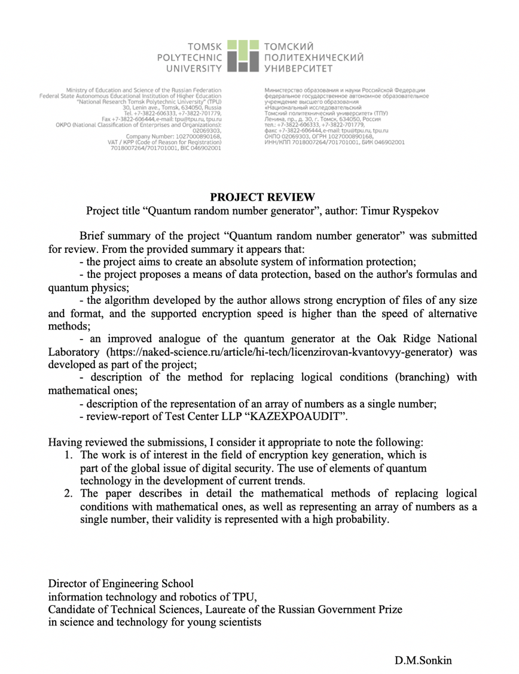

Slide 10
Hashing algorithm

Slide 11
0
1
2
3
3
8
60
The hashing algorithm is to replace two elements with one unique.
Details in the technical description. The presentation is an example of the Fibonacci numbers,
in the project geometric progression

Slide 12
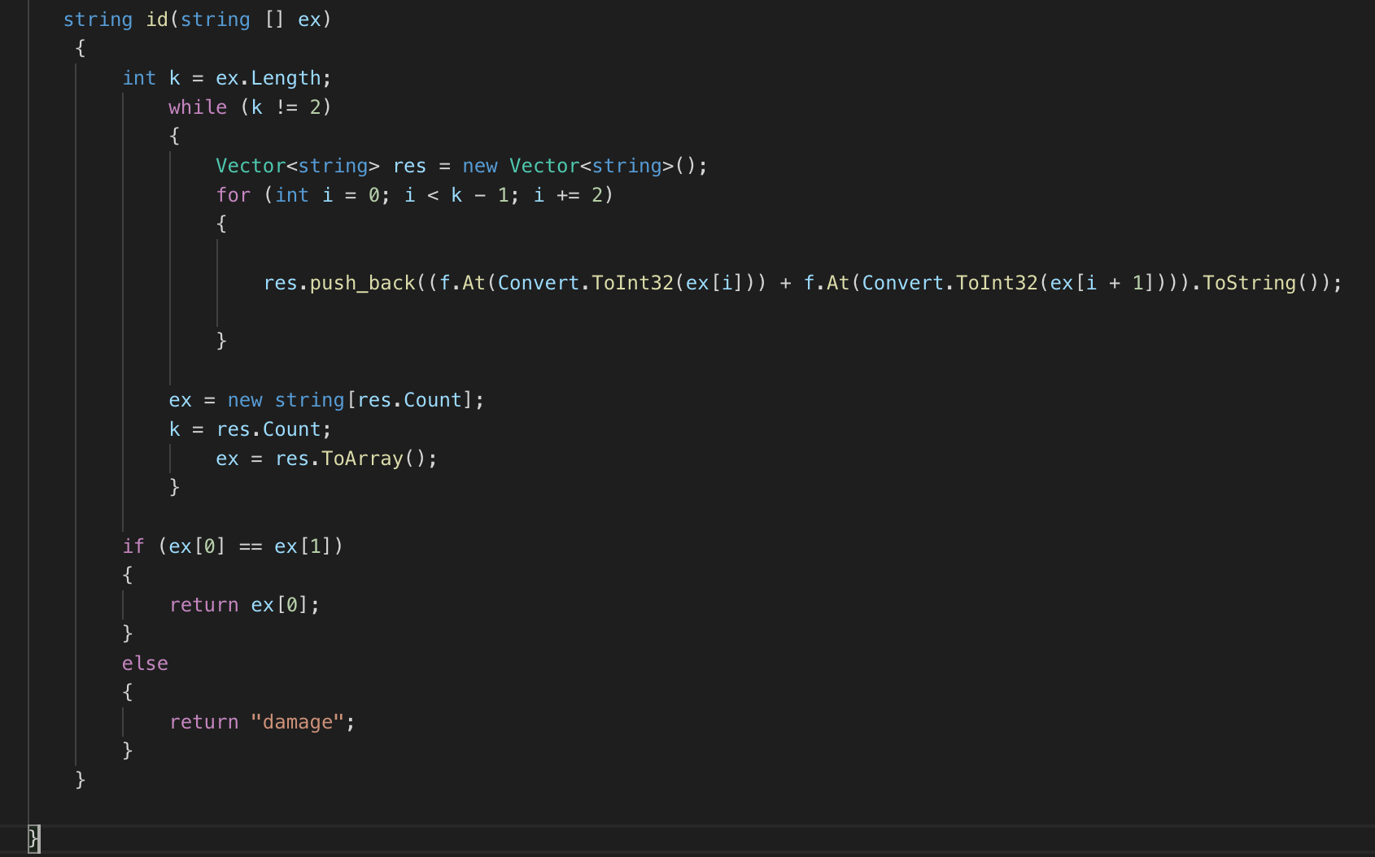

Slide 13
Advantages of project
Higher level of data encryption using a QRNG
A new hash algorithm that first solves the collision problem for combining two or more blocks (depending on the progression)
The algorithm can be used to detect plagiarism with binary trees, which can significantly increase protection against it.

Slide 14
Thank you for watching! Demo https://github.com/timurryspekov/absolute_hash_example

