Slide 1

Supply Chains Are Broken
Every day, millions depend on global supply chains. These systems are plagued by major issues.
Counterfeit products like fake medicines
Lack of transparency across the chain
Manual inefficiencies leading to errors
This results in delayed deliveries, consumer distrust, and huge financial losses.
by Sumit Kawor

Slide 2
The Real-World Cost of Inaction
Patient Safety at Risk
Retailer Losses
Increased Business Costs
Patients may receive unsafe, fake drugs, leading to severe health consequences.
Retailers suffer due to inventory errors, stockouts, or overstocking.
Companies pay more due to unnecessary middlemen and significant delays.

Slide 3




Blockchain-Based Transparency
End-to-End Tracking
Full visibility from supplier to customer.
QR Codes
Unique QR codes on each product batch for authenticity.
Smart Contracts
Automated actions reduce manual errors and disputes.

Slide 4




Safer Products. Smarter Operations.
Consumer Trust
Business Savings
Scan QR codes to verify product origin and authenticity.
Save money and time through streamlined operations.
Logistics Efficiency
Manufacturers cut logistics costs by up to 30%.

Slide 5





Target Audience
Pharmaceutical Companies
Logistics & Transport Firms
Retailers & Pharmacies
Preventing inventory errors and counterfeits.
Ensuring drug authenticity.
Optimizing delivery and tracking.
Health-Conscious Consumers
Verifying product safety and origin.

Slide 6
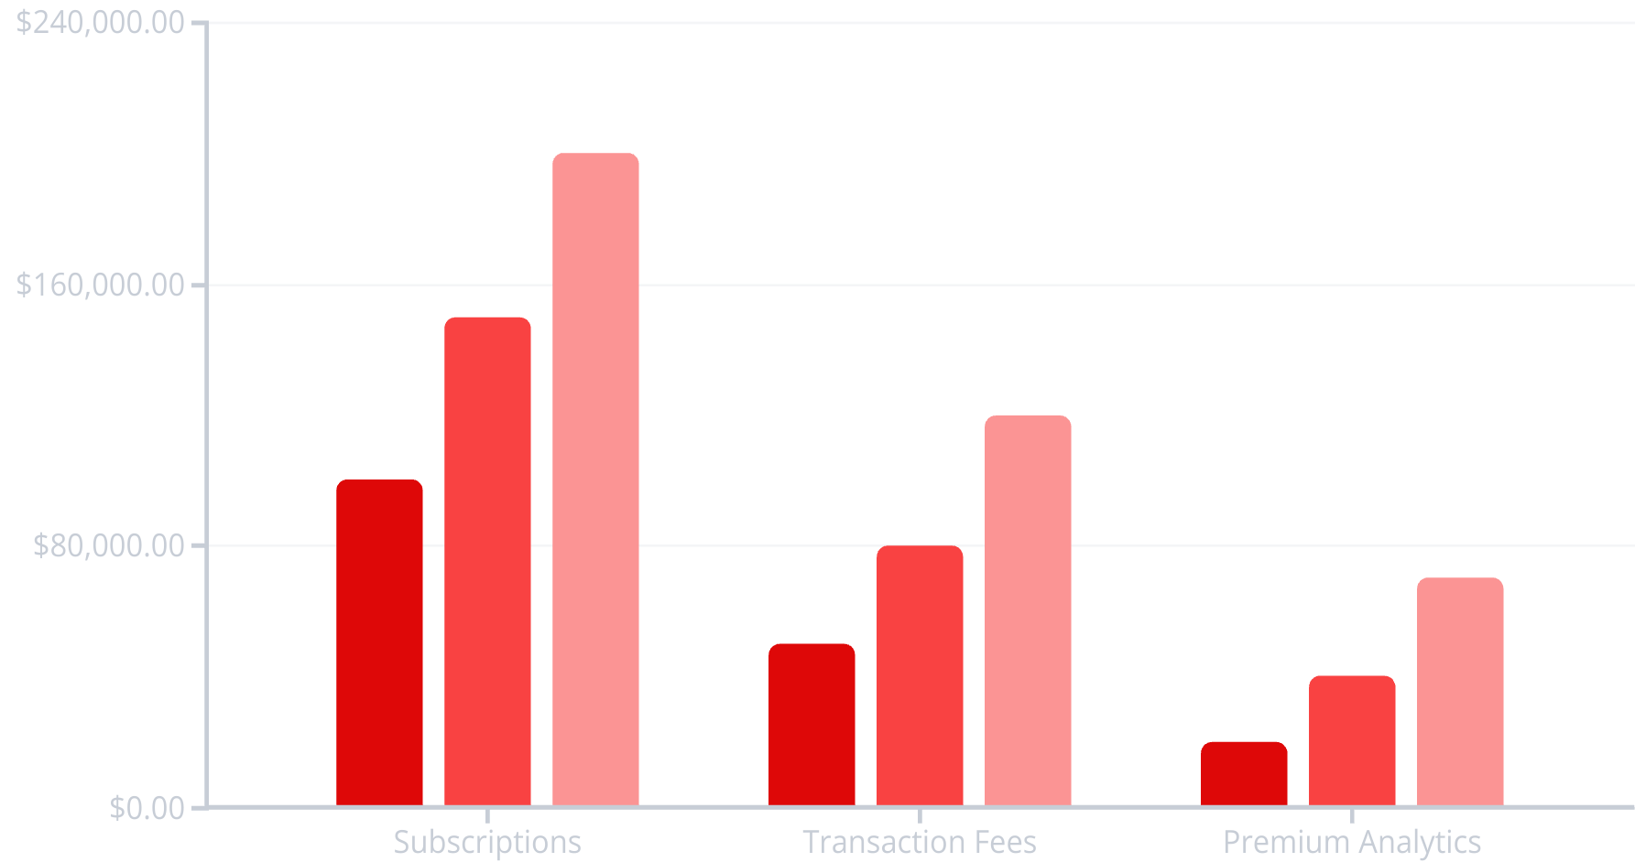
Scalable Revenue Model
Projected Q1
Projected Q2
Projected Q3
Our multi-faceted revenue model ensures sustained growth. Tiered subscription plans cater to businesses of all sizes, offering flexibility and value. Transaction fees on blockchain operations provide a direct link to platform usage, scaling with adoption. Premium analytics unlocks deeper insights for large enterprises, creating high-value recurring revenue.

Slide 7
Step-by-Step Supply Chain Flow
Admin Assigns Roles
1
Initial setup of participants.
2
Supplier Logs Materials
Raw materials entered onto blockchain.
Manufacturer Updates
3
Production progress recorded.
4
Transporter Tracks
Movement of goods monitored.
Distributor Verifies
5
Delivery confirmed on arrival.
6
Consumer Scans QR
Product authenticity confirmed.

Slide 8

A Safer, Smarter Supply Chain
Builds Trust
Drives Efficiency
Ensures authenticity and transparency.
Automates processes, reduces costs.
Enhances Safety
Protects consumers from counterfeits.
Our system builds trust, efficiency, and safety. Next steps include AI-based predictive analytics for demand forecasting, expansion to other industries like food and electronics, and IoT integration for real-time data.

