Slide 1
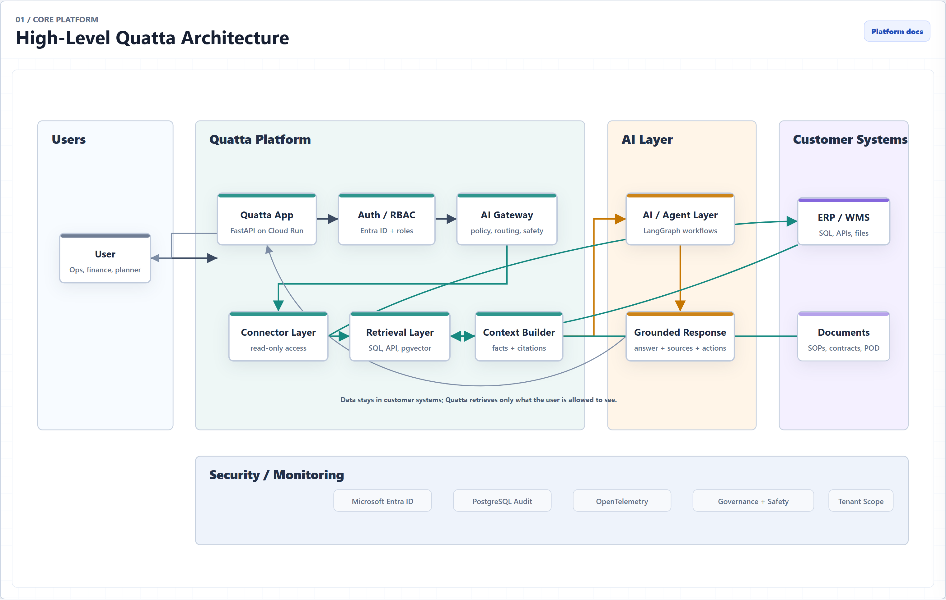
Notes:
Quatta architecture diagram: High-Level Quatta Architecture

Slide 2
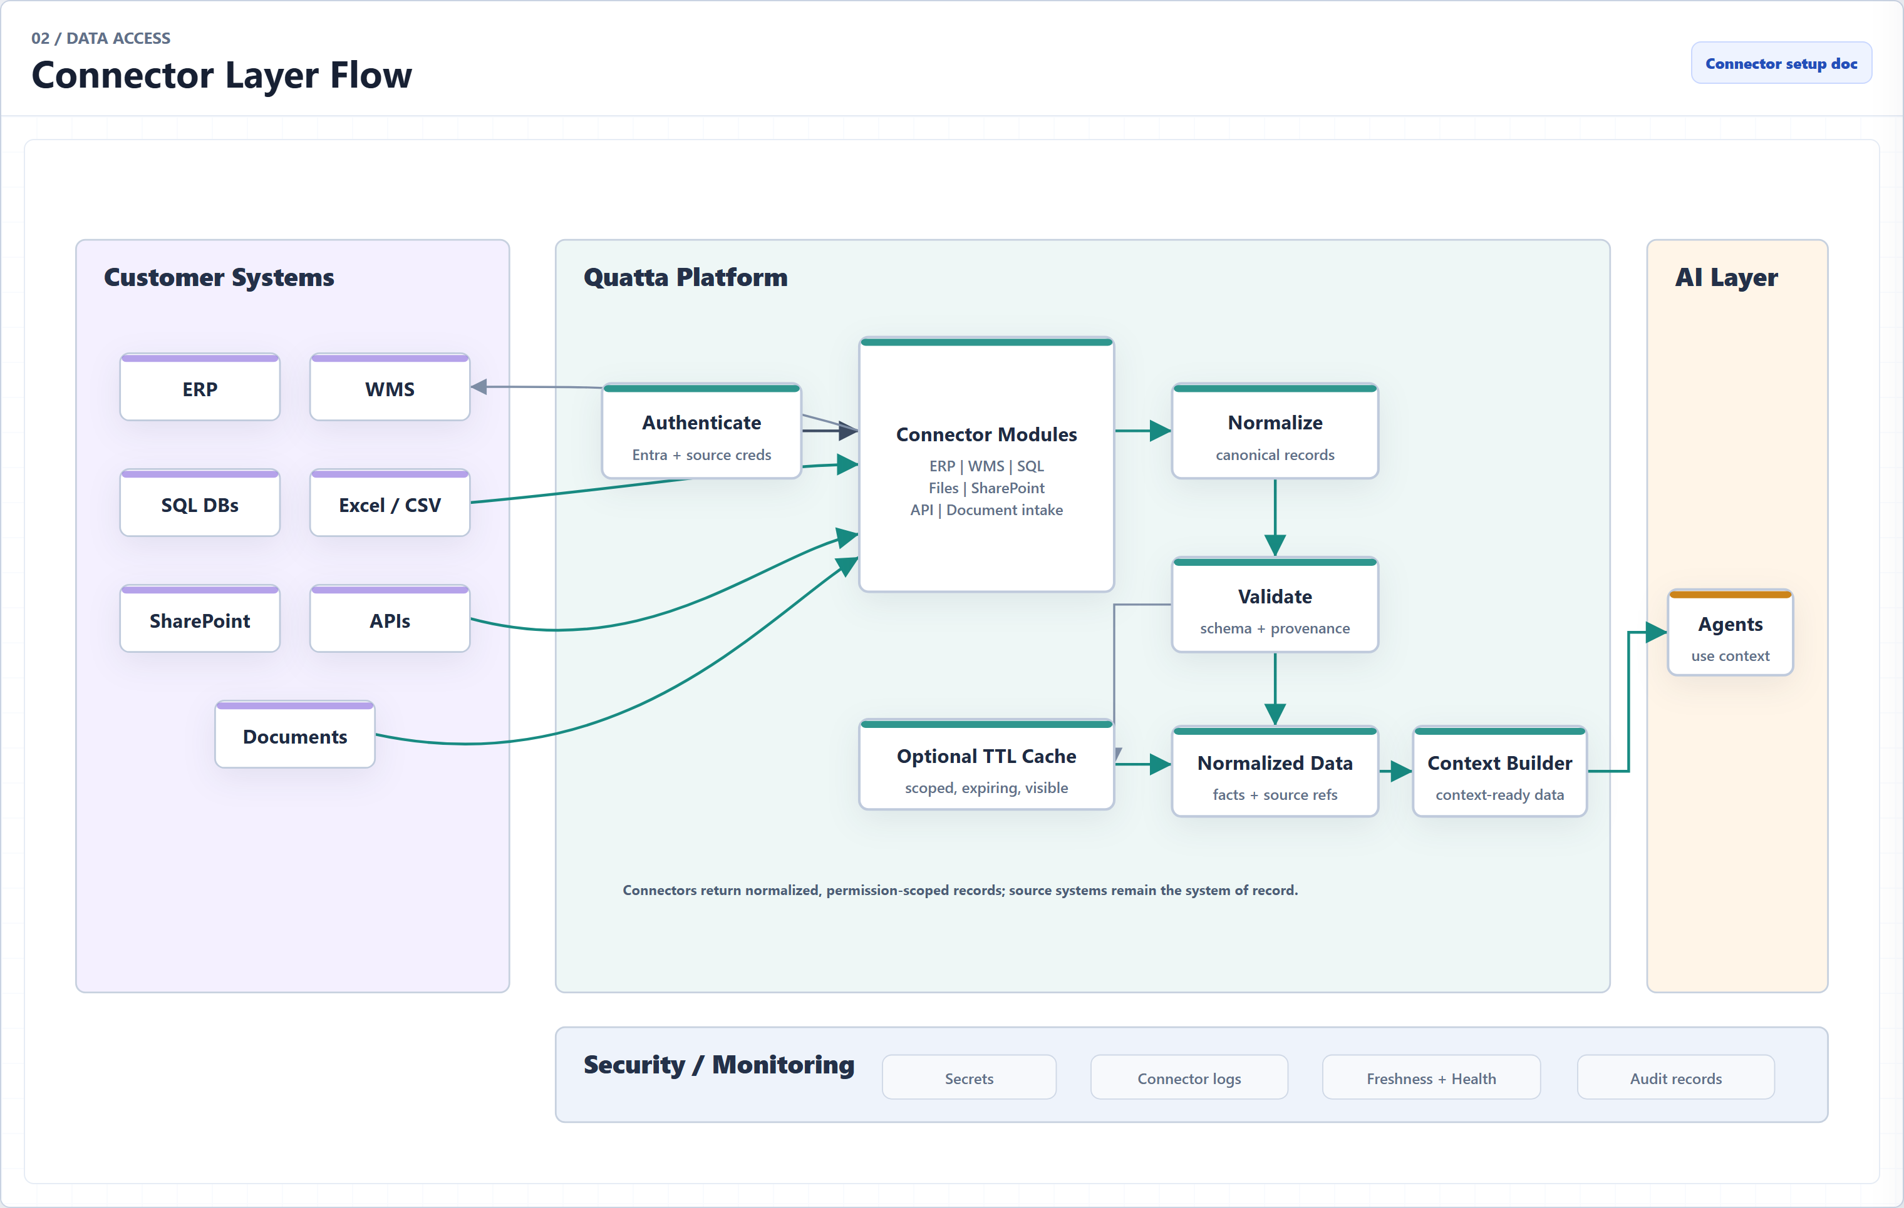
Notes:
Quatta architecture diagram: Connector Layer Flow

Slide 3
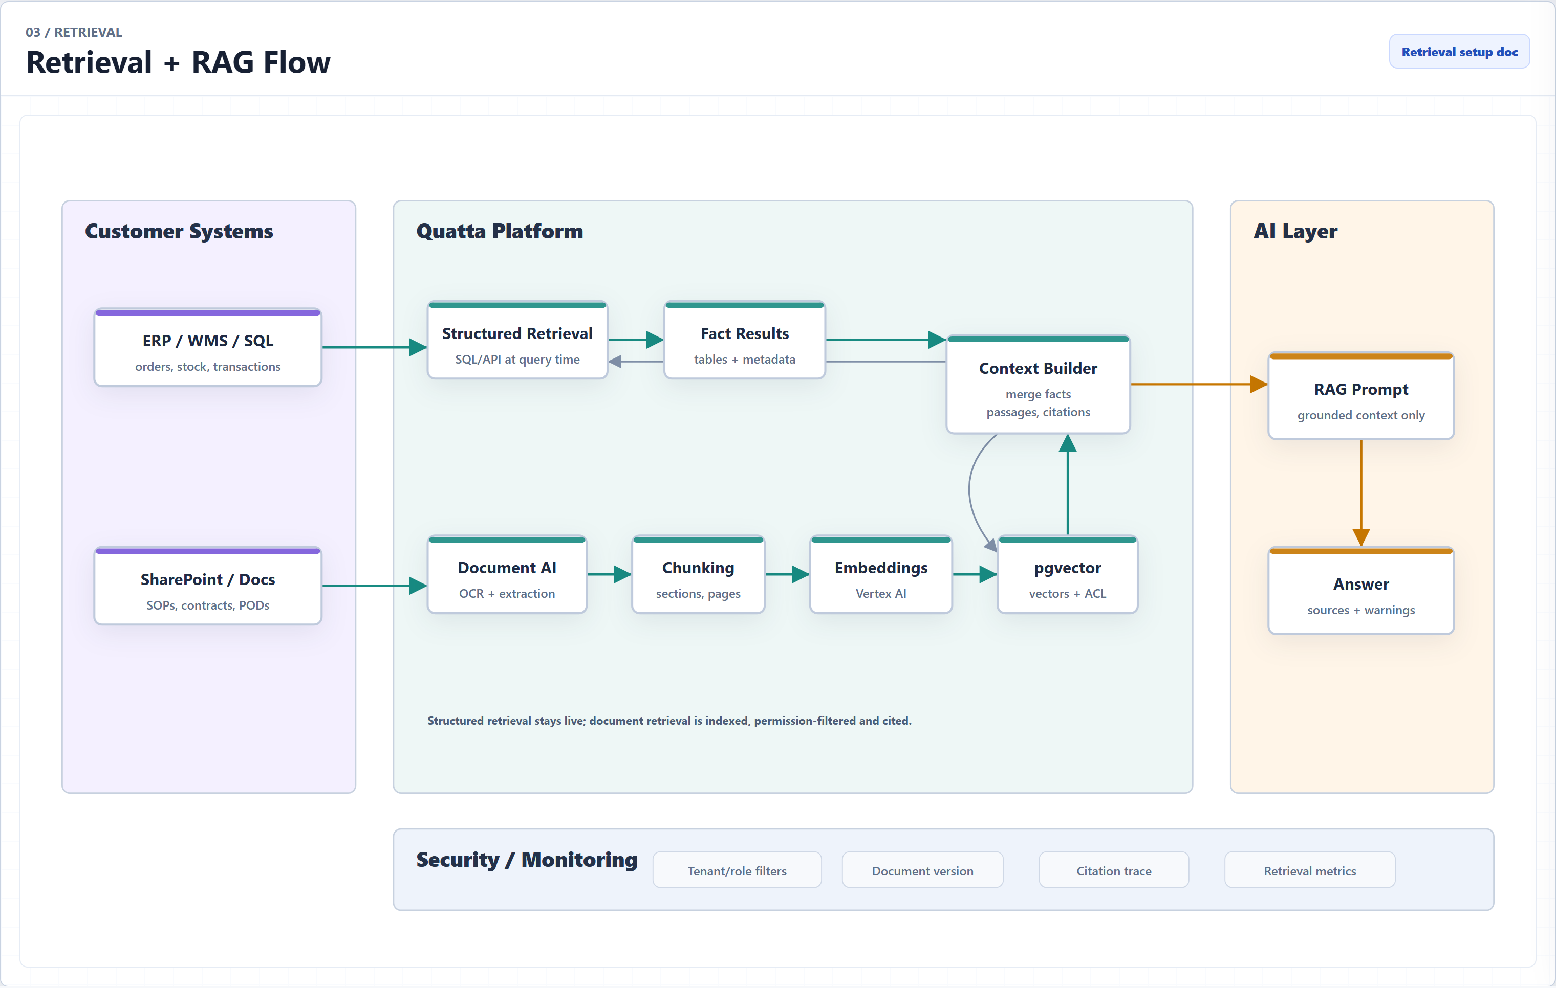
Notes:
Quatta architecture diagram: Retrieval + RAG Flow

Slide 4
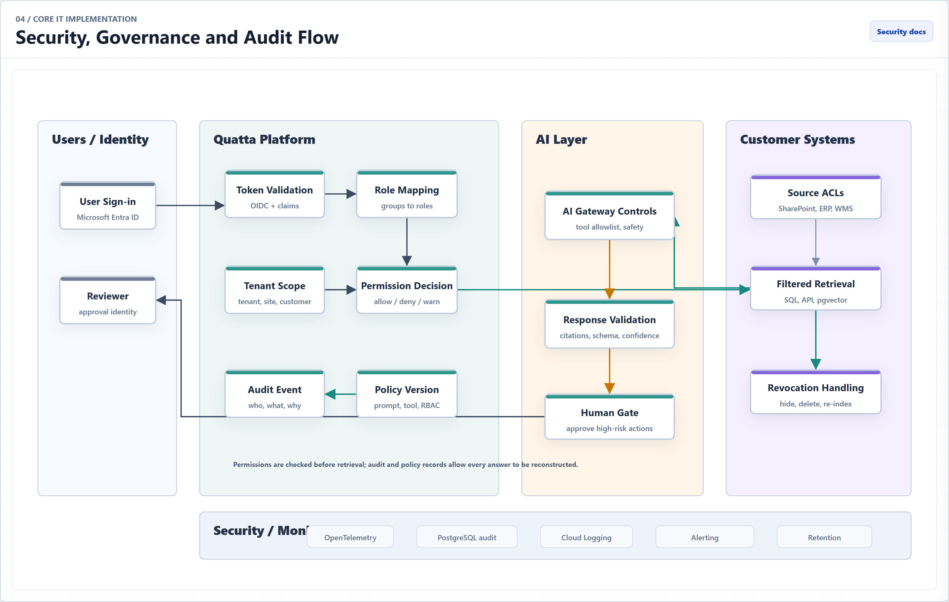
Notes:
Quatta architecture diagram: Security, Governance and Audit Flow

Slide 5
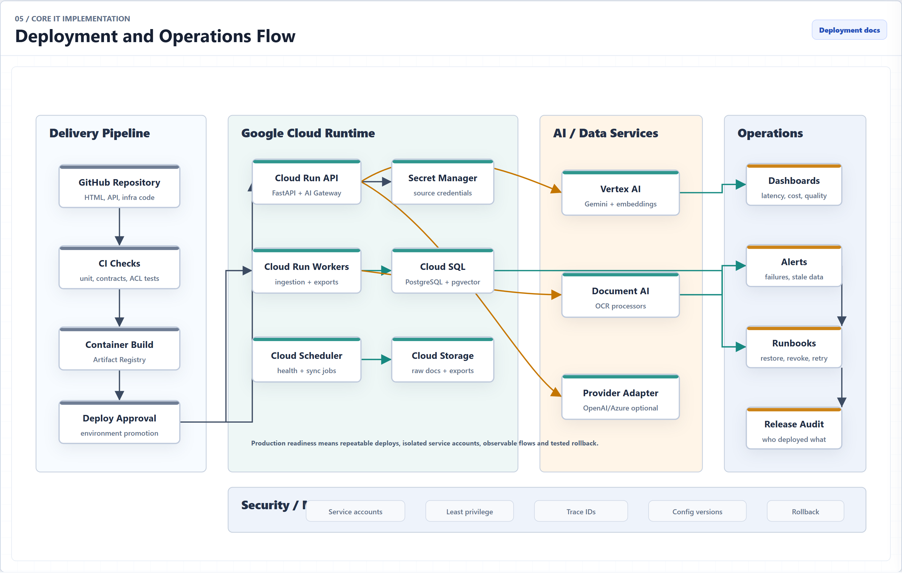
Notes:
Quatta architecture diagram: Deployment and Operations Flow

Slide 6
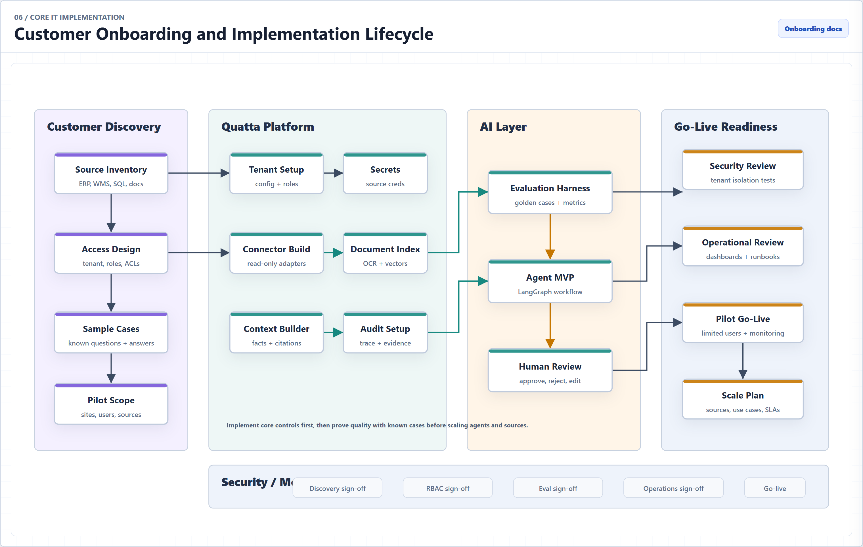
Notes:
Quatta architecture diagram: Customer Onboarding and Implementation Lifecycle

Slide 7
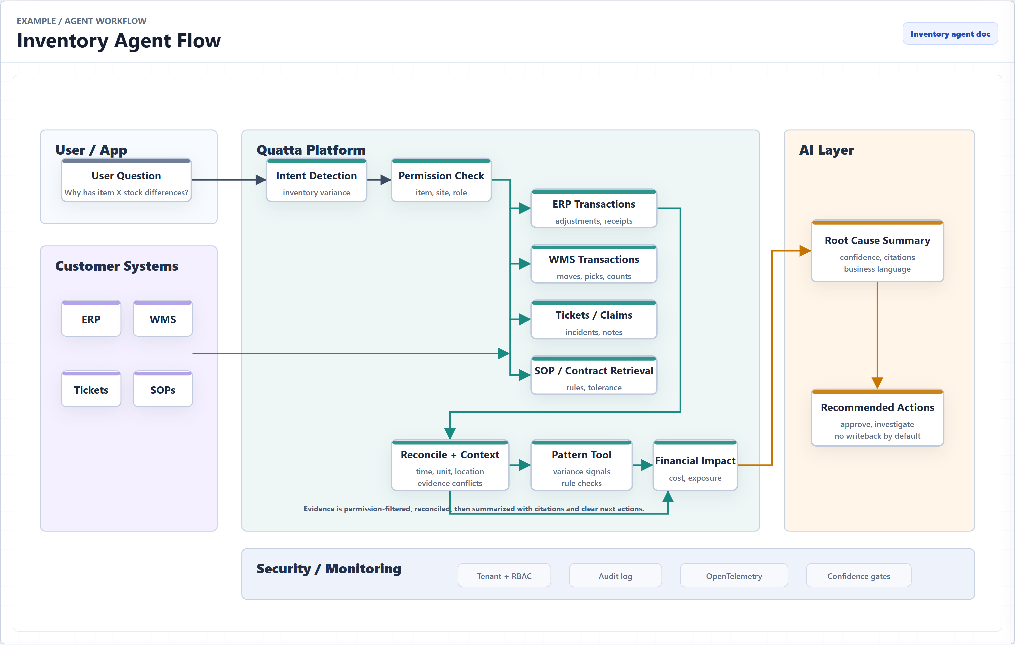
Notes:
Quatta architecture diagram: Example: Inventory Agent Flow

Slide 8
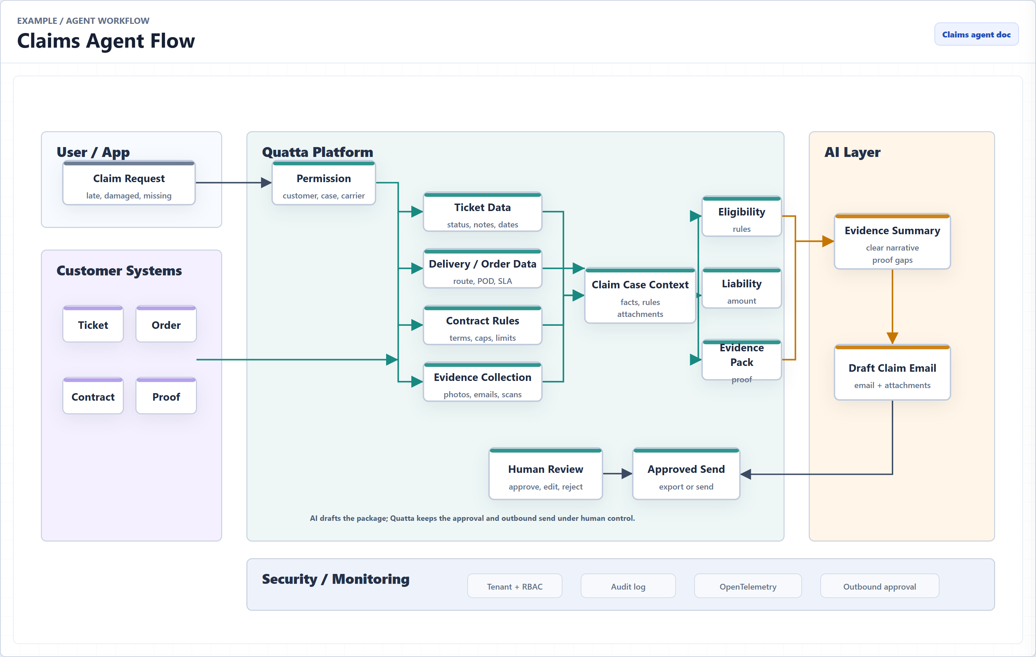
Notes:
Quatta architecture diagram: Example: Claims Agent Flow

