Slide 1
Collision detection on the GPU using CUDA
Nicky Advokaat
Tim van Dalen
Jules Wulms

Slide 2
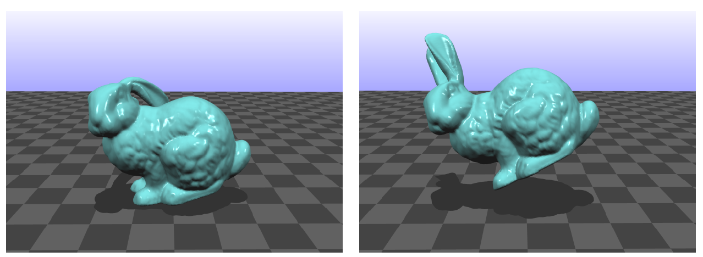
Context
Simulating deformable models
Tetrahedal elements

Slide 3
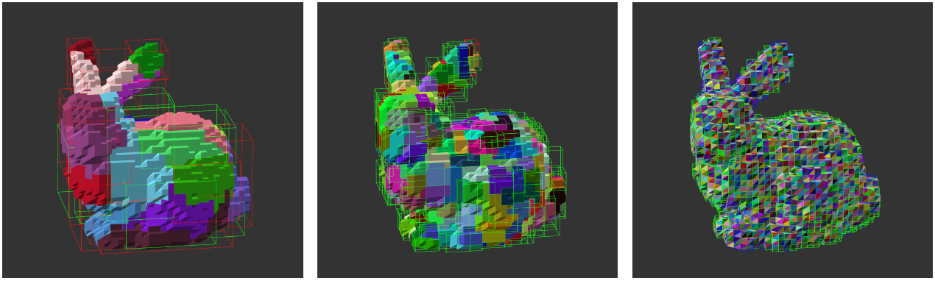
Problem Description
Collision Detection
Bounding Volume Hierarchy (BVH)
Detecting all possible collission pairs
Edge – Edge, Vertex – Face

Slide 4
Detecting all collision pairs
Detect all Face – Face potential collision pairs
{ Face – Face }
Conversion
{ Vertex – Face, Edge – Edge }

Slide 5
CPU Implementation
Task: transform CPU implementation to CUDA
Output
potentialVertexFace
Array nVertices * maxSize
potentialEdgeEdge
Array nEdges * maxSize
Issues
Unbalanced thread distribution
Pairs without intersecting bounding boxes

Slide 6
Approach
No GL on GPU cluster
Strip CPU implementation of GUI
Just run the collision detection routine once

Slide 7
Measuring
<sys/time.h>
Ms since unix epoch
Measure before and after

Slide 8
Hardware
gpucluster.ele.tue.nl
Node 2
Intel 8 core
nVidia GTX 570 (480 core)

Slide 9
Progress
A lot of data
Access to a lot of objects of host required

Slide 10

Questions?

