Slide 1
Collision detection on the GPU using CUDA
Nicky Advokaat
Tim van Dalen
Jules Wulms

Slide 2
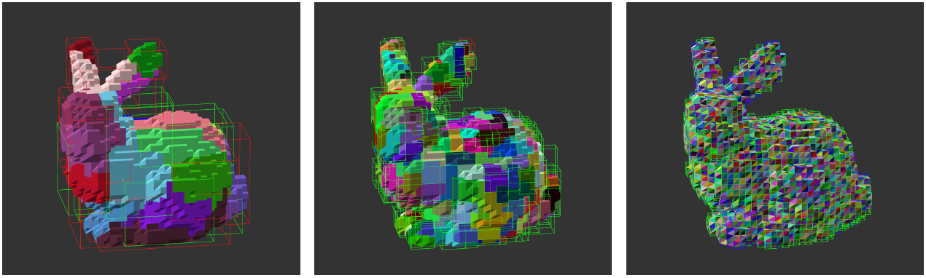
Problem Description
Collision Detection
Bounding Volume Hierarchy (BVH)
Detecting all possible collission pairs
Edge – Edge, Vertex – Face

Slide 3
Detecting all collision pairs
Detect all Face – Face potential collision pairs
{ Face – Face }
Conversion
{ Vertex – Face, Edge – Edge }

Slide 4
CPU Implementation
Task: transform CPU implementation to CUDA
Input
potentialFaceFace
Array nFaces * maxSize
Output
potentialVertexFace
Array nVertices * maxSize
potentialEdgeEdge
Array nEdges * maxSize

Slide 5
Solution
Sequential CPU -> parallel GPU implementation
We have to address concurrent access to variables
Concurrent access to output arrays
Using atomicAdd() on indexing array
Each thread gets unique index for output array
Create a mapping to parallel threads on GPU
16 x 16 threads per block
(nFaces / 16) x (maxSize / 16) blocks
Maximum of 65535 blocks in one dimension

Slide 6
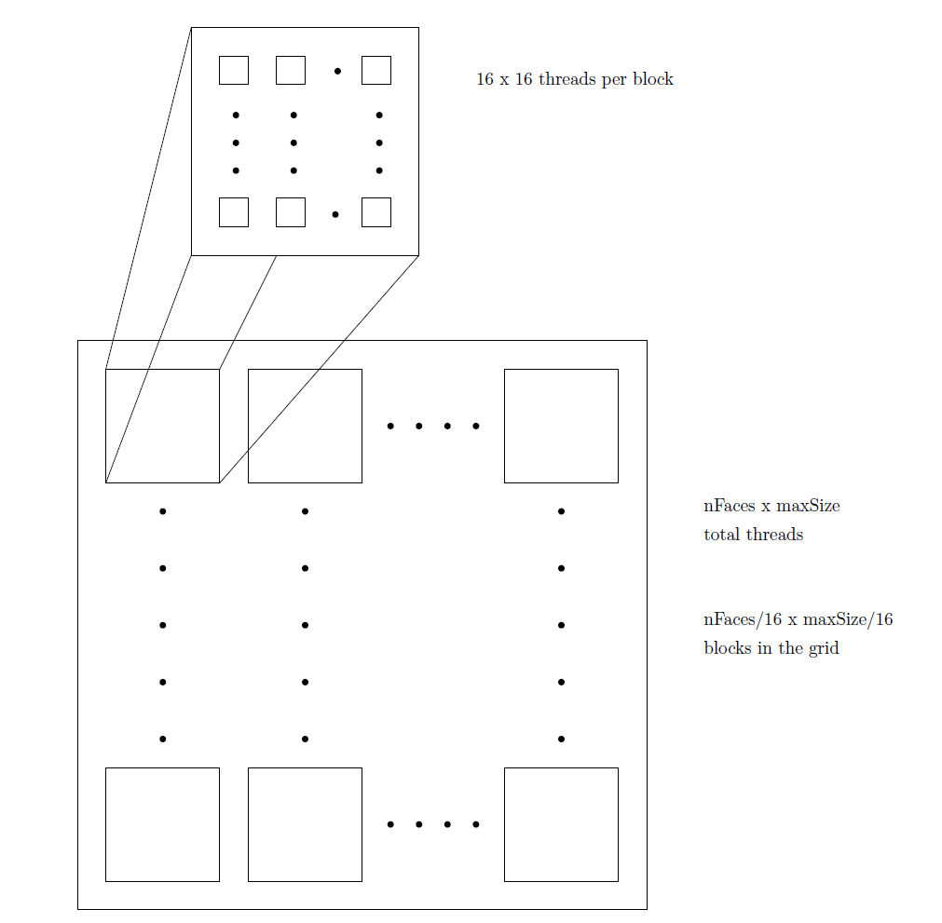
Solution

Slide 7
Solution
Balance edge-edge pairs in output
1| 2, 3, 4, 5 1| 3, 5 if A+B is even
2| 3, 4, 5 2| 1, 4 store at A
3| 4, 5 -> 3| 2, 5 else
4| 5 4| 1, 3 store at B
5| 5| 2, 5
(assuming A<B)

Slide 8
Solution
Memory fills up with all data:
Input
face-face pairs (nFaces*maxSize)
indexing array (nFaces)
Working data
Mappings (faces -> vertices, faces -> edges, edges -> vertices, vertices -> 3D points)
Bounding Boxes (collision for faces + need mapping)
Output
Vertex-face pairs (nVertices*maxSize)
Edge-edge pairs (nEdges*maxSize)
Indexing arrays (nVertices & nEdges)

Slide 9
Solution
What can we do to free memory?
Input
Work with batches, divide face-face pairs
Working data
All mappings for faces/edges/vertices needed
Not all bounding boxes (Only take leaves for faces!)
Output
Each face maps to arbitrary edge/vertex, so we need whole output array

Slide 10
Approach
No GL on GPU cluster
Strip CPU implementation of GUI
Just run the collision detection routine once

Slide 11
Measuring
<sys/time.h>
μs since unix epoch
Measure before and after
Not guaranteed to be correct => take multiple samples

Slide 12
Hardware
gpucluster.ele.tue.nl
Node 2
Intel 8 core
nVidia GTX 570 (480 core)

Slide 13
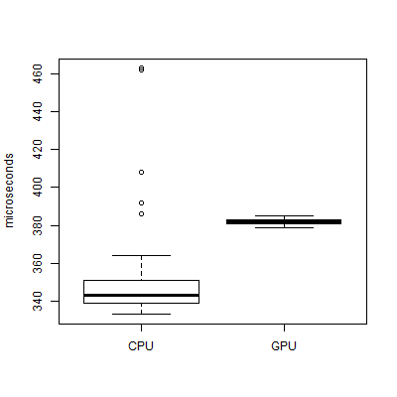
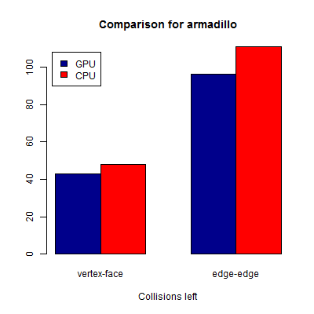
Armadillo

Slide 14
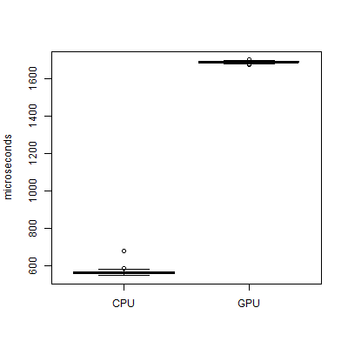
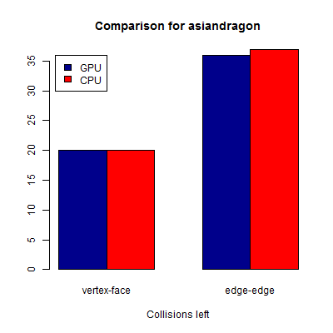
Asian dragon

Slide 15
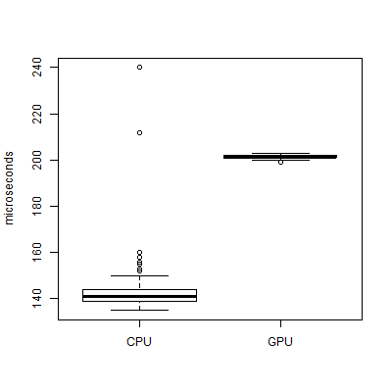
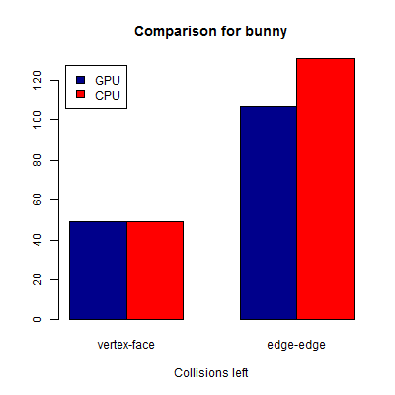
Bunny

Slide 16
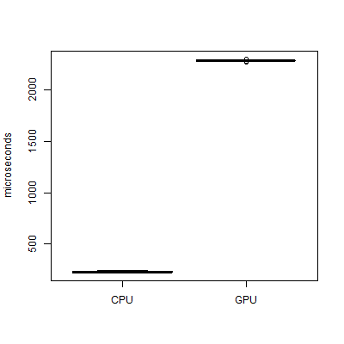
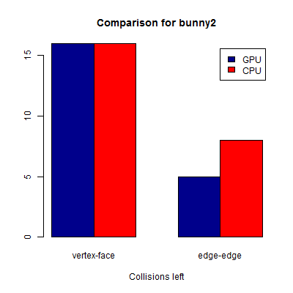
Bunny2

Slide 17
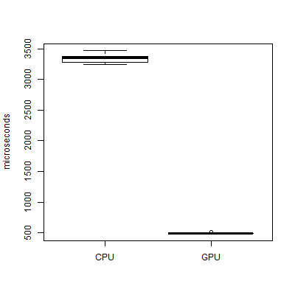
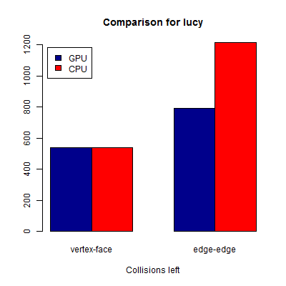
Lucy

Slide 18
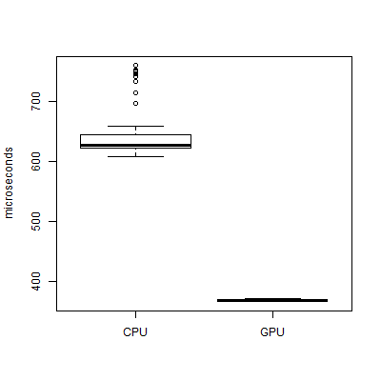
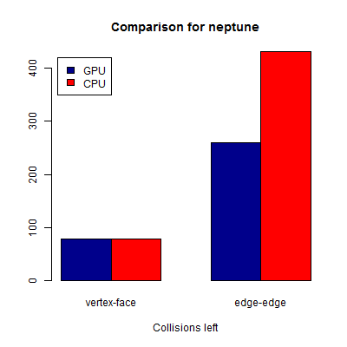
Neptune

Slide 19
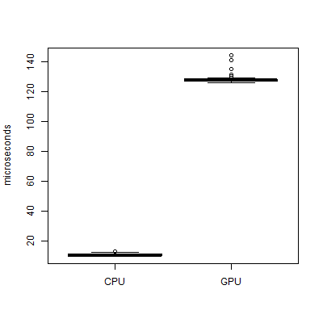
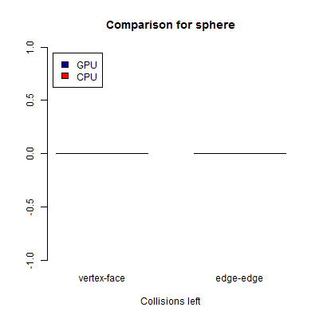
Sphere

Slide 20
Progress
A lot of data
Access to a lot of objects of host required

Slide 21

Questions?

