Slide 1
Collision detection on the GPU using CUDA
Nicky Advokaat
Tim van Dalen
Jules Wulms

Slide 2
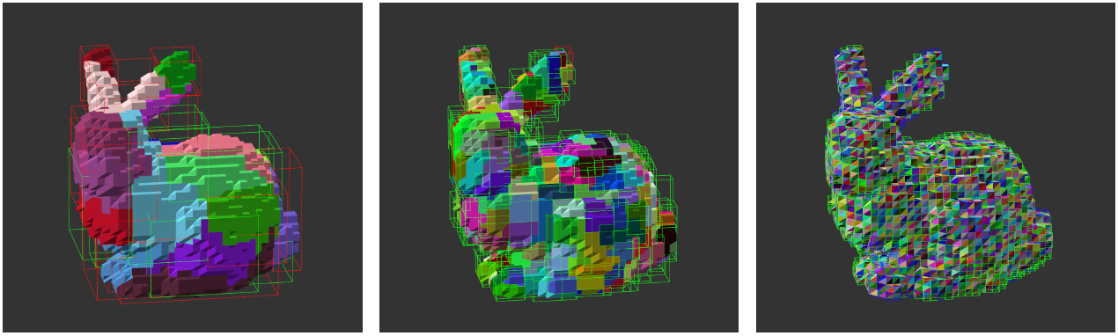
Problem Description
Collision Detection
Bounding Volume Hierarchy (BVH)
Detecting all possible collission pairs
Edge – Edge, Vertex – Face

Slide 3
Detecting all collision pairs
Detect all Face – Face potential collision pairs
{ Face – Face }
Conversion
{ Vertex – Face, Edge – Edge }

Slide 4
CPU Implementation
Task: transform CPU implementation to CUDA
Input
potentialFaceFace
Array nFaces * maxSize
Output
potentialVertexFace
Array nVertices * maxSize
potentialEdgeEdge
Array nEdges * maxSize

Slide 5
Solution
Sequential CPU -> parallel GPU implementation
We have to address concurrent access to variables
Concurrent access to output arrays
Using atomicAdd() on indexing array
Each thread gets unique index for output array
Create a mapping to parallel threads on GPU
16 x 16 threads per block
(nFaces / 16) x (maxSize / 16) blocks
Maximum of 65535 blocks in one dimension

Slide 6
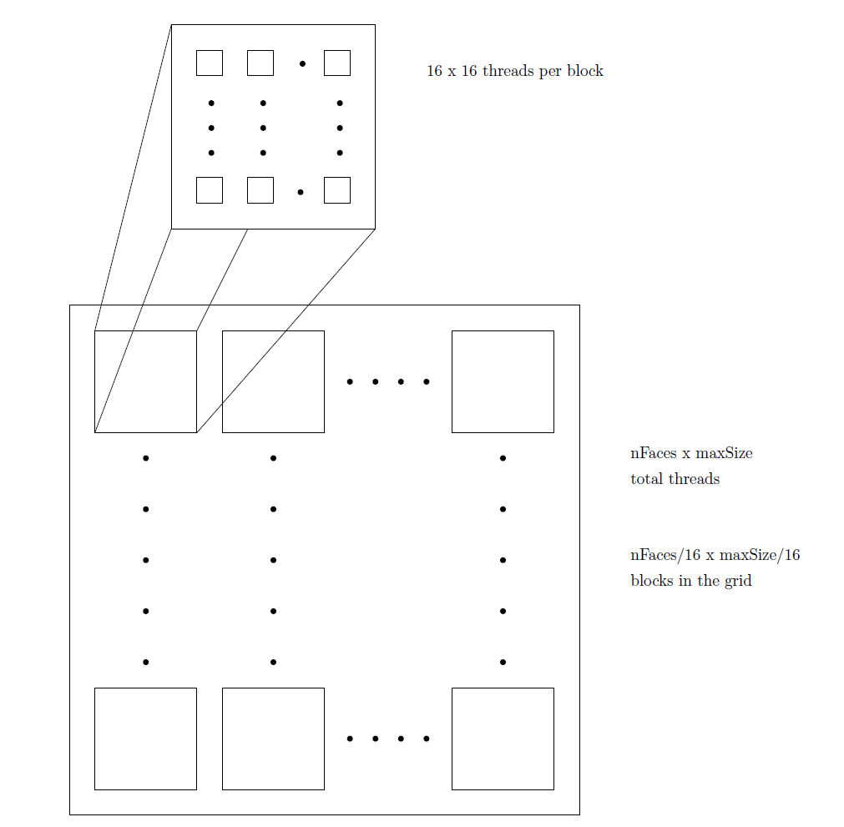
Solution

Slide 7
Solution
Balance edge-edge pairs in output
1| 2, 3, 4, 5 1| 3, 5 if A+B is even
2| 3, 4, 5 2| 1, 4 store at A
3| 4, 5 -> 3| 2, 5 else
4| 5 4| 1, 3 store at B
5| 5| 2, 5
(assuming A<B)

Slide 8
Solution
Memory fills up with all data:
Input
face-face pairs (nFaces*maxSize)
indexing array (nFaces)
Working data
Mappings (faces -> vertices, faces -> edges, edges -> vertices, vertices -> 3D points)
Bounding Boxes (collision for faces + need mapping)
Output
Vertex-face pairs (nVertices*maxSize)
Edge-edge pairs (nEdges*maxSize)
Indexing arrays (nVertices & nEdges)

Slide 9
Solution
What can we do to free memory?
Input
Work with batches, divide face-face pairs
Working data
All mappings for faces/edges/vertices needed
Not all bounding boxes (Only take leaves for faces!)
Output
Each face maps to arbitrary edge/vertex, so we need whole output array

Slide 10
Approach
No GL on GPU cluster
Strip CPU implementation of GUI
Just run the collision detection routine once

Slide 11
Measuring
<sys/time.h>
Ms since unix epoch
Measure before and after

Slide 12
Hardware
gpucluster.ele.tue.nl
Node 2
Intel 8 core
nVidia GTX 570 (480 core)

Slide 13
Progress
A lot of data
Access to a lot of objects of host required

Slide 14

Questions?

