Slide 1


Case Study: AI in Fraud Detection at Amegy Bank
This presentation outlines the transformative use of AI at Amegy Bank. It covers technology, benefits, challenges, and recommendations. This case study illustrates how financial institutions can protect assets. It also explains how to reduce losses using AI.
by Timothy Williams

Slide 2
Introduction to AI in Fraud Detection
Amergy Bank uses AI to fight fraud. This is critical with rising digital transactions and complex tactics.
AI offers a strong solution. It detects and prevents fraudulent activities effectively in real-time.
Fraud detection is crucial. It protects assets, maintains trust, and cuts losses. AI analyzes vast data and predicts fraud.

Slide 3

AI Technologies Utilized
1
Machine Learning (ML)
Analyzes data for fraud patterns.
2
Graph Neural Networks (GNNs)
Maps relationships to find fraud rings.
3
Natural Language Processing (NLP)
Detects fraudulent text.
4
Real-Time Monitoring
Flags suspicious activity fast.

Slide 4

Quantitative Benefits of AI
100M
Significant
Fewer
Loss Prevention
Fraud Reduction
False Positives
AI implementations have prevented losses exceeding $100 million annually.
AI systems reduce fraud by early anomaly detection.
Improved accuracy reduces unnecessary transaction flags.

Slide 5




Qualitative Benefits
Customer Trust
Scalability
Proactive Prevention
Protection reassures customers.
Handles large transaction volumes.
Detects emerging tactics early.

Slide 6




Technical Challenges
Data Privacy
Sensitive data raises regulatory issues.
High Costs
AI systems need investment.
Algorithm Bias
Models can have uneven detection.

Slide 7

Operational Challenges
1
Legacy System Integration
Incorporating AI can be complex.
2
Skill Gaps
Expertise is often lacking.

Slide 8



Ethical Challenges
2
Fair Treatment
1
Human Oversight
Automation Balance
3
Balancing automation with human oversight is key. This ensures fair treatment of flagged transactions. This challenge remains an ongoing concern.

Slide 9

Conclusion
AI transforms fraud detection at Amergy Bank. It offers real-time monitoring and enhanced accuracy.
It also provides scalability and reduces costs. Address challenges like costs and data privacy for best results.

Slide 10

Recommendations
Continuous Training
Transparency
Regulatory Compliance
Train staff to manage AI systems.
Ensure transparency in AI decisions.
Comply with data privacy laws.
Address these challenges proactively. Financial institutions can then replicate Amergy’s success.

Slide 11

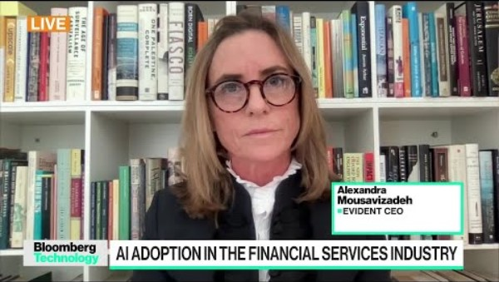
Amegy Bank, a leading financial institution, has integrated artificial intelligence (AI) to combat fraud. AI's real-time data analysis helps detect and prevent fraudulent activities, protecting customer assets, maintaining trust, and reducing financial losses.
AI has proven transformative for fraud detection at Amegy Bank, offering real-time monitoring, enhanced accuracy, and scalability while reducing operational costs and fraud incidents. However, challenges such as high implementation costs, data privacy concerns, and algorithmic biases must be addressed for optimal results.

