Slide 1
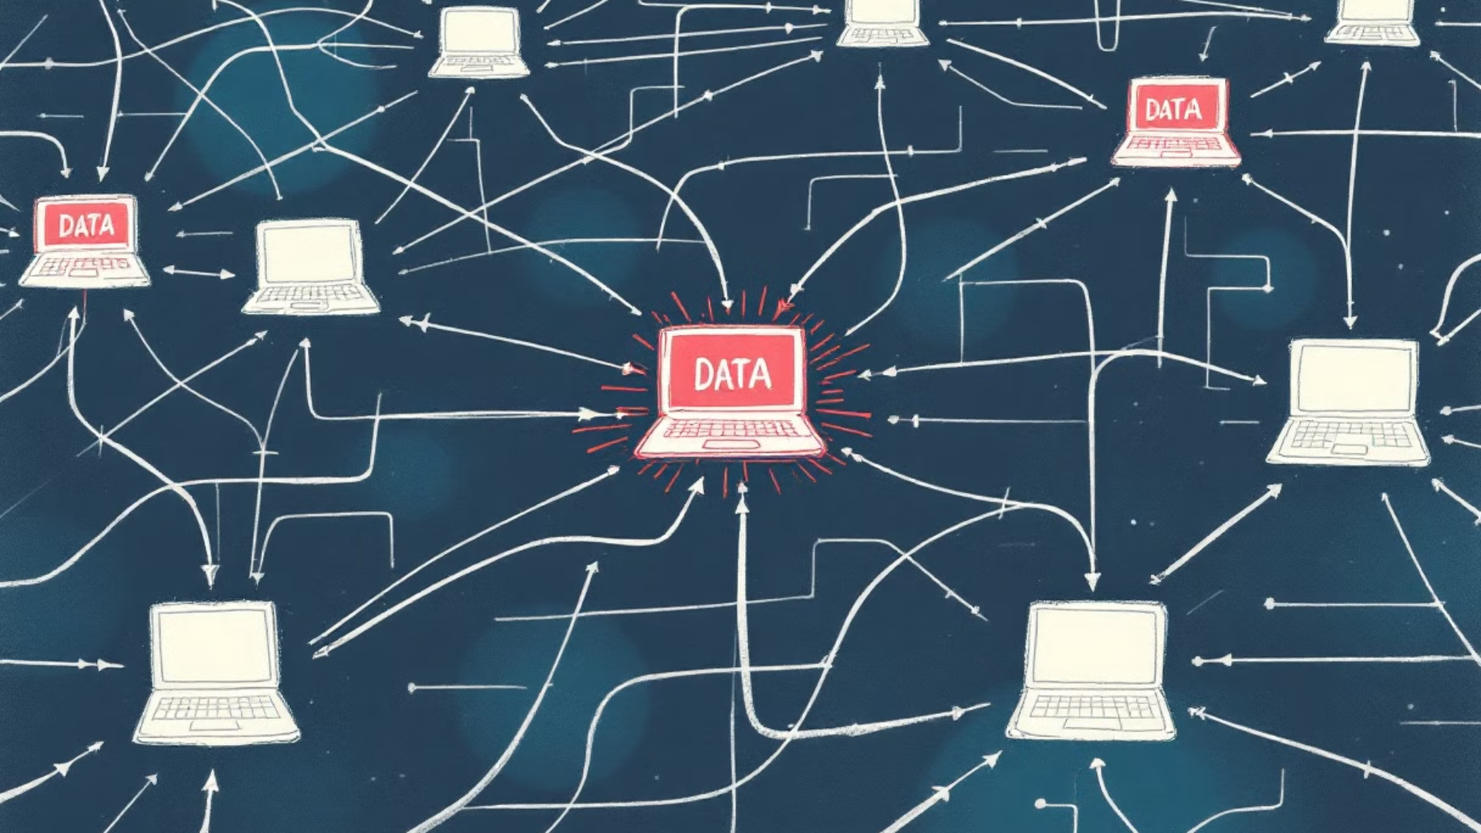
Third-Party Breaches: A Growing Threat to the Financial Sector
By: Timothy Williams
A staggering 97% of leading U.S. banks were affected by third-party data breaches in 2024. While specific data on the percentage of banks using third-party companies outside the country is unavailable, it's clear that a significant portion of the U.S. banking sector relies on external service providers for various operations.
Monitor External Attack Surfaces
Identify Single Points of Failure
Automatically Detect New Vendors
Execute automated scanning to uncover IT infrastructure and cybersecurity vulnerabilities throughout vendor and partner environments.
Chart essential business processes and technologies to pinpoint any single points of failure. Compile a watch list featuring these vendors.
Passively observe vendors' IT deployments to pinpoint and address concealed supply chain vulnerabilities.
Research indicates that a significant number of data breaches in the finance sector occur via third-party companies, with 61% of organizations experiencing a third-party data breach in the previous year. These statistics highlight the considerable threat posed by third-party breaches to the financial sector, demanding strong risk management practices to reduce their consequences.

