Slide 1


WikiLeaks: Exposing Truth or Threatening Security?
WikiLeaks, a non-profit media organization, was founded in 2006. Julian Assange sought to bring important news to the public. WikiLeaks publishes classified documents and media. It aims to expose human rights violations, corruption, and government misconduct. The organization has faced significant debate and legal challenges.
by Timothy Williams

Slide 2




WikiLeaks' Mission and Purpose
Global Reach
Anonymous Sources
Exposing Wrongdoing
WikiLeaks seeks to bring important news to a global audience.
Publishes classified documents from anonymous sources.
Aims to reveal human rights violations and corruption.

Slide 3
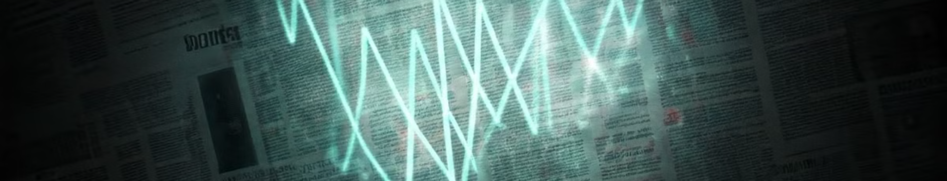
Major Releases by WikiLeaks
1
Collateral Murder
2
War Logs
2007 Baghdad airstrike footage exposed civilian deaths.
Afghanistan and Iraq war logs revealed war details.
3
Diplomatic Cables
4
Email Leaks
US diplomatic cables disclosed international relations.
Emails from governments exposed internal communications.

Slide 4

Impact and Controversies
WikiLeaks has significantly impacted human rights discussions and political events, particularly the 2016 US election, while facing criticism for potentially compromising national security and promoting conspiracy theories.
Human Rights
US Election
Criticism
Exposed serious violations of human rights and civil liberties.
Influenced the 2016 US election with DNC email releases.
Criticized for promoting conspiracy theories. Some believe WikiLeaks compromises national security.

Slide 5




Technical Infrastructure
Rebuilt Security
Following security breaches, WikiLeaks' infrastructure was rebuilt by "The Architect," enhancing encryption and anonymity measures for data handling.
Multiple Servers
To avoid censorship and legal action, WikiLeaks distributes its servers across various countries with strong protections for freedom of speech.
Insurance Files
Large, encrypted "insurance" files are created as a precautionary measure; these are released if WikiLeaks or Julian Assange face existential threats, ensuring continued transparency.
Notes:
WikiLeaks: A Global Platform for WhistleblowingWikiLeaks is a non-profit media organization founded by Julian Assange in 2006, dedicated to publishing classified and sensitive documents from anonymous sources13. Created as a secure platform for whistleblowers, the organization aims to bring important and often hidden information to public attention5.Key Founding DetailsFounded by Julian Assange, an Australian computer programmer and activist
Registered domain in 1999, but actively launched in 2006
Designed as an "uncensorable system for untraceable mass document leaking"5
Initial CharacteristicsInitially used a wiki model allowing site editing (which was later changed)
First publication in December 2006 was an unverified document from a Somali rebel leader
Rapidly grew to over 1.2 million documents in its first year3
Organizational Philosophy
Assange envisioned WikiLeaks as a platform practicing "scientific journalism" - providing primary source materials with minimal editorial commentary2. The organization seeks to expose governmental, corporate, and institutional secrets while protecting the identities of its sources3.

Slide 6

Challenges and Current Status
Submission Offline
1
System was offline from 2010 to 2015.
2
Funding Issues
Faces funding restrictions and legal challenges.
Limited Publication
3
Limited ability to publish due to Assange's imprisonment.

Slide 7




The Debate: Public Good or Security Risk?
Empowerment
Accountability
WikiLeaks empowers citizens by providing access to information that would otherwise be hidden, promoting transparency and informed public discourse.
It serves as a tool for holding governments and organizations accountable for their actions, potentially deterring misconduct and corruption.
1
2
Propaganda
Security Risk
Some view WikiLeaks as a platform for spreading propaganda and disinformation, potentially manipulating public opinion and undermining democratic processes.
4
Critics argue that WikiLeaks poses a significant security risk by publishing classified information, which could endanger individuals and compromise national security.
3

Slide 8

Key Takeaways
WikiLeaks' complex impact, ongoing societal debate, and continued legal challenges are key aspects to consider.
Complex Impact
Ongoing Debate
WikiLeaks has a complex global impact.
Debate continues over its role in society.
Legal Challenges
It continues to face legal challenges.

