Slide 1

BPDPKS Strategic Support
For
Palm-Based Renewable Energy Development
Palm Oil Plantation Fund Management Agency (BPDPKS)
February 2020

Slide 2
1.
Palm Oil Plantation Fund Management Agency:
Tasks and Functions

Slide 3
Vision dan Mission of BPDPKS
VISION
“To become a trusted fund management agency in the development of sustainable palm oil as a national strategic commodity for the welfare of the people of Indonesia.”
MISSION
Implementing Government policies in sustainable palm oil development programs through the collection and development and distribution of integrated and effective palm funds, professionally and accountably, for the benefit of :
Human Resource Development;
Research and development;
Promotion;
Rejuvenation;
Facilities and infrastructure;
Meeting Food Needs;
Downstream Oil Palm Plantation Industry;
Provision and Utilization of Biofuels

Slide 4
Legal Basis for the Establishment of BPDPKS
1
Law No. 17 of 2003 about State Finance
6
Presidential Regulation No. 61 of 2015 jo. Presidential Regulation No. 24 of 2016 jo. Presidential Regulation No. 66 of 2018 about Collecting and Using Palm Oil Plantation Funds
2
Law No. 1 of 2004 about the State Treasury
7
Regulation of Minister of Finance (PMK) No. 113 of 2015 about the Organization and Work Procedures of BPDPKS
3
Law No. 39 of 2014 about Plantation
4
PP No. 23 of 2005 jo. PP No. 74 Tahun 2012 about financial management of public service bodies
8
Decree of Minister of Finance (KMK) No. 650 of 2015 about the Establishment of BPDPKS as Public Service Agency
5
PP No. 24 of 2015 about Funding Plantation
9
PMK No. 136 of 2019 regarding the BPDPKS Service Tariff as Public Service Agency

Slide 5
BPDPKS Organizational Structure
(Regulation of Minister of Finance No. 113/PMK.01/2015)
Coordinating Ministry for Economics
Ministry of Agriculture
Ministry of Industry
Ministry of Trade
Ministry of Energy & Mineral Resources
Ministry of Finance
Professional
Professional
Professional
Coordinating Minister for Economics
Minister for Agriculture
Minister for Finance
Minister for Industry
Minister for Trade
Minister for Energy & MR
Minister for SOE
Minister for National Dev’t/ Bappenas
Professional
Professional
Professional
Steering Comittee
Supervisory Board
Board of Directors
CEO
Internal Auditor Unit (SPI)
Director of Finance, General, Compliance and Risk Management
Director of Fund Disbursements
Director of Fund Collection
Director of Planning and Fund Management
Director of Partnership
Division of Fund and Accounting
Division of Services Program
Division of Fund Collection and CPO Contribution
Division of Biodiesel Development
Division of SME and Coop
Division of Human Resources
Division of Disbursement Unit
Division of Cost Collection
Division of Replanting, Reforestation, dan Promotion of Plantation
Division of Company
Division of Compliance and Risk Management
Division of HR Education, Training & Development
Division of Public Institution and Civil Society

Slide 6
2.
Funding Support Mechanism

Slide 7
BPDPKS Performance Supports the Indonesian Palm Sector
Based on Perpres No. 61/2015 jo. Perpres No.66/2018
BPDPKS performance is based on the ability to collect, manage and distribute funds. The funds channeled are expected to have an impact on improving the performance of the Indonesian palm oil sector.
Collecting Funds
Managing Funds
Distributing
Funds
Impact
BPDPKS Performance
BPDPKS Performance coperated with Program Owner
Amount of funds raised
Sources of funds collected
Fund management accountability
Fund management results
Innovation of Fund distribution program
Amount and uptake of funds that were successfully channeled
Distribution accountability
The success of program implementation
Improving the performance of the palm oil sector: (1) Stabilization of the Price, (2) Improvement of Farmers' Welfare, (3) Development of a sustainable palm oil industry

Slide 8
3.
Biodiesel Fund Support: Background

Slide 9





Background: Commitment to SDGs
The use of palm-based biodiesel supports SDGs
Play a role in the development of renewable energy and reducing emissions
Support the moratorium not to add new palm plantations
Support forest fire prevention efforts
The use of palm-based biodiesel will create jobs, especially in rural areas
Supporting energy security through the use of renewable energy
Has an important role in economic development, creating jobs and saving foreign exchange

Slide 10
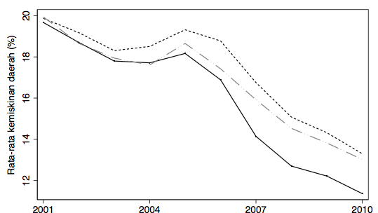
Background: Poverty Alleviation
Since 2000, the Indonesian Palm Oil Sector has helped 10 million people move out from poverty due to factors related to oil palm expansion and at least 1.3 million people in rural areas came out from the poverty line due to oil palm expansion.
20
10
18
million
16
People
Average Poverty Level (%)
14
Region with palm oil expansion
Move out from the poverty line due to the development of the palm oil industry
National
Region with no palm oil expansion
12
2001
2004
2007
2010
Regions with palm oil expansion have more significant reduction of poverty
compare to other region and national.
Source : Ryan B. Edwards, Center on Food Security and the Environment, Stanford University &
The National Team For The Acceleration of Poverty Reduction (TNP2K), 2016

Slide 11
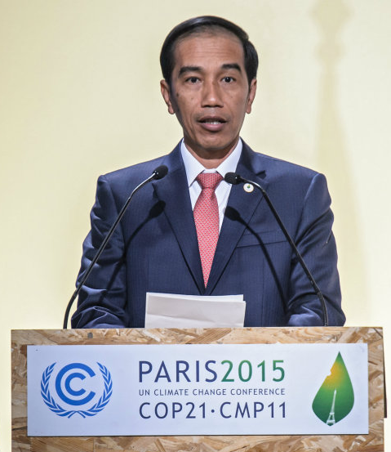





Target 23% renewable energy 2025 Meeting the target of 23% of the contribution of renewable energy in the total energy mix by 2025
Background – COP 21 Indonesia’s Commitment to International
Indonesia’s Commitment
Strategic Steps
Reduction of GHG Emission
Fulfill the government's commitment to reduce GHG emissions
Reducing Fuel Imports
Reducing fuel consumption and imports
Energy Independence
Increasing Energy Security and Independence
Balance of trade
Correcting the trade balance deficit
CPO Price Stabiliztion
Stabilizing the price of CPO through Biodiesel absorption
Save foreign exchange
Reducing fuel imports,
can save foreign exchange.
President Joko Widodo: Indonesia's commitment to reduce greenhouse gas (GHG) emissions by 29% under Business As Usual (BAU) in 2030 and up to 41% with international assistance (United Nations Framework Convention on Climate Change/UNFCCC - COP 21 in Paris 2015)
Downstreaming Oil Palm Industry
Increasing added value through downstream palm oil industry
‹#›

Slide 12
4.
Strategic Plan & Biodiesel Impact

Slide 13


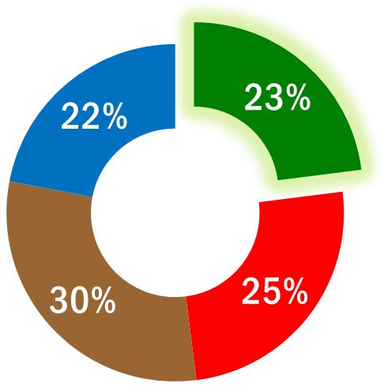


Strategic Plan: Stabilization of Palm & Renewable Energy Prices
The use of palm oil as biodiesel material helps Indonesia to realize the stabilization of oil palm prices, carrying out commitments in the environment including energy security
Indonesia Energy Mix by 2025
Renewable
Energy
Improve the performance of the Indonesian palm oil sector
Create Domestic Market
Natural Gas
400
Million TOE
Coal
Fossil Fuel
Absorb CPO excess in the market in the context of price stabilization
Improve the welfare of farmers

Slide 14
Improving the Performance of the Palm Sector: Strategic Plan
In order to support the Government's efforts to create CPO price stability, improve the performance of the Indonesian palm oil sector, improve farmers' welfare and use of renewable energy
CPO Price Stabilization
Farmers’ Welfare Improvement
Strengthening Downstream Industry
1
2
3
Consolidation Data of
Land Area and Palm Production [Improving data to find out more accurate CPO supply conditions]
Improving Support for Smallholder Palm Farmers through improved targeting
[Data Collection of Smallholder Palm Farmers
Palm Oil to
Bio-Hydrocarbon Fuel Conversion Program
[Research support for making catalysts, incentives for bio-hydrocarbon fuel producers]
Acceleration of Domestic Palm Oil Absorption
[Full application of B20, acceleration of B30, Cooking Oil]
Support for Improvement of Smallholder Palm Oil Supply Chain / Improving Competitiveness
[Improving supply management from farmers to PKS, PKS competitiveness and Improved logistics infrastructure]
Support for other Downstream Programs
[Research Support, Incentives for the Oleochemical Industry]
Export Market Expansion
[China, Pakistan & Bangladesh]
Provision of information services to smallholders
[Provision of FFB Reference Prices and Oil Palm Farmers Applications]
Short and Mid Term
Long Term

Slide 15




Impacts of the Biodiesel Program
Success in increasing the use of renewable energy, reducing emissions, creating jobs and reducing the trade balance deficit
(August 2015 to December 2019)
Pengurangan Emisi Gas Rumah Kaca (GRK)
Penggunaan biodiesel dari minyak sawit semakin meningkat
Kontribusi Pendapatan Pajak (PPN)
Penghematan mata uang asing melalui pengurangan impor minyak
23.17 Miliar Ton
CO₂
15.49
Miliar KL
IDR2,74 Triliun
USD6.81
Billion
Implementation of this policy also increases CPO demand, stabilizes CPO prices and improves farmers' welfare through rising FFB prices

Slide 16
5.
Moving Ahead: Palm Oil-Based Biohydrocarbons

Slide 17
Next Stage Palm Oil Development for Renewable Energy
In addition to the mandatory biodiesel program by utilizing FAME, the palm oil conversion program into Bio-Hydrocarbon Fuel to produce Green Diesel, Green Gasoline and Green Fuel Jet has begun
`
Development of Biodiesel & Green Fuel
Biodesel Development Target
Current Program
FAME
20% full in 2018
30% in 2020
B20
September
2018
Biodiesel
Palm
Oil
Pilot Project in 2019
January
2020
B30
Development Plan
Green
Diesel
Green
Fuel
Green
Gasoline
B50
January
2021
Green
Fuel Jet (Avtur)
‹#›

Slide 18
Development Scenarios
Biodiesel and Biohydrocarbons
The government declared that starting in 2022, palm oil will be used optimally as fuel.
Not limited to diesel fuel (diesel) but also a raw material from gasoline and aviation fuel.
This policy is intended to maintain the stability of oil prices and reduce our dependence
on oil imports while still considering the guarantee of palm oil availability for food and exports.
2018
2020
2021
2022
Biodiesel
+
Biohydrocarbons
B20
B30
50%
Biodiesel
‹#›

Slide 19
6.
Determinants of Success of Palm-Based Biohydrocarbons:
BPDPKS Strategic Recommendations

Slide 20



Recommendation # 1: Preparation of Oil Palm Plantations
Improvement of farmers' skills
Preparation of Plantations
Plantations Management through
It is necessary to prepare independent smallholder-based plantations that specifically provide feedstock for the green fuel industry.
The implementation of Good Agricultural Practice (GAP), also ISPO in supporting the creation of a palm oil industry that pays attention to the environment
Special Seed
Quality improvement and expansion of the rejuvenation program
Preparation of seeds that produce fresh fruit with oil content in accordance with the needs of the green fuel industry
‹#›

Slide 21




Recommendation # 2: Distillation, Logistics and Distribution Facilities
Distillation Process
Logistics and Distribution Facilities
Distillation
Storage
Refinery
Co-
Processing
Green
Gasoline
Green
Diesel
Consumer
Gas Station
Taking into account current conditions, 3 types of refining processes are needed: (1) Co-Processing, (2) Green Gasoline, and (3) Green Diesel.
Logistics facilities that guarantee the availability of green fuel evenly and on time throughout Indonesia
Incentive and regulatory schemes are needed to encourage private involvement in this refining business
‹#›

Slide 22


Green Fuel
Incentive
Incentive Schemes for Vehicle Manufacturers
Facility Distribution
Public Education
In the initial stages it may be necessary to have an incentive scheme similar to the biodiesel scheme
Tax incentives or other types of incentives are given to vehicle manufacturers which make the price of cars using green fuel more affordable for the public
Provision of infrastructure that ensures public access to green fuel
Education that encourages people to switch to using renewable energy
‹#›

Slide 23
Thank You

Slide 24
Badan Pengelola
Dana Perkebunan
Kelapa Sawit Gedung Graha Mandiri Lt. 5 Jl Imam Bonjol 61,
Jakarta Pusat 10310
P : 021-39832091
E : bpdpsawit@bpdp.or.id W : www.bpdp.or.id
IMPORTANT NOTICE:
This presentation is delivered subject to the agreed term of BPDP Sawit
The presentation and the accompanying slide pack are provide solely for the benefit of the parties and are not to be copied, quoted or referred into in whole or in part without BPDP Sawit prior written consent
BPDP Sawit accept no responsibility to anyone other than the parties identified for the information contained in this presentation
The presentation, data and other written information provide by BPDP Sawit are specifically to be used for the project and restricted for public

