Slide 1

Deutsche Bank Global M365 Rollout & User Adoption
A global transformation of unified communications and collaboration — 16,000 employees, one modern platform.

Slide 2

Between 2020 and 2022, Deutsche Bank embarked on a major global transformation to modernise its unified communications and collaboration ecosystem. The goal: to move away from legacy telephony and conferencing platforms and fully leverage the organisation's Microsoft Office 365 subscription, delivering a seamless, modern user experience for its 16,000 employees worldwide.

Slide 3
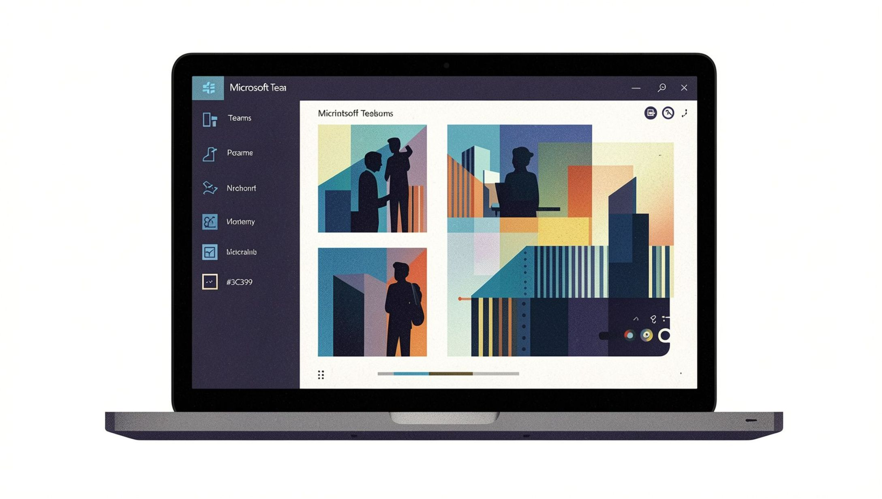
Programme Overview
The initiative focused on deploying Microsoft Teams as the central collaboration hub — integrating chat, voice, video, and document sharing into a single, secure environment.
The programme was designed not only as a technical rollout but as a cultural adoption journey, ensuring users embraced new ways of working across Deutsche Bank's global offices.

Slide 4

Key Deliverables
Unified Communications Transition
User Adoption Strategy
ServiceNow Integration
Developed and executed a structured adoption plan, including training, champions network, and multilingual support.
Embedded Teams and M365 workflows into ServiceNow, enabling streamlined IT support and request management.
Retired legacy telephony and conferencing platforms, migrating all users to Teams Voice and Meetings.

Slide 5
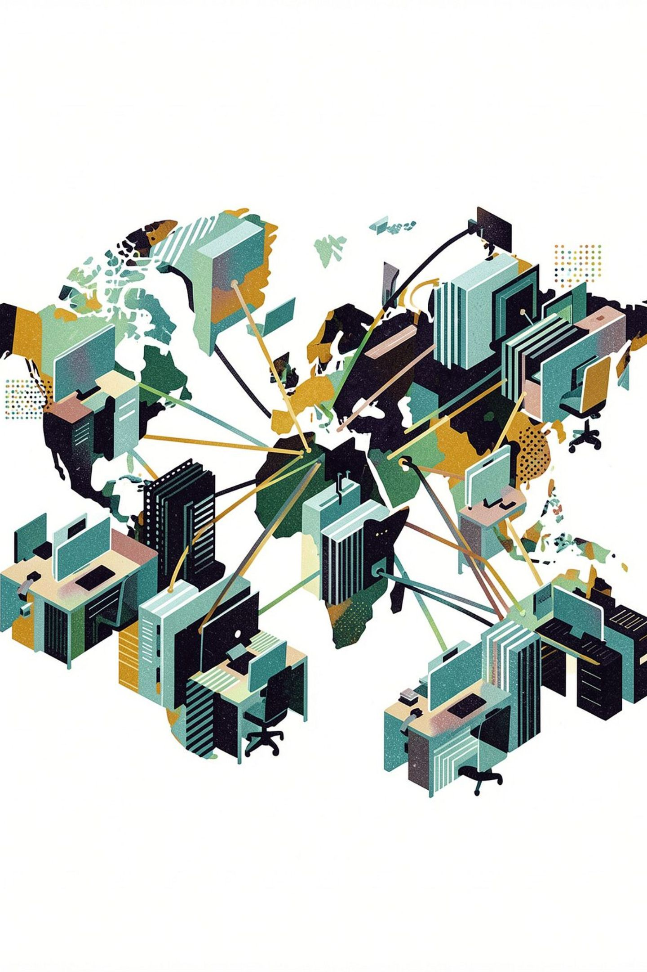
Key Deliverables (continued)
Performance & Reliability
Cost Optimisation
Achieved significant cost reductions through platform consolidation and licence rationalisation.
Delivered measurable gains in uptime, call quality, and collaboration speed.
Change Enablement
Partnered with business units to ensure smooth transition and sustained engagement post-go-live.

Slide 6
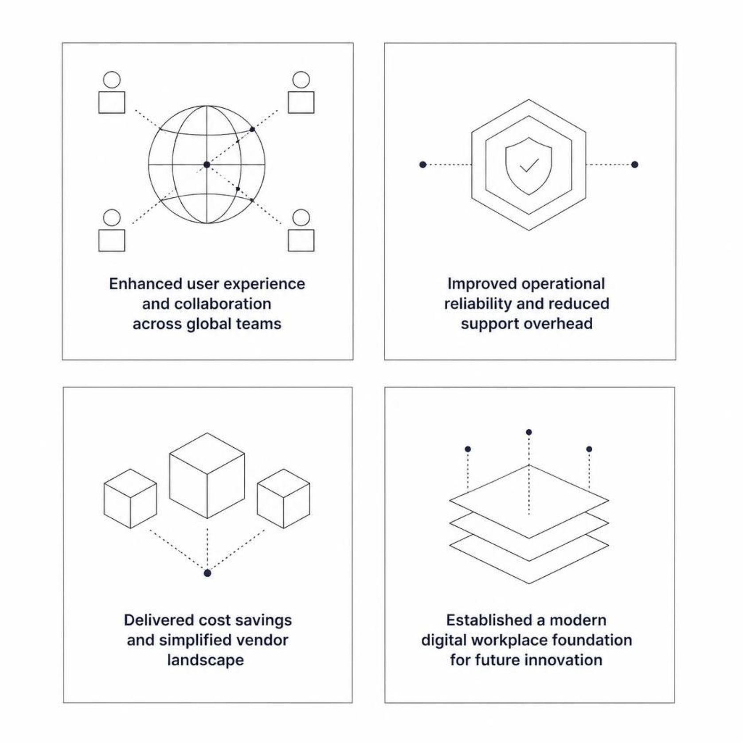
Outcomes
The Deutsche Bank M365 programme delivered measurable impact across four critical dimensions — from the day-to-day experience of employees to the long-term strategic positioning of the organisation's technology estate.
Enhanced user experience and collaboration across global teams
Improved operational reliability and reduced support overhead
Delivered cost savings and simplified vendor landscape
Established a modern digital workplace foundation for future innovation

Slide 7
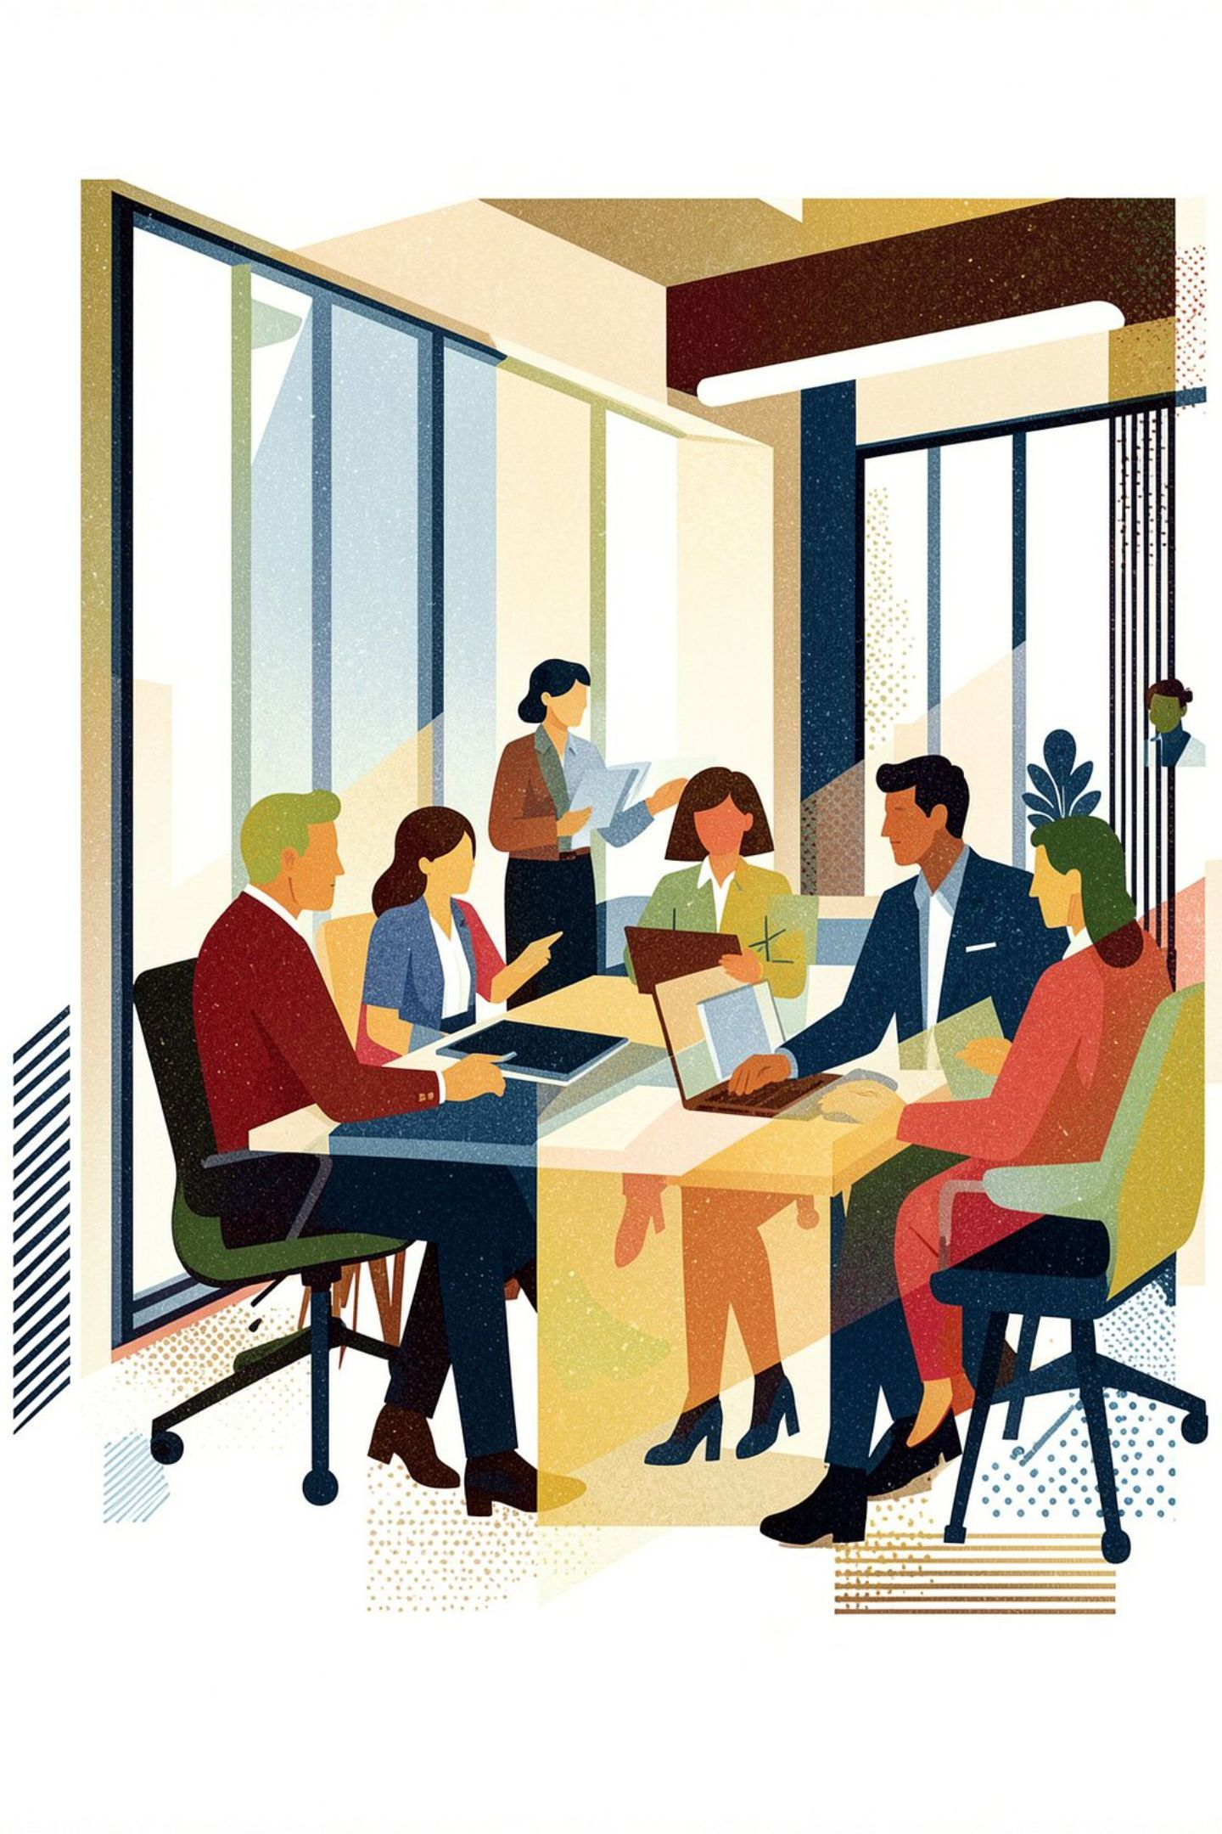
Result: A Modern, Connected, and Agile Workforce
The programme transformed Deutsche Bank's communication landscape — replacing fragmented legacy systems with a unified, cloud-based collaboration platform. It empowered employees to connect, share, and innovate securely from anywhere, aligning technology with the bank's strategic vision for agility and digital excellence.

Slide 8
Sources
DB.pdf

