Slide 1
Writing a dissertation
A step-by-step guide to structure
Notes:
These lectures slides are based on Scribbr’s Knowledge Base article “How to structure a dissertation,” which can be found here: https://www.scribbr.com/category/dissertation/
How to edit this presentation:
Click on “File” in the top-left corner.
Click on “Make a copy”
Select “Entire presentation”
Save the presentation in your personal Google Drive.
You can now edit the copy of this presentation!

Slide 2
What is a dissertation?
Notes:
This presentation will discuss the structure of a dissertation and how to approach writing each part.
First, let’s define the basic concept. What is a dissertation?

Slide 3
A dissertation is...
A long piece of academic writing
Based on original research
Usually submitted at the end of a degree
Tests your capacity for independent research
Sometimes called a thesis
Notes:
The dissertation is a long research and writing project you’ll usually do at the end of your degree.
Word counts vary by discipline, but it’s likely to be the longest academic text you’ve ever written.
The dissertation is an account of an independent, original piece of research you’ve designed and conducted yourself.
It tests your ability to conceive and complete an independent research project.
It’s worth noting that a dissertation is sometimes referred to as a thesis, or vice versa; the difference is usually between different levels of degree. In some places, “thesis” refers to the final project of a master’s degree, “dissertation” to the longer final project of a PhD; in other places, it’s the opposite.
Though the length and complexity vary, the basic structure of a dissertation is the same at any level.

Slide 4
What sections does a dissertation contain?
Notes:
Audience question: Do you have a good sense of the different parts of the dissertation? What sections are included?

Slide 5
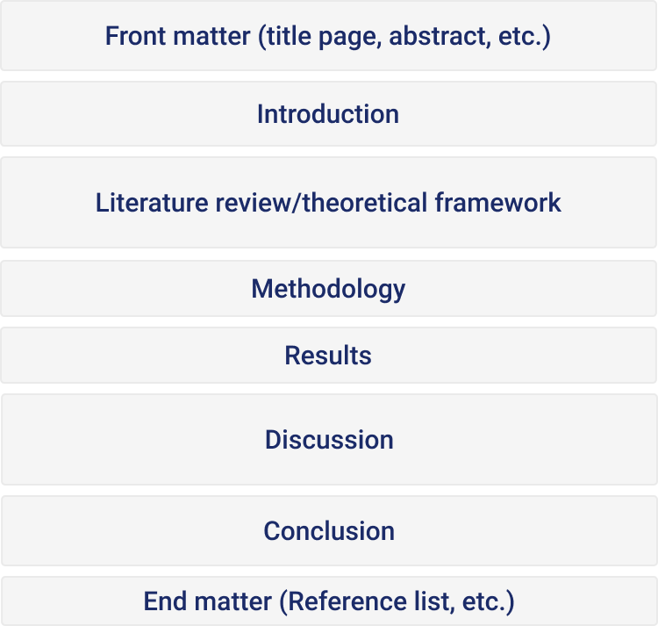
Notes:
The parts of a dissertation can be divided into three main sections: the front matter, the main text, and the end matter.
The different parts are visualized here according to their approximate sizes in the average dissertation.
The front matter is everything that comes before your introduction. This includes your title page, abstract, and table of contents; it might also include things like a list of figures and tables, list of abbreviations, and glossary.
The main text is the most important part of your dissertation—this is where you write up your research.
The main text is structured by chapters. For an empirical research project, your chapters will usually include an introduction, literature review, theoretical framework, methodology, results, discussion, and conclusion.
Finally, the end matter is what comes after the main text: your reference list or bibliography, and any appendices.

Slide 6
Check your guidelines!
The sections included vary
They may change based on your field…
...and the nature of your specific research
Check any guidelines you are given
Ask your supervisor if you’re unsure
Notes:
The sections included vary based on your field and the nature of your specific research.
Dissertations in the humanities, for example, can be much more flexibly structured.
Within the sciences and social sciences, different sections may sometimes be combined or differently titled.
It’s important to know which sections you do and do not need to include. Consult any guidelines you are given and follow established practice in your field.
Ask your supervisor if you’re still not sure which parts to include.

Slide 7
Front matter
Notes:
Let’s go through each section in the order they appear (though that’s not necessarily the order you’ll write them in).
To start with, we’ll look at the parts that make up the front matter.

Slide 8
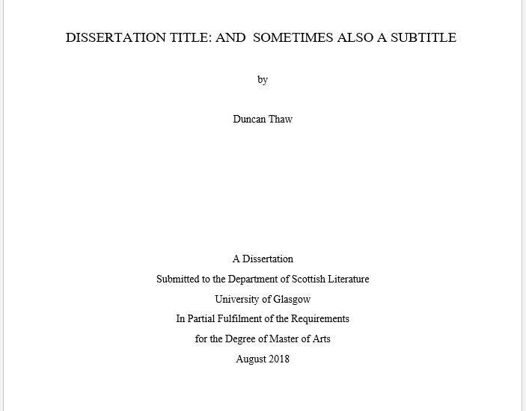
Title page
Dissertation title
Your name
Type of document
Department and institution
Degree program
Date of submission
Notes:
The title page is the very first page of your dissertation.
It’s something like the title page of a book: It includes the dissertation’s title and the name of the author (you!).
It usually lists your department, institution, and program, and the date of submission or graduation.
It sometimes also includes other information, such as your supervisor’s name and copyright information.
The exact requirements might vary depending on your department. Always check the guidelines, and use a template if your department provides one.
“Dissertation title page” article: https://www.scribbr.com/dissertation/title-page/

Slide 9
Acknowledgements
Less formal, more personal
No longer than a page
Thank people who helped you complete your dissertation
E.g. supervisors, friends and family, pets!
Notes:
An acknowledgements section is optional. It’s a place for you to thank anyone who helped you complete your dissertation.
Because of this, it doesn’t have to be written as formally as the rest of your dissertation; feel free to express yourself personally!
You can thank whoever you want, from people who directly helped with the research to those who you were just glad to have around during the process.
Note that if you do include an acknowledgements section, you should always thank your supervisor(s).
Audience question: The next section, and a tricky one, is the abstract. Do you have a sense of what it’s for?
“Dissertation acknowledgements” article: https://www.scribbr.com/dissertation/acknowledgements/
“How to Write the Acknowledgements Section” video: https://www.youtube.com/watch?v=9qUQwk1EERk

Slide 10
Abstract
State the main topic and aims of your research
Describe the methods you used
Summarize the main results
State your conclusions
Not an introduction but a summary
Notes:
The abstract is a brief summary of your whole dissertation. It allows your reader to understand your topic and argument at a glance.
Your abstract should state the topic and aims of your research, describe your methods, summarize the key results, and state your conclusions.
An abstract is not the same as an introduction; you’re not just introducing your research here, but providing a summary of the whole text.
For this reason, the abstract should be written at the end, after you’ve completed the main text. You need to know the structure and content of your whole dissertation before you write it.
“How to write an abstract” article: https://www.scribbr.com/dissertation/abstract/

Slide 11
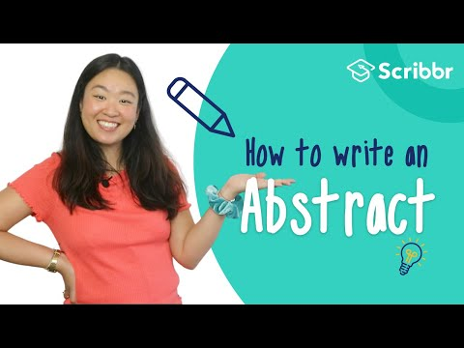
Notes:
An abstract can be a tough thing to write, since you have to pack a lot of information into a short space.
This video explores how to approach it in more detail.

Slide 12
Table of contents
Lists all sections that come after it
Can be auto-generated in Word
Clear, consistent headings
Notes:
The table of contents lists all the sections of your dissertation and the page numbers they appear on.
It does not list the title page, acknowledgements, or abstract, since these appear before it.
It can be tricky to format your table of contents manually and keep it up to date, so it’s recommended to use Word’s built-in table of contents generator to do it automatically.
Make sure that your headings are clear and consistently formatted throughout your text (in terms of things like numbering and capitalization) so that your table of contents reads well.
“Dissertation table of contents” article: https://www.scribbr.com/dissertation/table-of-contents/

Slide 13
Lists of figures and tables
Include if your dissertation has a lot of tables and figures
Tables and figures listed and numbered separately
Make sure all tables and figures are included
List in the order they appear in the text
Notes:
If you include a lot of tables and/or figures in your dissertation, it’s a good idea to include lists of each showing where they are located in the text.
Tables and figures each have their own separate numbering, and should appear in two separate lists here if you include both.
Make sure to include every table or figure that appears in the dissertation.
List them the order they appear in the text (the same order as they are numbered in).
A list of figures and tables should be formatted similarly to a table of contents.
“Figures and tables lists in your dissertation” article: https://www.scribbr.com/dissertation/figure-and-table-lists-in-your-dissertation/

Slide 14
List of abbreviations
Include if you use a lot of abbreviations
Define abbreviations here and in the main text
List alphabetically
Very well-known abbreviations not included
Notes:
Similarly, a list of abbreviations is worth including if you use a lot of abbreviations in your dissertation.
You should always define an abbreviation the first time you use it in the text, but it can also be helpful to the reader to have a comprehensive list to refer to.
Abbreviations should be listed and defined in alphabetical order (not the order they appear in the text).
For very well-known abbreviations that are used in everyday contexts, like “TV” and “USA,” there’s no need to define them either in the text or in the abbreviation list.
“List of abbreviations in the dissertation” article: https://www.scribbr.com/dissertation/list-of-abbreviations/

Slide 15
Glossary
Include if you use a lot of specialist terms
List terms alphabetically
Include a brief definition of each term
Consult with your supervisor to determine what terms you should define
Notes:
Finally, if you use a lot of specialist language that the reader may be unfamiliar with, a glossary might be included.
Terms are again listed alphabetically and defined in a concise manner.
Consult with your supervisor to see whether you should create a glossary and what terms should be included in it if so.
“Glossary of a dissertation” article: https://www.scribbr.com/dissertation/glossary-of-a-dissertation/

Slide 16
The main text
Notes:
With the front matter out of the way, it’s time to look at the parts that make up the main text of a dissertation.
This is the most substantial part of the text, and the part that will take the most careful writing and organization.

Slide 17
Introduction
Establish your research topic
Provide background information
Define the scope of your research
Show your work’s relevance
State your research questions and objectives
Give an overview of your structure
Notes:
The introduction is an important part of every dissertation. It tells your reader what your research is about and why it matters.
Start by presenting your topic in broad terms and providing relevant background information.
Then you can zoom in to define the scope of your research—which aspect of the topic are you focusing on?
In the introduction, it’s important to show the relevance of your work. The relevance might be practical, scientific, or both—you want to convince your reader that your dissertation is a worthwhile contribution to knowledge.
You can mention the current state of research and cite relevant sources here.
It’s also essential to state exactly what problem or question your research is addressing, and the specific objectives that you set out to achieve.
Finally, you’ll do some signposting—stating what each subsequent chapter will discuss to give the reader a general sense of your structure.
“How to write a dissertation introduction” article: https://www.scribbr.com/dissertation/introduction-structure/
“Developing strong research questions” article: https://www.scribbr.com/research-process/research-questions/
“Tips for writing an overview of your dissertation” article: https://www.scribbr.com/dissertation/tips-for-writing-an-overview-of-your-dissertation/

Slide 18
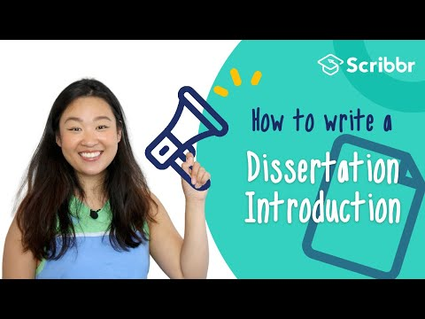
Notes:
There’s a lot of information to cover in your introduction, and it can be tough to do so effectively.
It’s often best to return to it later once you have a clearer idea of the rest of your text.
This video takes a closer look at the introduction.

Slide 19
Literature review
Search for sources
Select the most relevant
Critically evaluate sources
Make connections between them
Draw conclusions based on your review
Show how your own research builds on what you found
Notes:
The literature review is where you take a closer look at the literature on or around your chosen topic.
It’s often among the first parts you’ll write, and may even be assigned as a preliminary assignment before you start work on the dissertation itself. Your understanding of the literature will inform every other part of your research.
The point is to establish the state of existing research and find debates you need to consider, gaps you can address, and previous approaches that have been taken.
To conduct a literature review, you need to collect sources on your topic, narrow them down to the most relevant, read them, and evaluate them critically.
Make connections between different sources, looking for things like trends, debates, and gaps in the research.
Conclude your literature review by showing how your own research has been informed by the sources you’ve considered, and where it hopes to improve on them.
“How to write a literature review” article: https://www.scribbr.com/dissertation/literature-review/
“What Is a Literature Review?” video: https://www.youtube.com/watch?v=KkAnKGuX7fs

Slide 20
Theoretical framework
Often builds upon/includes the literature review
Define and analyze key theories, concepts & models
Show how they inform your own approach
Notes:
The theoretical framework is a section that often follows (or is combined with) the literature review in dissertations where you need to consider different theoretical approaches in depth.
A theoretical framework defines and analyzes key theories, concepts, and models involved in research on your topic.
Again, you’re looking at these theories to show how they inform your own approach, which you’ll define in more detail in the Methodology section.
“Developing your theoretical framework” article: https://www.scribbr.com/dissertation/theoretical-framework/

Slide 21
Methodology
Overall approach (e.g. qualitative, quantitative, experimental, ethnographic)
Data collection methods (e.g. surveys, interviews, archives)
Details: where, when, who?
Tools and materials (e.g. programs, lab equipment)
Data analysis methods (e.g. statistical analysis)
Obstacles faced during research
Notes:
The methodology section outlines the approach you took to your research in detail.
First, you’ll define the broad strokes of your approach—whether it’s qualitative or quantitative, for example, or whether you’re working with an overarching methodology like ethnography.
Then you’ll describe the details: How did you collect your data? When and where did the research take place? What specific tools and materials were used? What methods did you apply to analyze the data?
Especially in quantitative and experimental research, you should give enough detail to allow another researcher to replicate your study.
If you use methods that are unusual for your field, you should explain the rationale—your aim is to show that this was the best approach to answering your research question.
If relevant, recount any obstacles you encountered during the process. If something went wrong with your data collection, describe what happened and how you addressed it.
Write your methodology in the past tense, as the research has already been completed.
“How to write a research methodology” article: https://www.scribbr.com/dissertation/methodology/

Slide 22
Results
Report your results concisely and objectively
Include results relevant to your research questions
May include data visualizations (e.g. graphs, tables)
Don’t give subjective interpretations
Notes:
The results section is just what it sounds like: It’s where you report all the relevant results of your research.
You can structure the results around each question or hypothesis.
Complete data (e.g. full interview transcripts) can be included in an appendix later.
Data visualizations like graphs and tables may be used where they help you to present important aspects of your results more clearly.
Don’t include tables and figures that just replicate what you already explain in the text—they should add some kind of value.
In the results section, briefly state what answers the data provides to your research questions or whether each hypothesis was supported, but do not interpret the reasons why—this is saved for the discussion.
That said, with more qualitative kinds of research, the results and discussion are often combined; in that case, you can of course interpret.
“Dissertation results section” article: https://www.scribbr.com/dissertation/results/

Slide 23
Discussion
Interpret your results
Did they meet your expectations?
Did they fit the established framework?
What factors might have influenced any unexpected results?
Consider alternative interpretations
Acknowledge limitations
Notes:
In the discussion, then, you’ll interpret your results. This means trying to understand why these particular results were obtained, and what they suggest about your topic.
A key approach is to compare the obtained results to your expectations—especially any hypotheses established earlier.
Were the results as expected? Did they fit the established framework?
Ask what factors might have influenced your results, and consider different interpretations—not just the one you hope is true.
Be honest about any limitations of your data—for instance, related to your sample or data collection methods.
Audience question: The final section of the main text is the conclusion. How do you think it differs from the discussion?
“How to write a discussion section” article: https://www.scribbr.com/dissertation/discussion/

Slide 24
Conclusion
Answer your main research question
Make suggestions for future research
Show what you have contributed
Emphasize the importance of your research
Don’t introduce any new data, interpretations, or arguments
Notes:
The conclusion is where you wrap up your dissertation by concisely answering your main research question.
You can also provide suggestions for future research, based on your experience of the current research.
For example, were there any limitations to your approach that could be addressed? Does your research have implications that should be explored further?
You also want to again emphasize the importance of your topic and the relevance of your contribution to the field here; establish why your research was worthwhile.
The conclusion is not the place to introduce any new data, interpretations, or arguments. These should already have been covered in your results and discussion; if you find you have more to say, include it there, not here.
“How to write a thesis conclusion” article: https://www.scribbr.com/dissertation/write-conclusion/

Slide 25
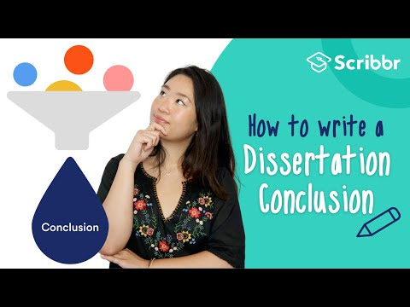
Notes:
Let’s take a look at another video to see how to approach the conclusion.

Slide 26
End matter
Notes:
With your main text finished, there’s just the end matter left.
This consists of your reference list or bibliography, and any appendices.

Slide 27
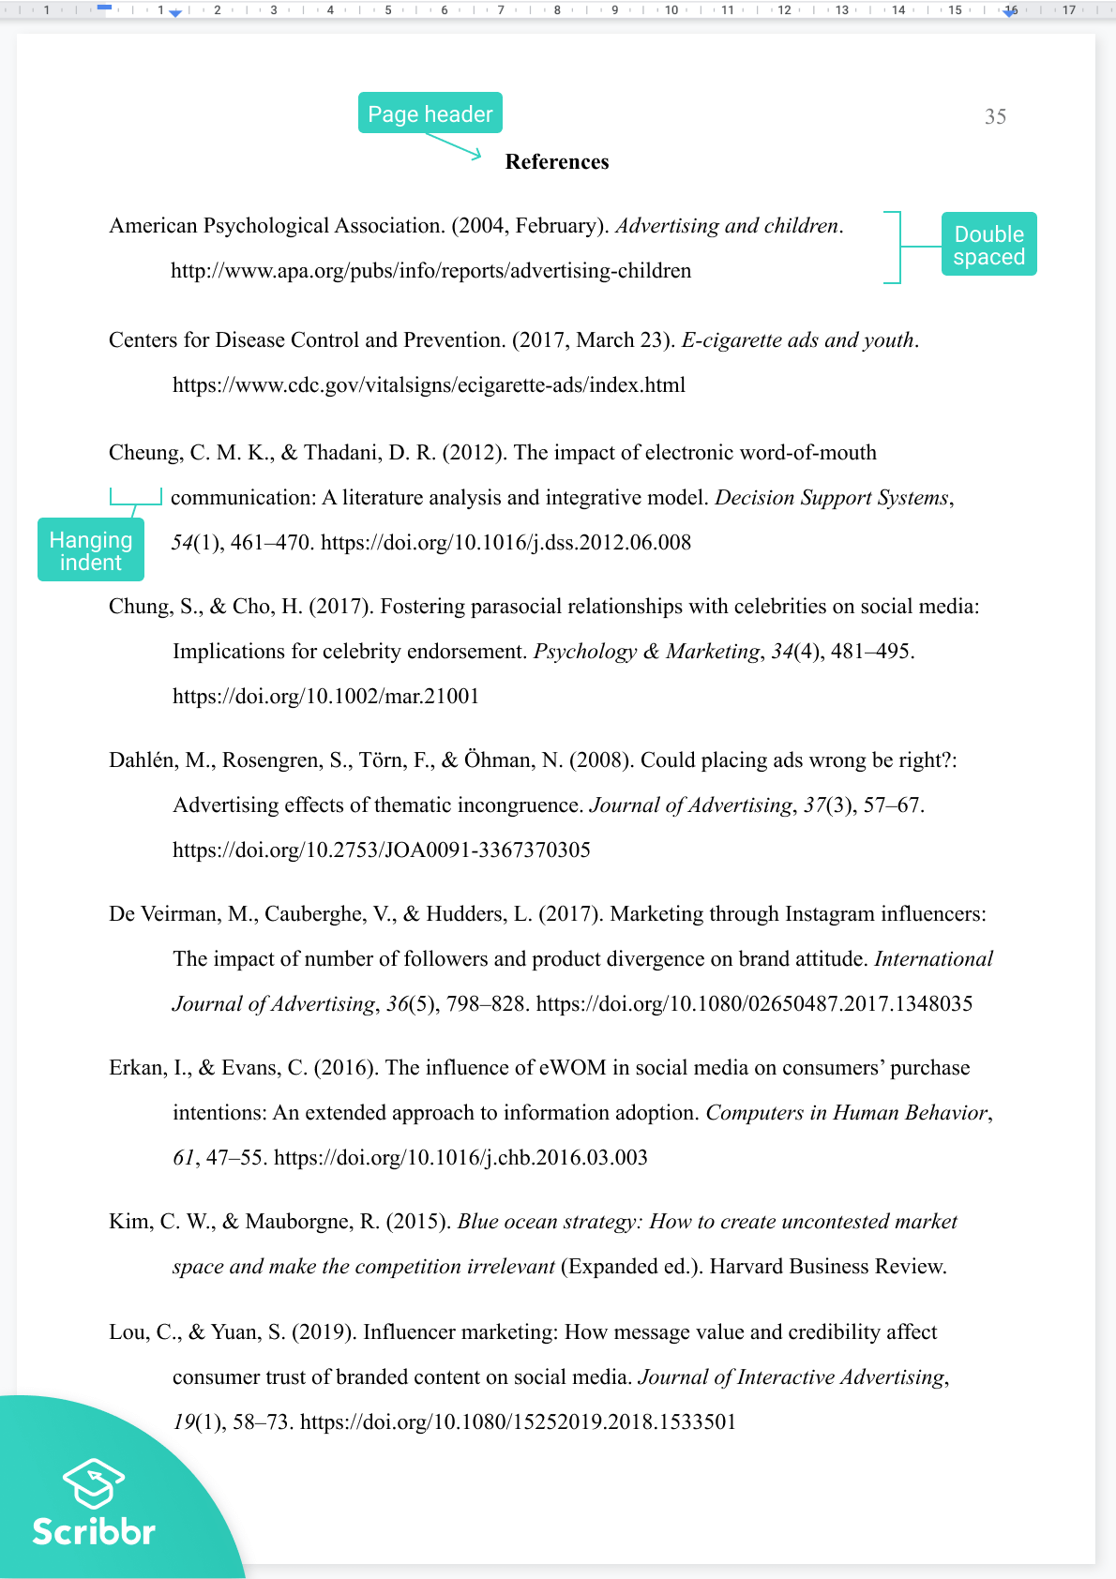
Reference list or bibliography
Lists all sources cited in your dissertation
Includes full and accurate details of each source
Format varies depending on style guide (e.g. APA, MLA)
Citation generators can help
Notes:
A reference list, sometimes called a bibliography, is an essential part of every dissertation.
It lists all the sources cited in your text: Anything you quoted, paraphrased, or otherwise referred to.
For each source, make sure you present full and accurate details, consistently formatted according to a specific citation style.
The exact information presented varies according to the citation style and the type of source, but usually details like the author, title, publisher, and publication date are included
Check your guidelines or ask your supervisor if you’re not sure what style guide you need to follow; common choices are APA and MLA, and the image here shows a reference list presented in APA style.
Referencing can be tricky. If you struggle to get the format right, online citation generators can be helpful tools to ensure consistency—but make sure you use one that is accurate and reliable.
APA citation generator: https://www.scribbr.com/apa-citation-generator/
MLA citation generator: https://www.scribbr.com/mla-citation-generator/

Slide 28
Appendices
Present additional data or documents not included in your main text
E.g. interview transcripts, survey questions, tables of data
If you have multiple appendices, they are numbered (Appendix 1, Appendix 2…)
Notes:
Appendices are the very last part of your dissertation. These are optional.
Use appendices to include any additional information from your research that did not appear in the main text but may be useful for the reader to have access to.
For example, if your research involved a survey, you might list the questions here; if it involved a lot of numerical data, you might present it in tables here.
You might have just one appendix, several, or none. If there’s just one, title it “Appendix.” If there are several, number them “Appendix 1, Appendix 2,” etc.
Also give each appendix a clear subtitle—for example “Appendix 1: Interview transcripts.”
If you don’t have any additional information to present, you don’t need any appendices.
“An appendix to a dissertation” article: https://www.scribbr.com/dissertation/appendix/

Slide 29
Recommended resources

Slide 30



Free Scribbr resources
Knowledge Base (300+ articles)
Citation Generator
YouTube Channel
Notes:
Scribbr provides high-quality articles and videos for free. Every month over 2 million students make use of these resources.

Slide 31
Hi, we’re Scribbr 👋
We are a team of 60 people in Amsterdam, and we partner with more than 500 freelance editors across the globe to help students graduate and become better academic writers.
Every day, we work hard on our Proofreading & Editing service, Plagiarism Checker, Citation Generator, Knowledge Base and educational YouTube channel.

Slide 32
Guidelines for using this presentation
This presentation can be freely used and modified for educational purposes. You may:
Display this presentation in a classroom environment
Modify, add, or delete slides
Distribute this presentation in print or in private student environments (e.g. Moodle, BlackBoard, Google Classroom)
Please do give credit to Scribbr for creating this resource.
Questions or feedback? Email shona@scribbr.com and we’ll be in touch!
Notes:
How to edit this presentation:
Click on “File” in the top-left corner.
Click on “Make a copy”
Select “Entire presentation”
Save the presentation in your personal Google Drive.
You can now edit the copy of this presentation!

