Slide 1
Twitter Network Analysis with NetworkX
Celia La, Sarah Guido
PyCon 2015
@celiala, @sarah_guido

Slide 2

About us: Sarah Guido
Data scientist at Bitly
NYC Python and PyGotham organizer
O’Reilly Media author
@sarah_guido

Slide 3



About us: Celia La
Software engineer at Knewton
PyGotham and Write/Speak/Code
@celiala

Slide 4
About this talk
Installation
Intro to network theory/NetworkX
Intro to the Twitter API
Lesson!

Slide 5
Installation
Github repo!
Let’s try opening IPython notebook

Slide 6
The basics of network theory

Slide 7
What is a network?
Collection of points joined by lines
Mathematically: graph
Representation of relationships between discrete objects

Slide 8
What is a network?
Can be thought of as
a complicated data structure
a complex system
a way of exploring data

Slide 9
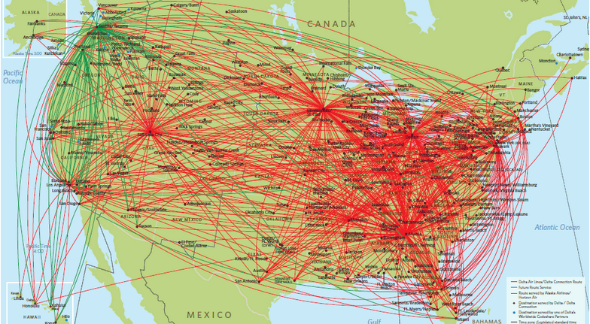
What is a network?

Slide 10
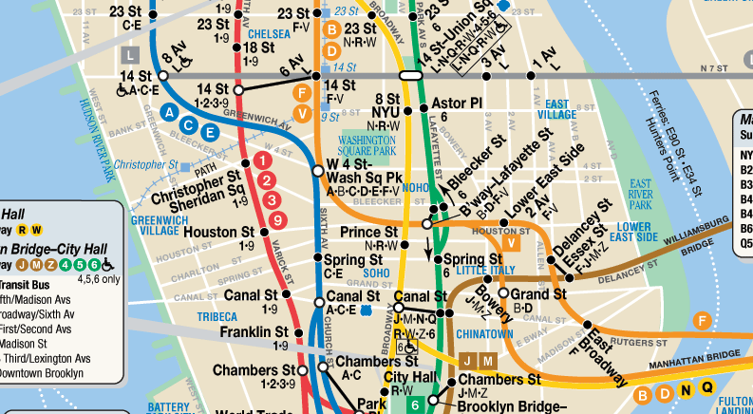
What is a network?

Slide 11
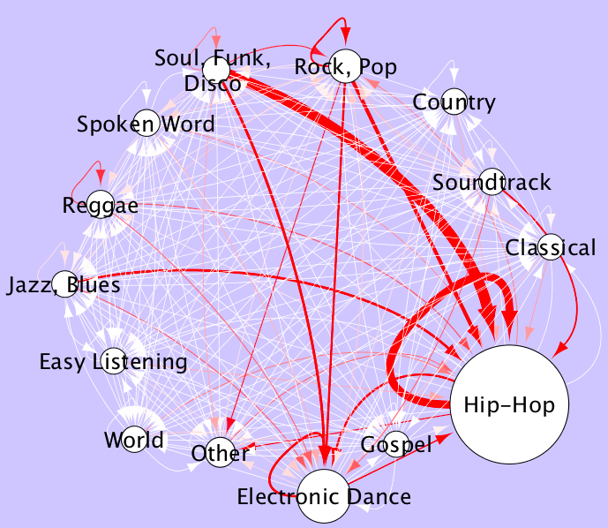
What is a network?

Slide 12
Basics
Vertex/node
Edge
Directed
Connectivity
Path
Weight
Degree

Slide 13
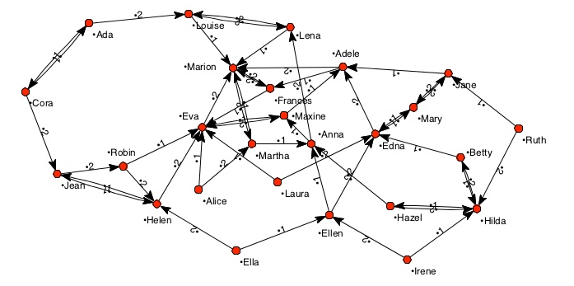
Basics – directed/weighted

Slide 14
Describing a network
Connected
Unconnected

Slide 15
Describing a network
Degree distribution
1 node with 4 edges
1 node with 2 edges
4 nodes with 1 edge
Distribution:
[(1: 4), (1: 2), (4: 1)]
F
D
E
C
B
A

Slide 16
Describing a network
Average shortest path
A to E
A – B – D – E = 3 hops
A – B – C – D – E = 4 hops
D
E
C
B
A

Slide 17
Describing a network
Centrality
Degree: number of connections
Betweenness: number of shortest paths from all nodes to all others that pass through a particular node
Closeness: average length of the shortest paths between a specific node and all other nodes in the graph

Slide 18
Describing a network
Degree centrality
Most edges == most important
D: 4 edges
Normalized degree:
divide by maximum possible degree (n – 1)
6 nodes means 5 possible connections
4 / 5 = 0.8
F
D
E
C
B
A

Slide 19
Describing a network
Betweenness centrality
Between many pairs of nodes
D: between 9 pairs
AC, AE, AF, BC, BE, BF, CE, CF,EF
Normalized
number of shortest paths divided by:
[(n −1) (n −2) / 2]
[(6 – 1) (6 – 2) / 2] = 10
D: 9/10 = 0.9
F
D
E
C
B
A

Slide 20
Describing a network
Closeness centrality
Average length of shortest paths
n – 1 / (sum of all shortest paths)
D: 6 – 1 / (1 + 1 + 1 + 1 + 2) = 0.83
A: 6 - 1 / (1 + 3 + 2 + 3 + 3) = 0.43
F
D
E
C
B
A

Slide 21
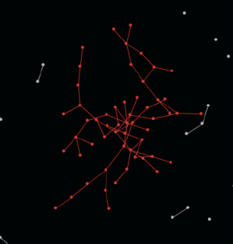
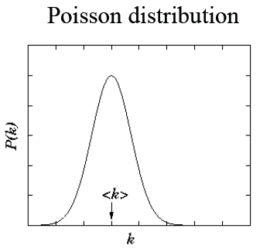
Modeling networks
Random (Erdos-Renyi) network
Nodes connected at random
Binomial distribution of edges connected to each node

Slide 22
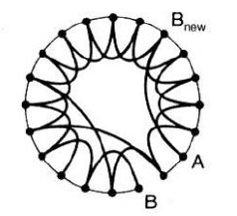
Modeling networks
Small world network
Six degrees of separation
Dense subgraph

Slide 23
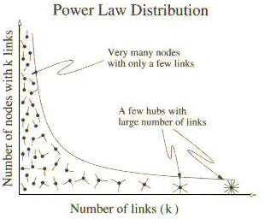
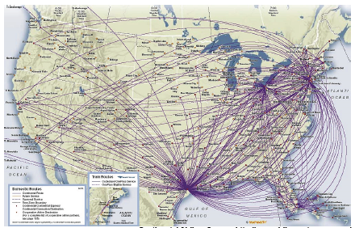
Modeling networks
Scale-free networks
Power law distribution when scaled up – looks the same no matter the scale

