Slide 1
Recommend Restaurants for Yelp Users
DAT-NYC-25
Tim Lin

Slide 2

Purpose
Create a recommendation system based on user's review text and star ratings for restaurants in Las Vegas with the data provided by Yelp Data Challenge.
Can apply to millions of online products.

Slide 3
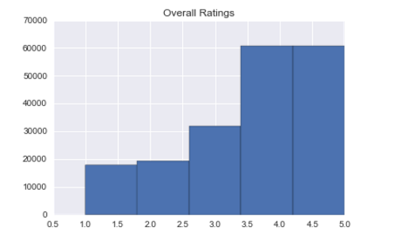
Dataset
Yelp Challenge Dataset
60K business, 1M reviews, 366K users across 10 cities.
Only focus on food service business in Las Vegas, NV.
Data:
1.7K business with 2.5K unique IDs
7.8k users with 190K reviews
Star rating from 1 to 5

Slide 4
Recommendation System
Wiki Definition: Engines of information filtering system that seek to predict the ‘rating’ or ‘preference’ that user would give to an item.
Collaborative filtering:
Make recommendation based user preferences.
Content-based filtering:
Recommend items based on items characteristics.

Slide 5
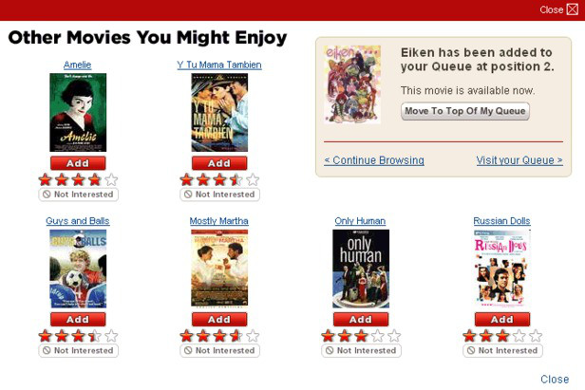
Collaborative Filtering (CF) “Because you liked this, we think you’d also like this”
Basic Assumption
User give ratings to an items
Clients who had similar tastes in the past, will have similar tastes in the future.

Slide 6
Approach
Use the preference of crowd to recommend items
Methods:
Item-based
Model-based
Input:
Matrix of ratings given by users
Output:
Top-n most similar items
Prediction indicating likeness of a certain item

Slide 7
Item-based CF
Idea:
use similarity between items to make prediction.
Approach:
Look for rating similar item 5.
And use ratings for these item to predict the missing value.
 | Item1 | Item2 | Item3 | Item4 | Item5
Alice | 5 | 3 | 4 | 4 | ?
User1 | 3 | 1 | 2 | 3 | 3
User2 | 4 | 3 | 4 | 3 | 5
User3 | 3 | 3 | 1 | 5 | 4
User4 | 1 | 5 | 5 | 2 | 1

Slide 8
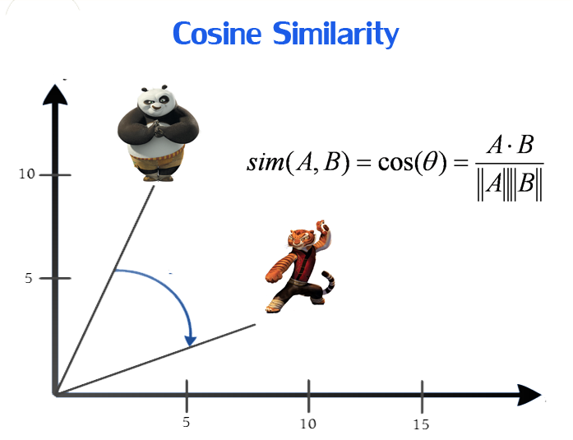
Measure of Similarity
Cosine Similarity
Items are put into vector in n-dimensional space
Similarity is calculated based on the angle between the vectors

Slide 9
Model-Based CF
Make prediction based on learned model (singular value decomposition, SVD)
Idea:
Reduce the dimension in data for faster prediction generation
SVD captures important features and weight their weight in data
Pros:
Constant time to make recommendation.
Filter out noise
Detect nontrivial correlations in the data
Cons:
Lost of information since original data is used.

Slide 10
Singular Value Decomposition (Golub and Kahan 1965)
Any Matrix M can be decomposed into a product of three matrices:
U and V are left and right singular vectors which retain the most import features/ latent variables.
Application:
both user and items are represented in term of these latent variables.
Item vector characteristic of given features and user vector represent the preferences for a given feature.
Rating are the sum of user vector and item vector by taking their dot products.

Slide 11
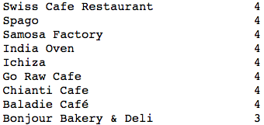
User:

Slide 12
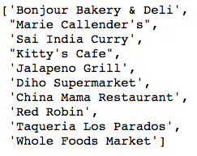
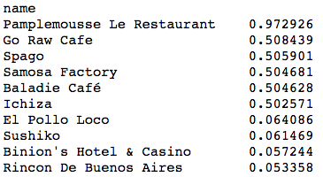
Result
Item-based
Model-Based

Slide 13
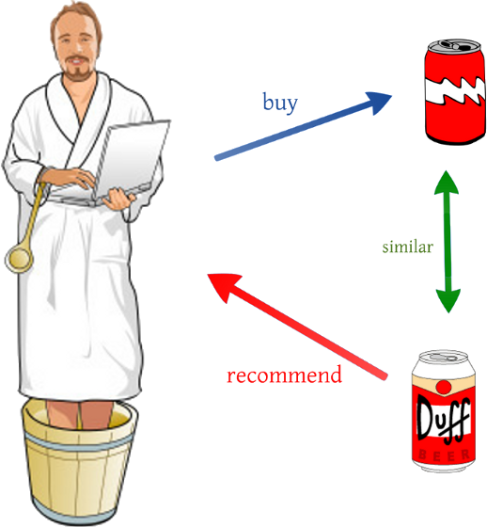
Content-Based Filtering
Assumption:
if you like an item in the past, you’re going to love a item with the same characteristics.

Slide 14
Approach
Recommend similar item that user liked in the past based o properties of items.
Methods:
Built a item profile and a user profile
Type of restaurant
Recommend items that are similar to those a user like in the past.
Dot product
Linear regression

Slide 15

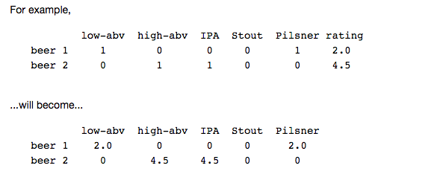
Profiles
Restaurant Profile
Use categories of a restaurant
User Profile
Distribute it star ratings over the features and take the average of all ratings per user to get a user profile.

Slide 16
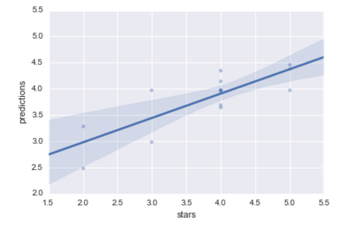
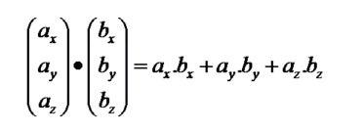
Predictions
Dot Products
Linear Regression

Slide 17
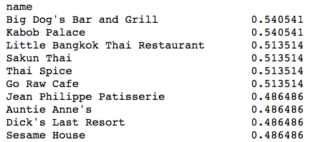
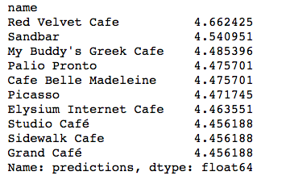
Results
Dot Product
Linear Regression

Slide 18
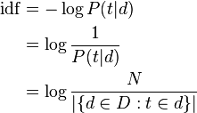
Content? Collaborative?
Use the review text to map the feature of the restaurant.
using frequency-inverse document frequency
A statistics measure of how import a word is to a document in a collection of corpus
Recommend business based on similar text review using cosine similarity.

Slide 19
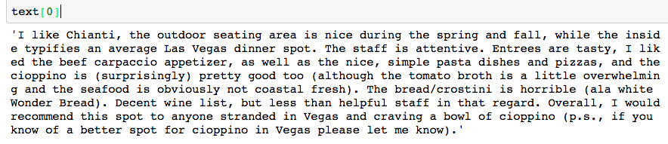
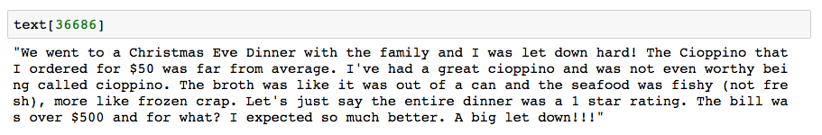

Result

Slide 20
Evaluation
There is no way to mathematical way to evaluation these models.
Can follow up with user if they actually go to these recommended restaurants.
How useful:
For vendor, expose their products.
For customer, product that they did not know of.

