Slide 1
American Equity Option Valuation Practical Guide
John Smith
FinPricing

Slide 2
American Equity Option
Summary
American Equity Option Introduction
The Use of American Equity Options
Valuation
Practical Guide
A Real World Example

Slide 3
American Equity Option
American Option Introduction
An American option give an investor the right but not the obligation to buy a call or sell a put at a set strike price at any time prior to the contract’s expiry date.
Since investors have the freedom to exercise their American options at any time during the life of the contract, they are more valuable than European options, which can only be exercised at maturity.
Investors and traders can use equity options to take a long or short position in a stock without actually buying or shorting the stock.
This is advantageous because taking a position with options allows the investor/trader more leverage in that the amount of capital needed is much less than a similar outright long or short position on margin.
Investors/traders can therefore profit more from a price movement in the underlying stock.

Slide 4
American Equity Option
American Option Introduction
American options provide investors a way to hedge risk or speculate. Also option trading can limit an investor’s risk and leverage investing potential.
Option investors have a number of strategies they can utilize, depending on risk tolerance and expected return.
Buying call options allows you to benefit from an upward price movement. The right to buy stock at a fixed price becomes more valuable as the price of the underlying stock increases.
Put options may provide a more attractive method than shorting stock for profiting on stock price declines.
If you have an established profitable long stock position, you can buy puts to protect this position against short-term stock price declines.
An option seller earns the premium if the underlying stock price would not change much.

Slide 5
American Equity Option
Valuation
In general, American options do not have a closed-form solution.
There are several closed-form models to approximate the price of an American option: Roll-Geske-Whaley, Barone-Adesi and Whaley, Bjerksund and Stensland.
Those approximations are quite inaccurate in dealing with discrete dividends.
To accreately value an American option, one needs to use a numerical approach.
The most popular numerical methods are tree, lattice, partial differential equation (PDE) and Monte Carlo.
FinPricing is using the Black-Scholes PDE plus finite difference method to price an American equity option.

Slide 6
American Equity Option
Valuation (Cont)
The finite difference model is one of the most popular methods to solve the PDE equation for American options.
There are three finite difference approximations most widely used for pricing American options: the Explicit, Fully Implicit and Crank-Nicolson models.
Among them, the Crank-Nicolson is unconditionally stable with respect to domain discretization and is the most accurate.
Compared with the binomial tree method or the Barone-Adesi and Whaley model, Crank-Nicolson also has obvious advantages of computation speed and accuracy.

Slide 7
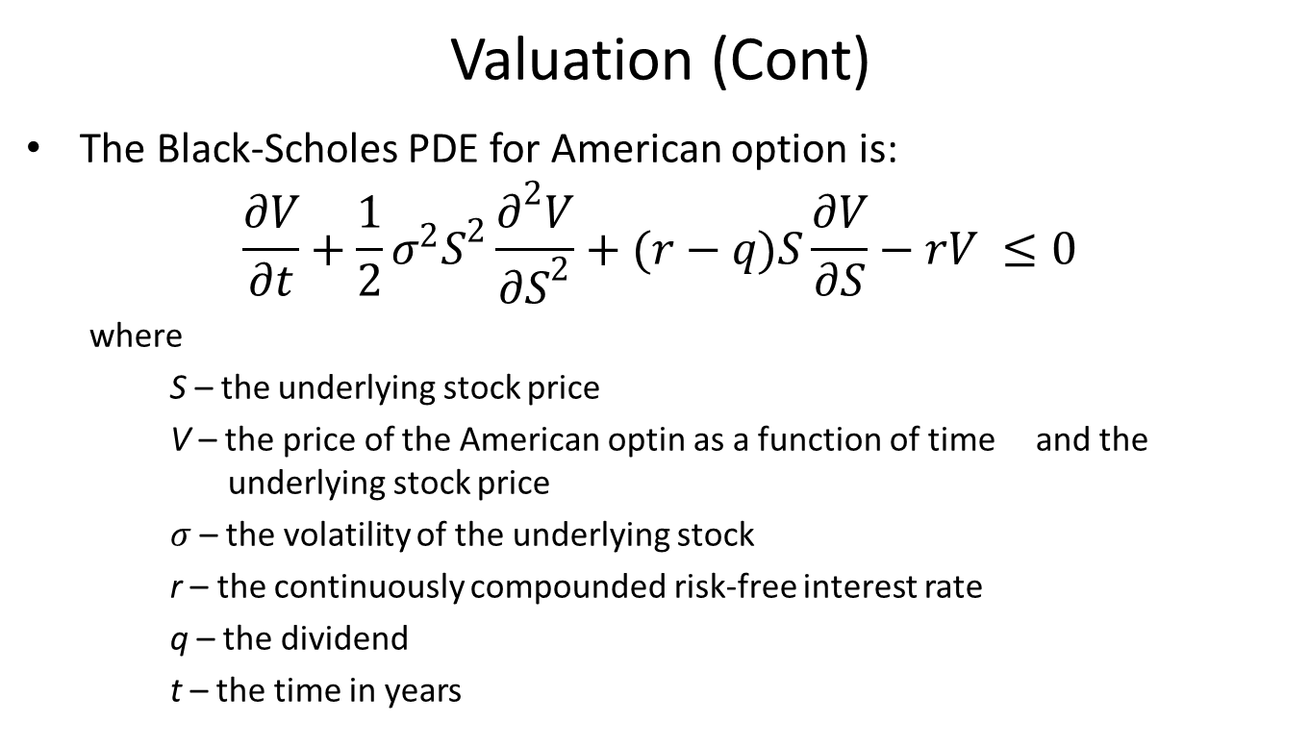
American Equity Option
Valuation (Cont)
The Black-Scholes PDE for American option is:
$$\frac{∂V}{∂t}+\frac{1}{2}σ^{2}S^{2}\frac{∂^{2}V}{{∂S}^{2}}+(r−q)S\frac{∂V}{∂S}−rV ≤0$$
where
S – the underlying stock price
V – the price of the American optin as a function of time and the underlying stock price
$σ$ – the volatility of the underlying stock
r – the continuously compounded risk-free interest rate
q – the dividend
t – the time in years

Slide 8
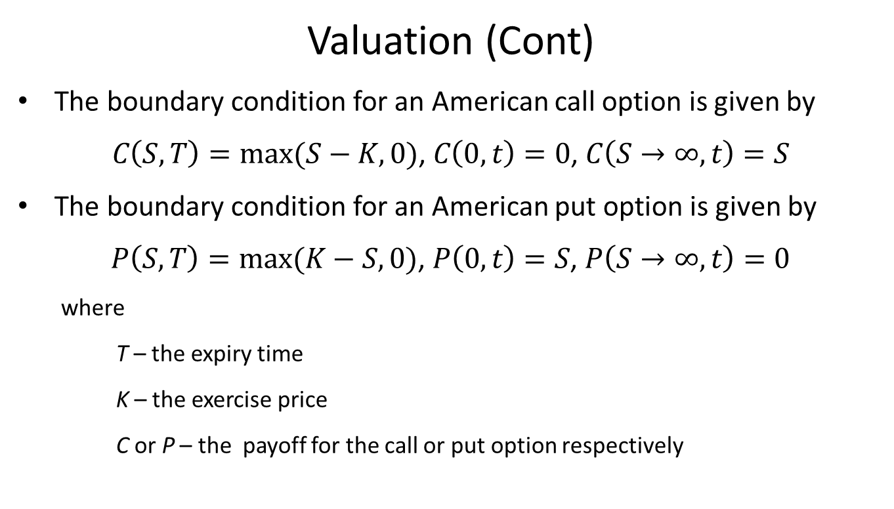
American Equity Option
Valuation (Cont)
The boundary condition for an American call option is given by
$C\left(S,T\right)=max(S−K,0)$, $C\left(0,t\right)=0$, $C\left(S→∞,t\right)=S$
The boundary condition for an American put option is given by
$P\left(S,T\right)=max(K−S,0)$, $P\left(0,t\right)=S$, $P\left(S→∞,t\right)=0$
where
T – the expiry time
K – the exercise price
C or P – the payoff for the call or put option respectively

Slide 9
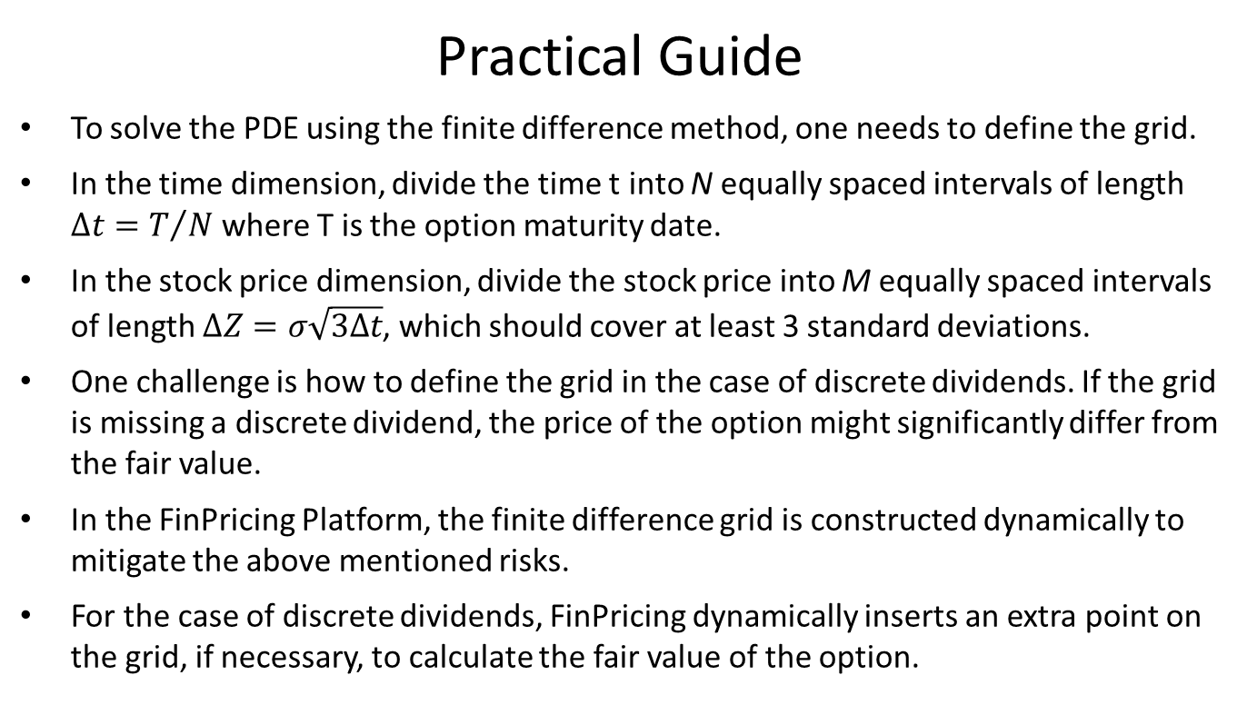
American Equity Option
Practical Guide
To solve the PDE using the finite difference method, one needs to define the grid.
In the time dimension, divide the time t into N equally spaced intervals of length $∆t=T/N$ where T is the option maturity date.
In the stock price dimension, divide the stock price into M equally spaced intervals of length $∆Z=σ\sqrt{3∆t}$, which should cover at least 3 standard deviations.
One challenge is how to define the grid in the case of discrete dividends. If the grid is missing a discrete dividend, the price of the option might significantly differ from the fair value.
In the FinPricing Platform, the finite difference grid is constructed dynamically to mitigate the above mentioned risks.
For the case of discrete dividends, FinPricing dynamically inserts an extra point on the grid, if necessary, to calculate the fair value of the option.

Slide 10
American Equity Option
A Real World Example
Underlying equity | CCJ.N
Currency | USD
Strike | 8
Maturity Date | 1/19/2018
Call or Put | Put
Buy or Sell | Buy
Exercise Type | American
Settlement Type | Physical
Position | 250000

Slide 11
Thank You
You can find more details at
http://www.finpricing.com/lib/EqAmerican.html

