Slide 1
Equity Asian Option Valuation Practical Guide
John Smith
FinPricing

Slide 2
Asian Equity Option
Summary
Asian Equity Option Introduction
The Use of Asian Equity Options
Valuation
Practical Guide
A Real World Example

Slide 3
Asian Equity Option
Asian Option Introduction
An Asian option or average option is a special type of option contract where the payoff depends on the average price of the underlying asset over a certain period of time
The payoff is different from the case of a European option or American option, where the payoff of the option contract depends on the price of the underlying stcok at exercise date.
Asian options allow the buyer to purchase (or sell) the underlying asset at the average price instead of the spot price.
Asian options are commonly seen options over the OTC markets.
Average price options are less expensive than regular options and are arguably more appropriate than regular options for meeting some of the needs of corporate treasurers.

Slide 4
Asian Equity Option
The Use of Asian Options
One advantage of Asian options is that they reduce the risk of market manipulation of the underlying instrument at maturity.
Because of the averaging feature, Asian options reduce the volatility inherent in the option; therefore, Asian options are typically cheaper than European or American options.
Asian options have relatively low volatility due to the averaging mechanism. They are used by traders who are exposed to the underlying asset over a period of time
The Asian option can be used for hedging and trading Equity Linked Notes issuance.
The arithmetic average price options are generally used to smooth out the impact from high volatility periods or prevent price manipulation near the maturity date.

Slide 5
Asian Equity Option
Valuation
The payoff of an average price call is max(0, S_{avg} - K) and that of an average price put is max(0, K- S_{avg}), where S_{avg} is the average value of the underlying asset calculated over a predetermined averaging period.
If the underlying asset price S is assumed to be lognormally distributed and S_{ave} is a geometric average of the S’s, analytic formulas are available for valuing European average price options. This is because the geometric average of a set of lognormally distributed variables is also lognormal.
When, as is nearly always the case, Asian options are defined in terms of arithmetic averages, exact analytic pricing formulas are not available. This is because the distribution of the arithmetic average of a set of lognormal distributions does not have analytically tractable properties.
However, the distribution of arithmetic average can be approximated to be lognormal by moment matching technical.

Slide 6
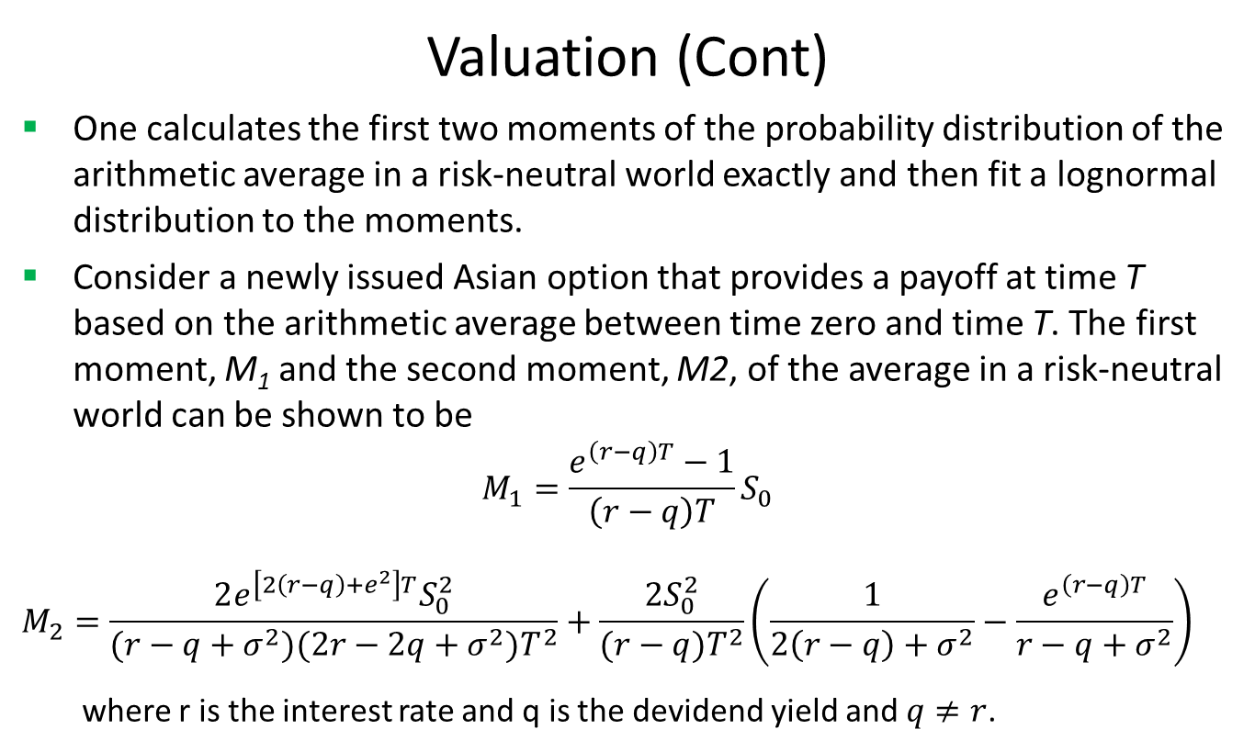
Asian Equity Option
Valuation (Cont)
One calculates the first two moments of the probability distribution of the arithmetic average in a risk-neutral world exactly and then fit a lognormal distribution to the moments.
Consider a newly issued Asian option that provides a payoff at time T based on the arithmetic average between time zero and time T. The first moment, M₁ and the second moment, M2, of the average in a risk-neutral world can be shown to be
$$M_{1}=\frac{e^{\left(r−q\right)T}−1}{\left(r−q\right)T}S_{0}$$
$$M_{2}=\frac{2e^{\left[2\left(r−q\right)+e^{2}\right]T}S_{0}^{2}}{(r−q+σ^{2})(2r−2q+σ^{2})T^{2}}+\frac{2S_{0}^{2}}{(r−q)T^{2}}\left(\frac{1}{2\left(r−q\right)+σ^{2}}−\frac{e^{\left(r−q\right)T}}{r−q+σ^{2}}\right)$$
where r is the interest rate and q is the devidend yield and $q≠r$.

Slide 7
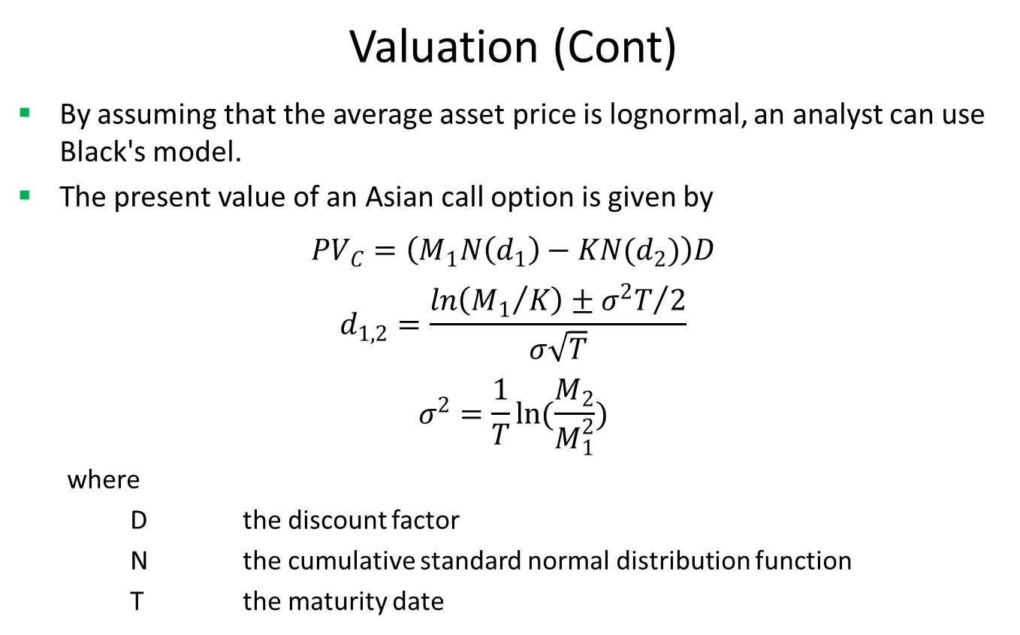
Asian Equity Option
Valuation (Cont)
By assuming that the average asset price is lognormal, an analyst can use Black's model.
The present value of an Asian call option is given by
$${PV}_{C}=\left(M_{1}N\left(d_{1}\right)−KN(d_{2})\right)D$$
$$d_{1,2}=\frac{ln\left({M_{1}}/K\right)±{σ^{2}T}/2}{σ\sqrt{T}}$$
$$σ^{2}=\frac{1}{T}ln(\frac{M_{2}}{M_{1}^{2}})$$
where
D the discount factor
N the cumulative standard normal distribution function
T the maturity date

Slide 8
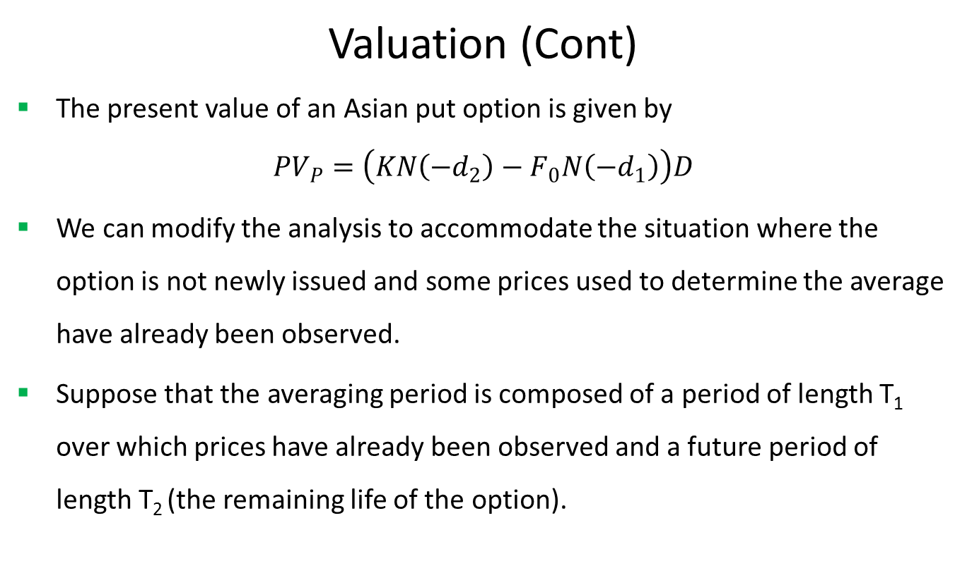
Asian Equity Option
Valuation (Cont)
The present value of an Asian put option is given by
$${PV}_{P}=\left(KN\left({−d}_{2}\right)−F_{0}N\left(−d_{1}\right)\right)D$$
We can modify the analysis to accommodate the situation where the option is not newly issued and some prices used to determine the average have already been observed.
Suppose that the averaging period is composed of a period of length T₁ over which prices have already been observed and a future period of length T₂ (the remaining life of the option).

Slide 9
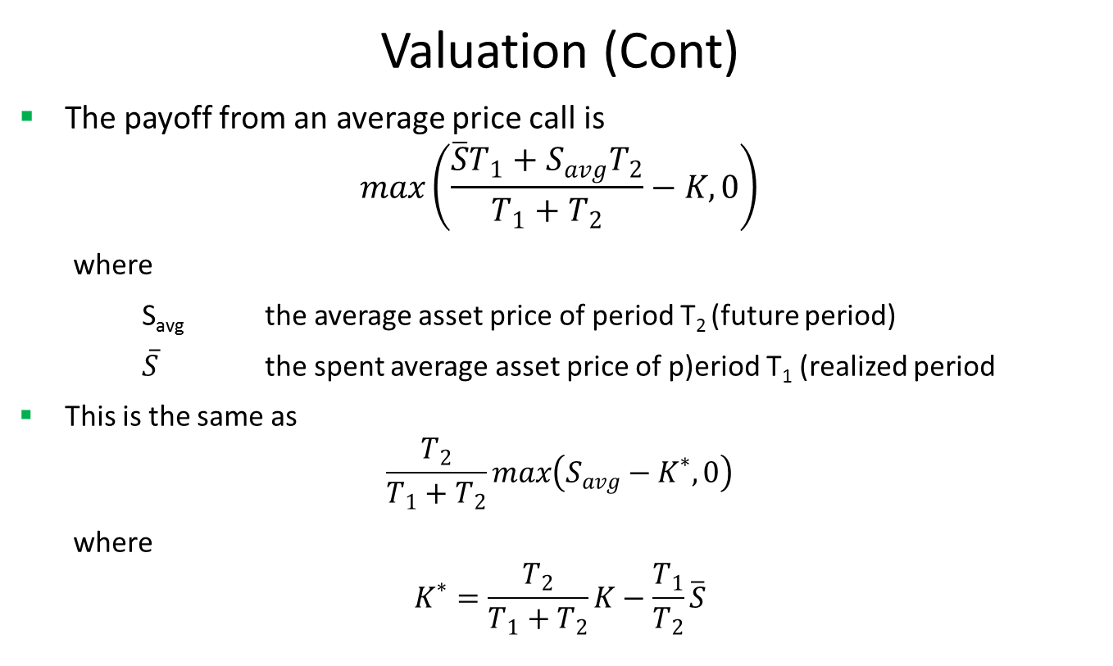
Asian Equity Option
Valuation (Cont)
The payoff from an average price call is
$$max\left(\frac{\overline{S}T_{1}+S_{avg}T_{2}}{T_{1}+T_{2}}−K,0\right)$$
where
S_{avg} the average asset price of period T₂ (future period)
$\overline{S}$ the spent average asset price of p)eriod T₁ (realized period
This is the same as
$$\frac{T_{2}}{T_{1}+T_{2}}max\left(S_{avg}−K^{∗},0\right)$$
where
$$K^{∗}=\frac{T_{2}}{T_{1}+T_{2}}K−\frac{T_{1}}{T_{2}}\overline{S}$$

Slide 10
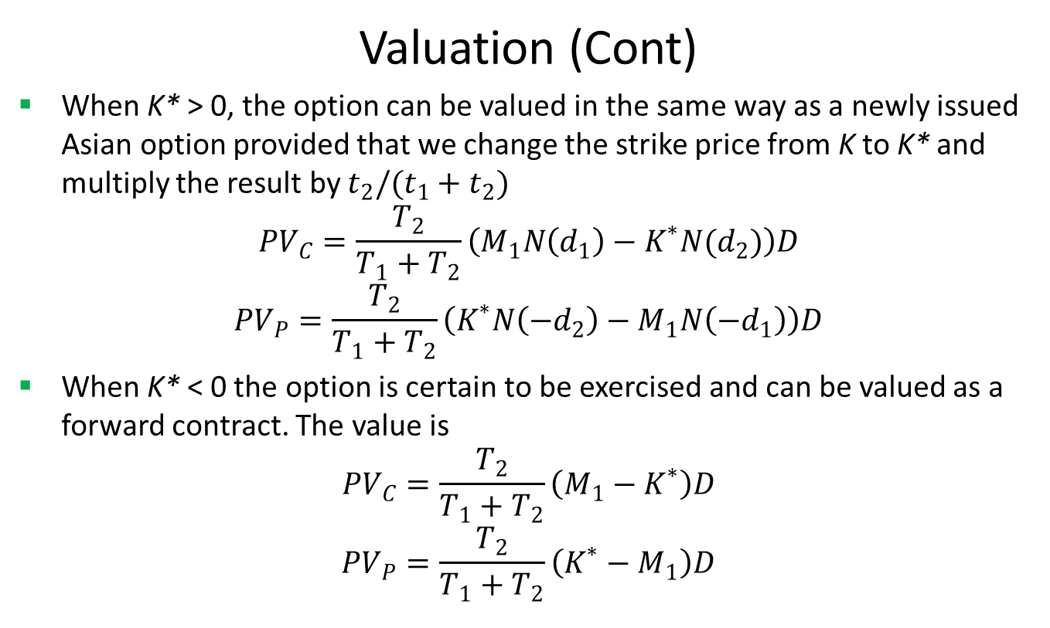
Asian Equity Option
Valuation (Cont)
When K* > 0, the option can be valued in the same way as a newly issued Asian option provided that we change the strike price from K to K* and multiply the result by $t_{2}/(t_{1}+t_{2})$
$${PV}_{C}=\frac{T_{2}}{T_{1}+T_{2}}\left(M_{1}N\left(d_{1}\right)−K^{∗}N(d_{2})\right)D$$
$${PV}_{P}=\frac{T_{2}}{T_{1}+T_{2}}\left(K^{∗}N\left({−d}_{2}\right)−M_{1}N\left({−d}_{1}\right)\right)D$$
When K* < 0 the option is certain to be exercised and can be valued as a forward contract. The value is
$${PV}_{C}=\frac{T_{2}}{T_{1}+T_{2}}\left(M_{1}−K^{∗}\right)D$$
$${PV}_{P}=\frac{T_{2}}{T_{1}+T_{2}}\left(K^{∗}−M_{1}\right)D$$

Slide 11
American Equity Option
Practical Guide
First calculate the spent average based on realized spot price.
Then compute the adjusted strike using the spent average
After that obtain the first and second moments.
Use the moments to get the adjusted volatility.
Finally calculate the present value via BlackScholes formula.
FinPricing is using the Turnbull-Wakeman model. Another well-known model is the Levy Model

Slide 12
American Equity Option
A Real World Example
Face Value | 3361.12
Currency | CAD
Start Date | 1/10/2017
Maturity Date | 7/10/2017
Call or Put | Call
Buy or Sell | Sell
Underlying Assets | .GSPTXBA
Position | -2790.764362
Spent Average | 4104.9327

Slide 13
Thank You
You can find more details at
http://www.finpricing.com/lib/EqAsian.html

