Slide 1
Equity Basket Option Pricing Guide
John Smith
FinPricing

Slide 2
Equity Basket
Summary
Equity Basket Option Introduction
The Use of Equity Basket Options
Equity Basket Option Payoffs
Valuation
Practical Guide
A Real World Example

Slide 3
Equity Basket
Equity Basket Option Introduction
A basket option is a financial contract whose underlying is a weighted sum or average of different assets that have been grouped together in a basket.
A basket option can be used to hedge the risk exposure to or speculate the market move on the underlying stock basket.
Because it involves just one transaction, a basket option often costs less than multiple single options.
The most important feature of a basket option is its ability to efficiently hedge risk on multiple assets at the same time.
Rather than hedging each individual asset, the investor can manage risk for the basket, or portfolio, in one transaction.
The benefits of a single transaction can be great, especially when avoiding the costs associated with hedging each and every individual component.

Slide 4
Equity Basket
The Use of Basket Options
A basket offers a combination of two contracdictory benefits: focus on an investment style or sector, and diversification across the spectrum of stocks in the sector.
Buying a basket of shares is an obvious way to participate in the anticipated rapid appreciation of a sector, without active management.
An investor bullish on a sectr but wanting downside protection may favor a call option on a basket of shares from that sector.
A trader who think the market overestimates a basket’s volatility may sell a butterfly spread on the basket.
A relatively risk averse investor may favor a basket buy or write.
A trader who anticipates that the average correlation among different shares is going to increase might buy a basket option.

Slide 5
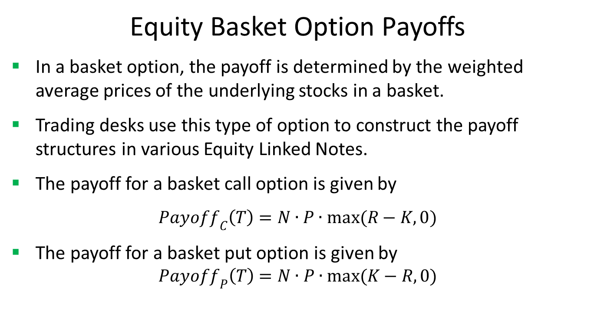
Equity Basket
Equity Basket Option Payoffs
In a basket option, the payoff is determined by the weighted average prices of the underlying stocks in a basket.
Trading desks use this type of option to construct the payoff structures in various Equity Linked Notes.
The payoff for a basket call option is given by
${Payoff}_{C}\left(T\right)=N∙P∙max(R−K,0)$
The payoff for a basket put option is given by
$${Payoff}_{P}\left(T\right)=N∙P∙max(K−R,0)$$

Slide 6
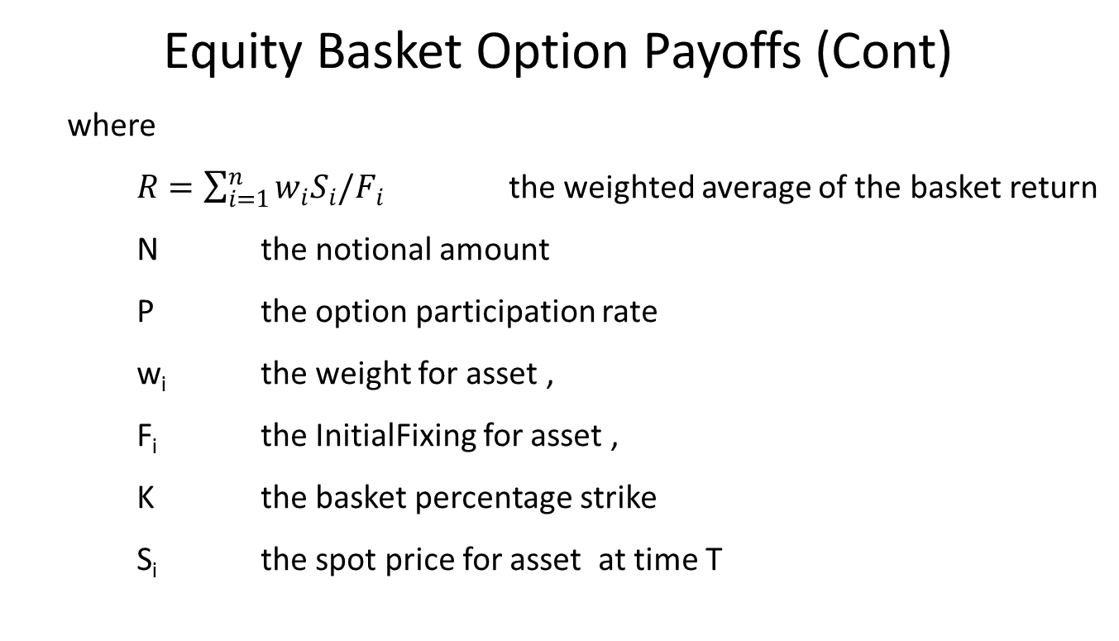
Equity Basket
Equity Basket Option Payoffs (Cont)
where
$R=\sum_{i=1}^{n}{w_{i}S_{i}/F_{i}}$ the weighted average of the basket return
N the notional amount
P the option participation rate
w_{i} the weight for asset ,
F_{i} the InitialFixing for asset ,
K the basket percentage strike
S_{i} the spot price for asset at time T

Slide 7
Equity Basket
Valuation
The Asian basket option payoff function can be solved either analytically or using Monte Carlo simulation
In this paper, we focus on the analytical solution. It assumes that the basket price can be approximated by a lognormal distribution with moments matched to the distribution of the weighted sum of the individual stock prices.
The model includes two- and three-moment matching algorithms.
The model also can be used to price an Asian basket option by including a period of dates in the averaging schedule.
The payoff types covered by the model include calls and puts, as well as digital calls and digital puts.

Slide 8
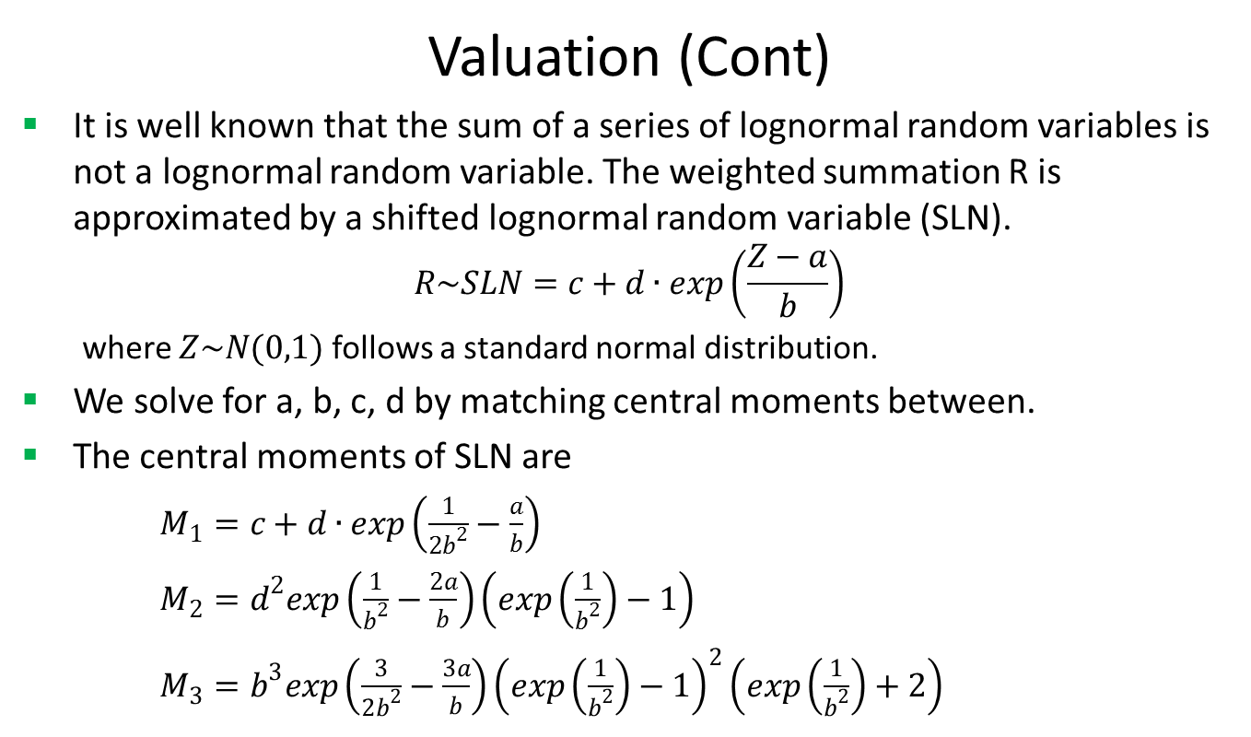
Equity Basket
Valuation (Cont)
It is well known that the sum of a series of lognormal random variables is not a lognormal random variable. The weighted summation R is approximated by a shifted lognormal random variable (SLN).
$$R\sim SLN=c+d∙exp\left(\frac{Z−a}{b}\right)$$
where $Z\sim N(0,1)$ follows a standard normal distribution.
We solve for a, b, c, d by matching central moments between.
The central moments of SLN are
$M_{1}=c+d∙exp\left(\frac{1}{2b^{2}}−\frac{a}{b}\right)$
$M_{2}=d^{2}exp\left(\frac{1}{b^{2}}−\frac{2a}{b}\right)\left(exp\left(\frac{1}{b^{2}}\right)−1\right)$
$M_{3}=b^{3}exp\left(\frac{3}{2b^{2}}−\frac{3a}{b}\right){\left(exp\left(\frac{1}{b^{2}}\right)−1\right)}^{2}\left(exp\left(\frac{1}{b^{2}}\right)+2\right)$

Slide 9
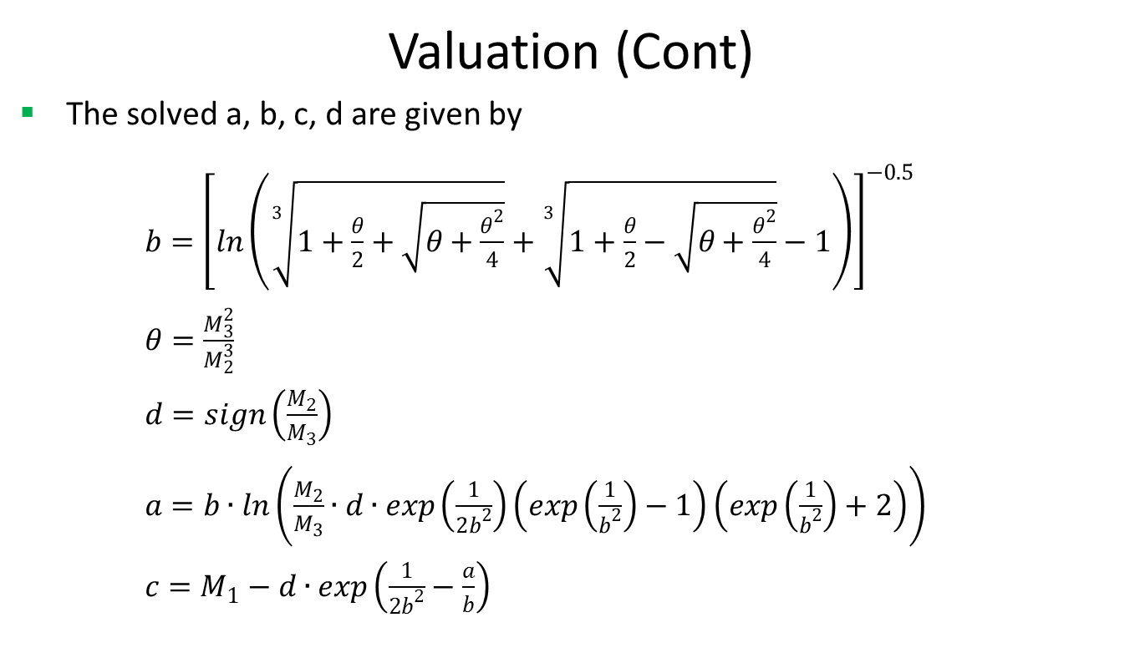
Equity Basket
Valuation (Cont)
The solved a, b, c, d are given by
$b={\left[ln\left(\sqrt[3]{1+\frac{θ}{2}+\sqrt{θ+\frac{θ^{2}}{4}}}+\sqrt[3]{1+\frac{θ}{2}−\sqrt{θ+\frac{θ^{2}}{4}}}−1\right)\right]}^{−0.5}$
$θ=\frac{M_{3}^{2}}{M_{2}^{3}}$
$d=sign\left(\frac{M_{2}}{M_{3}}\right)$
$a=b∙ln\left(\frac{M_{2}}{M_{3}}∙d∙exp\left(\frac{1}{2b^{2}}\right)\left(exp\left(\frac{1}{b^{2}}\right)−1\right)\left(exp\left(\frac{1}{b^{2}}\right)+2\right)\right)$
$c=M_{1}−d∙exp\left(\frac{1}{2b^{2}}−\frac{a}{b}\right)$

Slide 10
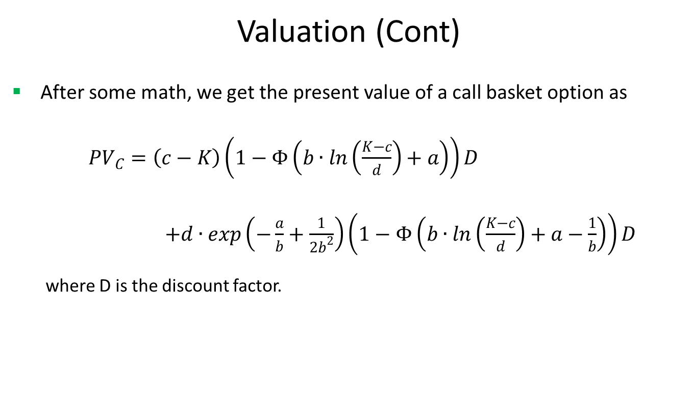
Equity Basket
Valuation (Cont)
After some math, we get the present value of a call basket option as
${PV}_{C}=\left(c−K\right)\left(1−Φ\left(b∙ln\left(\frac{K−c}{d}\right)+a\right)\right)D$
$+d∙exp\left(−\frac{a}{b}+\frac{1}{2b^{2}}\right)\left(1−Φ\left(b∙ln\left(\frac{K−c}{d}\right)+a−\frac{1}{b}\right)\right)D$
where D is the discount factor.

Slide 11
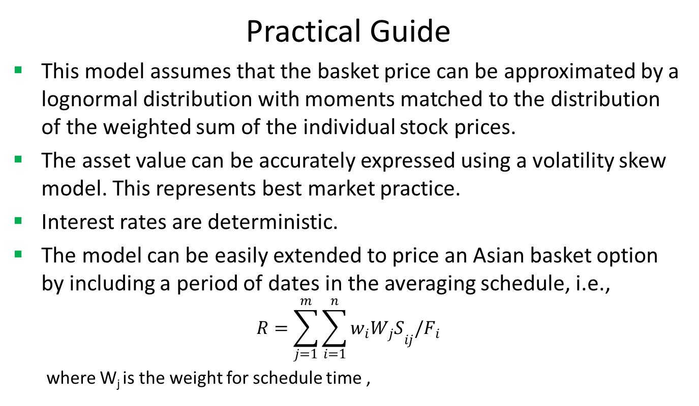
Equity Basket
Practical Guide
This model assumes that the basket price can be approximated by a lognormal distribution with moments matched to the distribution of the weighted sum of the individual stock prices.
The asset value can be accurately expressed using a volatility skew model. This represents best market practice.
Interest rates are deterministic.
The model can be easily extended to price an Asian basket option by including a period of dates in the averaging schedule, i.e.,
$$R=\sum_{j=1}^{m}{\sum_{i=1}^{n}{w_{i}{W_{j}S}_{ij}/F_{i}}}$$
where W_{j} is the weight for schedule time ,

Slide 12
Equity Basket
A Real World Example
Face Value | 87.5
Currency | USD
Digital Rebate | 1
Maturity Date | 6/16/2017
Call or Put | Call
Buy or Sell | Sell
Position | -21800
Underlying Assets | Initial Fixing
CTXS.O | 87.5
LOGM.O | 87.5

Slide 13
Thank You
You can find more details at
http://www.finpricing.com/lib/EqBasket.html

