Slide 1
Convertible Bond Difinition and Pricing Guide
John Smith
FinPricing

Slide 2
Equity Convertible
A convertible bonds can be thought of as a normal corporate bond with embedded options, which enable the holder to exchange the bond for the issuer's stock. Having properties of both stocks and bonds, convertibles can be an attractive choice for investors and have tended to have lower risk.
Issuers have several reasons to use convertible financing. By issuing convertibles they can lower their cost of debt funding compared to straight debt alone. Lower-credit companies who may not be able to access the straight debt market can often still issue convertible debt. Companies who anticipate equity appreciation can use convertibles to defer equity financing to a time when growth has been achieved.
Investors find several features of convertibles appealing. They offer greater satiability of income than common stock. They provide a yield that is often higher than the dividend yield of common stock. Finally, because they are often theoretically underpriced, they may provide a cheap source of common stock volatility.

Slide 3
Equity Convertible
Summary
Convertible Bond Introduction
The Use of Convertible Bonds
Valuation
Implementation
A Real World Example

Slide 4
Equity Convertible
Convertible Bond Introduction
A convertible bond has an embedded call option that gives bondholders the right to convert their bonds into equity at a given time for a predetermined number of shares in the issuing company.
An reverse convertible bond has an embedded put option that gives the issuer the right to convert the bond into shares of equity at a set date.
Convertible bonds typically have lower yields than the yields on similar bonds without the convertible option.
Reverse convertible bonds usually have shorter terms to maturity and higher yields than most other bonds
Most convertible bonds are subordinated debt of the issuer. In the event of bankruptcy, the claims of other bondholders take priority over convertible bondholders except the preferred and common stock owners.

Slide 5
Equity Convertible
The Use of convertible bonds
By issuing convertibles the companies can lower their cost of debt funding compared to straight debt alone.
Lower-credit companies who may not be able to access the straight debt market can often still issue convertible debt.
Companies who anticipate equity appreciation can use convertibles to defer equity financing to a time when growth has been achieved.
Convertible bonds offer greater satiability of income than common stock.
They provide a yield that is often higher than the dividend yield of common stock.
Given the optionality, convertibles have tended to have lower risk.

Slide 6
Equity Convertible
Valuation
Convertible bonds are hybrid securities that have both debt and equity features.
The valuation of convertible or reverse convertible bonds can be quite complex because of its dual nature as a normal bond and as an equity call/put option.
There is no closed-form solution for convertibles.
Convertible prices can only be solved by numerical methods, such as, Monte Carlo simulation, tree/lattice approaches, or partial differentiao equation (PDE) solutions.
The valuation of a convertible bond normally has a backward nature since there is no way of knowing whether the convertible should be converted without knowledge of the future value.

Slide 7
Equity Convertible
Valuation (Cont)
Three sources of randomness exist in a convertible bond: the stock price, the interest rate, and the credit spread.
Interest rate is assumed to be constant as the effect of a stochastic interest rate on convertible bond prices is so small that it can be neglected.
Accurately modeling the equity process appears crucial.
Since convertible bonds are issued mainly by start-up or small companies, credit risk plays an important role in the valuation.
FinPricing uses PDE to price convertible and reverse convertible bonds, and use Monte Carlo simulation to value convertibles with exotic path-dependent trigger provisions.

Slide 8
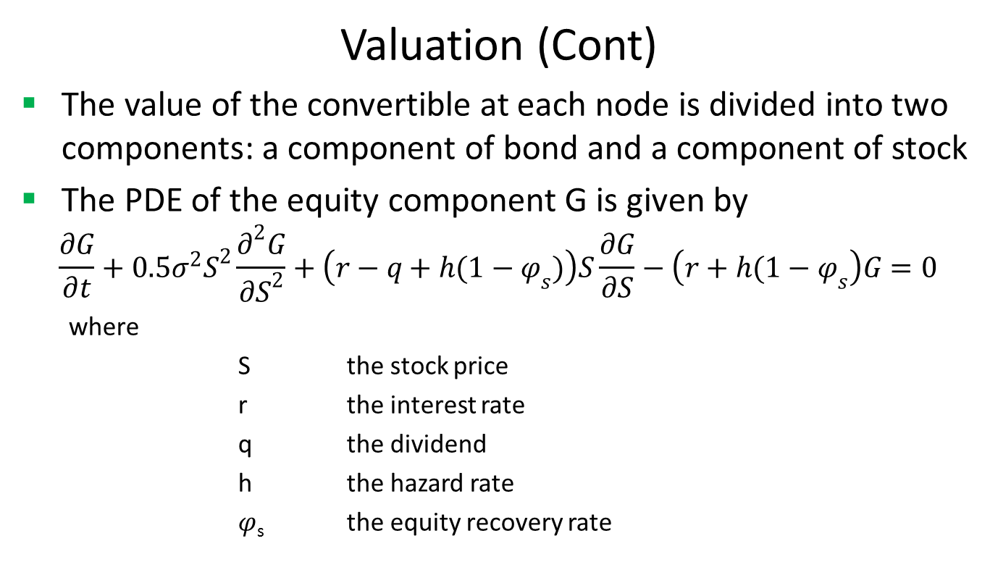
Equity Convertible
Valuation (Cont)
The value of the convertible at each node is divided into two components: a component of bond and a component of stock
The PDE of the equity component G is given by
$$\frac{∂G}{∂t}+0.5σ^{2}S^{2}\frac{∂^{2}G}{{∂S}^{2}}+\left(r−q+h(1−φ_{s})\right)S\frac{∂G}{∂S}−\left(r+h(1−φ_{s}\right)G=0$$
where
S the stock price
r the interest rate
q the dividend
h the hazard rate
$φ$_{s} the equity recovery rate

Slide 9
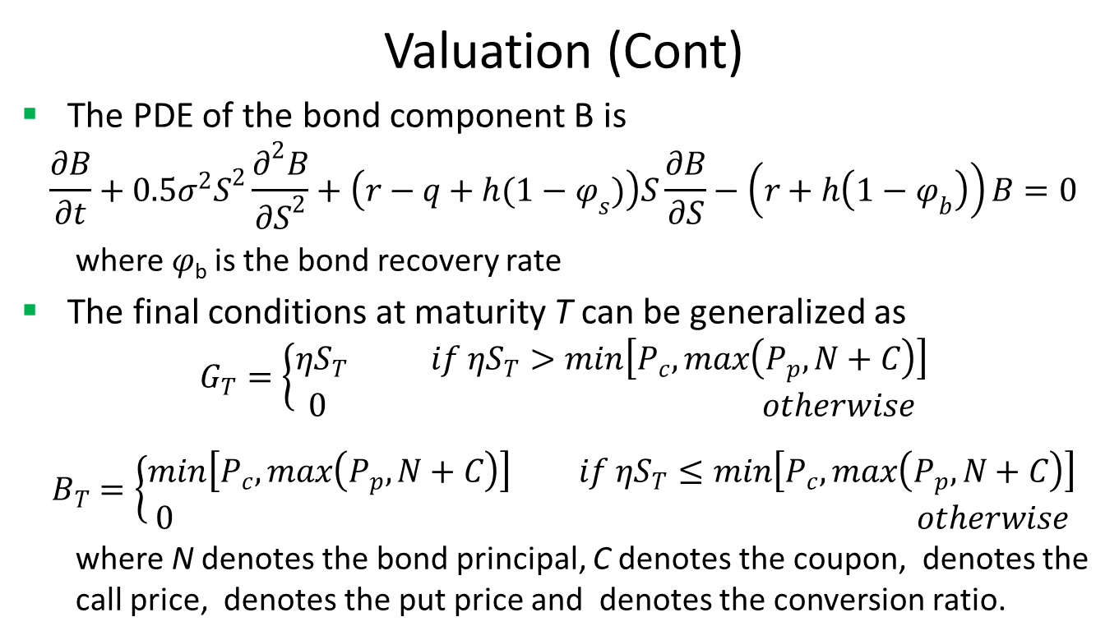
Equity Convertible
Valuation (Cont)
The PDE of the bond component B is
$$\frac{∂B}{∂t}+0.5σ^{2}S^{2}\frac{∂^{2}B}{{∂S}^{2}}+\left(r−q+h(1−φ_{s})\right)S\frac{∂B}{∂S}−\left(r+h\left(1−φ_{b}\right)\right)B=0$$
where $φ$_{b} is the bond recovery rate
The final conditions at maturity T can be generalized as
$$G_{T}=\left\{\begin{matrix}ηS_{T} if ηS_{T}>min\left[P_{c},max\left(P_{p},N+C\right)\right] \\ 0 otherwise\end{matrix}\right.$$
$$B_{T}=\left\{\begin{matrix}min\left[P_{c},max\left(P_{p},N+C\right)\right] if ηS_{T}≤min\left[P_{c},max\left(P_{p},N+C\right)\right] \\ 0 otherwise\end{matrix}\right.$$
where N denotes the bond principal, C denotes the coupon, denotes the call price, denotes the put price and denotes the conversion ratio.

Slide 10
Equity Convertible
Implementation
The valuation can be done via backward induction. The procedure is as follows.
For i = penultimateTime to currentTime
determine accrual interest and call/put prices
determine boundary nodes
use the PSOR (Projected Successive over Relaxation) method to obtain the
continuation value of the bond component and the continuation value of the equity component , applying the constraints.
EndFor
The value at node[0][y] is the convertible bond price where the equity price at node[0][y] is equal to the current market stock price.

Slide 11
Equity Convertible
A Real World Example
Underlying Equity | EFN.TO | Conversion Ratio | 52.35
Convertible Bond ISIN | CA286181AB88 | Conversion Start Date | 1/1/2016
Currency | CAD | Conversion End Date | 6/30/2020
Face Value | 100 | Coupon | 0.0425
Percent Redemption | 1 | First Coupon Date | 12/31/2015
DayCount | dc30360U | First Settle Date | 5/29/2015
Call Start Date | 6/30/2018 | Coupon Frequency | SEMIANNUAL
Call End Date | 6/29/2020 | Roll Type | Following
Call Price | 100 | Issue Price | 100
Call Notice Period | 30 | Market Quote Type | CLEAN
Call Trigger | 125 | Maturity | 6/30/2020
Trigger days | 20 | Par Amount | 1000

Slide 12
Thank You
You can find more details at
http://www.finpricing.com/lib/EqConvertible.html

