Slide 1
Equity Forward and Future Introduction and Valuation
John Smith
FinPricing
http://www.finpricing.com

Slide 2
Equity Forward Future
Summary
Equity Forward Introduction
Equity Future Introduction
The Use of Equity Forwards and Futures
Valuation
A Real World Example

Slide 3
Equity Forward Future
Equity Forward Introduction
An Equity Forward contract is an agreement between two counterparties to buy a specific number of equity stocks, stock index or basket at a given price (called strike price) at a given date.
Equity forward contracts are traded over the counter (OTC) and are customized to meet the user's special needs.
Equity forward contracts are cash settled in most cases.
No cash changes hands until the maturity of the contract.
At maturity, the two counterparties exchange a cashflow equivalent to the difference between the stock closing price and the strike price.

Slide 4
Equity Forward Future
Equity Future Introduction
In an equity future contract parties commit to buy or sell a specified amount of an individual equity or a basket of equities or an equity index at an agreed contract price on a specified date.
A future takes place on an organized exchange where the all of the contract's terms and conditions, except price, are formalized. The future's standardization helps to create liquidity in the marketplace enabling participants to close out positions before expiration.
Stock Index Futures are futures contracts used to replicate the performance of an underlying stock market index.
The holders of long positions in single stock futures typically do not receive dividends and holders of short positions do not pay dividends

Slide 5
Equity Forward Future
The Use of Equity Forwards and Futures
Both forwards and futures can be used for hedging against an existing equity positions.
People also use equity forwards or futures to speculate on future movements of indices or individual stocks.
Buysers benefit from price increases while sellers benefit from price decreases
Forwards have credit risk, but futures do not because a clearing house guarantees against default risk
Both forwards and futures are usually traded with greater leverage.
Single-stock futures may be cash-settled or physically settled while index futures are always cash-settled.

Slide 6
Equity Forward Future
Valuation
Equity futures prices are usually quoted in the same way as equity prices quoted in the underlying cash market by exchanges.
A pricing model is mainly used to calculate risk for a future contract, although it is utilized for computing both price and risk for a forward.
The theoretical value of a future/forward depends on the dividend model assumption.
There are two types of dividends: dividend yield (continuous dividend) or discrete dividend.

Slide 7
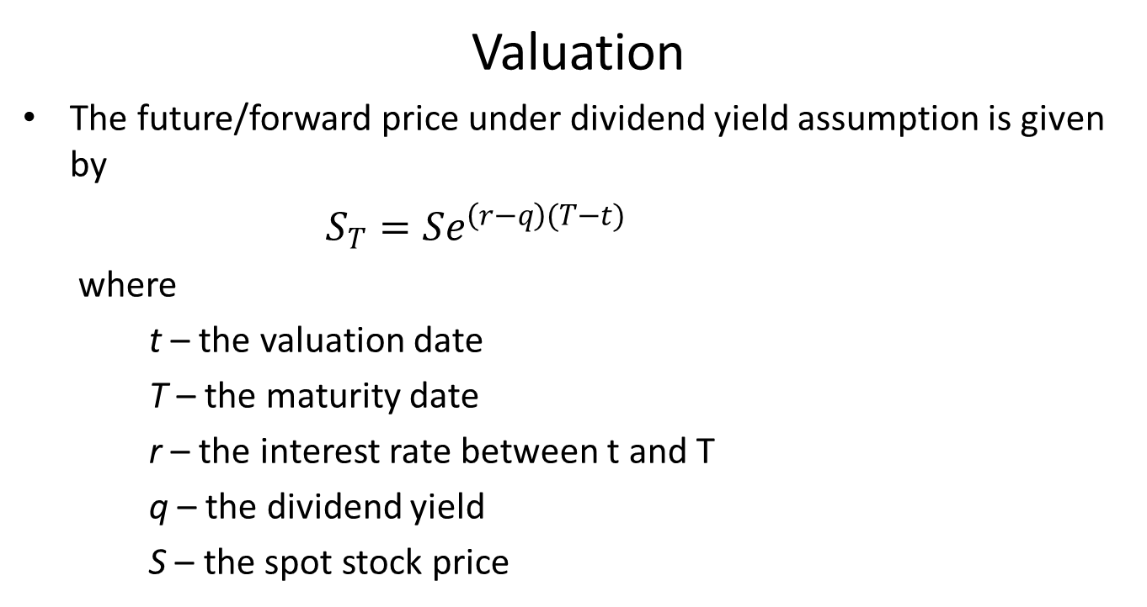
Equity Forward Future
Valuation
The future/forward price under dividend yield assumption is given by
$S_{T}=Se^{\left(r−q\right)(T−t)}$
where
t – the valuation date
T – the maturity date
r – the interest rate between t and T
q – the dividend yield
S – the spot stock price

Slide 8
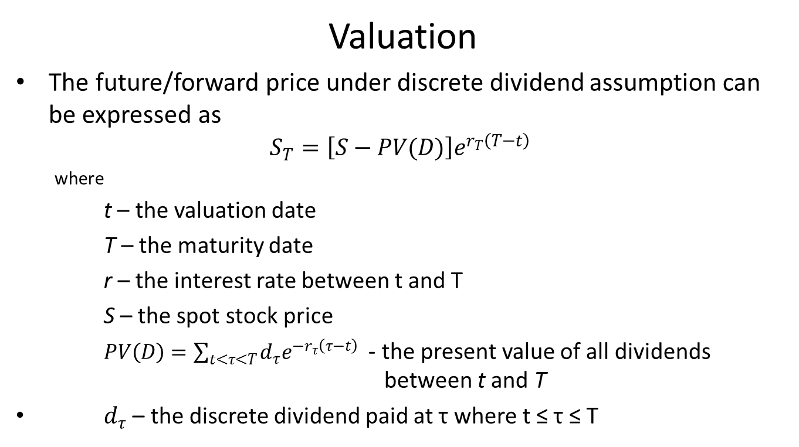
Equity Forward Future
Valuation
The future/forward price under discrete dividend assumption can be expressed as
$$S_{T}=\left[S−PV(D)\right]e^{r_{T}\left(T−t\right)}$$
where
t – the valuation date
T – the maturity date
r – the interest rate between t and T
S – the spot stock price
$PV\left(D\right)=\sum_{t<τ<T}{d_{τ}e^{−r_{τ}\left(τ−t\right)}}$ - the present value of all dividends between t and T
$d_{τ}$ – the discrete dividend paid at τ where t ≤ τ ≤ T

Slide 9
Equity Forward Future
Practical Guide
Equity future/forward price is very simple under dividend yield assumption. Unfortunately there is no or almost no dividend yield existing in the market, although sometimes people may convert discrete dividends into dividend yields for analytic tractability purpose.
For this reason, we focus on discrete dividends only in our pricing framework.
One key for pricing an equity product is to correctly calculate equity forward taking all discrete dividends into account.

Slide 10
Equity Forward Future
An Real World Example
Currency | USD
Maturity Date | 3/17/2017
Future Symbol | ESH7
Underlying Symbol | .SPX
Position | 1000

Slide 11
Thank You
You can find more details at
http://www.finpricing.com/lib/EqFuture.html

