Slide 1
Equity Option Introduction and Valuation
John Smith
FinPricing

Slide 2
Equity Option
Summary
Equity Option Introduction
The Use of Equity Options
Equity Option Payoffs
Valuation
Practical Guide
A Real World Example

Slide 3
Equity Option
Equity Option Introduction
Equity options, which are the most common type of equity derivatives, give an investor the right but not the obligation to buy a call or sell a put at a set strike price prior to the contract’s expiry date.
Equity options are derivatives that means their value is derived from the value of an underlying equity.
Investors and traders can use equity options to take a long or short position in a stock without actually buying or shorting the stock.
This is advantageous because taking a position with options allows the investor/trader more leverage in that the amount of capital needed is much less than a similar outright long or short position on margin.
Investors/traders can therefore profit more from a price movement in the underlying stock.

Slide 4
Equity Option
The Use of Equity Options
Equity options or stock options provide investors a way to hedge risk or speculate.
Option investors have a number of strategies they can utilize, depending on risk tolerance and expected return.
Buying call options allows you to benefit from an upward price movement. The right to buy stock at a fixed price becomes more valuable as the price of the underlying stock increases.
Put options may provide a more attractive method than shorting stock for profiting on stock price declines.
If you have an established profitable long stock position, you can buy puts to protect this position against short-term stock price declines.
An option seller earns the premium if the underlying stock price would not change much.

Slide 5

Equity Option
Equity Option Payoffs
The payoff of a call option
$$Payoff=N∗max(S−K,0)$$
where N – the notional; S – the stock price; K – the strike.
The payoff diagram of a call option

Slide 6

Equity Option
Equity Option Payoffs (Cont)
The payoff of a put option
$$Payoff=N∗max(K−S,0)$$
where N – the notional; S – the stock price; K – the strike.
The payoff diagram of a put option

Slide 7
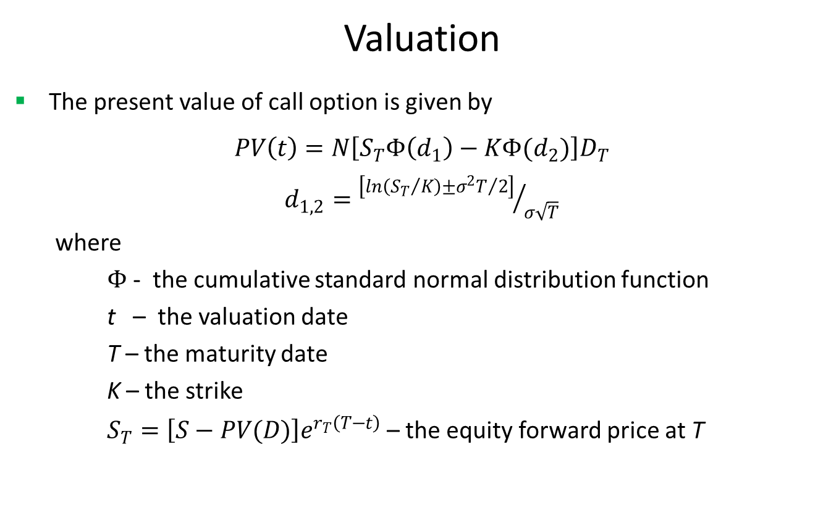
Equity Option
Valuation
The present value of call option is given by
$PV\left(t\right)=N\left[S_{T}Φ\left(d_{1}\right)−KΦ(d_{2})\right]D_{T}$
$d_{1,2}={\left[ln\left({S_{T}}/K\right)±{σ^{2}T}/2\right]}/{σ\sqrt{T}}$
where
$Φ$ - the cumulative standard normal distribution function
t – the valuation date
T – the maturity date
K – the strike
$S_{T}=\left[S−PV(D)\right]e^{r_{T}\left(T−t\right)}$– the equity forward price at T

Slide 8
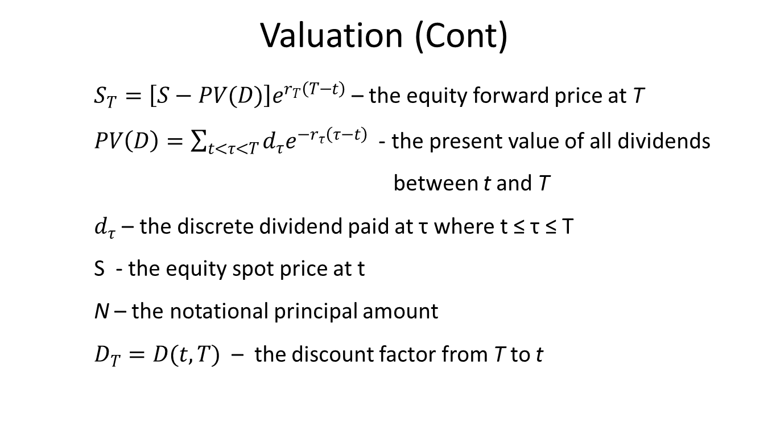
Equity Option
Valuation (Cont)
$S_{T}=\left[S−PV(D)\right]e^{r_{T}\left(T−t\right)}$– the equity forward price at T
$PV\left(D\right)=\sum_{t<τ<T}{d_{τ}e^{−r_{τ}\left(τ−t\right)}}$ - the present value of all dividends
between t and T
$d_{τ}$ – the discrete dividend paid at τ where t ≤ τ ≤ T
S - the equity spot price at t
N – the notational principal amount
$D_{T}=D(t,T)$ – the discount factor from T to t

Slide 9
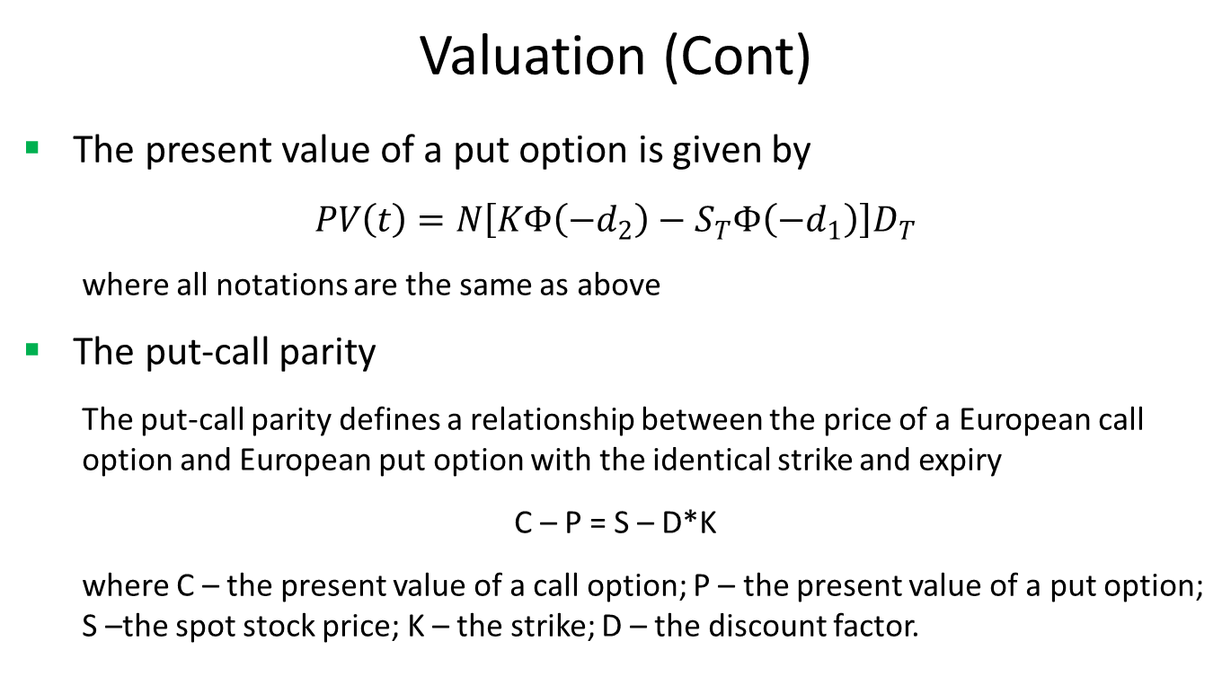
Equity Option
Valuation (Cont)
The present value of a put option is given by
$PV\left(t\right)=N\left[KΦ\left(−d_{2}\right)−S_{T}Φ\left({−d}_{1}\right)\right]D_{T}$
where all notations are the same as above
The put-call parity
The put-call parity defines a relationship between the price of a European call option and European put option with the identical strike and expiry
C – P = S – D*K
where C – the present value of a call option; P – the present value of a put option; S –the spot stock price; K – the strike; D – the discount factor.

Slide 10
Equity Option
Practical Guide
Equity options are valued via the Black model in the market.
First, you need to construct an interest zero rate curve by bootstring some most liquity interest rate instruments.
Second, you need to construct an arbitrage-free volatility surface. FinPricing is using SVI model to construct equity volatility surface.
Then you need to calculate equity forward price correctly by taking all dividends into account.
Finally, you can get the price via the Black formula.

Slide 11
Equity Option
A Real World Example
Underlying equity | .CSEARC5E
Currency | USD
Strike | 150.4292
Maturity Date | 2/24/2022
Call or Put | Call
Exercise Type | European
Settlement Type | Physical
Position | 598.2881

Slide 12
Thank You
You can find more details at
http://www.finpricing.com/lib/EqOption.html

