Slide 1
A Pratical Guide for Pricing Equity Swap
John Smith
FinPricing

Slide 2
Equity Swap
Summary
Equity Swap Introduction
The Use of Equity Swap
Valuation
Practical Guide
A Real World Example

Slide 3
Equity Swap
Equity Swap Introduction
An equity swap is an OTC contract between two parties to exchange a set of cash flows in the future. Normally one party pays the return based on capital gains and dividends realized on an equity security and the other party pays the return based on a floating interest rate plus a spread.
The party receiving the equity returns gains exposure to the performance of the reference equity without actually owning the equity; hence this instrument can be used to obtain a leveraged exposure.
On the other hand, the party receiving payments based on the reference rate receives protection against a loss in the value of the underlying equity.
Unlike other swap types, the equity swap notional resets on each cash flow reset date, depending on the performance of the underlying asset.

Slide 4
Equity Swap
The Use of Equity Swap
Equity swaps allow parties to potentially benefit from returns of an equity security without the need to own its shares.
A party enters an equity swap with the objective of either obtaining return exposure or hedge existing equity risk for a period of time.
An equity swap can be used to transfer both the credit risk and the market risk of an underlying asset.
Equity swaps can be also used to avoid transaction costs (including Tax), to avoid locally based dividend taxes, limitations on leverage (notably the US margin regime) or to get around rules governing the particular type of investment that an institution can hold.
Equity swaps can make investment barriers vanish and help an investor create leverage.

Slide 5
Equity Swap
Valuation
There are two legs in an equity swap: an equity leg and a floating interest leg.
The payoff for both legs could be set at every reset date or at maturity; or could be one side at maturity and the other at every reset date.
The price of the swap is the difference between the present values of both legs' cash flows. In other words, the present value of swap is net of present value of "equity leg" and "money market leg".

Slide 6
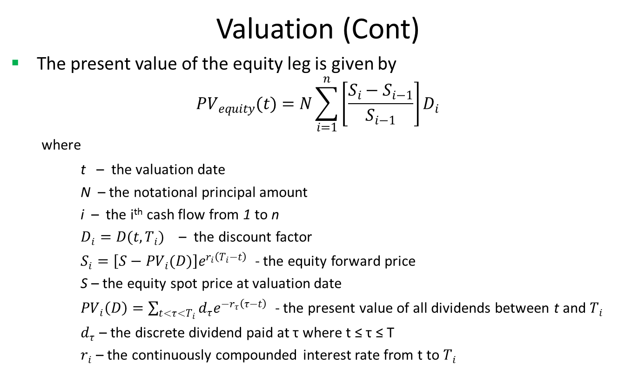
Equity Swap
Valuation (Cont)
The present value of the equity leg is given by
$${PV}_{equity}(t)=N\sum_{i=1}^{n}{\left[\frac{S_{i}−S_{i−1}}{S_{i−1}}\right]D_{i}}$$
where
t – the valuation date
N – the notational principal amount
i – the i^{th} cash flow from 1 to n
$D_{i}=D(t,T_{i})$ – the discount factor
$S_{i}=\left[S−{PV}_{i}(D)\right]e^{r_{i}\left(T_{i}−t\right)}$ - the equity forward price
S – the equity spot price at valuation date
${PV}_{i}\left(D\right)=\sum_{t<τ<T_{i}}{d_{τ}e^{−r_{τ}\left(τ−t\right)}}$ - the present value of all dividends between t and $T_{i}$
$d_{τ}$ – the discrete dividend paid at τ where t ≤ τ ≤ T
$r_{i}$ – the continuously compounded interest rate from t to $T_{i}$

Slide 7
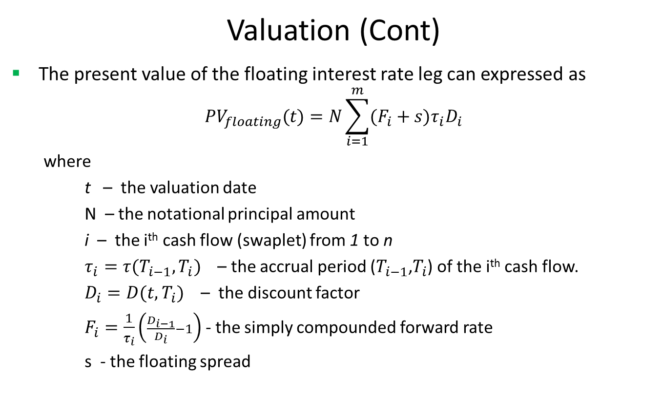
Equity Swap
Valuation (Cont)
The present value of the floating interest rate leg can expressed as
$${PV}_{floating}(t)=N\sum_{i=1}^{m}{(F_{i}+s)τ_{i}D_{i}}$$
where
t – the valuation date
N – the notational principal amount
i – the i^{th} cash flow (swaplet) from 1 to n
$τ_{i}=τ(T_{i−1},T_{i})$ – the accrual period ($T_{i−1}$,$T_{i}$) of the i^{th} cash flow.
$D_{i}=D(t,T_{i})$ – the discount factor
$F_{i}=\frac{1}{τ_{i}}\left(\frac{D_{i−1}}{D_{i}}−1\right)$ - the simply compounded forward rate
s - the floating spread

Slide 8

Equity Swap
Valuation (Cont)
The present value of the equity swap from the equity receiver perspective is given by
$PV\left(t\right)={PV}_{equity}\left(t\right)−{PV}_{floating}$(t)

Slide 9
Equity Swap
Practical Guide
We consider discrete dividends only as described in the equity future note.
To value an equity swap, you need to generate cash flows first, based on the start time, end time and payment frequency of the leg, plus calendar (holidays), business convention (e.g., modified following, following, etc.) and whether sticky month end.
Second, an interest rate curve needs to be constructed via the most liquid interest rate instruments.
Then, you need to compute equity forward prices correctly by accounting for all discrete dividends. This is a key factor for all equity related valuation.
Accrual period is calculated according to the start date and end date of a cash flow plus day count convention
Forward rate is continuously compounded rather than other compounding types

Slide 10
Equity Swap
A Real World Example

Slide 11
Thank You
You can find more details at
http://www.finpricing.com/lib/EqSwap.html

