Slide 1
Equity Warrant Difinitin and Pricing Guide
John Smith
FinPricing

Slide 2
Equity Warrant
Summary
Equity Warrant Introduction
The Use of Equity Warrants
Equity Warrant Payoffs
Valuation
Valuation Model Assumption
A Real World Example

Slide 3
Equity Warrant
Equity Warrant Introduction
An equity warrant gives the holder the right to purchase shares at a fixed price from a firm. It is an option on the common stock of a firm issued by the same firm.
Warrants are in many ways similar to call options, but a few key differences distinguish them.
Warrants tend to have longer durations than do exchange-traded call options.
They are traded over the counter more often than on an exchange.
Investors cannot write warrants like they can options.
Warrants do not pay dividends or come with voting rights.
When warrants are exercised, the company typically issues new shares at the exercise price to fill the order, resulting dilutioon of the share value.

Slide 4
Equity Warrant
The Use of Equity Warrants
Investors are attracted to warrants as a means of leveraging their positions in a security.
Warrants provide investors a way to hedge risk or speculate. They can also be used to exploiting arbitrage opportunities.
Warrants are frequently attached to bonds or preferred stock as a sweetener, which can be used to enhance the yield of the bond and make them more attractive to potential buyers.
Most commonly issued warrants are often detachable, meaning that they can be separated from the bond and sold on the secondary market.
Wedded warrants are not detachable. The investor must surrender the bond or preferred stock in order to exercise it.
Naked Warrants are issued on their own.

Slide 5
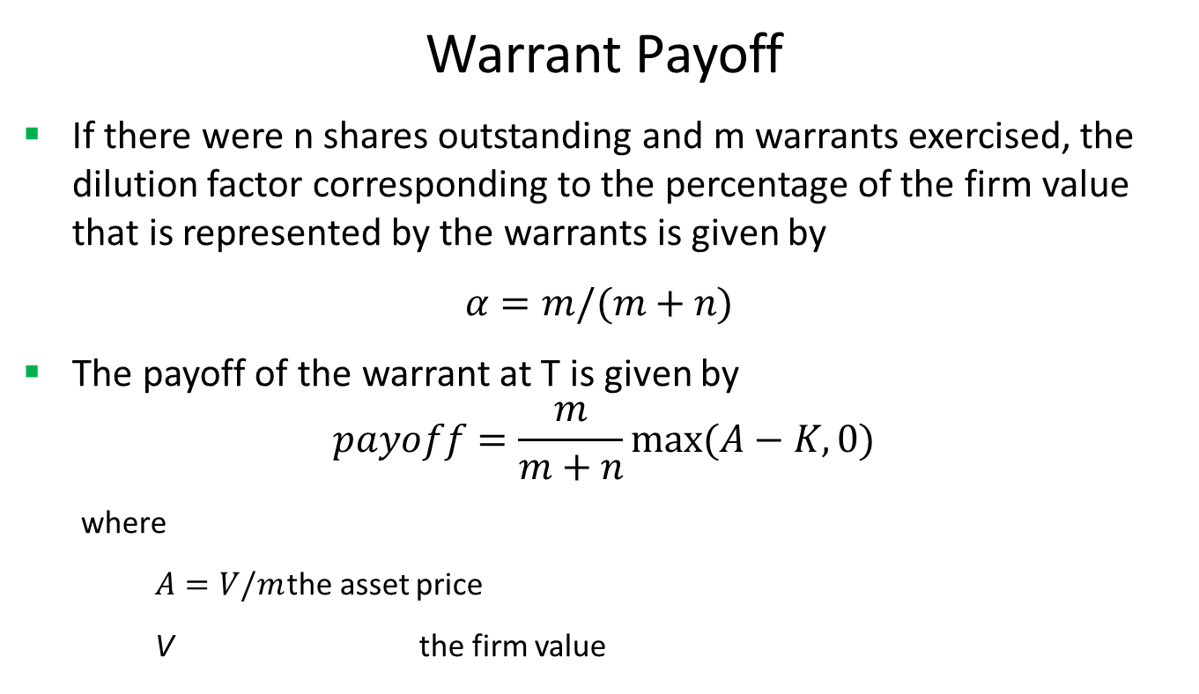
Equity Warrant
Warrant Payoff
If there were n shares outstanding and m warrants exercised, the dilution factor corresponding to the percentage of the firm value that is represented by the warrants is given by
$α=m/(m+n)$
The payoff of the warrant at T is given by
$$payoff=\frac{m}{m+n}max(A−K,0)$$
where
$A=V/m$ the asset price
V the firm value

Slide 6
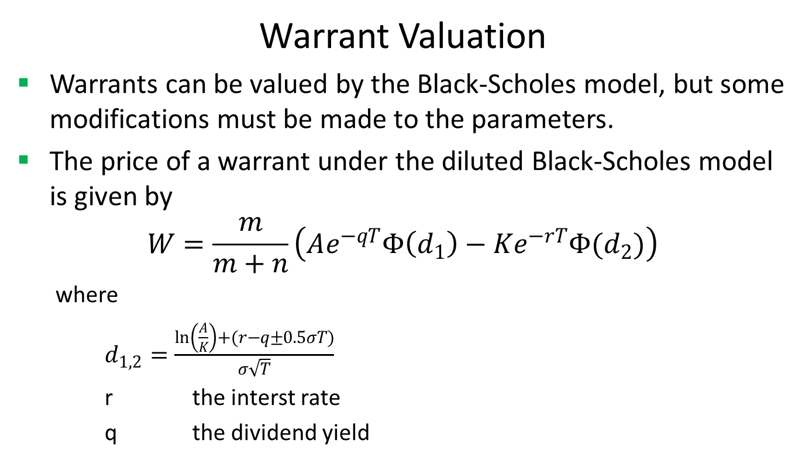
Equity Warrant
Warrant Valuation
Warrants can be valued by the Black-Scholes model, but some modifications must be made to the parameters.
The price of a warrant under the diluted Black-Scholes model is given by
$$W=\frac{m}{m+n}\left(Ae^{−qT}Φ\left(d_{1}\right)−Ke^{−rT}Φ(d_{2})\right)$$
where
$d_{1,2}=\frac{\ln\left(\frac{A}{K}\right)+(r−q±0.5σT)}{σ\sqrt{T}}$
r the interst rate
q the dividend yield

Slide 7
Equity Warrant
Warrant Valuation (Cont)
Strictly speaking, A is the asset price of the firm and σ is the volatility of the firm (not stock). Both of them are not observable.
For simplicity, people may use stock price and stock volatility to replace the firm value A and the firm volatility σ above, although this simplification generally underestimates the warrant’s price.

Slide 8
Equity Warrant
Valuation Model Assumption
There are several assumptions in this simplified warrant mode.
The price process of the stock follows a geometric Brownian motions.
The stock provides a continuous dividend
The risk-free interest rate is deterministic.
The volatility is constant.
The asset value per share is equal to the stock price.
The volatility of the firm is equal to the volatility of the stock.

Slide 9
Equity Warrant
A Real World Example
Outstanding Shares | 109254024
Underlying equity | BTX.A
Currency | USD
Strike | 4.55
Maturity Date | 10/1/2018
CallPut | Call
Exercise Type | European
Settlement Type | Physical
Position | 2038

Slide 10
Thank You
You can find more details at
http://www.finpricing.com/lib/EqWarrant.html

