Slide 1
Pricing Amortizing Bond and Accreting Bond
David Lee
FinPricing
http://www.finpricing.com

Slide 2
Amortizing Bond
Summary
Amortizing Bond an Accreting Bond Introduction
The Use of Amortizing Bonds and Accreting Bonds
Valuation
Practical Guide
A Real World Example

Slide 3
Amortizing Bond
Amortizing Bond and Accreting Bond Introduction
An amortizing bond is a bond whose principal (face value) decreases due to repaying part of the principal along with the coupon payments.
Each payment to the amortizing bond holder consists of a portion of interest and a portion of principal.
An accreting bond is a bond whose principal increases during the life of the deal.
Each payment to the accreting bond holder is just a part of interest. The other part of coupon is added to the principal of the bond.

Slide 4
Amortizing Bond
The Use of Amortizing Bonds and Accreting Bonds
An amortizing bond is used specifically for tax purposes as the amortized principal is treated as part of a company’s interest expense.
The issuer credits the amortized principal amount to interest payable, i.e., an accrued liability.
An accreting bond is used to improve the profit of the existing bond and make it more marketable.
Pension funds and insurance companies are major investors in accreting bonds.

Slide 5
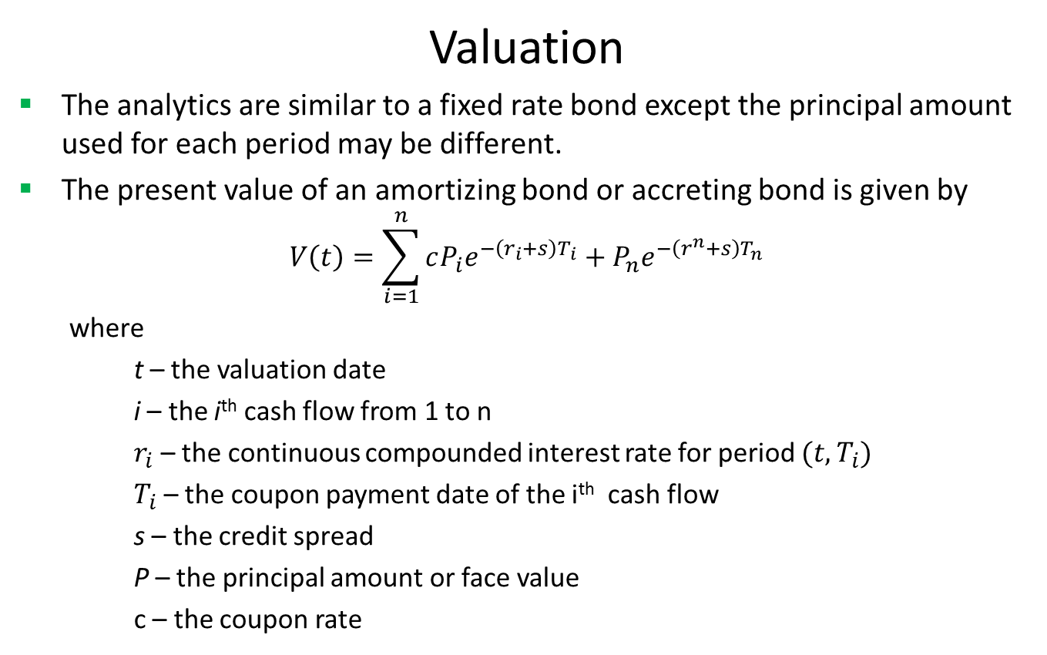
Amortizing Bond
Valuation
The analytics are similar to a fixed rate bond except the principal amount used for each period may be different.
The present value of an amortizing bond or accreting bond is given by
$$V\left(t\right)=\sum_{i=1}^{n}{cP_{i}e^{−\left(r_{i}+s\right)T_{i}}+P_{n}e^{−\left(r^{n}+s\right)T_{n}}}$$
where
t – the valuation date
i – the i^{th} cash flow from 1 to n
$r_{i}$ – the continuous compounded interest rate for period $(t,T_{i})$
$T_{i}$ – the coupon payment date of the i^{th} cash flow
s – the credit spread
P – the principal amount or face value
c – the coupon rate

Slide 6
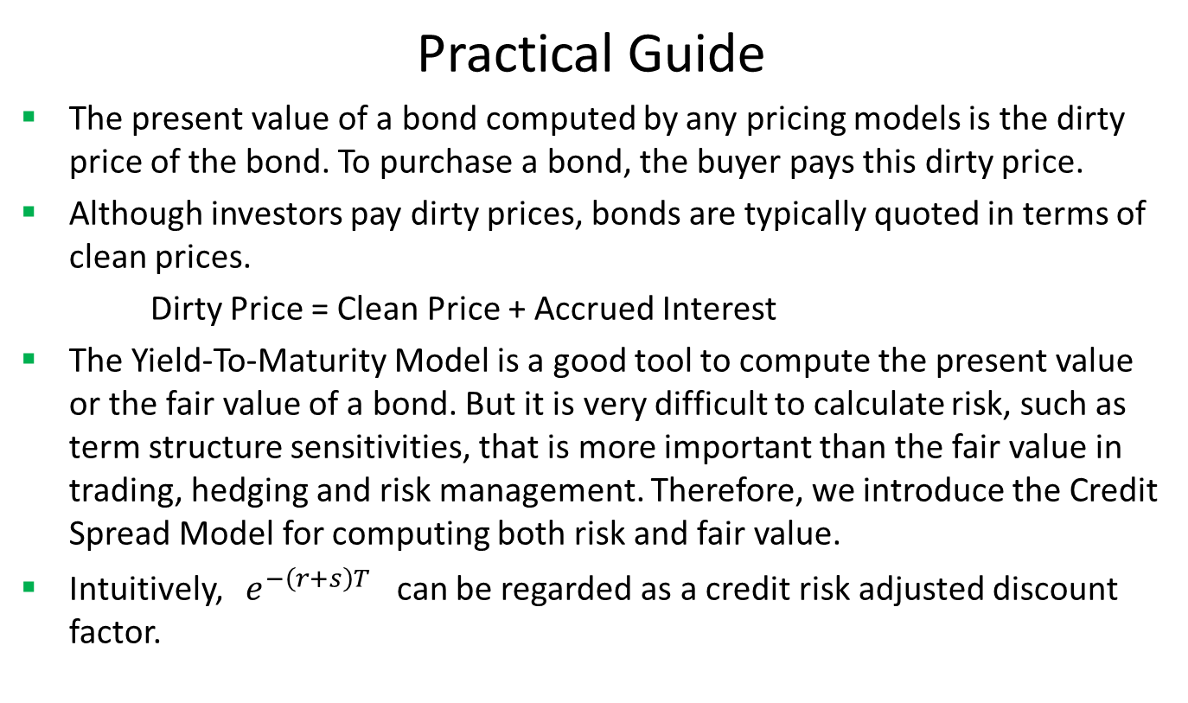
Amortizing Bond
Practical Guide
The present value of a bond computed by any pricing models is the dirty price of the bond. To purchase a bond, the buyer pays this dirty price.
Although investors pay dirty prices, bonds are typically quoted in terms of clean prices.
Dirty Price = Clean Price + Accrued Interest
The Yield-To-Maturity Model is a good tool to compute the present value or the fair value of a bond. But it is very difficult to calculate risk, such as term structure sensitivities, that is more important than the fair value in trading, hedging and risk management. Therefore, we introduce the Credit Spread Model for computing both risk and fair value.
Intuitively, $e^{−\left(r+s\right)T}$ can be regarded as a credit risk adjusted discount factor.

Slide 7
Amortizing Bond
Practical Guide (Cont)
To use the model, one should first calibrate the model price to the market quoted price by solving the credit spread. Comparing to curve construction or calibration for exotic products, the solving here is very simple.
After making the model price equal to the market price, one can calculate sensitivities by shocking interest rate curve and credit spread.
We use LIBOR curve plus credit spread rather than bond specific curves for discounting because bond specific curves rarely exist in the market, especially issued by small entities. Using LIBOR curve plus credit spread not only accounts for credit/issuer risk but also solves the missing data issue.

Slide 8
Amortizing Bond
A Real World Example

Slide 9
Thank You
You can find more information at
http://www.finpricing.com/lib/FiAmortizingBond.html

