Slide 1
Fixed Rate Bond Valuation and Risk
David Lee
FinPricing
http://www.finpricing.com

Slide 2
Fixed Rate Bond
Summary
Fixed Rate Bond Introduction
The Use of Fixed Rate Bond
Valuation: Yield-to-Maturity Approach
Valuation: Credit Spread Approach
Practical Guide
A Real World Example

Slide 3
Fixed Rate Bond
Fixed Rate Bond Introduction
A bond is a debt instrument in which an investor loans money to the issuer for a defined period of time.
The investor will receive coupons paid by the issuer at a predetermined interest rate at specified dates before bond maturity.
The bond principal will be returned at maturity date.
A fixed rate bond is usually a long term paper.
Bonds are usually issued by companies, municipalities, states/provinces and countries to finance a variety of projects and activities.

Slide 4
Fixed Rate Bond
The Use of Fixed Rate Bond
Fixed rate bonds generally pay higher coupons than interest rates.
An investor who wants to earn a guaranteed interest rate for a specified term can choose fixed rate bonds.
The benefit of a fixed rate bond is that investors know for certain how much interest rate they will earn and for how long.
Due to the fixed coupon, the market value of a fixed rate bond is susceptible to fluctuation in interest rate and therefore has a significant interest rate risk.
The long maturity schedule and fixed coupon rate offers an investor a solidified return.
The real value of a fixed rate bond is also susceptible to inflation rate given its long term

Slide 5
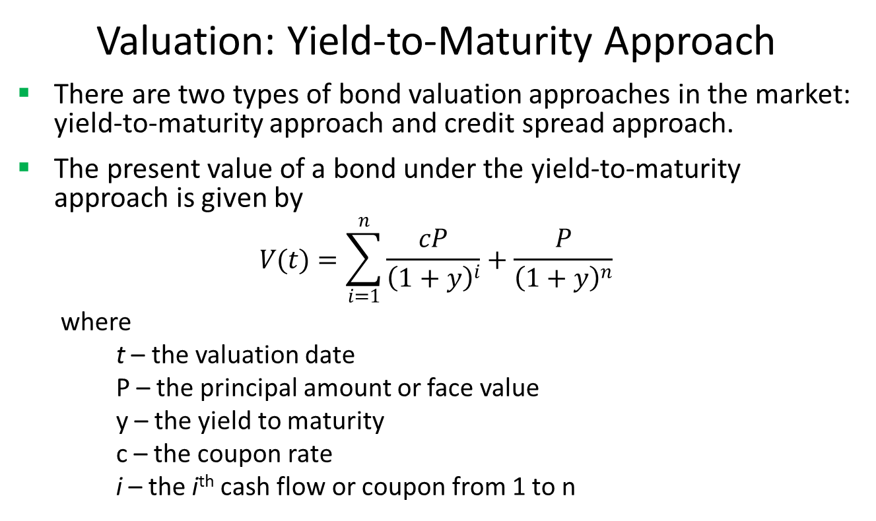
Fixed Rate Bond
Valuation: Yield-to-Maturity Approach
There are two types of bond valuation approaches in the market: yield-to-maturity approach and credit spread approach.
The present value of a bond under the yield-to-maturity approach is given by
$$V(t)=\sum_{i=1}^{n}{\frac{cP}{{\left(1+y\right)}^{i}}+\frac{P}{{\left(1+y\right)}^{n}}}$$
where
t – the valuation date
P – the principal amount or face value
y – the yield to maturity
c – the coupon rate
i – the i^{th} cash flow or coupon from 1 to n

Slide 6
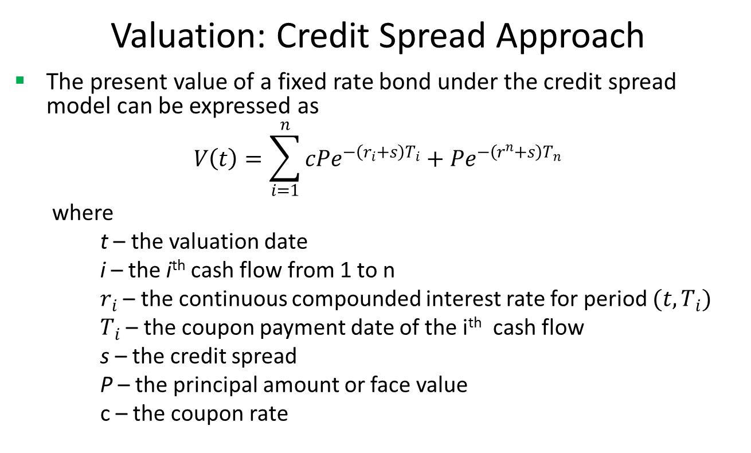
Fixed Rate Bond
Valuation: Credit Spread Approach
The present value of a fixed rate bond under the credit spread model can be expressed as
$$V\left(t\right)=\sum_{i=1}^{n}{cPe^{−\left(r_{i}+s\right)T_{i}}+Pe^{−\left(r^{n}+s\right)T_{n}}}$$
where
t – the valuation date
i – the i^{th} cash flow from 1 to n
$r_{i}$ – the continuous compounded interest rate for period $(t,T_{i})$
$T_{i}$ – the coupon payment date of the i^{th} cash flow
s – the credit spread
P – the principal amount or face value
c – the coupon rate

Slide 7
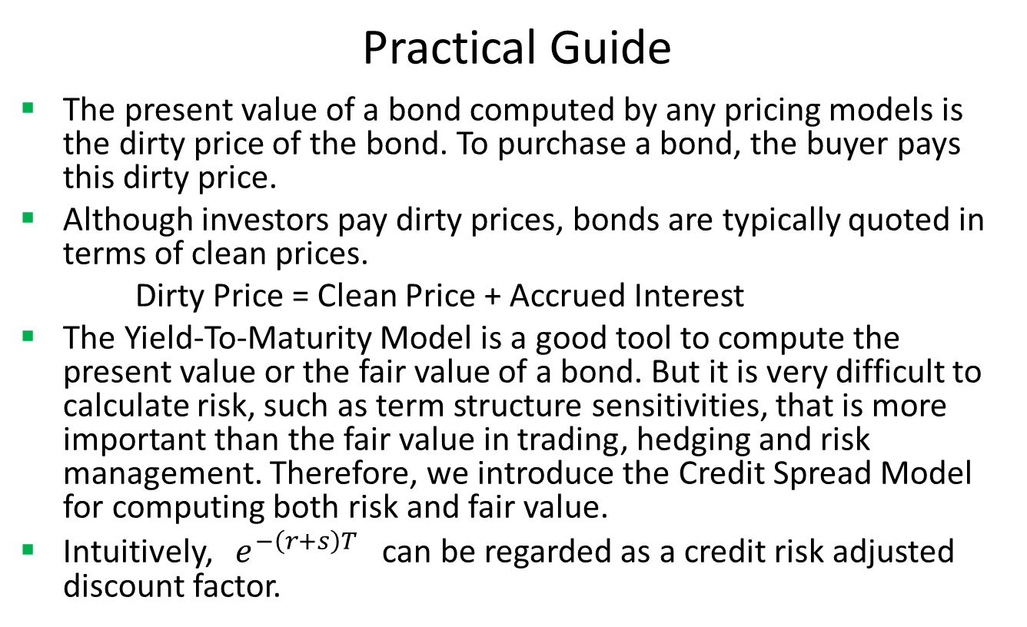
Fixed Rate Bond
Practical Guide
The present value of a bond computed by any pricing models is the dirty price of the bond. To purchase a bond, the buyer pays this dirty price.
Although investors pay dirty prices, bonds are typically quoted in terms of clean prices.
Dirty Price = Clean Price + Accrued Interest
The Yield-To-Maturity Model is a good tool to compute the present value or the fair value of a bond. But it is very difficult to calculate risk, such as term structure sensitivities, that is more important than the fair value in trading, hedging and risk management. Therefore, we introduce the Credit Spread Model for computing both risk and fair value.
Intuitively, $e^{−\left(r+s\right)T}$ can be regarded as a credit risk adjusted discount factor.

Slide 8
Fixed Rate Bond
Practical Guide (Cont)
To use the model, one should first calibrate the model price to the market quoted price by solving the credit spread. Comparing to curve construction or calibration for exotic products, the solving here is very simple.
After making the model price equal to the market price, one can calculate sensitivities by shocking interest rate curve and credit spread.
We use LIBOR curve plus credit spread rather than bond specific curves for discounting because bond specific curves rarely exist in the market, especially issued by small entities. Using LIBOR curve plus credit spread not only accounts for credit/issuer risk but also solves the missing data issue.

Slide 9
Fixed Rate Bond
A Real World Example
Buy Sell | Buy
Calendar | NYC
Coupon Type | Fixed
Currency | USD
First Coupon Date | 11/15/1988
Interest Accrual Date | 5/15/1988
Issue Date | 5/16/1988
Last Coupon Date | 11/15/2017
Maturity Date | 5/15/2018
Settlement Lag | 1
Face Value | 100
Pay Receive | Receive
Day Count | dcActAct
Payment Frequency | 6M
Coupon | 0.09125

Slide 10
Fixed Rate Bond
Thank You
You can find more information at
http://www.finpricing.com/lib/FiBond.html

