Slide 1
Bond Future Definition and Valuation
David Lee
FinPricing
http://www.finpricing.com

Slide 2
Bond Futures
Summary
Bond Future Introduction
The Use of Bond Futures
Valuation
Practical Guide
A Real World Example

Slide 3
Bond Futures
Bond Future Introduction
A bond future is a future contract in which the asset for delivery is a government bond.
Any government bonds that meet the maturity specification of a future contract are eligible for delivery.
All eligible delivery bonds construct the delivery basket where each bond has its own conversion factor.
Conversion factors are used to equalise the coupon and accrued interest differences of all the deliverable bonds.
The seller usually picks up the cheapest bond in the basket to deliver, called the cheapest-to-deliver (CTD).
The CTD bond is normally delivered on the last delivery day of the month.

Slide 4
Bond Futures
The Use of Bond Futures
Bond futures are exchange-traded with maturities of 2, 5, 10, 30 years, where the typical underlings are treasury notes or bonds.
There are established global markets for bond futures.
Bond futures provide a liquid alternative for managing interest rate risk.
Investors use bond futures to hedge an existing portfolio against adverse interest rate movements or enhance the long-term performance of the portfolio.
Arbitrageurs profit from the price difference between the spot bonds and the bond futures.
Speculators use bond futures in the hope of making a profit on short-term movements in prices.

Slide 5
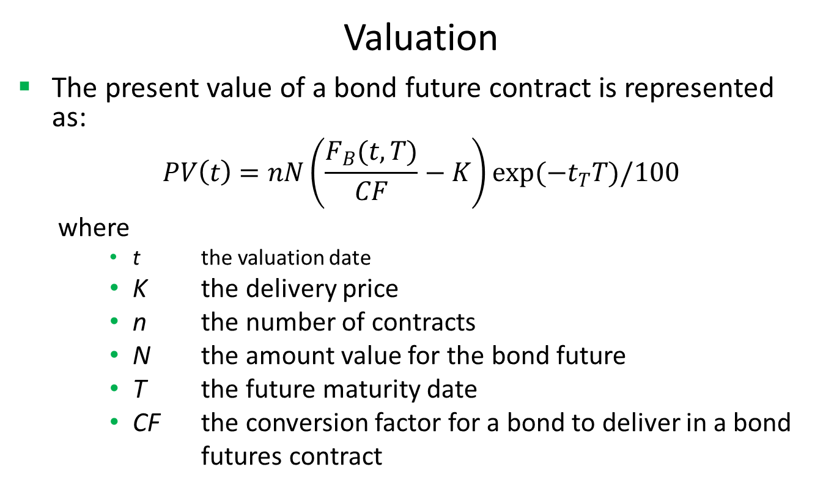
Bond Futures
Valuation
The present value of a bond future contract is represented as:
$$PV\left(t\right)=nN\left(\frac{F_{B}(t,T)}{CF}−K\right)exp(−t_{T}T)/100$$
where
t the valuation date
K the delivery price
n the number of contracts
N the amount value for the bond future
T the future maturity date
CF the conversion factor for a bond to deliver in a bond
futures contract

Slide 6
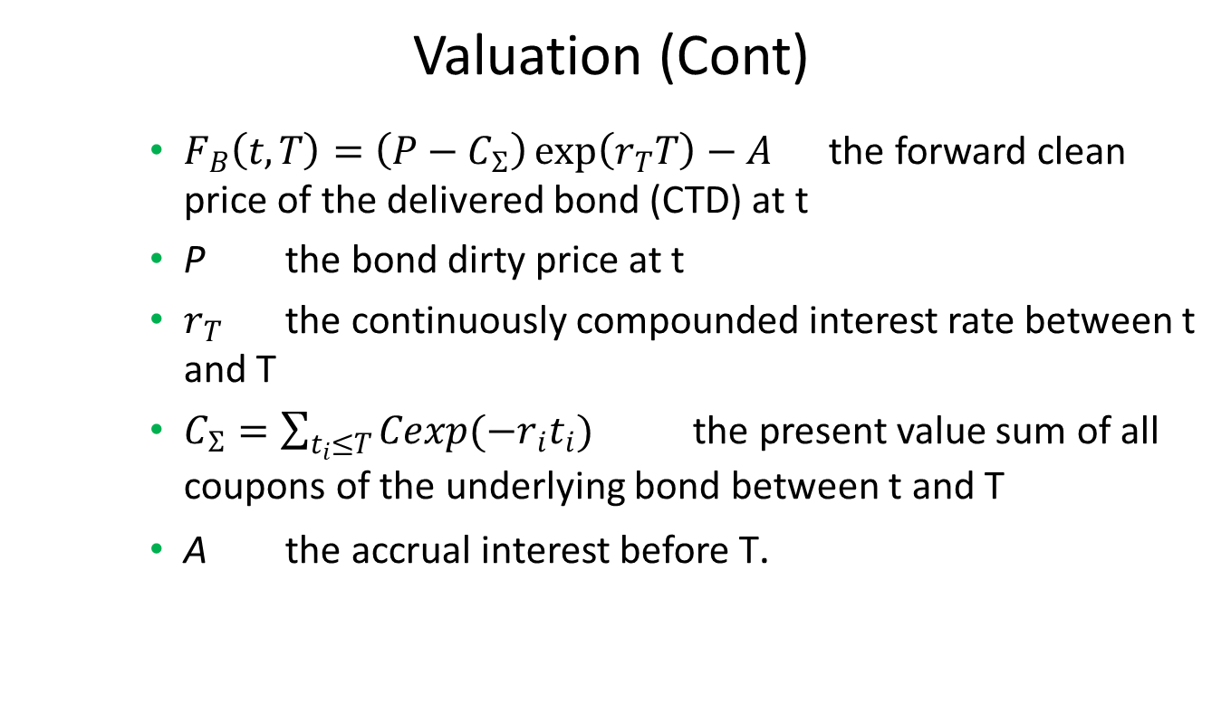
Bond Futures
Valuation (Cont)
$F_{B}\left(t,T\right)=\left(P−C_{Σ}\right)\exp\left(r_{T}T\right)−A$ the forward clean price of the delivered bond (CTD) at t
P the bond dirty price at t
$r_{T}$ the continuously compounded interest rate between t and T
$C_{Σ}=\sum_{t_{i}≤T}{Cexp(−r_{i}t_{i})}$ the present value sum of all coupons of the underlying bond between t and T
A the accrual interest before T.

Slide 7
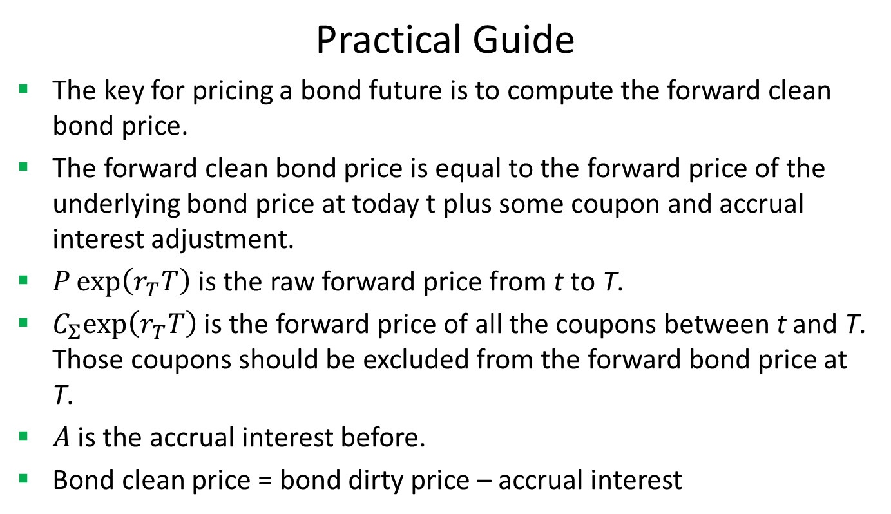
Bond Futures
Practical Guide
The key for pricing a bond future is to compute the forward clean bond price.
The forward clean bond price is equal to the forward price of the underlying bond price at today t plus some coupon and accrual interest adjustment.
$P\exp\left(r_{T}T\right)$ is the raw forward price from t to T.
$C_{Σ}exp\left(r_{T}T\right)$ is the forward price of all the coupons between t and T. Those coupons should be excluded from the forward bond price at T.
$A$ is the accrual interest before.
Bond clean price = bond dirty price – accrual interest

Slide 8
Bond Futures
A Real World Example
Buy Sell | Sell
Currency | USD
Contract Size | 50000
Conversion Factor | 0.8272
First Delivery Date | 6/1/2017
Last Delivery Date | 6/30/2017
Future Ticker | TYM17
Future Ticker Size | 64
Future Ticker Value | 15.625
Number of Contract | 83
Quote Price | 124.46875
Trade Date | 2/23/2017
Future Maturity Date | 6/21/2017
Underlying Bond Type | UST
Underlying Bond Coupon | 0.0275
Underlying Bond Maturity Date | 2/15/2024

Slide 9
Thank You
You can find more information at
http://www.finpricing.com/lib/FiBondFuture.html

