Slide 1
Bond Future Option Valuation Guide
David Lee
FinPricing
http://www.finpricing.com

Slide 2
Bond Future Option
Summary
Bond Future Option Introduction
The Use of Bond Future Options
Valuation – European Style
Valuation – American Style
Practical Guide
A Real World Example

Slide 3
Bond Future Option
Bond Future Option Introduction
A bond future option is an option contract that gives the holder the right but not the obligation to buy or sell a bond future at a predetermined price.
The writer/seller receives a premium from the buyer for undertaking this obligation.
Options are leveraged instruments that allow the owner to control a large amount of the underlying asset with a smaller amount of money.
Bond future options offer significant advantages for reducing costs, enhancing returns and managing risk.
Bond future options could be European style or American style.

Slide 4
Bond Future Option
The Use of Bond Future Options
Bond futures options are also exchange traded derivatives on treasury instruments.
Bond future options provide market participants with the ability to adjust their interest rate exposures.
A bond future option is also a good tool for hedging, income enhancement, duration adjustments, interest rate speculation and spread trading.
Investors use bond future options to hedge an existing portfolio against adverse interest rate movements or enhance the long-term performance.
Arbitrageurs profit from the price difference between the spot bonds and the bond futures.
Speculators use bond future option in the hope of making a profit on short-term movements in prices.

Slide 5
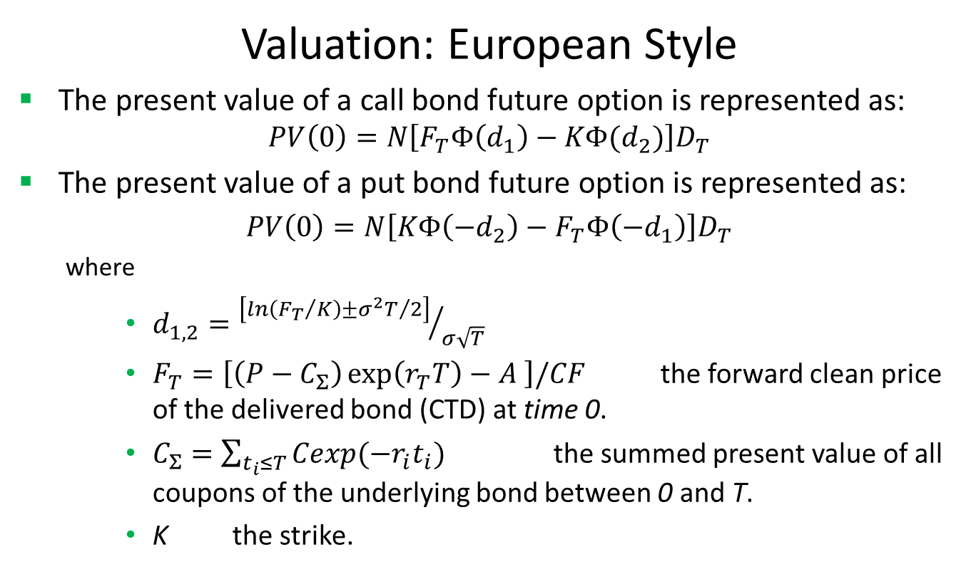
Bond Future Option
Valuation: European Style
The present value of a call bond future option is represented as:
$$PV\left(0\right)=N\left[F_{T}Φ\left(d_{1}\right)−KΦ(d_{2})\right]D_{T}$$
The present value of a put bond future option is represented as:
$PV\left(0\right)=N\left[KΦ\left(−d_{2}\right)−F_{T}Φ\left({−d}_{1}\right)\right]D_{T}$
where
$d_{1,2}={\left[ln\left({F_{T}}/K\right)±{σ^{2}T}/2\right]}/{σ\sqrt{T}}$
$F_{T}=\left[\left(P−C_{Σ}\right)\exp\left(r_{T}T\right)−A \right]/CF$ the forward clean price of the delivered bond (CTD) at time 0.
$C_{Σ}=\sum_{t_{i}≤T}{Cexp(−r_{i}t_{i})}$ the summed present value of all coupons of the underlying bond between 0 and T.
K the strike.

Slide 6
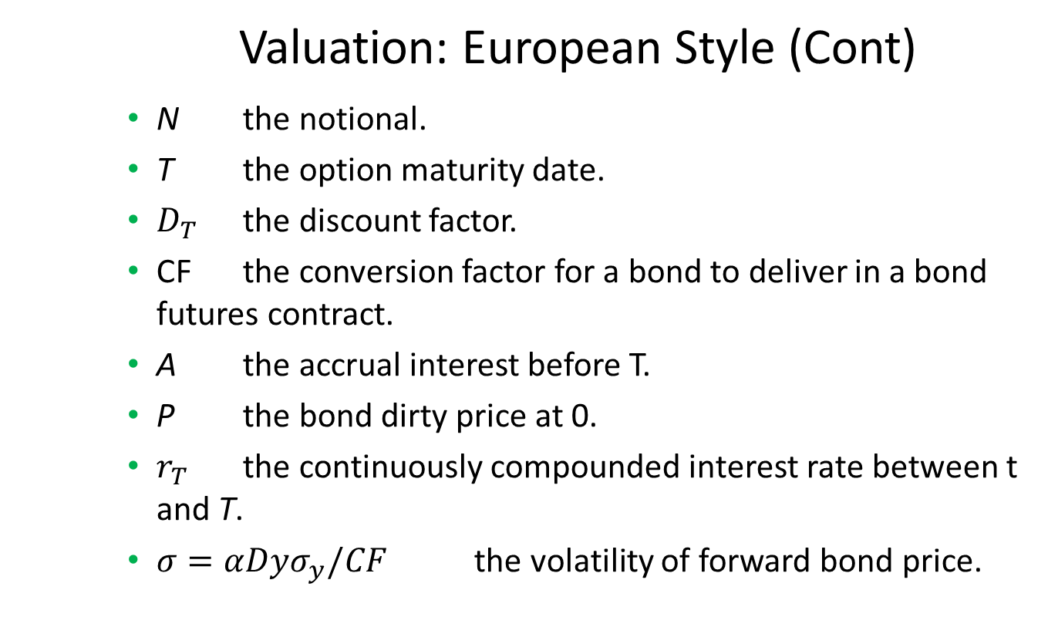
Bond Future Option
Valuation: European Style (Cont)
N the notional.
T the option maturity date.
$D_{T}$ the discount factor.
CF the conversion factor for a bond to deliver in a bond futures contract.
A the accrual interest before T.
P the bond dirty price at 0.
$r_{T}$ the continuously compounded interest rate between t and T.
$σ=αDyσ_{y}/CF$ the volatility of forward bond price.

Slide 7
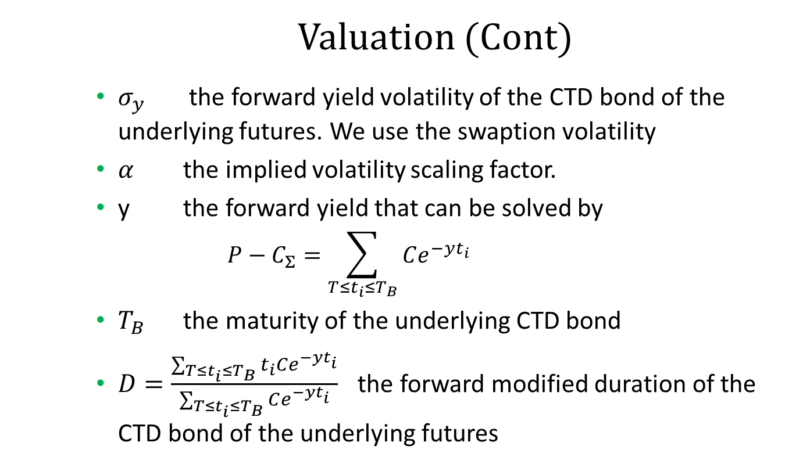
Bond Future Option
Valuation (Cont)
$σ_{y}$ the forward yield volatility of the CTD bond of the underlying futures. We use the swaption volatility
$α$ the implied volatility scaling factor.
y the forward yield that can be solved by
$$P−C_{Σ}=\sum_{T≤t_{i}≤T_{B}}{Ce^{−yt_{i}}}$$
$T_{B}$ the maturity of the underlying CTD bond
$D=\frac{\sum_{T≤t_{i}≤T_{B}}{t_{i}Ce^{−yt_{i}}}}{\sum_{T≤t_{i}≤T_{B}}{Ce^{−yt_{i}}}}$ the forward modified duration of the CTD bond of the underlying futures

Slide 8
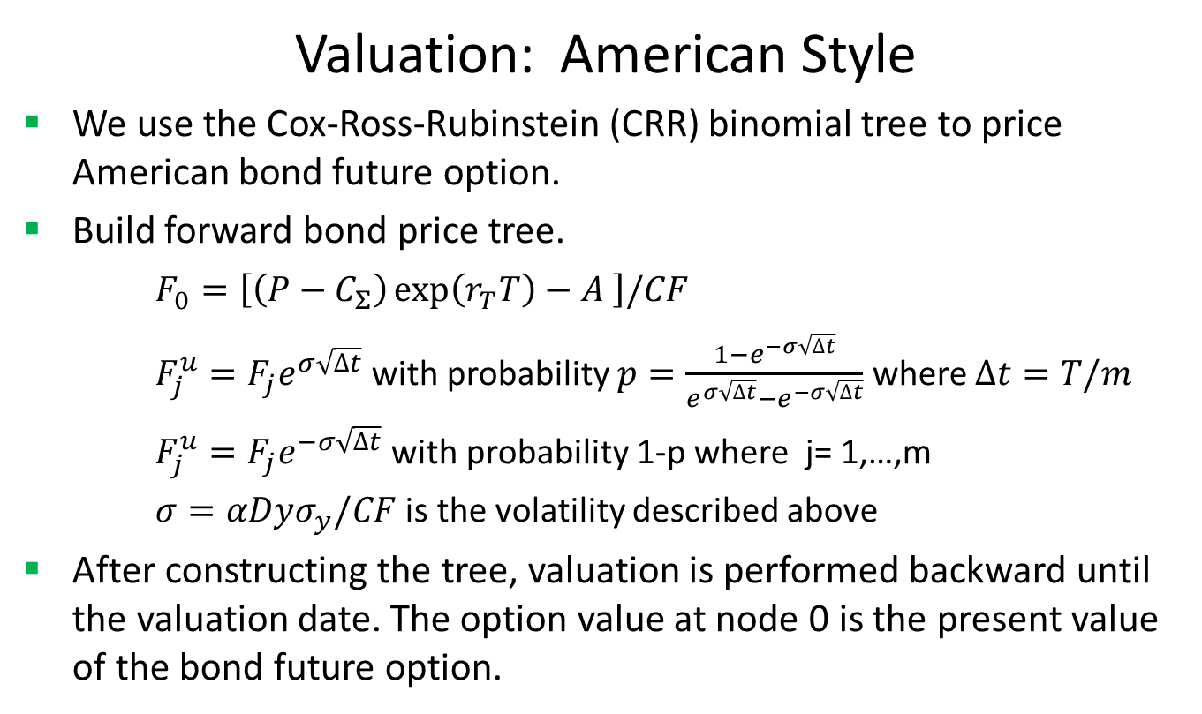
Bond Future Option
Valuation: American Style
We use the Cox-Ross-Rubinstein (CRR) binomial tree to price American bond future option.
Build forward bond price tree.
$F_{0}=\left[\left(P−C_{Σ}\right)\exp\left(r_{T}T\right)−A \right]/CF$
$F_{j}^{u}=F_{j}e^{σ\sqrt{∆t}}$ with probability $p=\frac{1−e^{−σ\sqrt{∆t}}}{e^{σ\sqrt{∆t}}−e^{−σ\sqrt{∆t}}}$ where $∆t=T/m$
$F_{j}^{u}=F_{j}e^{−σ\sqrt{∆t}}$ with probability 1-p where j= 1,…,m
$σ=αDyσ_{y}/CF$ is the volatility described above
After constructing the tree, valuation is performed backward until the valuation date. The option value at node 0 is the present value of the bond future option.

Slide 9
Bond Future Option
Practical Guide
First compute the CTD forward bond price first.
Then determine the volatility of the forward bond price.
After that, call Black formula for pricing European bond future options.
Or build binomial tree to value American bond future options.

Slide 10
Bond Future Option
A Real World Example
Option Specification |  | Future Specification
Buy Sell | Buy | Contract Size | 33333.33
Call Put | Call | Conversion Factor | 0.8851
Currency | USD | First Delivery Date | 6/1/2017
Option Maturity Date | 5/26/2017 | Last Delivery Date | 6/30/2017
Option Expiry Date | 5/26/2017 | Future Ticker | USM17
Strike | 151 | Future Ticker Size | 32
Option Ticker | USM17C 151 | Future Ticker Value | 31.25
Settlement Amount | -173875 | Number of Contract | 52
Settlement Date | 2/9/2017 | Quote Price | 3.34375
 |  | Trade Date | 2/9/2017
 |  | Future Maturity Date | 6/21/2017
 |  | Underlying Bond Type | UST
 |  | Underlying Bond Coupon | 0.05
 |  | Underlying Bond Maturity Date | 5/15/2037

Slide 11
Thank You
You can find more information at
http://www.finpricing.com/lib/FiBondFutureOption.html

