Slide 1

Callable Bond and Vaulation Dmitry Popov FinPricing http://www.finpricing.com

Slide 2
Callable Bond
Summary
Callable Bond Definition
The Advantages of Callable Bonds
Callable Bond Payoffs
Valuation Model Selection Criteria
LGM Model
LGM Assumption
LGM calibration
Valuation Implementation
A real world example

Slide 3
Callable Bond
Callable Bond Definition
A callable bond is a bond in which the issuer has the right to call the bond at specified times (callable dates) from the investor for a specified price (call price).
At each callable date prior to the bond maturity, the issuer may recall the bond from its investor by returning the investor’s money.
The underlying bond can be a fixed rate bond or a floating rate bond.
A callable bond can therefore be considered a vanilla underlying bond with an embedded Bermudan style option.
Callable bonds protect issuers. Therefore, a callable bond normally pays the investor a higher coupon than a non-callable bond.

Slide 4
Callable bond
Advantages of Callable Bond
Although a callable bond is a higher cost to the issuer and an uncertainty to the investor comparing to a regular bond, it is actually quite attractive to both issuers and investors.
For issuers, callable bonds allow them to reduce interest costs at a future date should rate decrease.
For investors, callable bonds allow them to earn a higher interest rate of return until the bonds are called off.
If interest rates have declined since the issuer first issues the bond, the issuer is like to call its current bond and reissues it at a lower coupon.

Slide 5
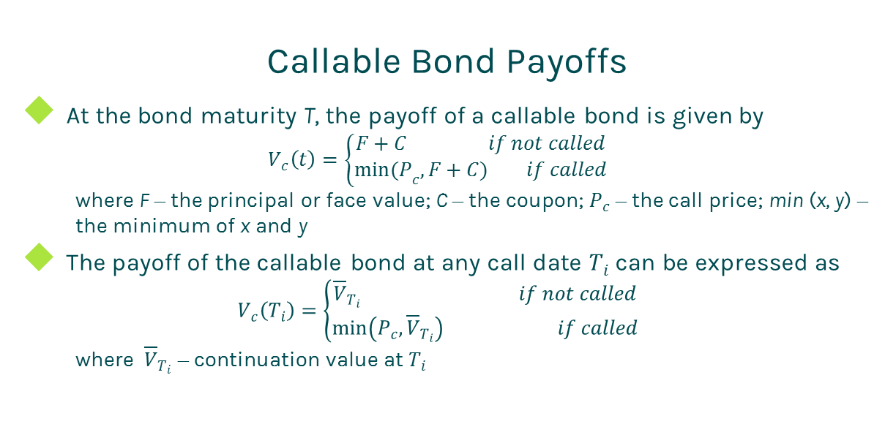
Callable Bond
Callable Bond Payoffs
At the bond maturity T, the payoff of a callable bond is given by
$$V_{c}\left(t\right)=\left\{\begin{matrix}F+C if not called \\ {min(P}_{c}, F+C) if called\end{matrix}\right.$$
where F – the principal or face value; C – the coupon; $P_{c}$ – the call price; min (x, y) – the minimum of x and y
The payoff of the callable bond at any call date $T_{i}$ can be expressed as
$$V_{c}\left(T_{i}\right)=\left\{\begin{matrix}{\overline{V}}_{T_{i}} if not called \\ \min\left(P_{c},{\overline{V}}_{T_{i}}\right) if called\end{matrix}\right.$$
where ${\overline{V}}_{T_{i}}$ – continuation value at $T_{i}$

Slide 6
Callable Bond
Model Selection Criteria
Given the valuation complexity of callable bonds, there is no closed form solution. Therefore, we need to select an interest rate term structure model and a numerical solution to price them numerically.
The selection of interest rate term structure models
Popular interest rate term structure models:
Hull-White, Linear Gaussian Model (LGM), Quadratic Gaussian Model (QGM), Heath Jarrow Morton (HJM), Libor Market Model (LMM).
HJM and LMM are too complex.
Hull-White is inaccurate for computing sensitivities.
Therefore, we choose either LGM or QGM.

Slide 7
Callable Bond
Model Selection Criteria (Cont)
The selection of numeric approaches
After selecting a term structure model, we need to choose a numerical approach to approximate the underlying stochastic process of the model.
Commonly used numeric approaches are tree, partial differential equation (PDE), lattice and Monte Carlo simulation.
Tree and Monte Carlo are notorious for inaccuracy on sensitivity calculation.
Therefore, we choose either PDE or lattice.
Our decision is to use LGM plus lattice.

Slide 8
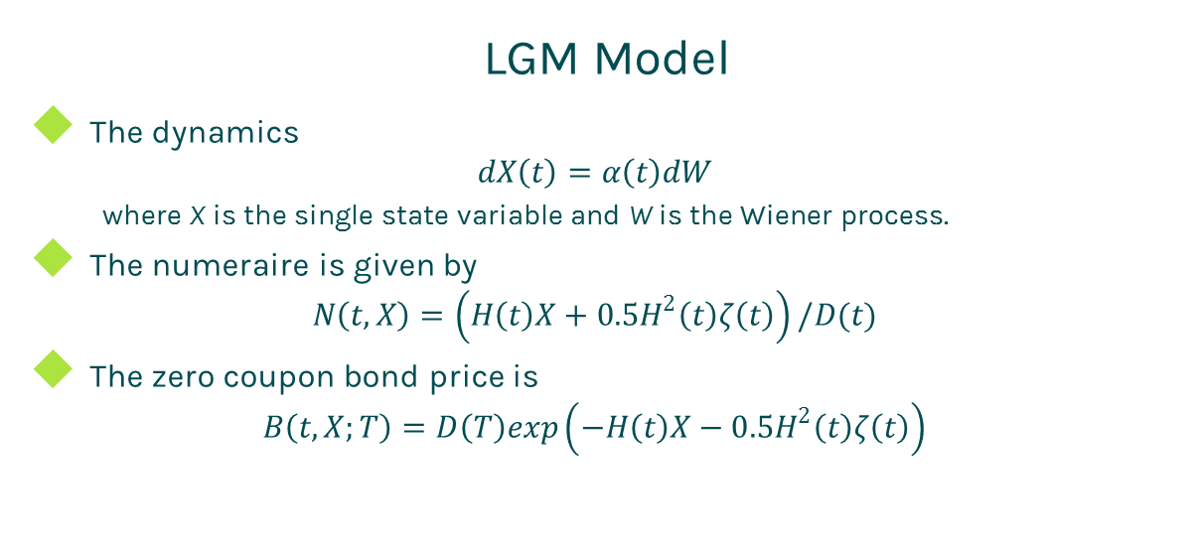
Callable Bond
LGM Model
The dynamics
$$dX\left(t\right)=α\left(t\right)dW$$
where X is the single state variable and W is the Wiener process.
The numeraire is given by
$$N\left(t,X\right)=\left(H\left(t\right)X+0.5H^{2}\left(t\right)ζ\left(t\right)\right)/D(t)$$
The zero coupon bond price is
$$B\left(t,X;T\right)=D\left(T\right)exp\left(−H\left(t\right)X−0.5H^{2}\left(t\right)ζ\left(t\right)\right)$$

Slide 9
Callable Bond
LGM Assumption
The LGM model is mathematically equivalent to the Hull-White model but offers
Significant improvement of stability and accuracy for calibration.
Significant improvement of stability and accuracy for sensitivity calculation.
The state variable is normally distributed under the appropriate measure.
The LGM model has only one stochastic driver (one-factor), thus changes in rates are perfected correlated.

Slide 10
Callable Bond
LGM calibration
Match today’s curve
At time t=0, X(0)=0 and H(0)=0. Thus Z(0,0;T)=D(T). In other words, the LGM automatically fits today’s discount curve.
Select a group of market swaptions.
Solve parameters by minimizing the relative error between the market swaption prices and the LGM model swaption prices.

Slide 11
Callable Bond
Valuation Implementation
Calibrate the LGM model.
Create the lattice based on the LGM: the grid range should cover at least 3 standard deviations.
Calculate the payoff of the callable bond at each final note.
Conduct backward induction process iteratively rolling back from final dates until reaching the valuation date.
Compare exercise values with intrinsic values at each exercise date.
The value at the valuation date is the price of the callable bond.

Slide 12
Callabe Bond
A real world example
Bond specification |  | Callable schedule
Buy Sell | Buy | Call Price | Notification Date
Calendar | NYC | 100 | 1/26/2015
Coupon Type | Fixed | 100 | 7/25/2018
Currency | USD
First Coupon Date | 7/30/2013
Interest Accrual Date | 1/30/2013
Issue Date | 1/30/2013
Last Coupon Date | 1/30/2018
Maturity Date | 7/30/2018
Settlement Lag | 1
Face Value | 100
Pay Receive | Receive
Day Count | dc30360
Payment Frequency | 6
Coupon | 0.015

Slide 13
Thanks!
You can find more details at
http://www.finpricing.com/lib/IrCallableBond.html

