Slide 1
Floating Rate Notes Valuation and Risk
David Lee
FinPricing
http://www.finpricing.com

Slide 2
Floating Rate Note
Summary
Floating Rate Note (FRN) or Floating Rate Bond Introduction
The Use of Floating Rate Notes
Valuation
Practical Guide
A Real World Example

Slide 3
Floating Rate Note
Floating Rate Note Introduction
A floating rate note (FRN), also called floating rate bond, is a bond in which the investor will receive coupons paid by the issuer at a floating coupon equivalent to a money market reference rate, such as LIBOR or federal fund rate plus a spread at specified dates before bond maturity.
The bond principal will be returned at maturity date.
Almost all FRNs have quarterly coupons.
FRNs are usually issued by corporations, federal agencies, municipalities and states/provinces to finance a variety of projects and activities.

Slide 4
Floating Rate Note
The Use of Floating Rate Notes
A FRN carry little interest rate risk as its duration is close to zero due to periodic reset.
The price of a FRN has very low sensitivity to changes in interest rates because the floating coupon increases but the discounting also increases as interest rate rises.
An investor who wants conservative investments may choose floating rate bonds.
FRNs become more popular when interest rates are expected to increase.
A FRN carry lower yield than fixed rate bonds of the same maturity.
FRNs have unpredictable coupon payments.

Slide 5
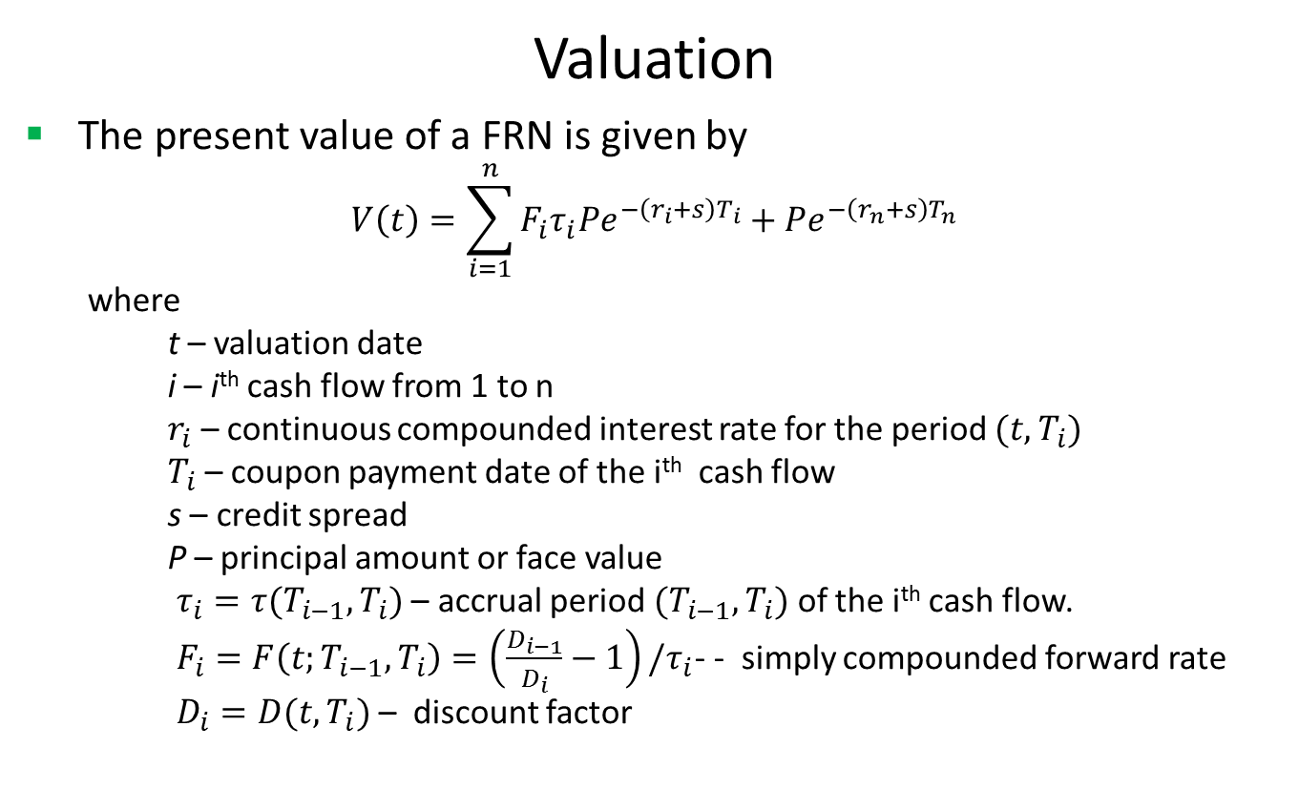
Floating Rate Note
Valuation
The present value of a FRN is given by
$$V\left(t\right)=\sum_{i=1}^{n}{F_{i}τ_{i}Pe^{−\left(r_{i}+s\right)T_{i}}+Pe^{−\left(r_{n}+s\right)T_{n}}}$$
where
t – valuation date
i – i^{th} cash flow from 1 to n
$r_{i}$ – continuous compounded interest rate for the period $(t,T_{i})$
$T_{i}$ – coupon payment date of the i^{th} cash flow
s – credit spread
P – principal amount or face value
$τ_{i}=τ(T_{i−1},T_{i})$ – accrual period $(T_{i−1},T_{i})$ of the i^{th} cash flow.
$F_{i}=F\left(t;T_{i−1},T_{i}\right)=\left(\frac{D_{i−1}}{D_{i}}−1\right)/τ_{i}$- - simply compounded forward rate
$D_{i}=D(t,T_{i})$ – discount factor

Slide 6
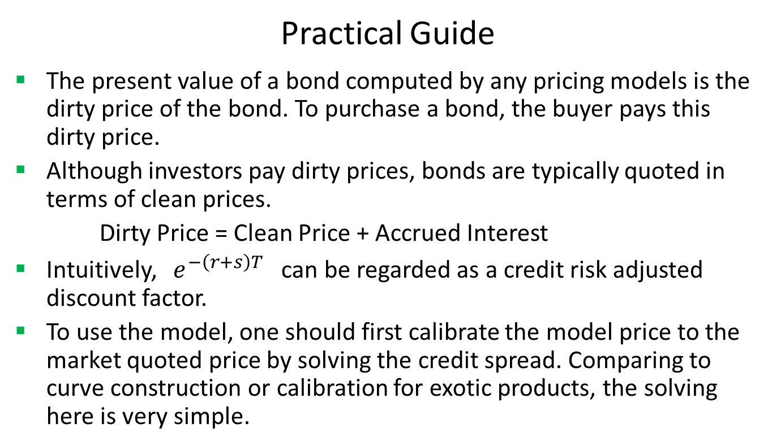
Floating Rate Note
Practical Guide
The present value of a bond computed by any pricing models is the dirty price of the bond. To purchase a bond, the buyer pays this dirty price.
Although investors pay dirty prices, bonds are typically quoted in terms of clean prices.
Dirty Price = Clean Price + Accrued Interest
Intuitively, $e^{−\left(r+s\right)T}$ can be regarded as a credit risk adjusted discount factor.
To use the model, one should first calibrate the model price to the market quoted price by solving the credit spread. Comparing to curve construction or calibration for exotic products, the solving here is very simple.

Slide 7
Floating Rate Note
Practical Guide (Cont)
After making the model price equal to the market price, one can calculate sensitivities by shocking interest rate curve and credit spread.
We use LIBOR curve plus credit spread rather than bond specific curves for discounting because bond specific curves rarely exist in the market, especially issued by small entities. Using LIBOR curve plus credit spread not only accounts for credit/issuer risk but also solves the missing data issue.
Usually the forecasting curve is different from the discounting curve. For instance, the forecasting curve is the treasury curve but the discounting curve is the LIBOR curve plus credit spread.

Slide 8
Floating Rate Note
A Real World Example
Buy Sell | Buy
Calendar | NYC
Coupon Type | Floating
Currency | USD
First Coupon Date | 10/31/2015
Interest Accrual Date | 7/31/2015
Issue Date | 7/31/2015
Last Coupon Date | 4/30/2017
Maturity Date | 7/31/2017
Settlement Date | 7/31/2015
Settlement Lag | 1
Principal | 100
Pay Receive | Receive
Day Count | dcAct360
Payment Frequency | 3M
Spread | 0.00077

Slide 9
Thank You
You can find more information at
http://www.finpricing.com/lib/FiFrn.html

